Slide 1

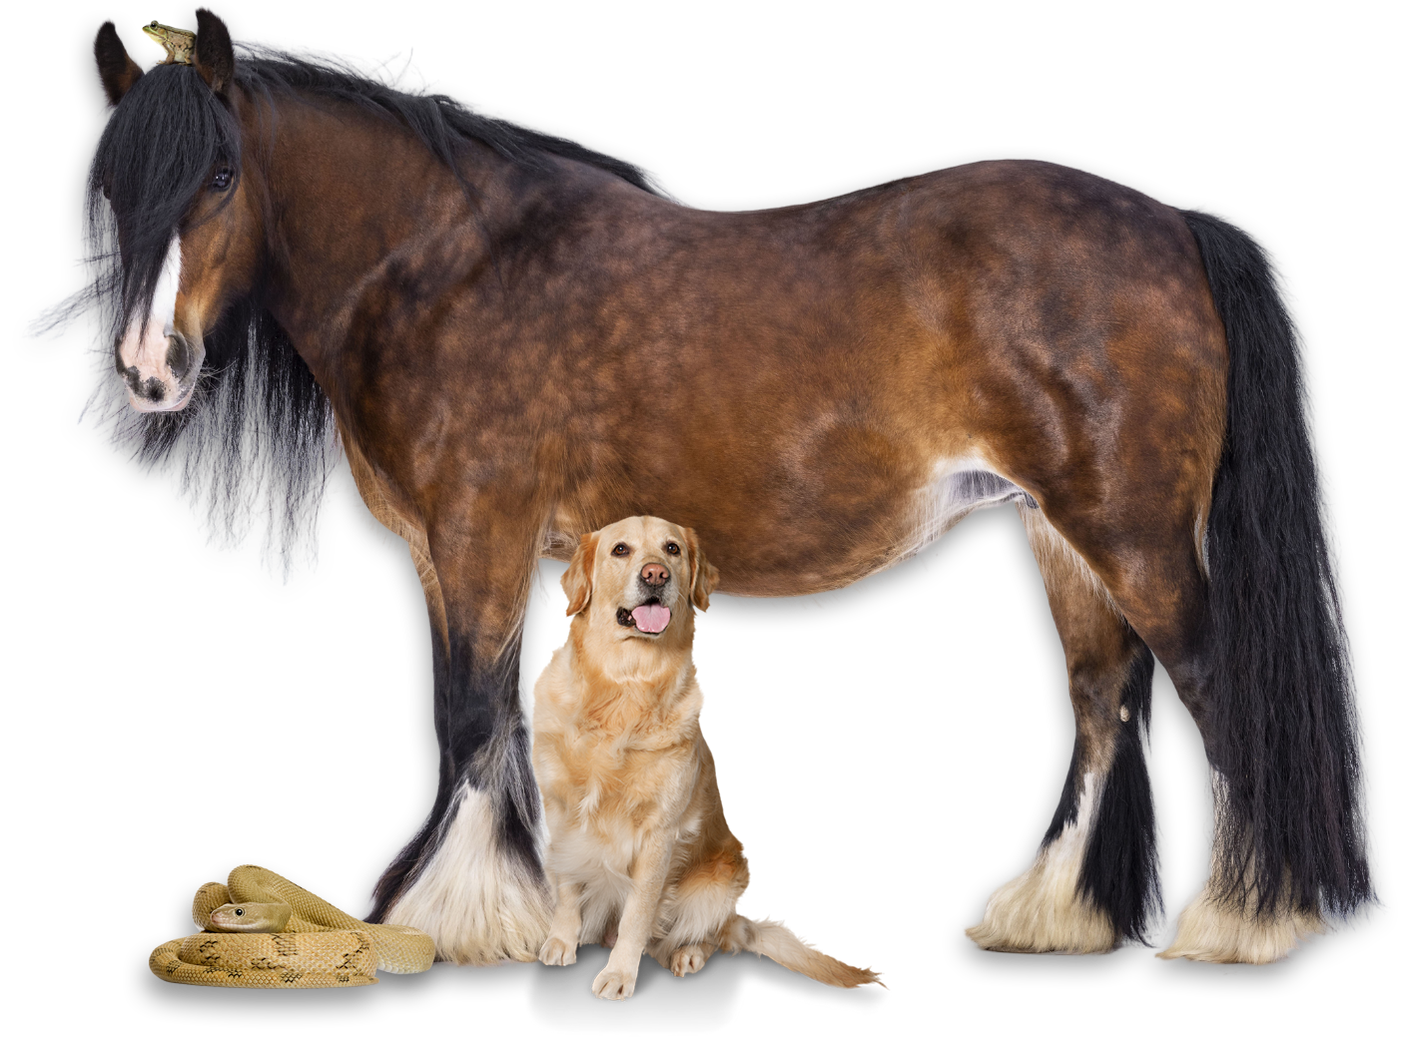
Egg detectives: which animals lay eggs?

Slide 2

Egg or not?
Let's see what you already know. ​
​
Over the next few slides, a picture of an animal will appear. Use your whiteboards to answer the questions: ​
​
Do these animals lay eggs? ​
​
How do you know?

Slide 3
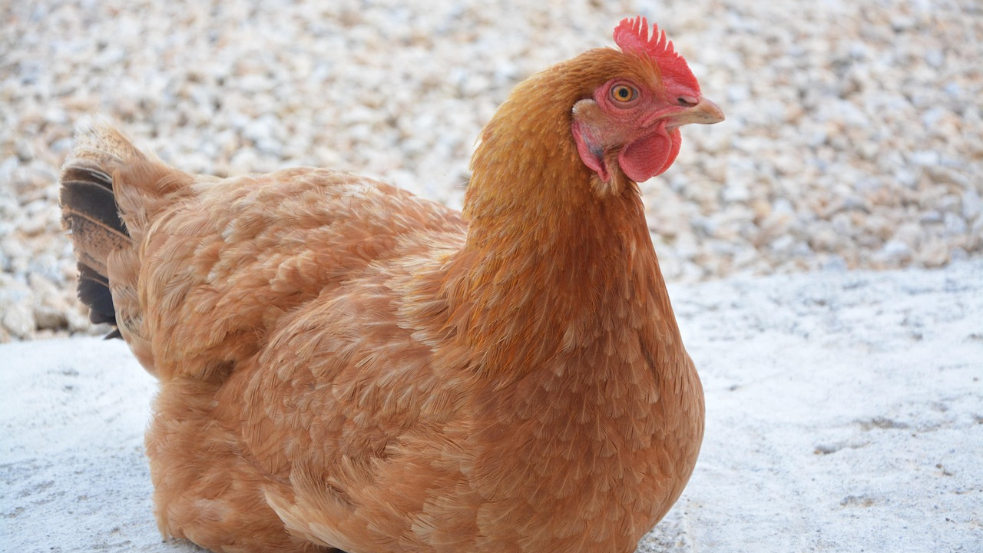
Egg or not?

Slide 4
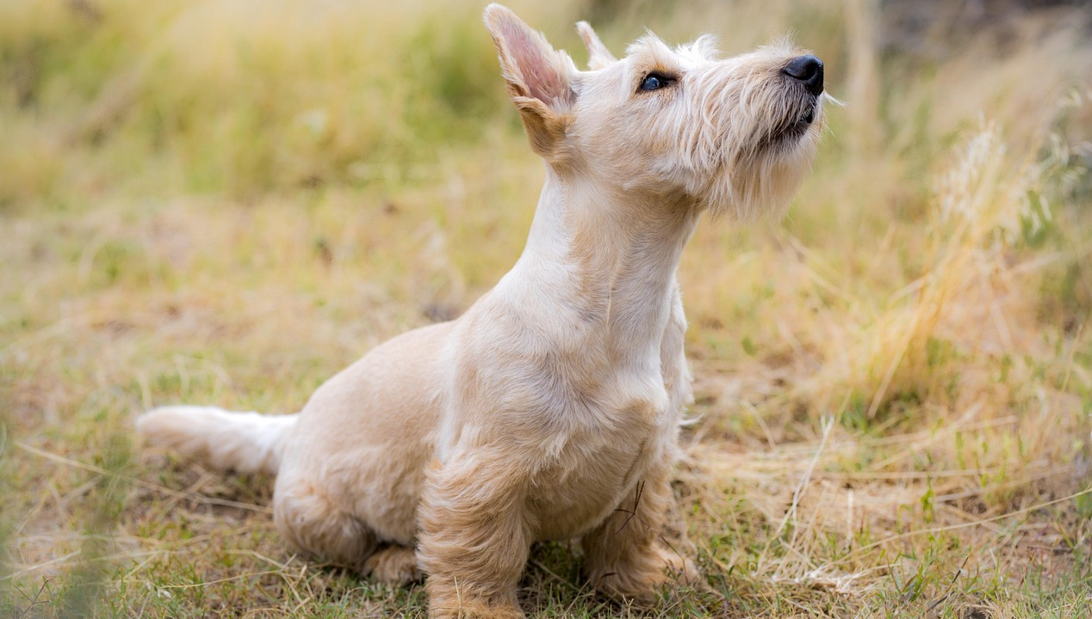
Egg or not?

Slide 5
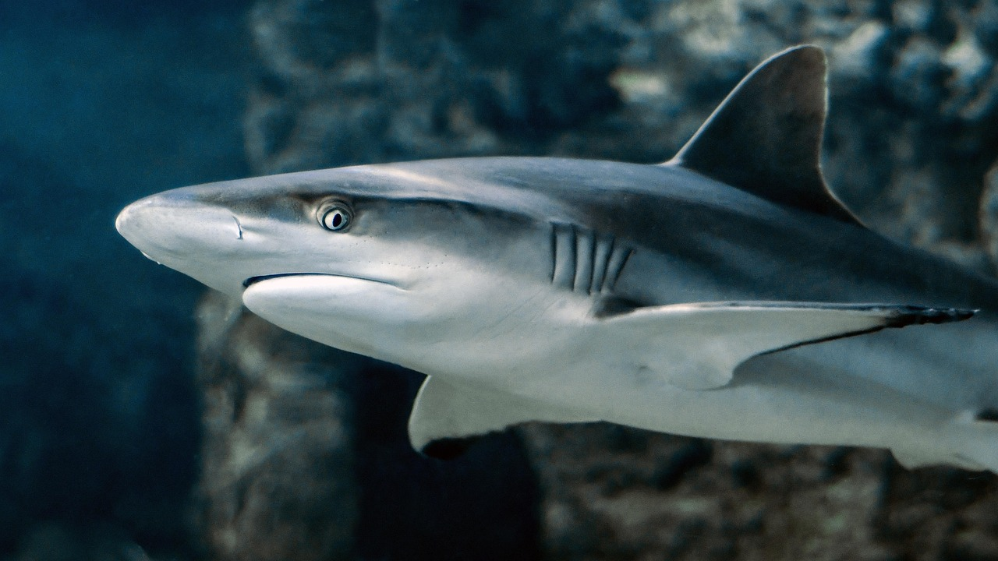
Egg or not?

Slide 6
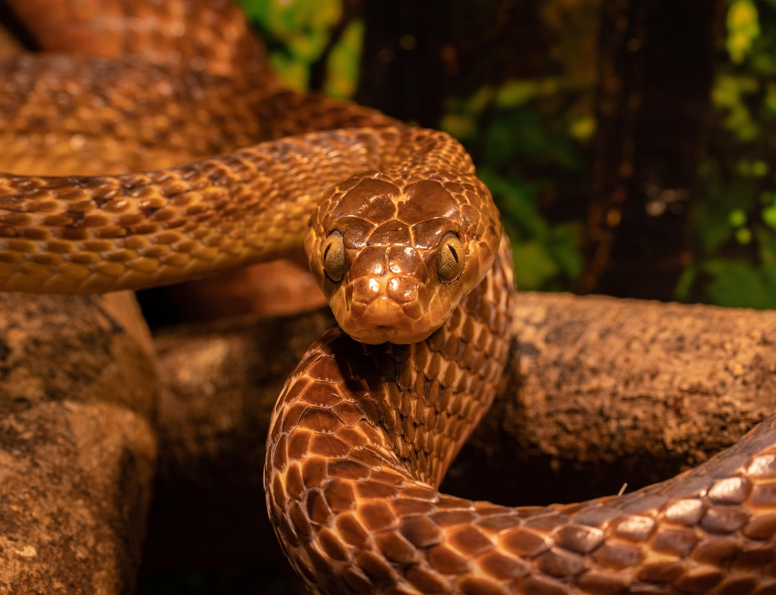
Egg or not?

Slide 7

Egg or not?

Slide 8
Egg layers
There are two different types of animal when it comes to eggs.
Oviparous and Viviparous

Slide 9
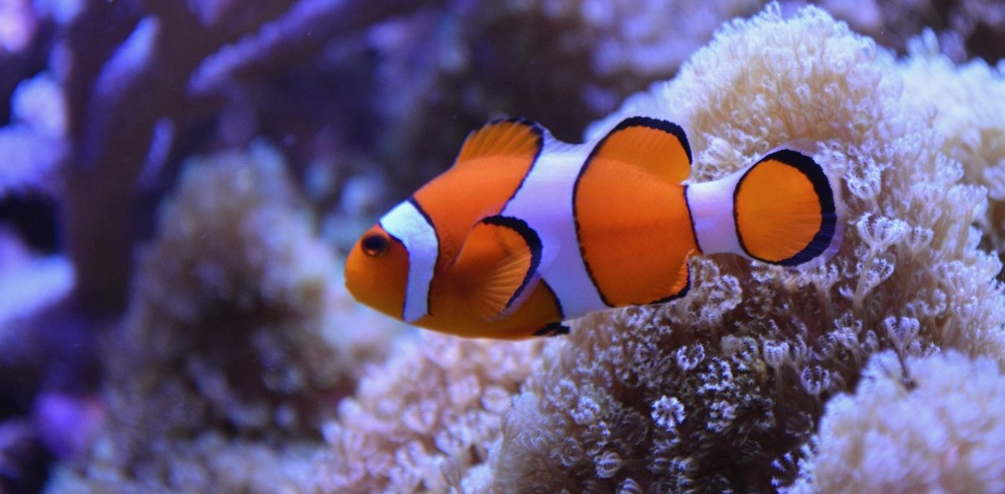
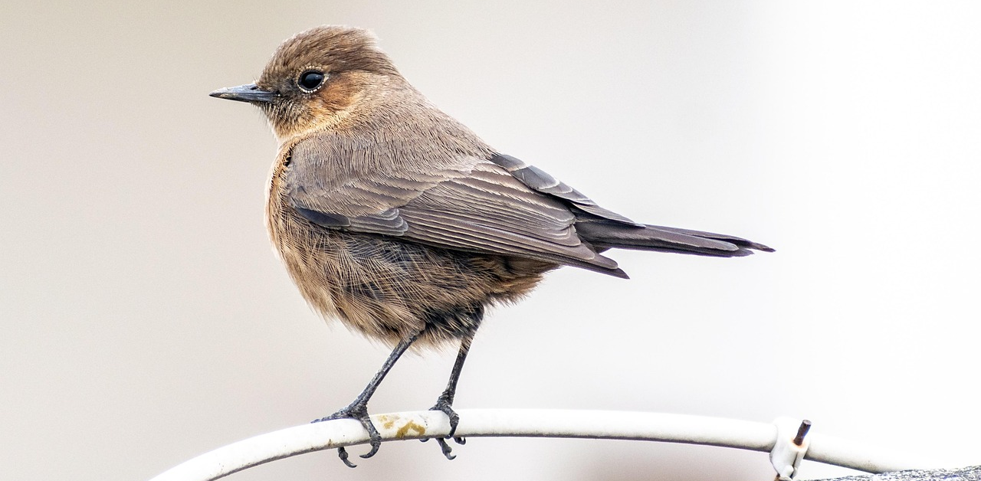
Oviparous animals
Oviparous animals are animals that lay eggs such as birds, most fish, most reptiles, most amphibians and most insects.

Slide 10
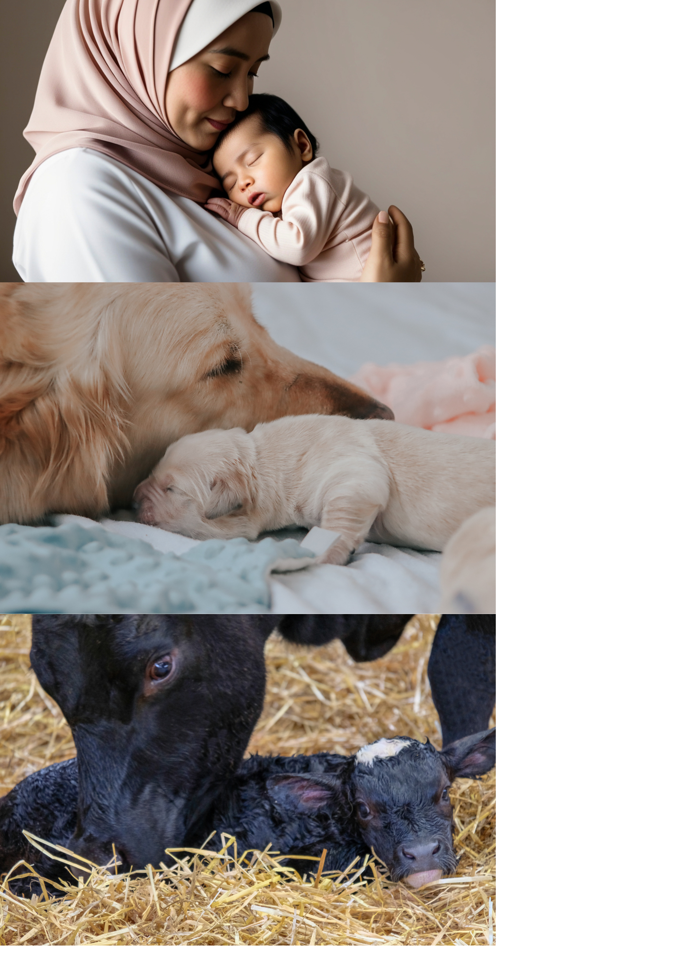
Viviparous animals
Viviparous animals are animals that give birth to live young. These are mostly mammals, like humans.

Slide 11
How animals have babies
Eggs | Live births
Animals lay eggs Egg develops outside the mother’s body Mother may protect eggs or sometimes leaves them | Animal gives birth to live young Baby develops inside the mother’s body Mother nourishes and cares for the baby after birth

Slide 12
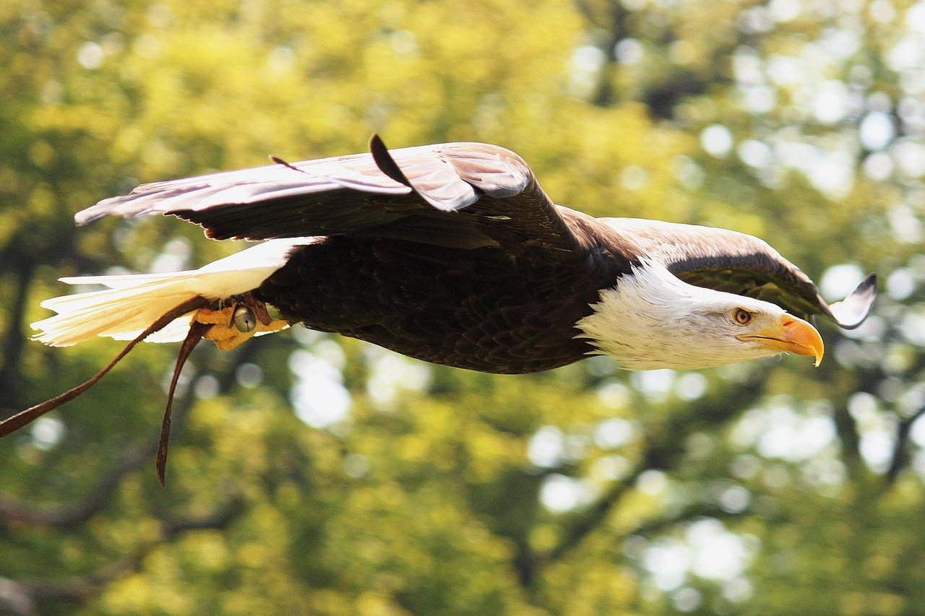
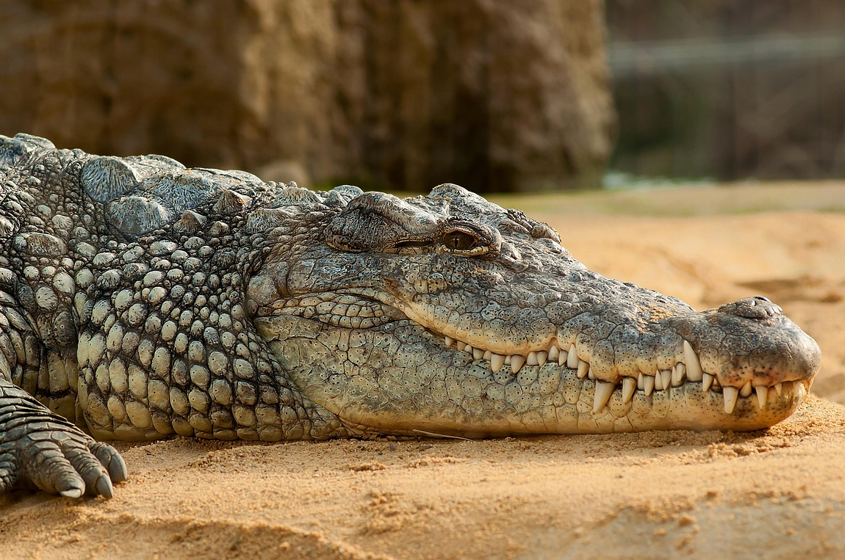
Types of egg-laying animals
Many animals lay eggs, but not all eggs are the same.
Birds ​
Birds' eggs usually have hard shells. Most birds lay their eggs in a nest and sit on them to keep them warm. Keeping the eggs warm helps them to develop.
Reptiles​
Reptile eggs all come in different shapes and sizes. Some reptiles lay their eggs in sand or soil, but some hide them underground to keep them safe. Crocodiles guard their eggs fiercely, unlike other reptiles!

Slide 13
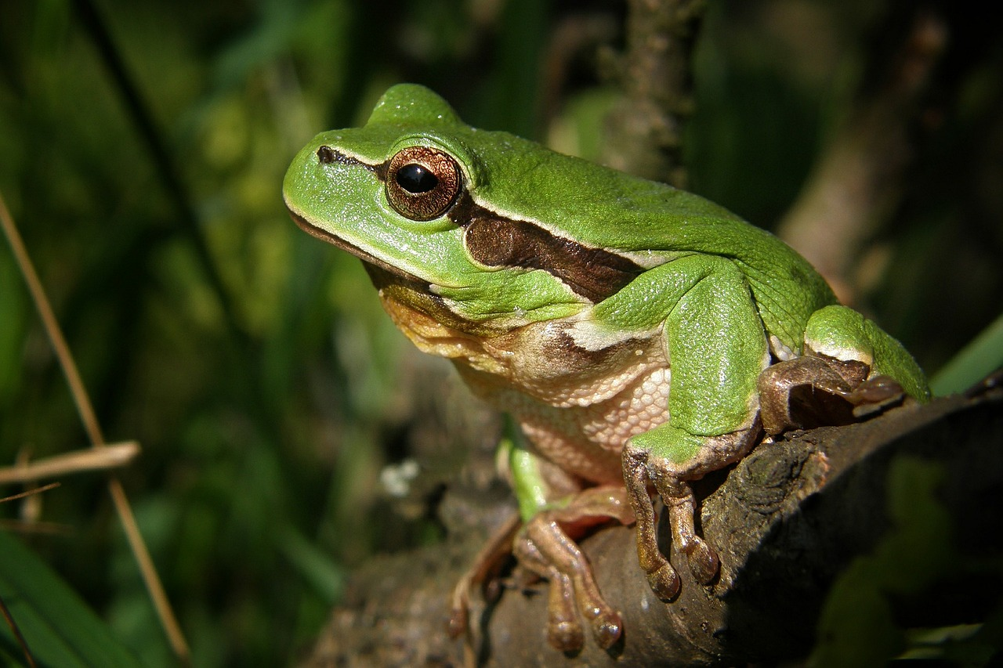
Types of egg-laying animals
Birds ​
Birds' eggs usually have hard shells. Most birds lay their eggs in a nest and sit on them to keep them warm. Keeping the eggs warm helps them to develop.
Many animals lay eggs, but not all eggs are the same.
Reptiles​
Reptile eggs all come in different shapes and sizes. Some reptiles lay their eggs in sand or soil, but some hide them underground to keep them safe. Crocodiles guard their eggs fiercely, unlike other reptiles!
Amphibians​
Amphibians' eggs are mostly soft and jelly like. Their eggs are laid in water. These eggs don't need a shell as the water protects them as they grow.

Slide 14
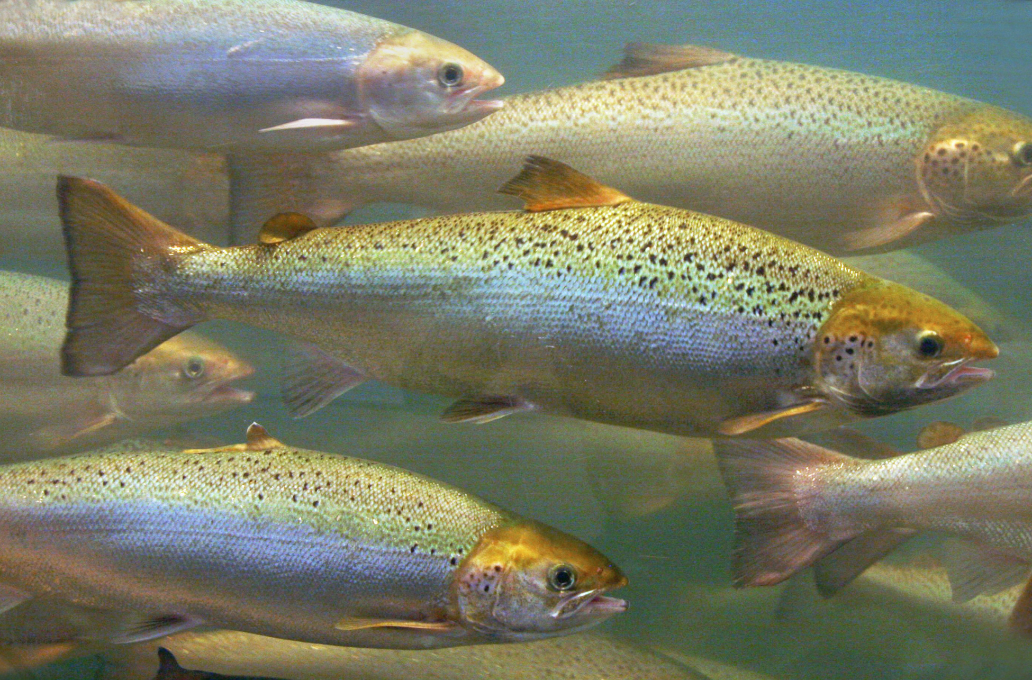
Types of egg-laying animals
Reptiles​
Reptile eggs all come in different shapes and sizes. Some reptiles lay their eggs in sand or soil, but some hide them underground to keep them safe. Crocodiles guard their eggs fiercely, unlike other reptiles!
Many animals lay eggs, but not all eggs are the same.
Amphibians​
Amphibians' eggs are mostly soft and jelly like. Their eggs are laid in water. These eggs don't need a shell as the water protects them as they grow.
Fish​
Fish usually lay hundreds to thousands of eggs at one time. Most fish don't protect their eggs and leave them to develop. In the case of a jawfish, the eggs are protected by the male jawfish keeping them in his mouth! ​

Slide 15
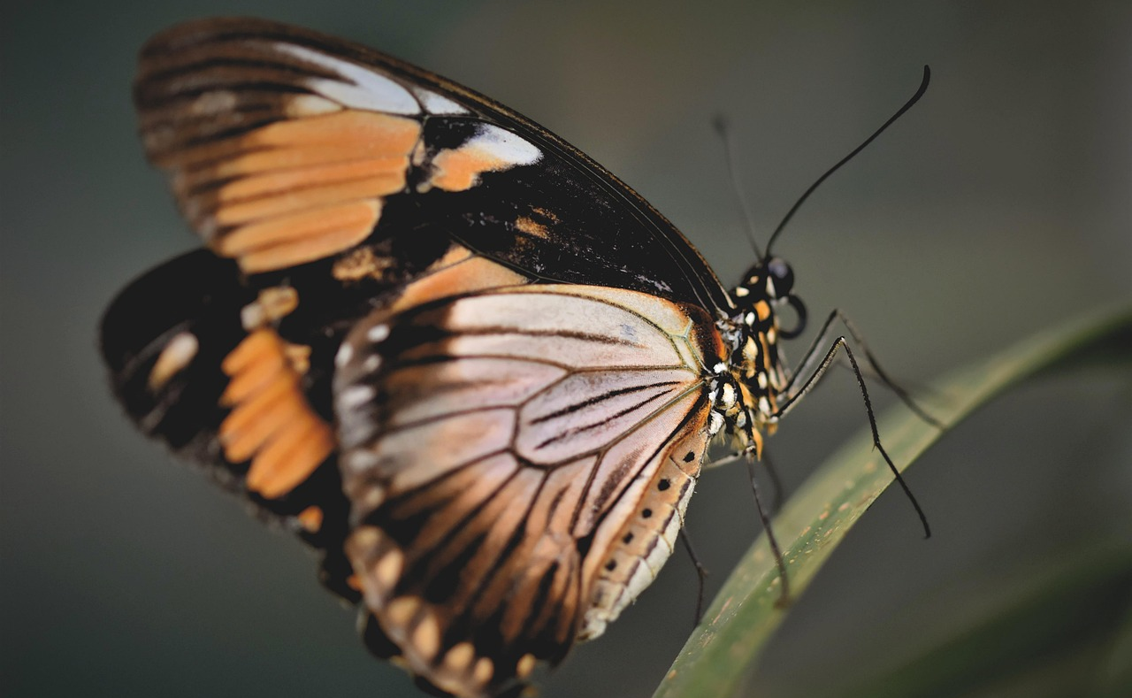
Types of egg-laying animals
Amphibians​
Amphibians' eggs are mostly soft and jelly like. Their eggs are laid in water. These eggs don't need a shell as the water protects them as they grow.
Many animals lay eggs, but not all eggs are the same.
Fish​
Fish usually lay hundreds to thousands of eggs at one time. Most fish don't protect their eggs and leave them to develop. In the case of a jawfish, the eggs are protected by the male jawfish keeping them in his mouth! ​
Insects​
Insect eggs come in all shapes and sizes. They are tiny and laid in clusters on the ground or on leaves. Some insects hide their eggs well to protect the larvae (insect baby). ​

Slide 16
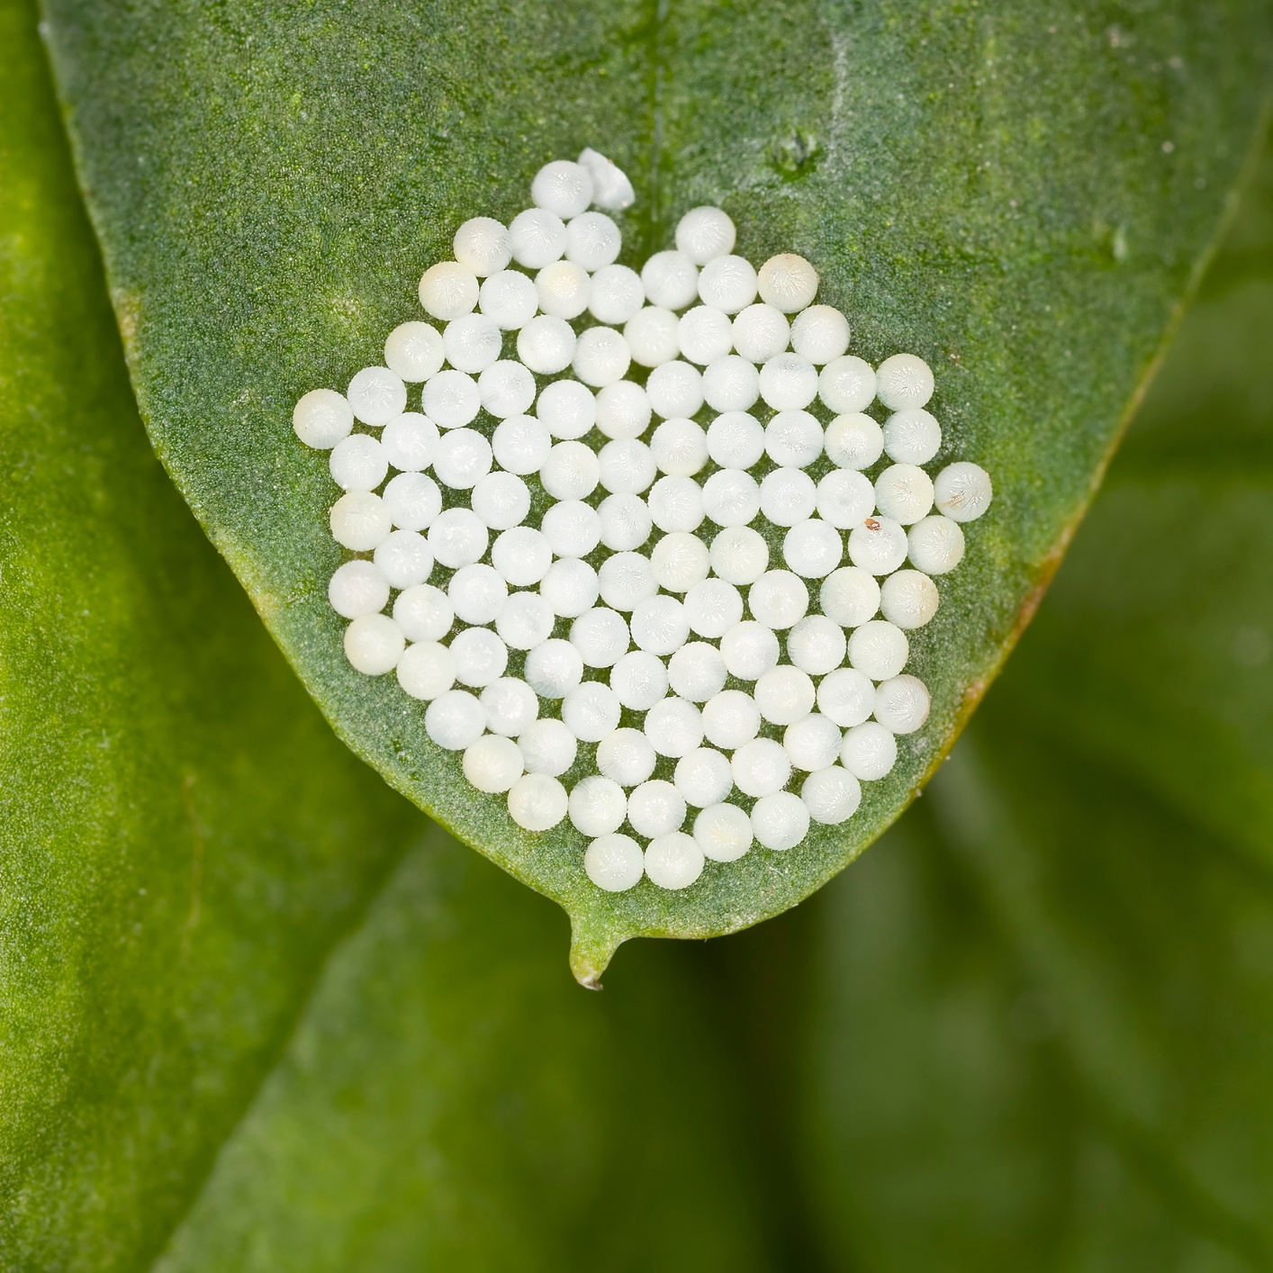
Types of egg-laying animals
Fish​
Fish usually lay hundreds to thousands of eggs at one time. Most fish don't protect their eggs and leave them to develop. In the case of a jawfish, the eggs are protected by the male jawfish keeping them in his mouth! ​
Many animals lay eggs, but not all eggs are the same.
Insects​
Insect eggs come in all shapes and sizes. They are tiny and laid in clusters on the ground or on leaves. Some insects hide their eggs well to protect the larvae (insect baby). ​

Slide 17

Egg-laying animal fact files
You are going to become egg detectives and create a fact file about an egg-laying animal. ​
​
You will need to find out what type of animal it is, how it lays its eggs and at least one amazing fact. ​

Slide 18
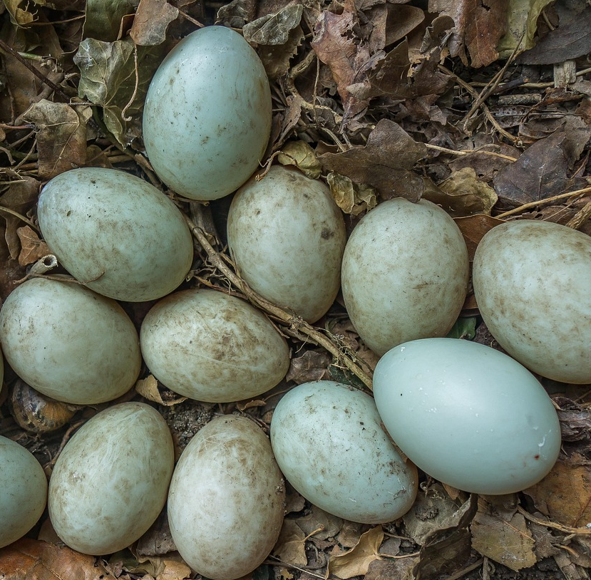
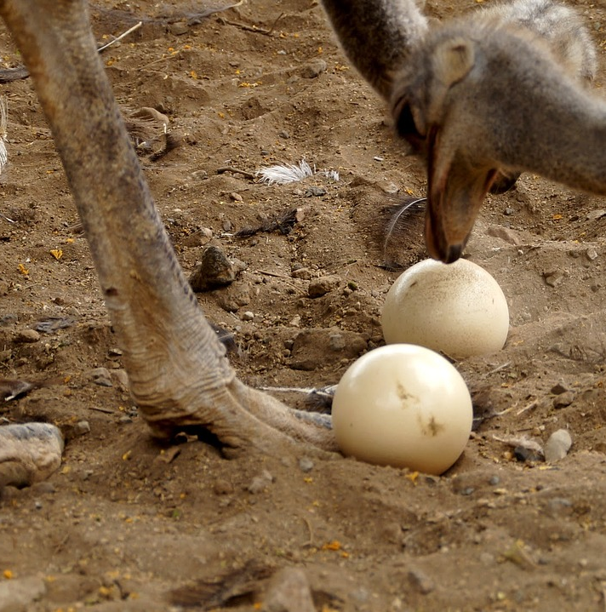
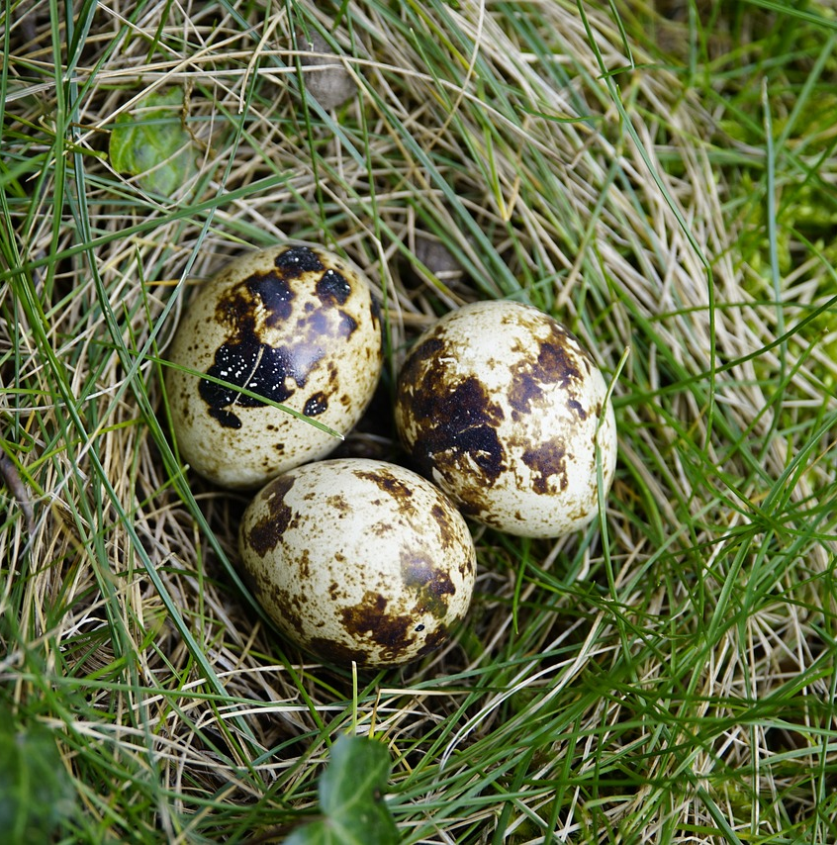
Eggstreme animal knowledge
Quiz time!
1. Do all birds lay eggs?
Yes, all birds lay eggs. Have you ever seen a bird’s egg before?

Slide 19
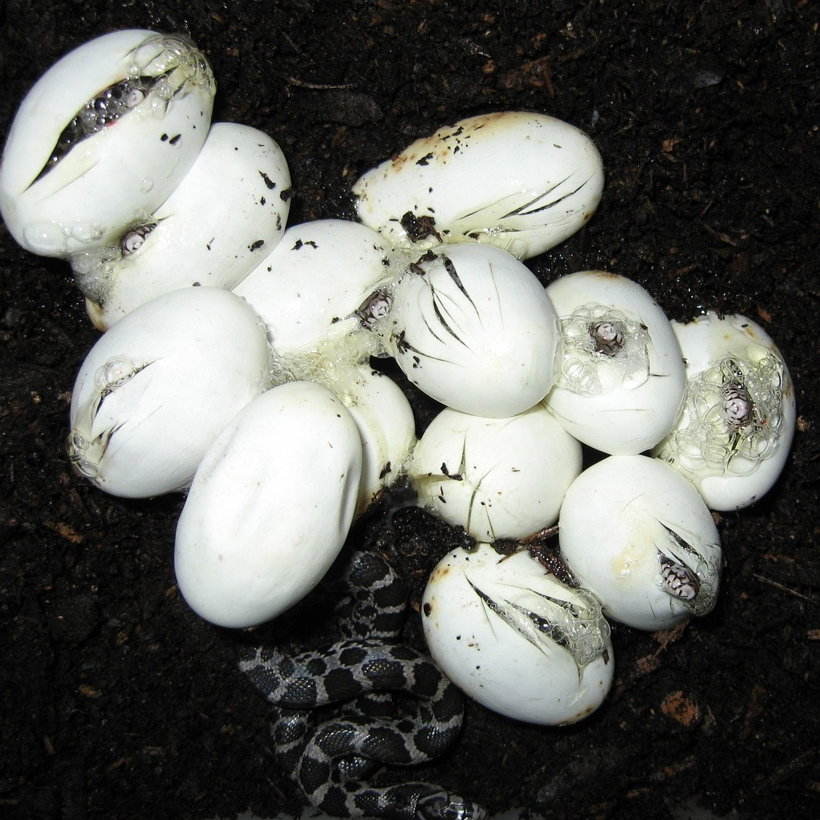
Eggstreme animal knowledge
Quiz time!
2. Which of these animals lay eggs?
A. Cat
B. Snake
C. Dolphin
What helped you decide?
What do snakes have in common with other egg-laying animals?

Slide 20
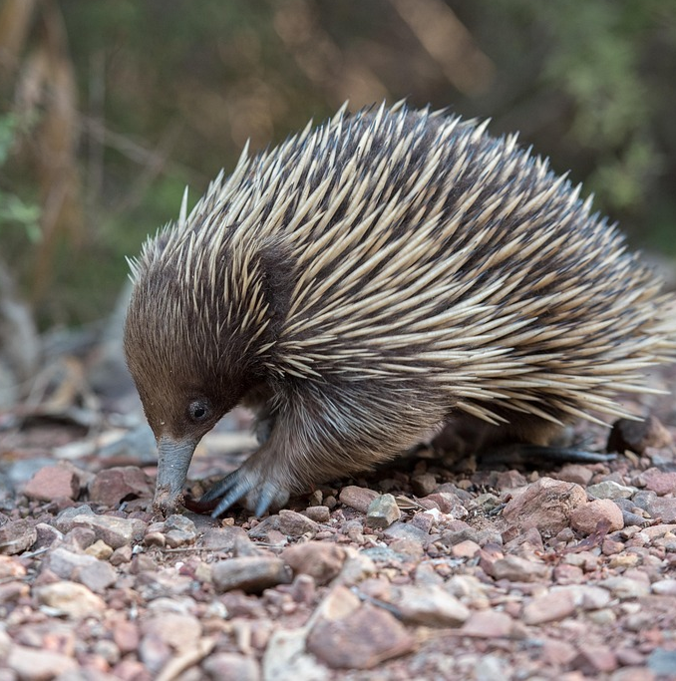
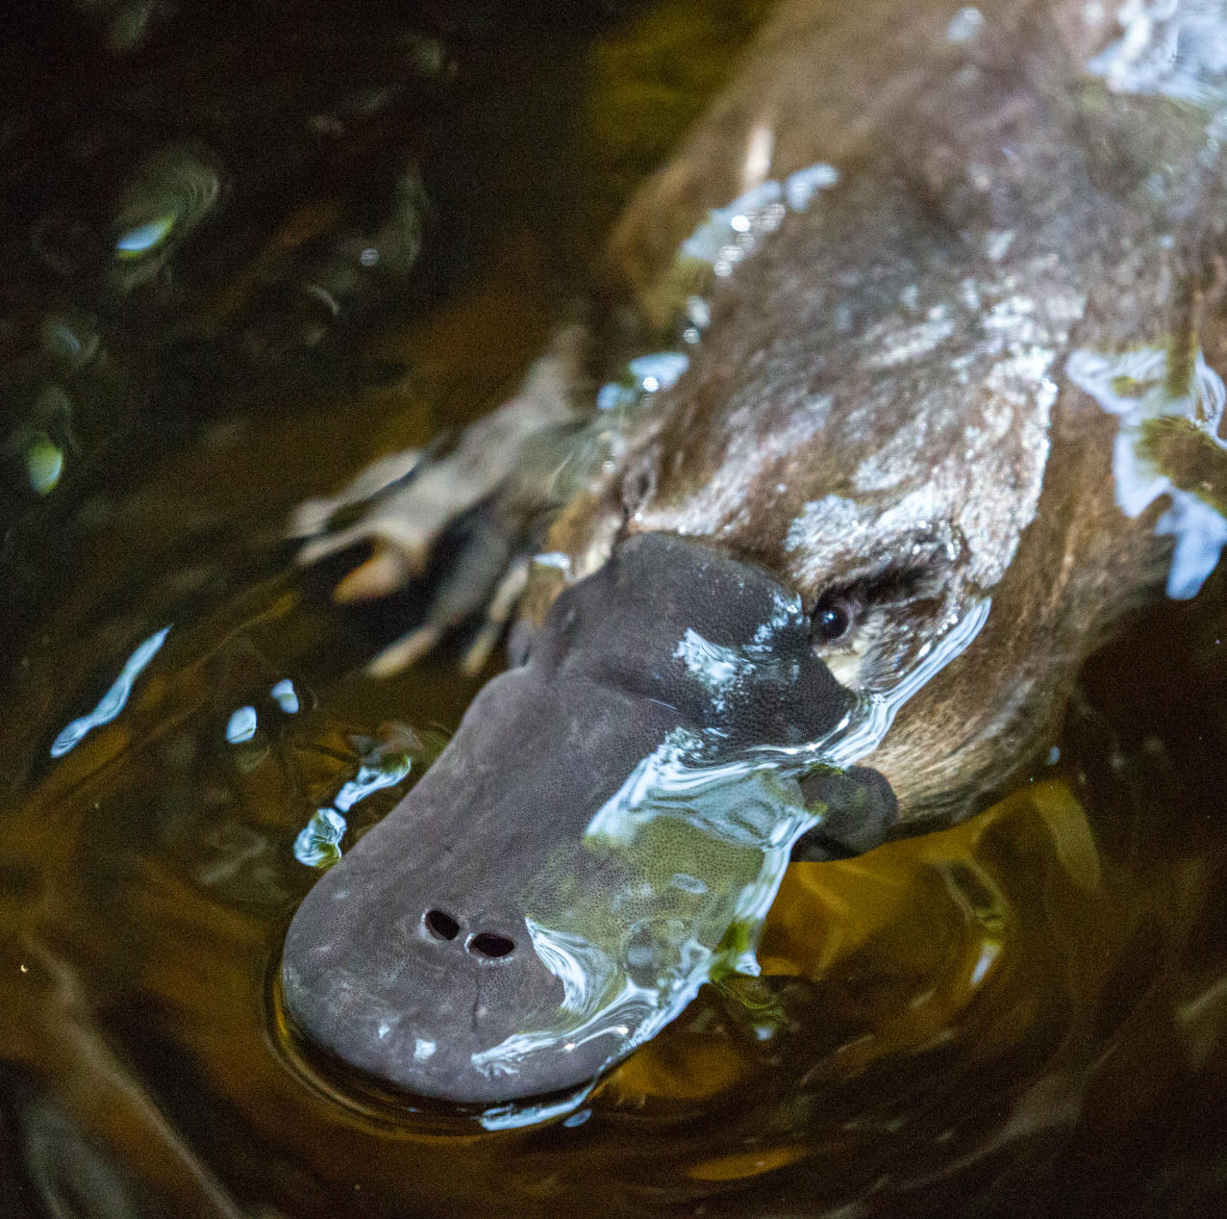
Eggstreme animal knowledge
Quiz time!
3. True or false?
All mammals give birth to live young?
True
False
Platypuses and echidnas are mammals that lay eggs. ​
​
They are a special type of mammal called monotremes which means that even though they have the same features as other mammals (fur, feed their babies milk) they also lay eggs

Slide 21
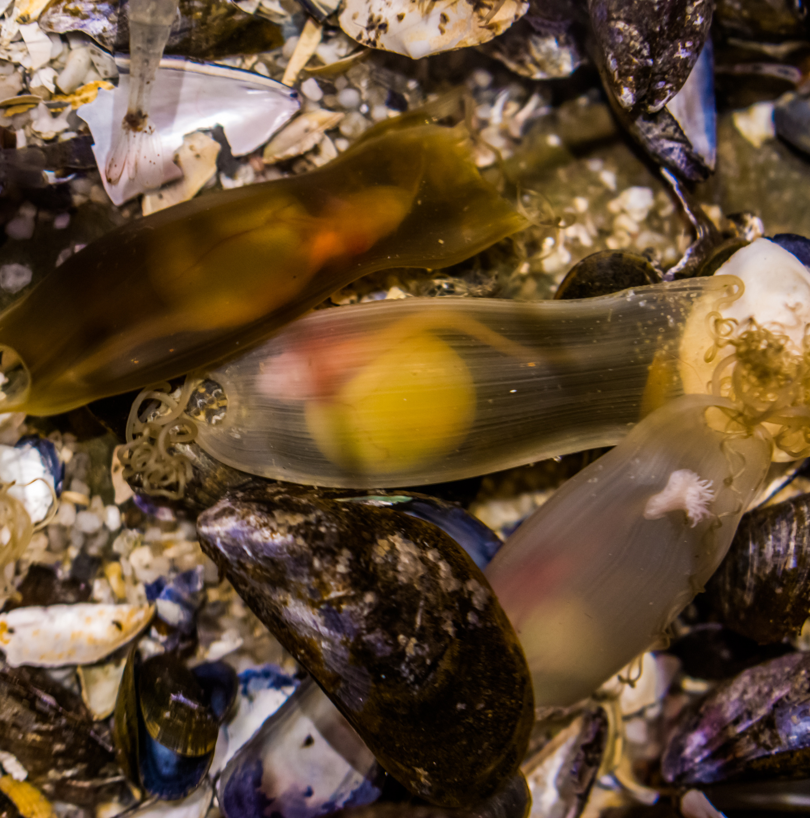
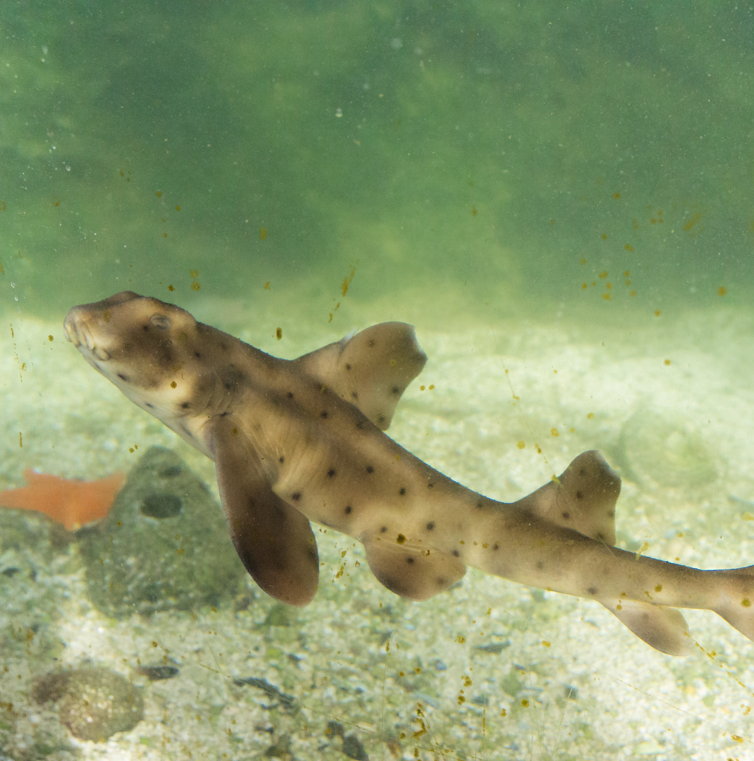
Eggstreme animal knowledge
Quiz time!
4. Does a shark lay eggs?
Some do; some don't. ​
​
About 40% of shark species do in fact lay eggs. ​
​
Some types of shark that lay eggs are cat sharks, horn sharks, bamboo sharks and carpet sharks.

Slide 22
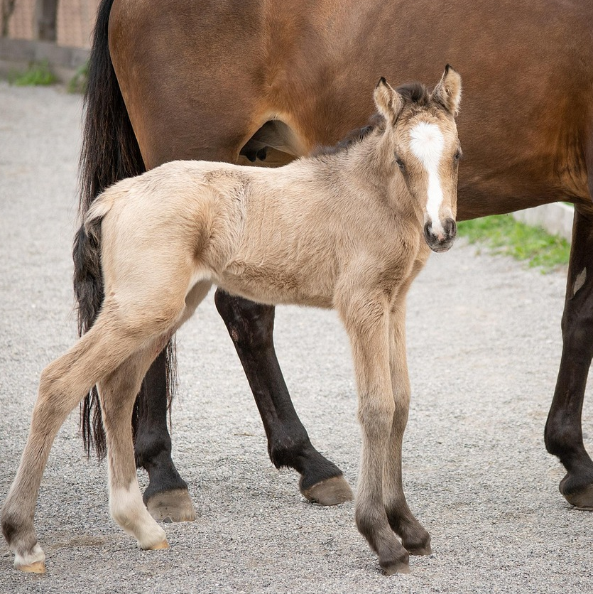
Eggstreme animal knowledge
Quiz time!
5. Which one of these animals is viviparous?
A. Frog
B. Owl
C. Horse
A Horse is a non-egg-laying mammal.

Slide 23
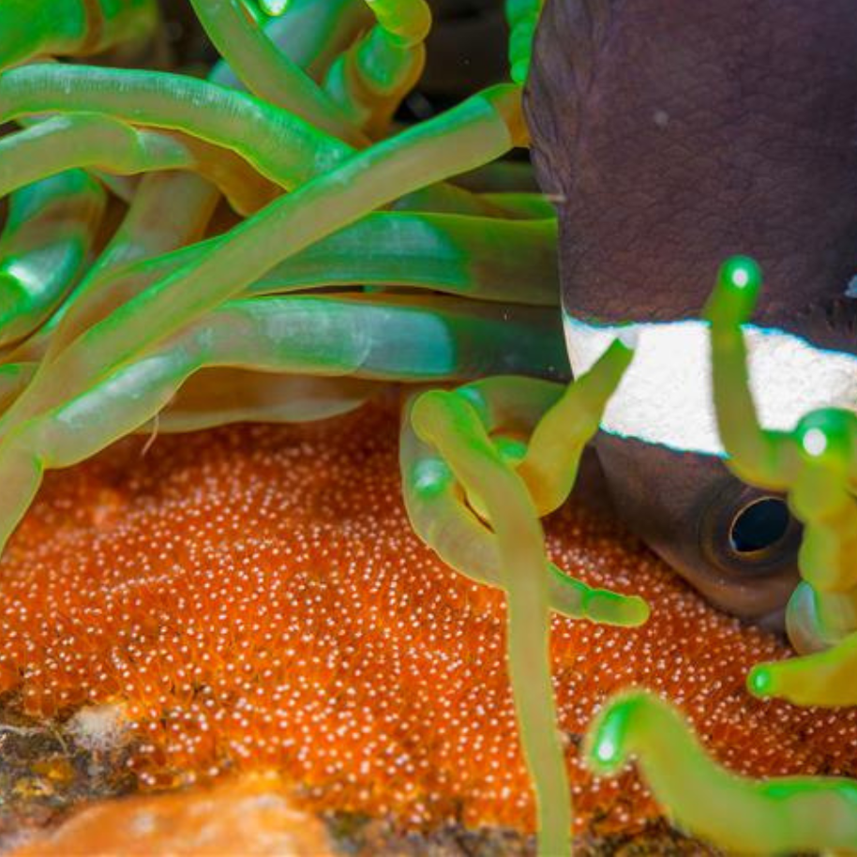
Eggstreme animal knowledge
Quiz time!
6. Which group usually lays the most eggs at one time?
A. Fish
B. Mammals
C. Birds
Fish lay lots of eggs at one time because most of their
eggs don't survive to grow into adults. This is because strong currents can wash them away, they can be eaten by bigger fish, or they may not be protected, as most fish don't defend their eggs. ​

Slide 24

Well done egg detectives!
Today we have learned which animals lay eggs and which give birth to live young.
We have also created some fantastic fact files about egg-laying animals.

Slide 25

Brought to you by

