Slide 1

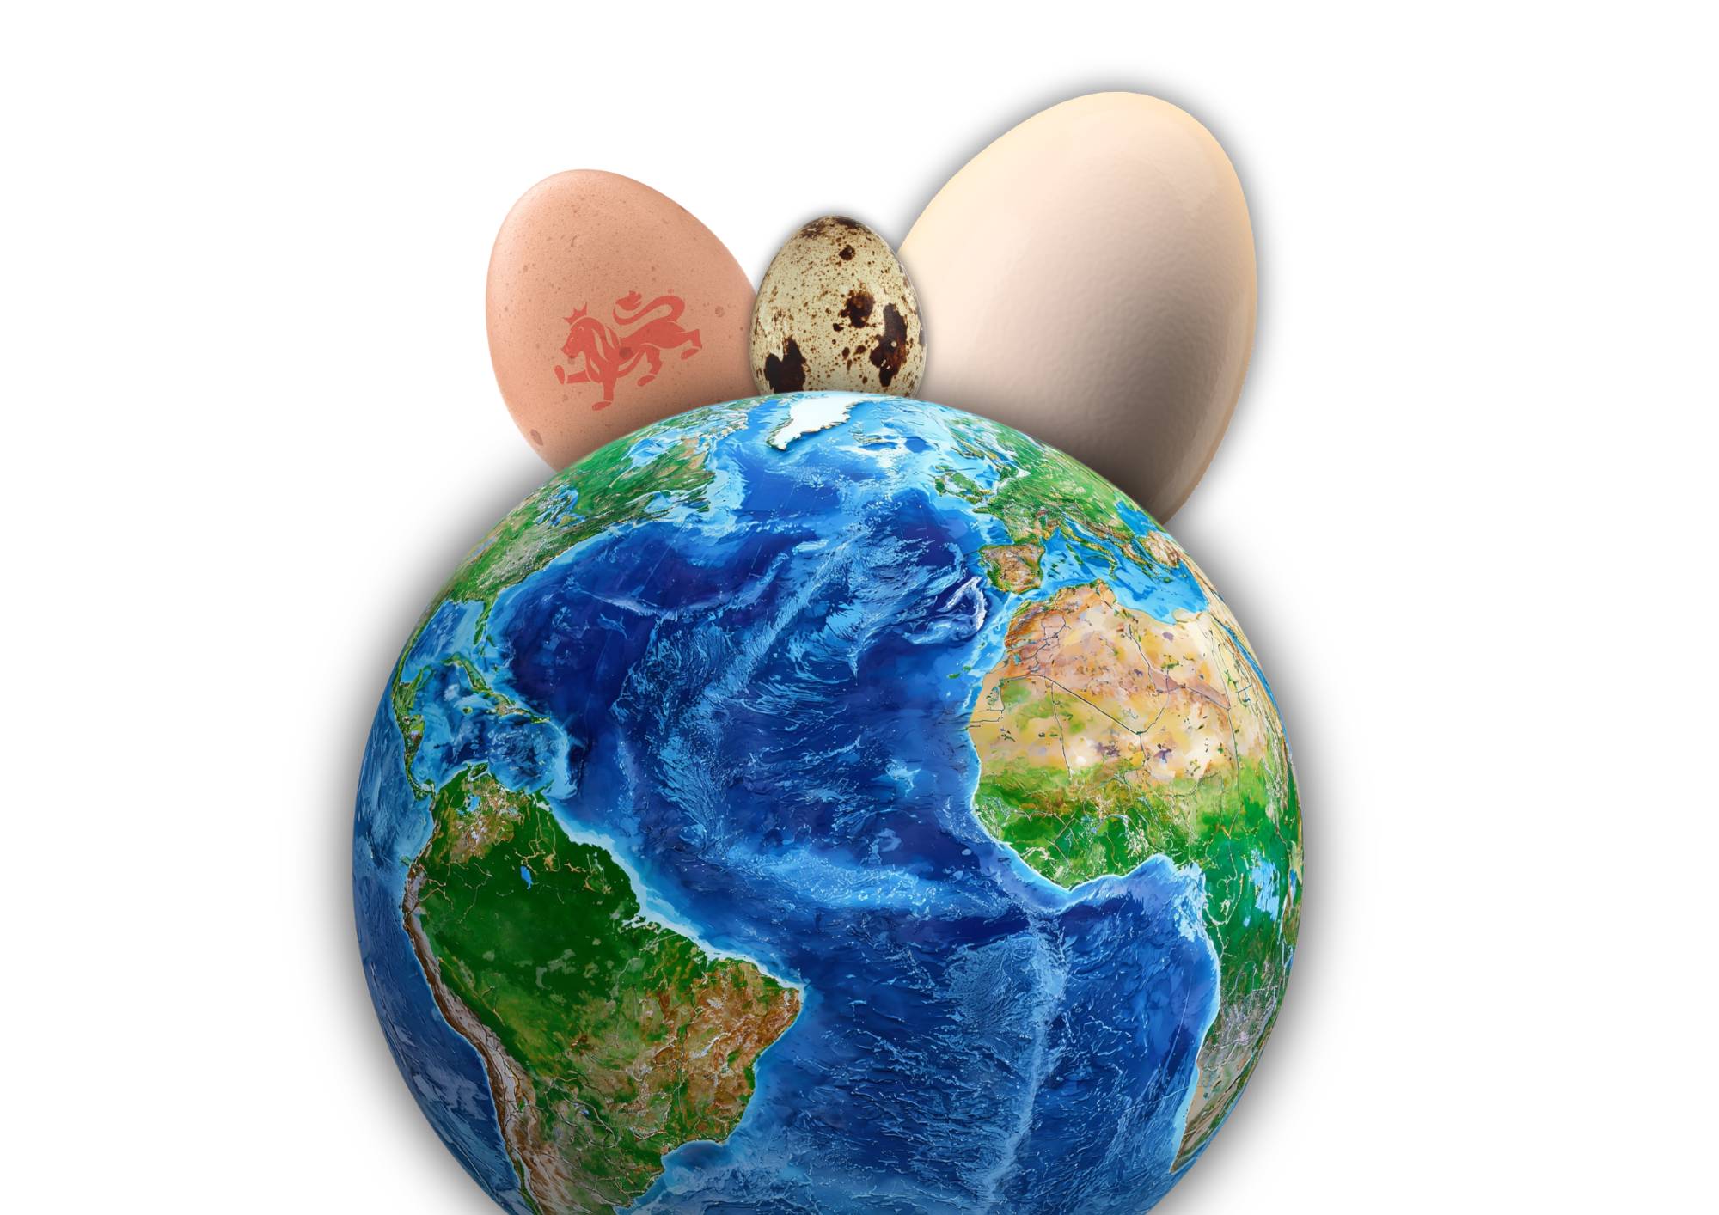
Egg explorers

Slide 2
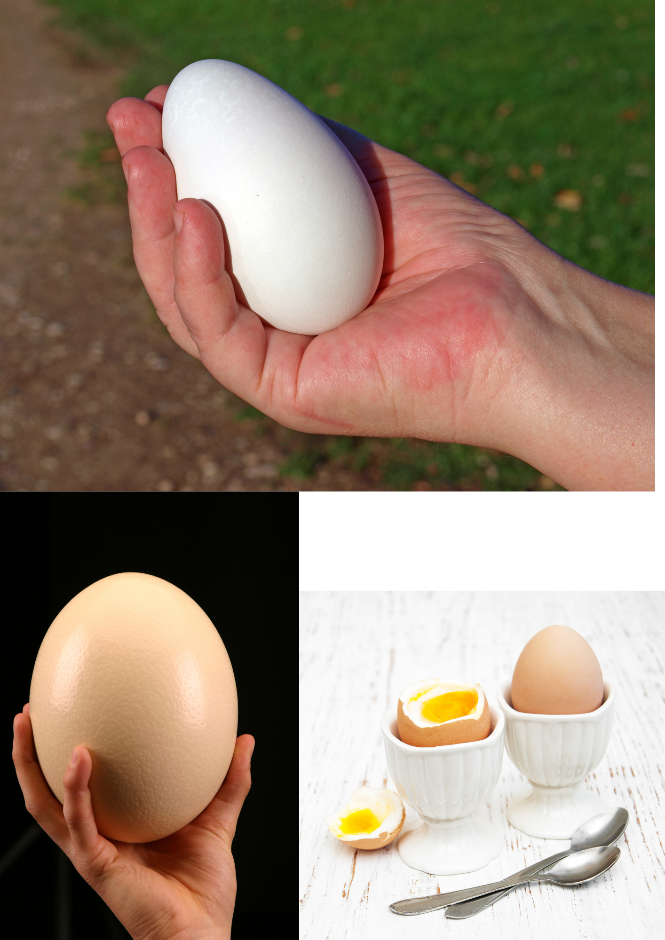
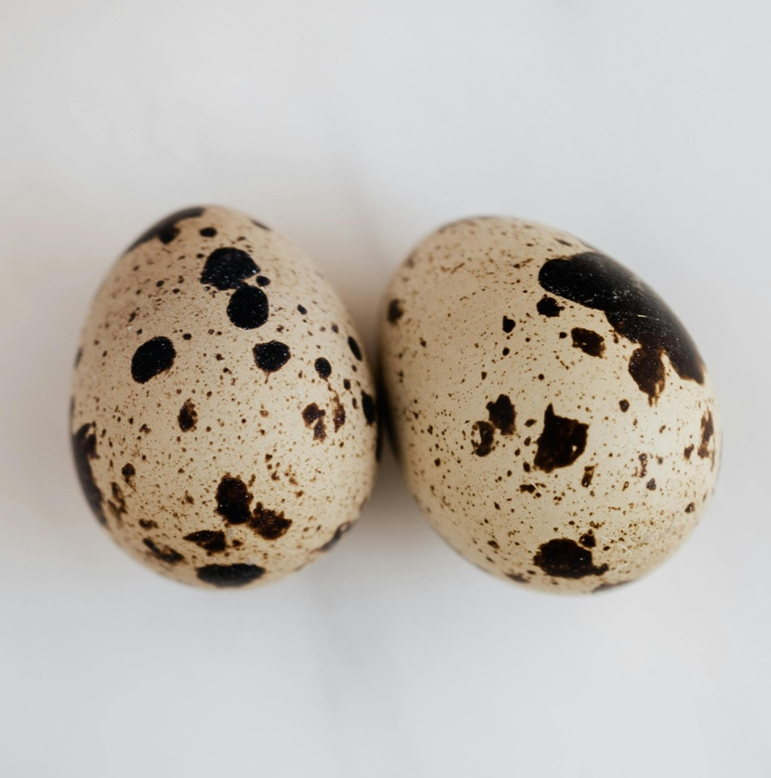
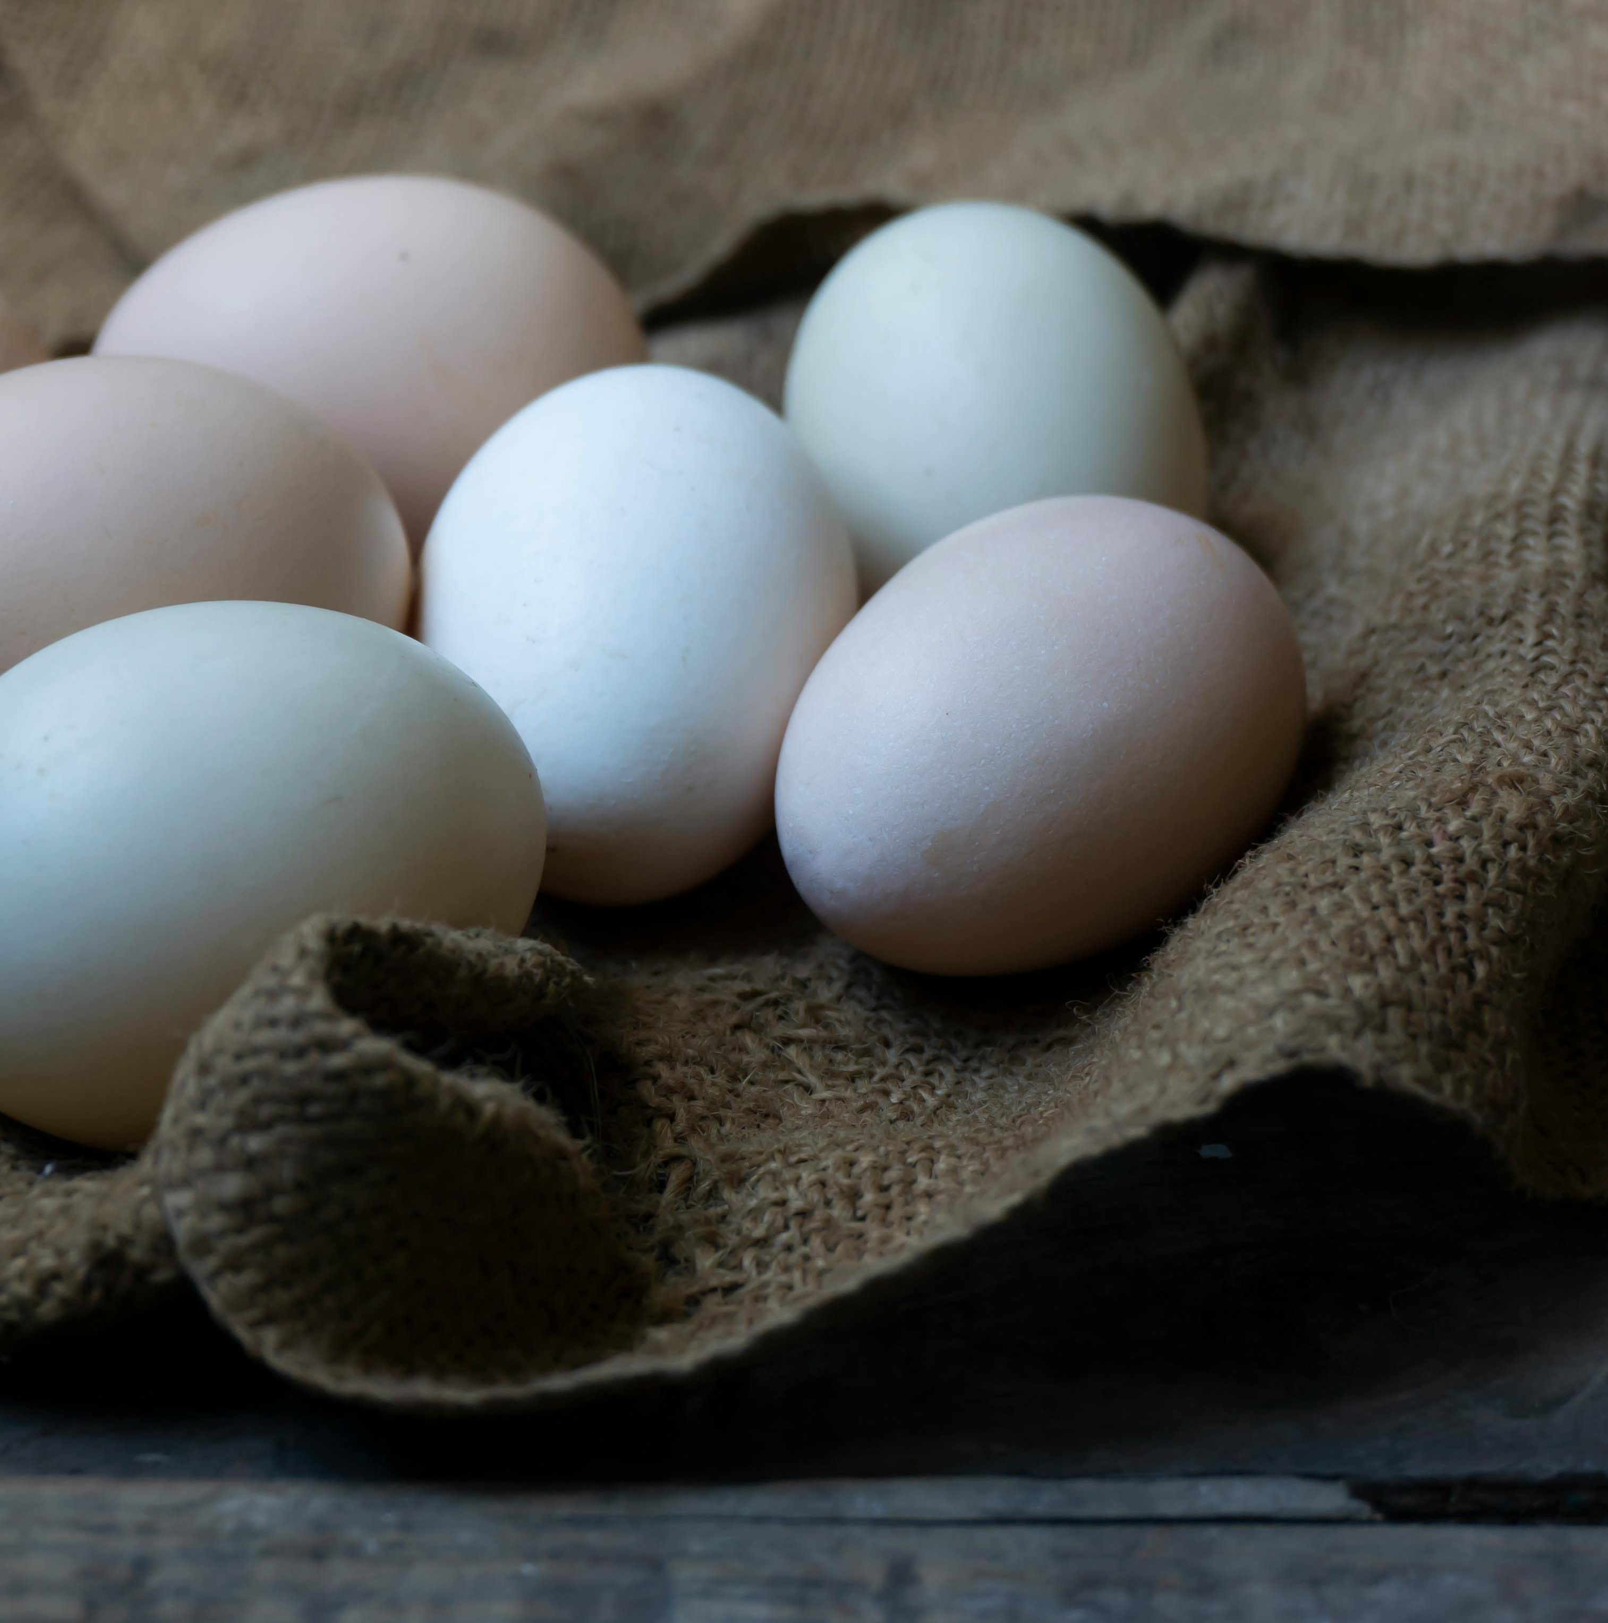
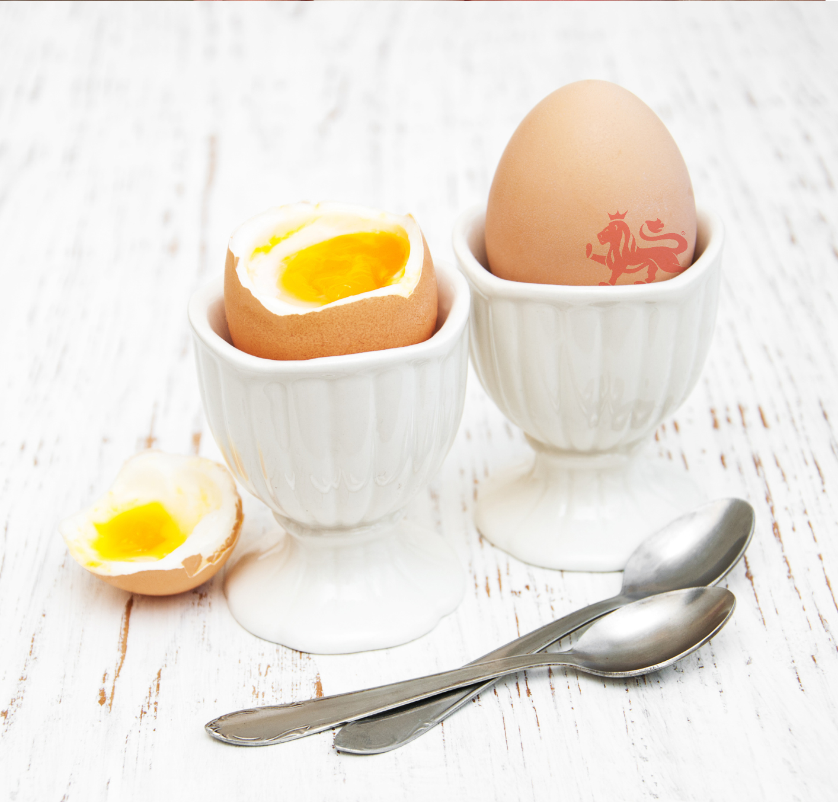
Let’s talk about eggs
Which eggs have you seen or eaten?
Do you know what type of egg they are?
Which is the biggest?
Which one do you think comes from the furthest away from where we are?

Slide 3
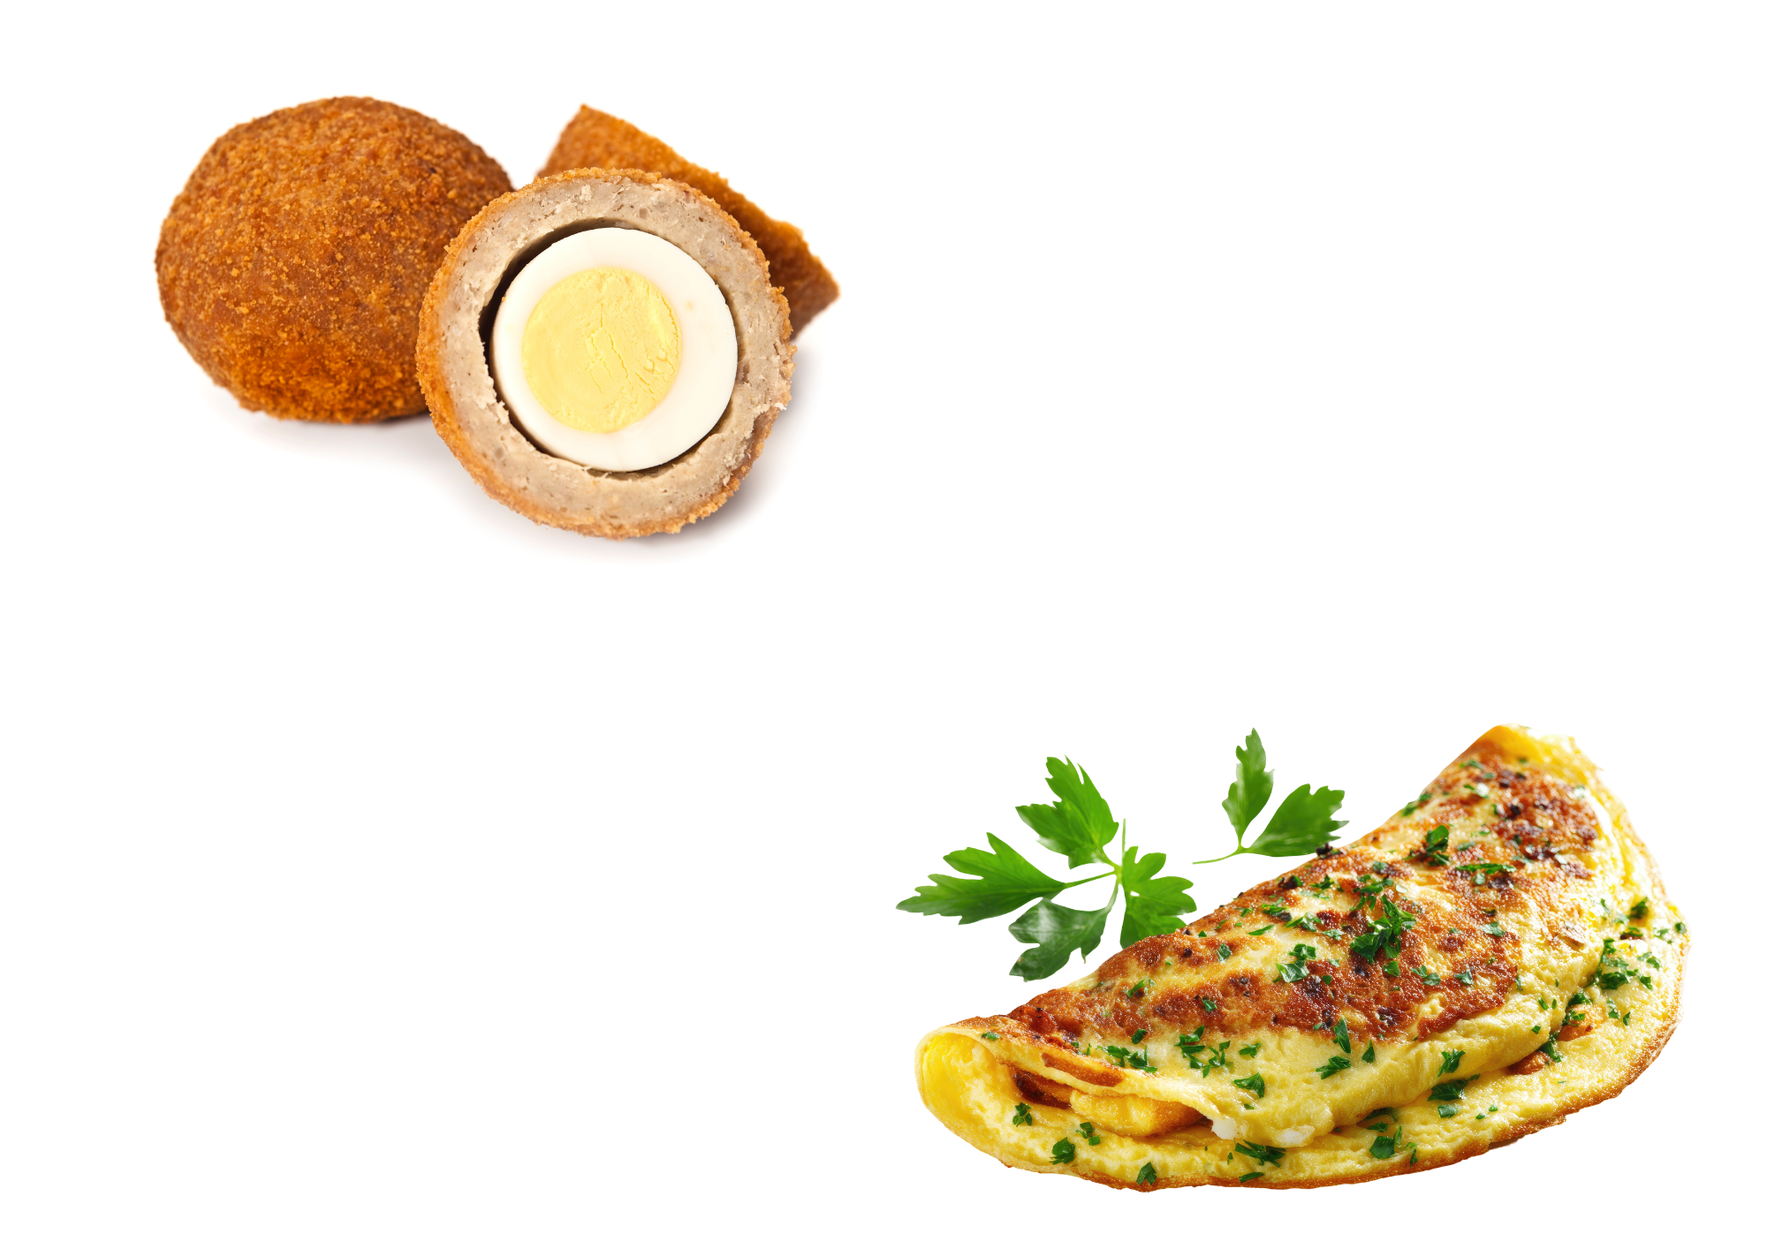
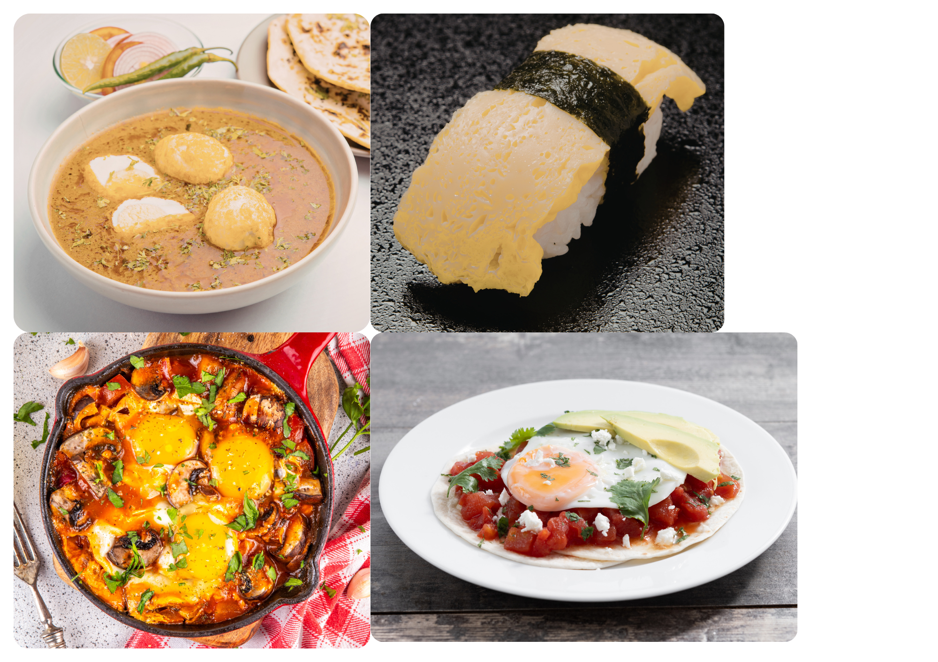
Eggs in different places
Lots of people around the world eat eggs, but how they eat them can be very different! ​
Which places do you think these egg dishes come from?

Slide 4
Eggs in different places
French omelette​​
A light and fluffy egg roll from France. Sometimes it has cheese, herbs or vegetables inside. ​
Tamago sushi​
Sweet, folded eggs on top of rice from Japan. People eat it with chopsticks or with their fingers. ​
Egg curry​
Boiled eggs in a spicy sauce from India. It is usually eaten with rice or bread.
Huevos rancheros ​
Fried eggs served on tortillas with beans and sauce from Mexico. A common breakfast. ​
Shakshuka​
Eggs cooked in a tasty tomato sauce from North Africa. It is often eaten for breakfast or lunch. ​​
Scotch egg​
A boiled egg wrapped in sausage meat and bread crumbs from the UK. It can be eaten hot or cold. ​

Slide 5

Use your map to place where the dishes come from.
UK
France
Japan
North Africa
Mexico
India

Slide 6
Egg comparison
Are these dishes anything like the egg dishes you eat at home?
What’s the same and what’s different?

Slide 7
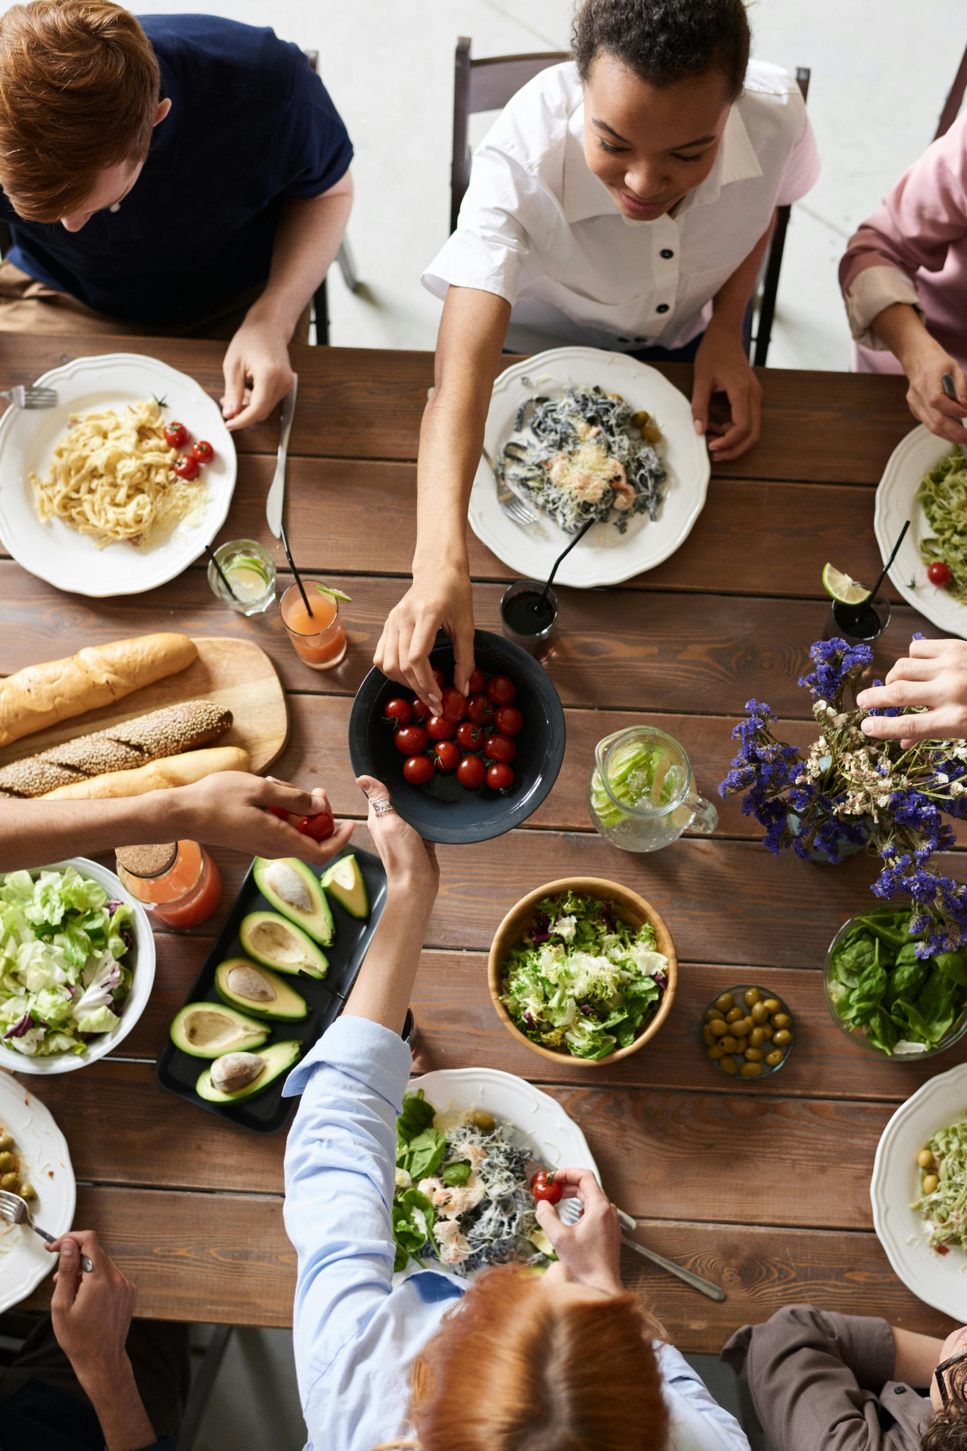
Celebrating diversity through food
Why is it important for us to learn about food from other countries?
Learning about the different food everyone eats helps us understand and respect each other. ​

Slide 8
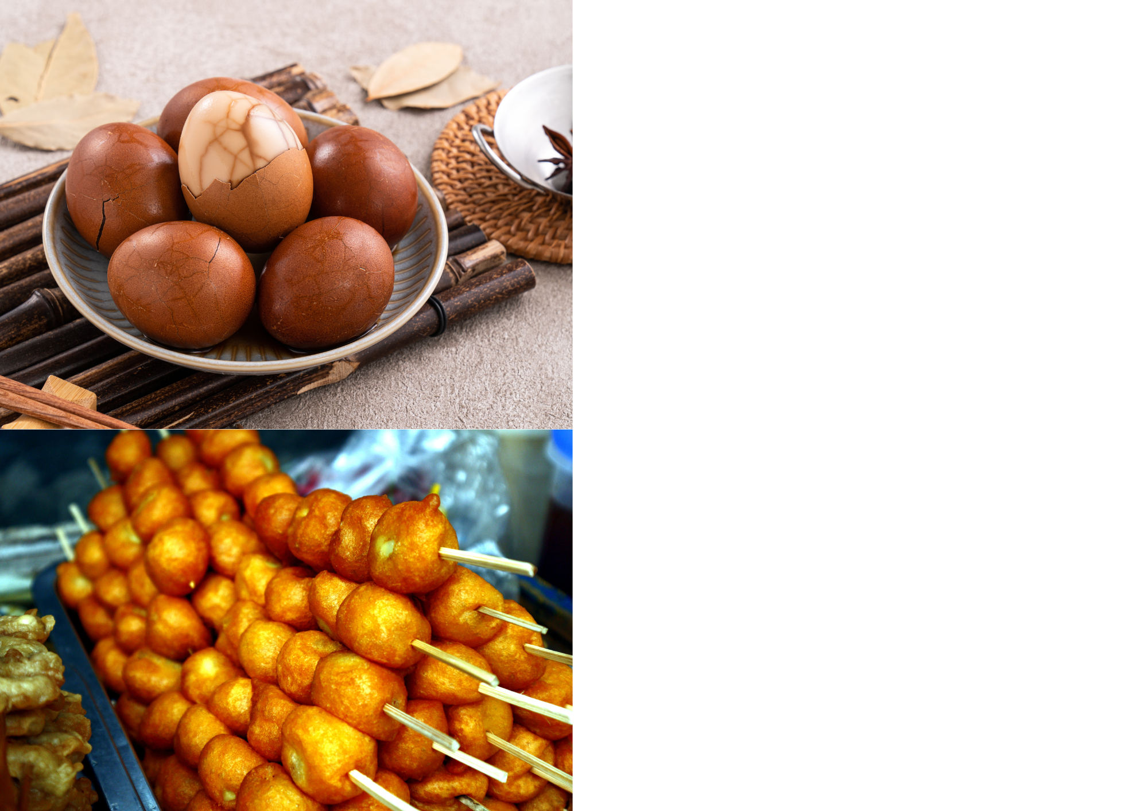
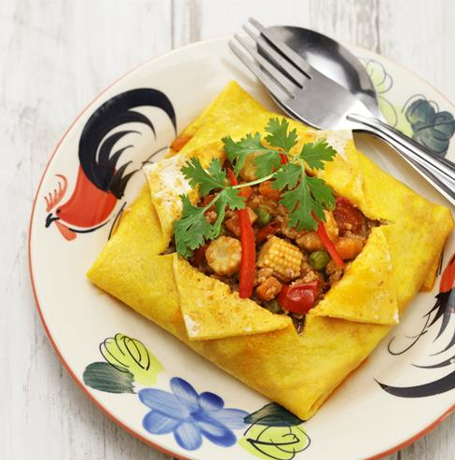
Fun egg facts
Tea eggs are hen eggs that
are gently cracked and soaked
in tea and spices, which makes
pretty patterns on the shell and adds flavour. People in China often eat them as a snack. ​
Khai Yat Sai meaning 'stuffed
eggs’ ​are eggs filled with
vegetables and meat then fried.
People in Thailand eat them as a tasty meal. ​
Which one would you try and why?
Ostrich eggs are very big. One
Egg is the same as 24 hen eggs.
Some people in Australia eat them
for a giant breakfast. It takes a long time to cook one egg as they are so large. ​
Kwek-Kwek are small quail
eggs covered in a bright orange
batter and fried until crunchy.
People in the Philippines eat them as a tasty snack! ​

Slide 9

Eggs around the world
What is one new thing you learned?​
​
Which egg dish surprised you?​
​
Eggs come from farms all over the world, and we can enjoy them in many different ways, but buying and eating British eggs helps us support our local farmers and our country!

Slide 10

Brought to you by

