Slide 1
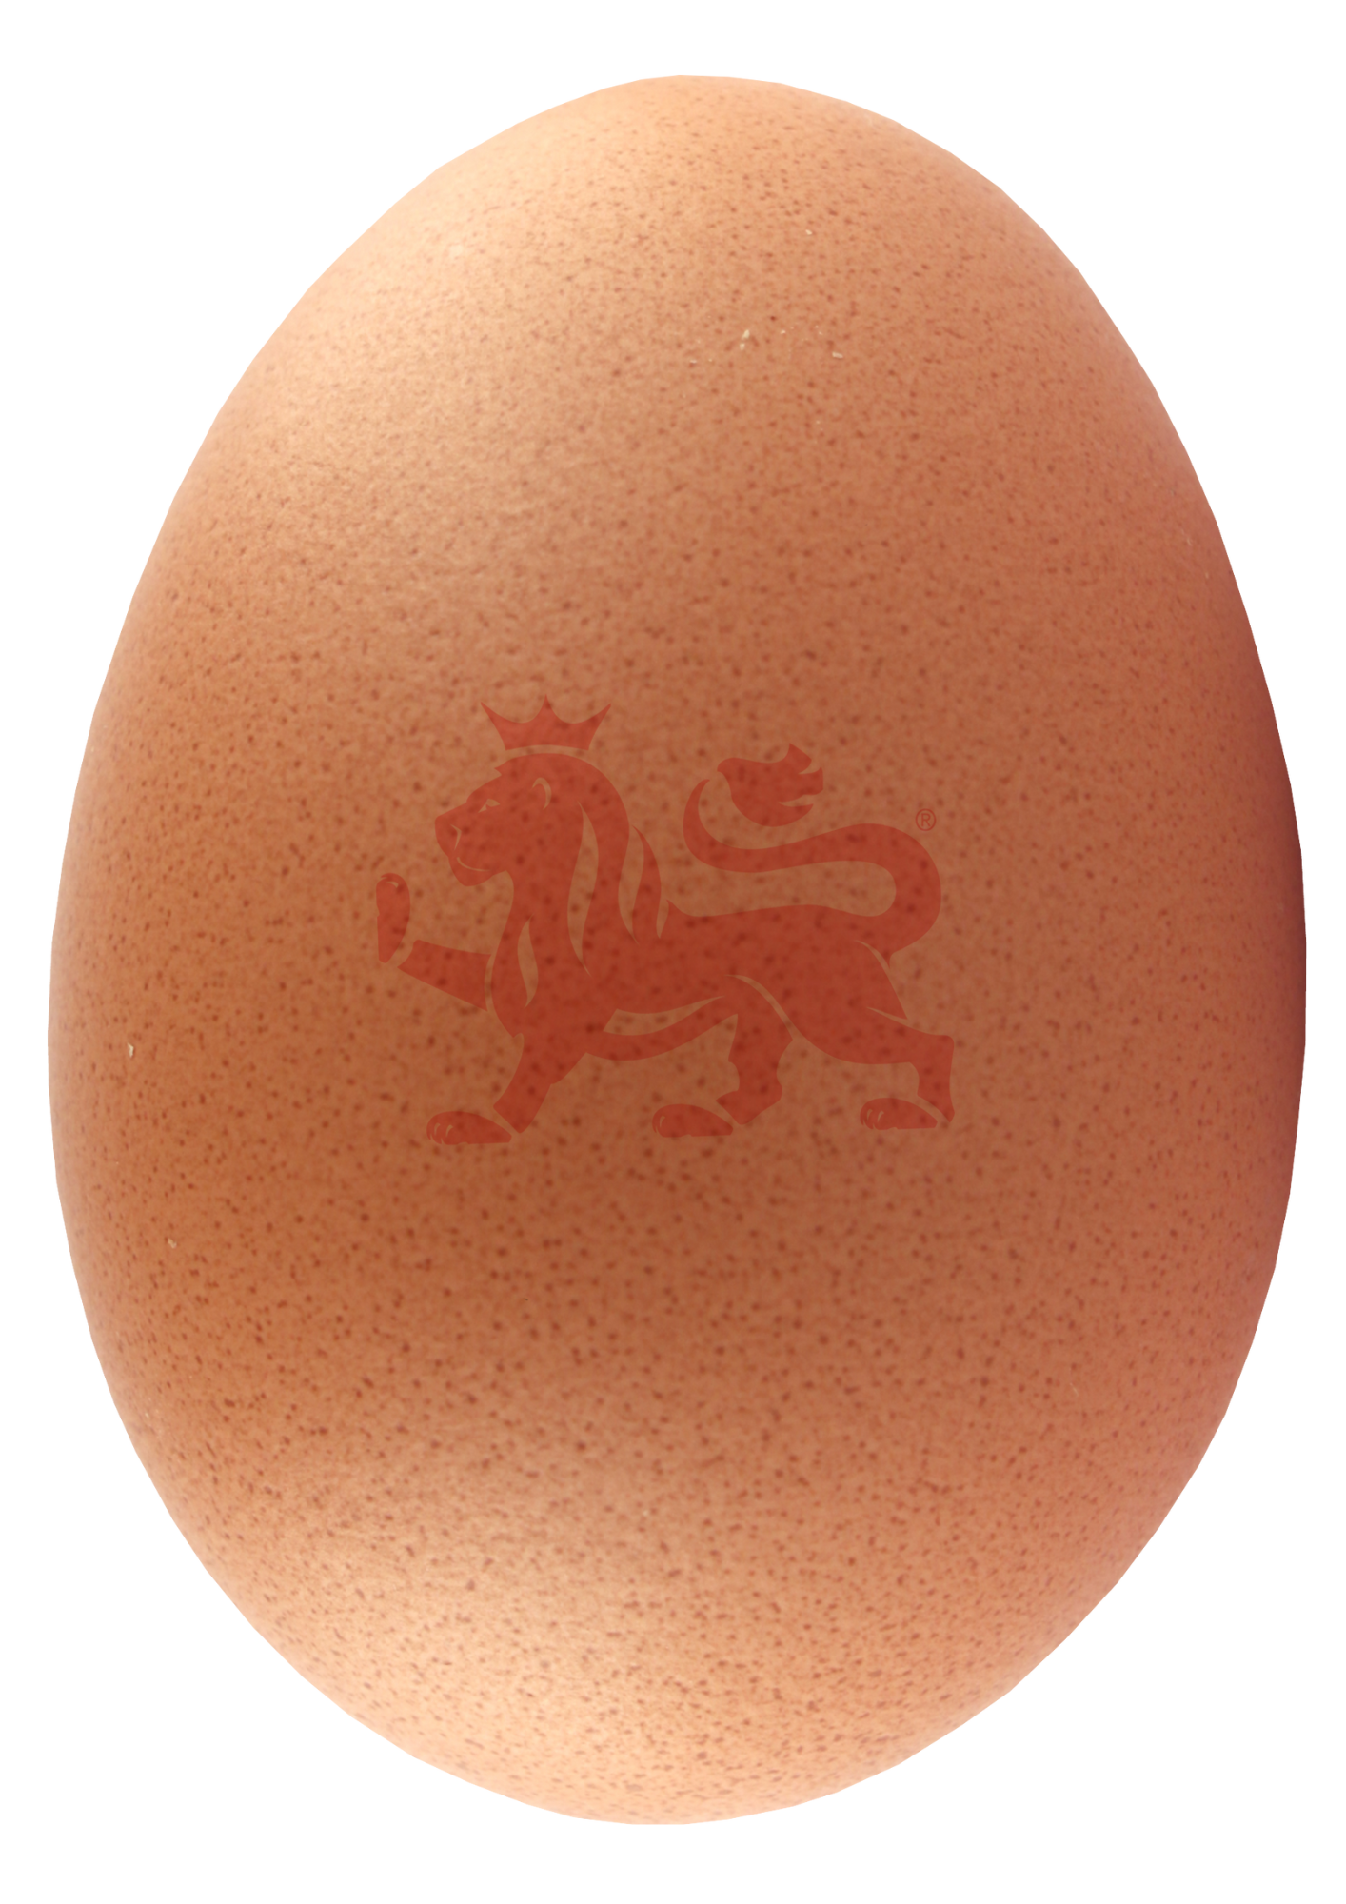

Eggs are eggscellent

Slide 2
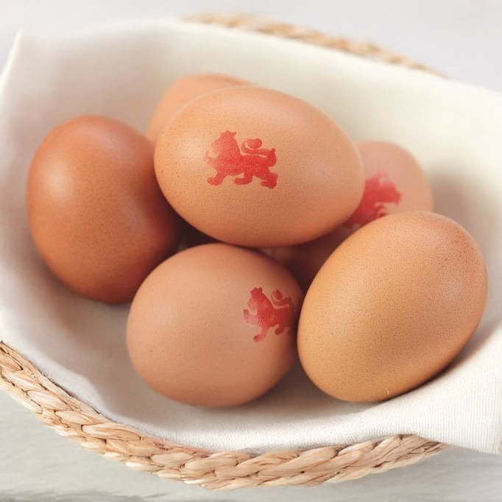
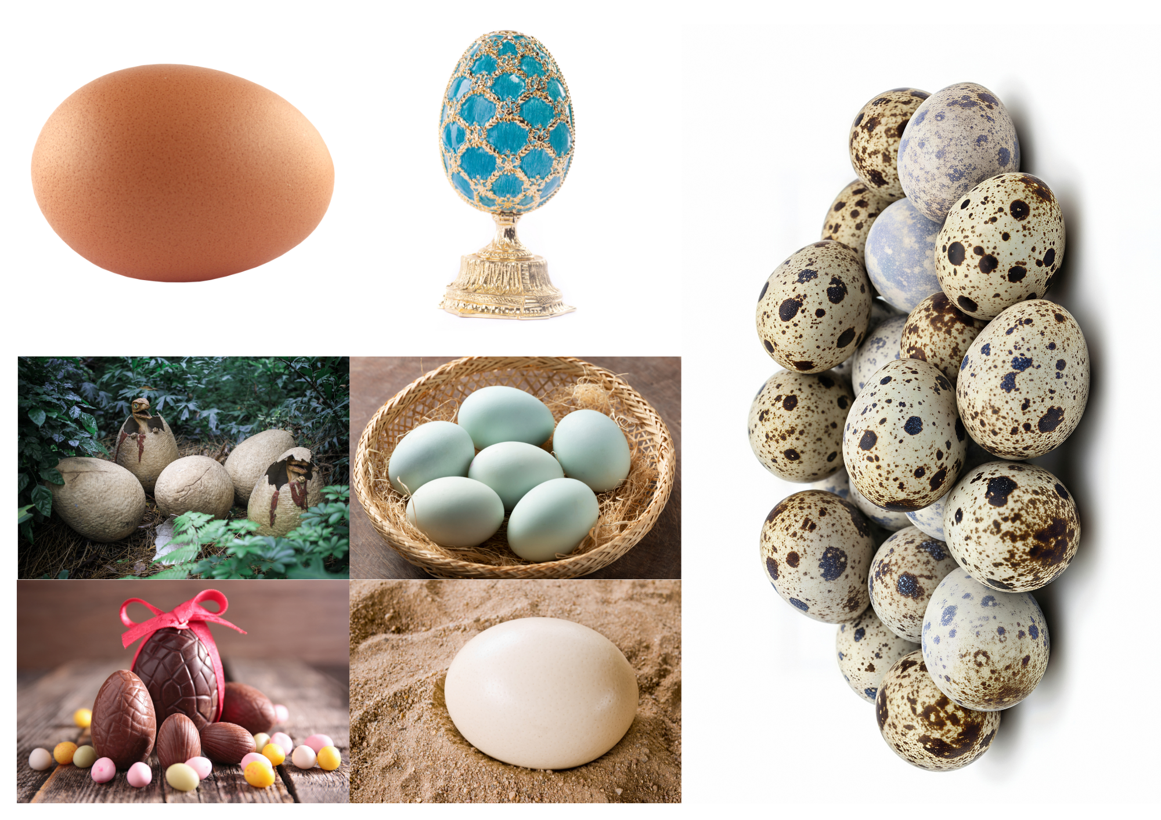

Odd egg out
Which is the odd one out? Justify your decision.

Slide 3
Describe, describe, describe
You have just used lots of fantastic descriptive language to explain your choices. ​
​
In today's lesson, we are going to build on those skills to describe eggs in even more detail.

Slide 4
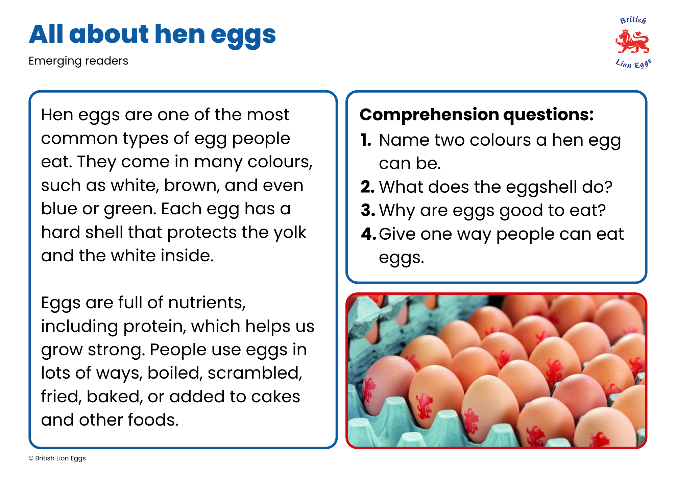
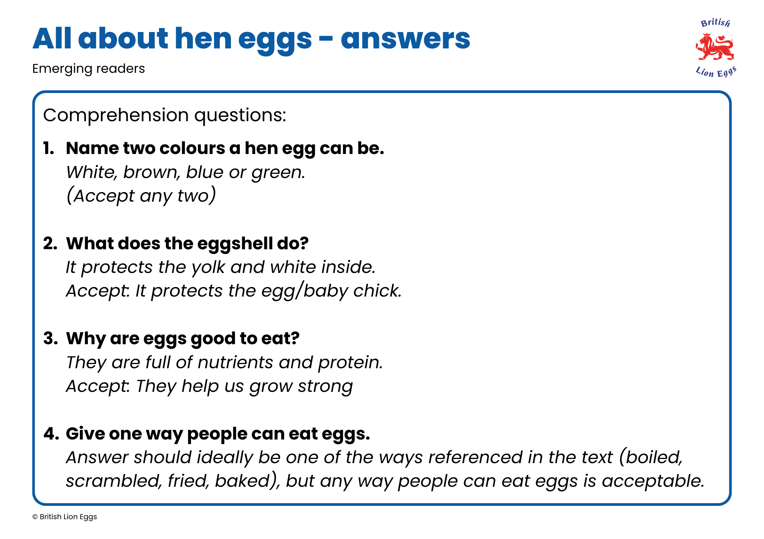
Egg fact or fiction
Now, you are going to read an information text about eggs and answer the questions.

Slide 5
Egg adjectives
How many different adjectives can you think of that describe eggs?
Can you think of a simile or metaphor?

Slide 6
Eggsplanations
Choose from one of these two writing activities:
Non-fiction
Creative writing
Write a top 5 egg facts page. ​
Remember to include: ​
Headings​
Bullet points​
Similes and metaphors​
Descriptive adjectives​
Imagine you are in an egg about to hatch. Write a diary entry describing how you are feeling, your surroundings and what is happening.

Slide 7
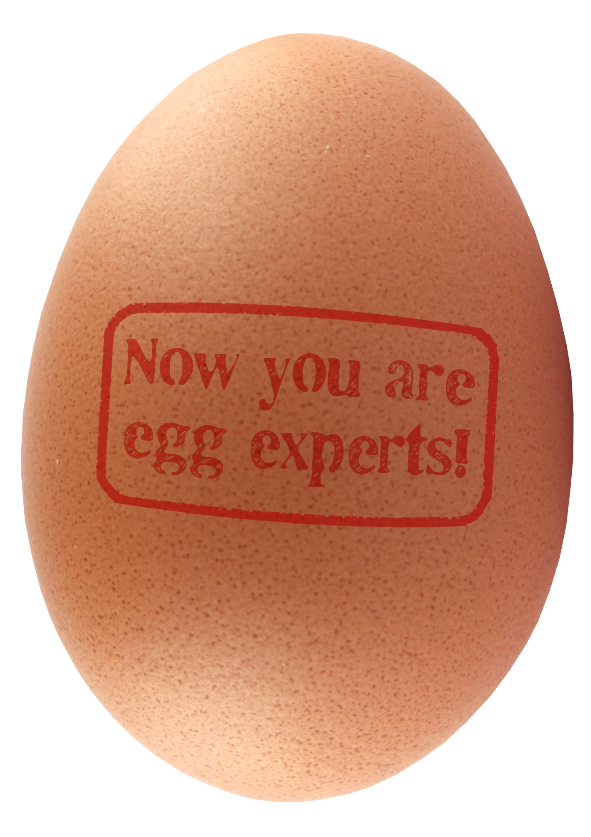
Sharing eggscellence
Wow! What a lot you know.
Share your favourite egg fact with a partner.
What do you think is the most eggscellent adjective or piece of writing?

Slide 8

Brought to you by

