Slide 1

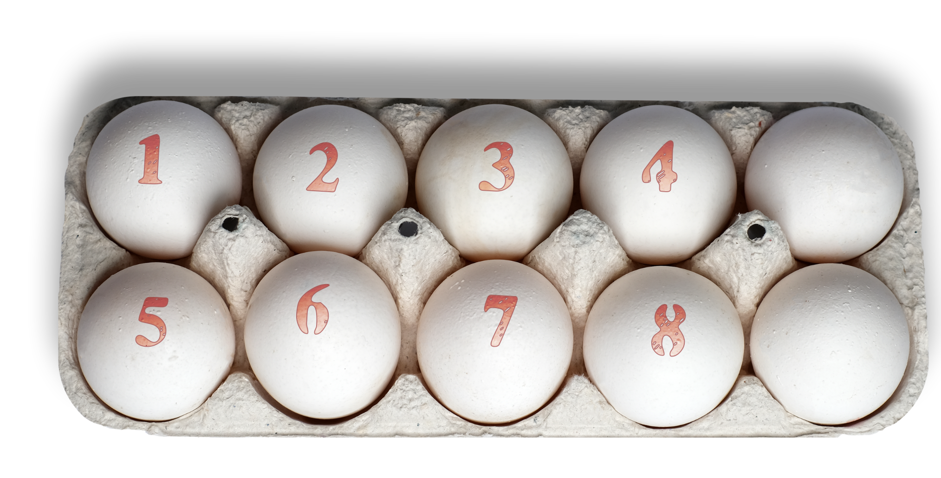
Eggsploring numbers

Slide 2
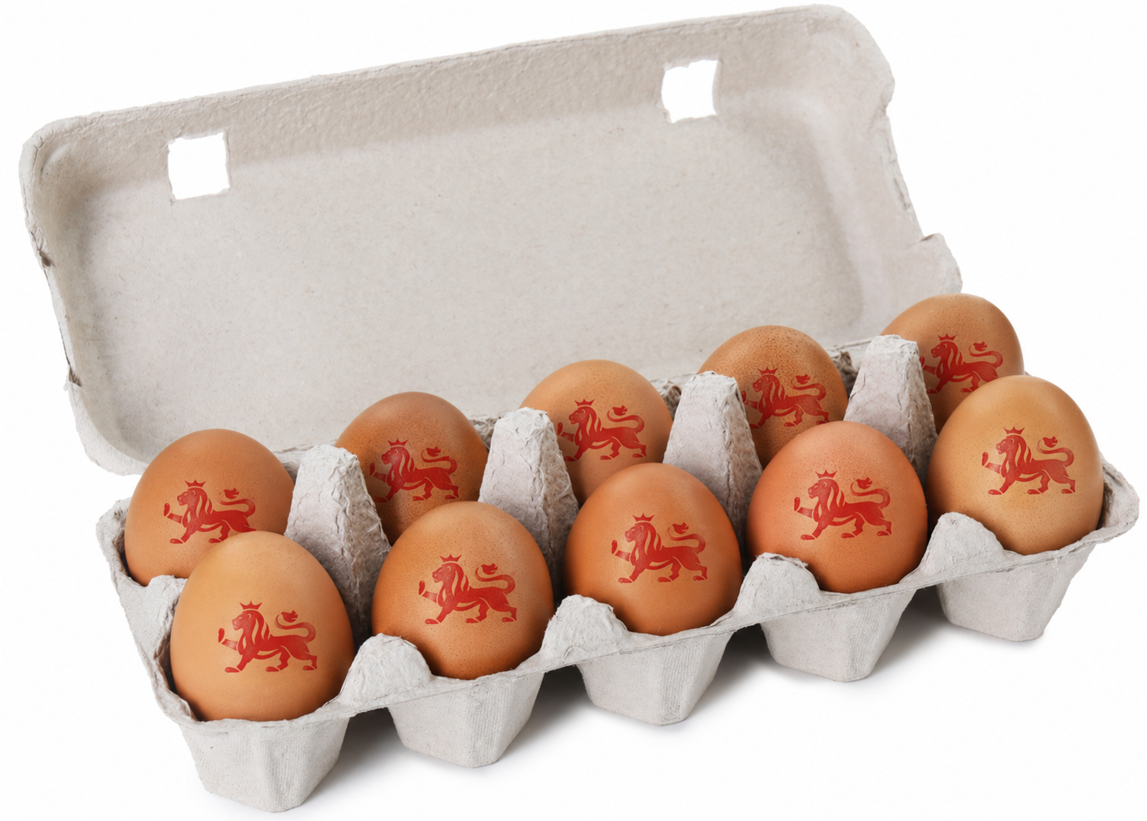
Eggscellent counting and sharing​
​Today, we are going to be counting, grouping and sharing using eggs. ​
We will learn to count eggs accurately, put eggs into groups and share eggs equally and fairly.

Slide 3

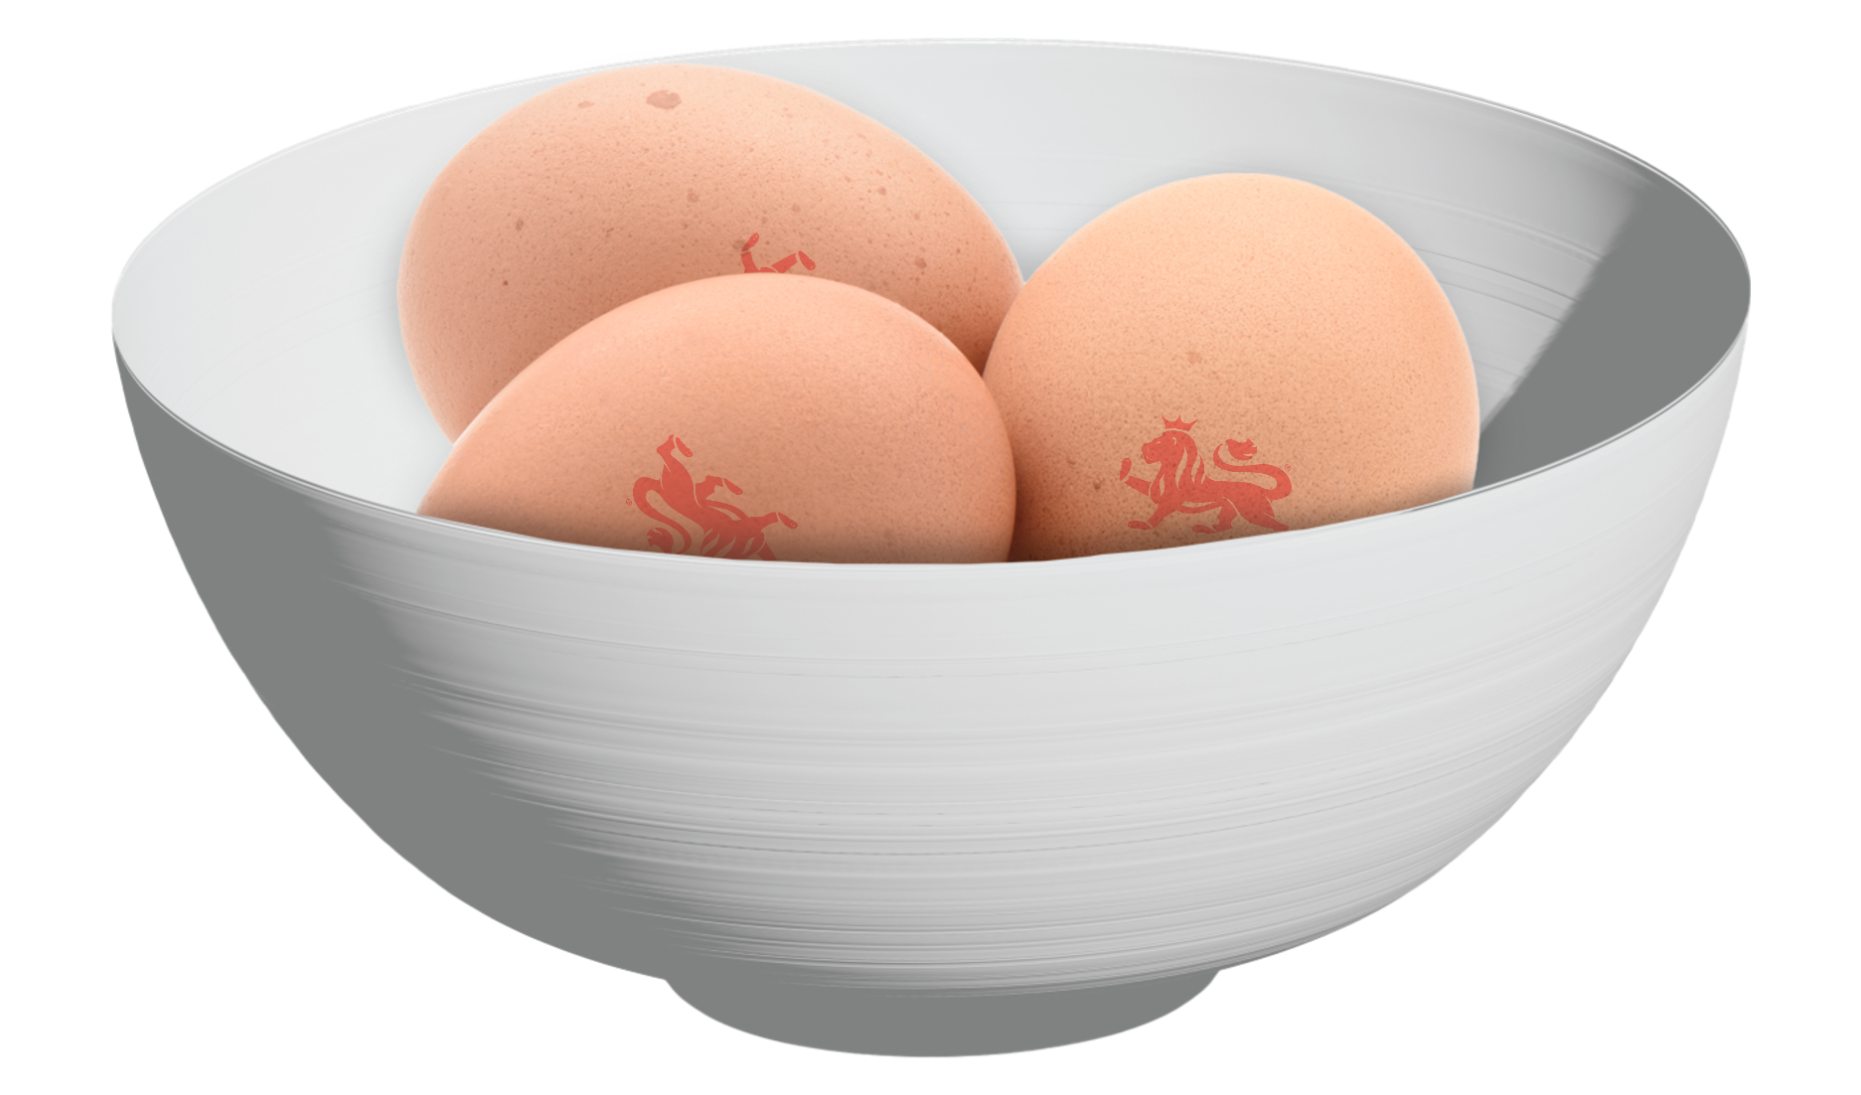

Key words
Some of the key words you are going to need to know for this lesson are: ​
Count
Group
Equal
1
3
2
4
Share
Half

Slide 4
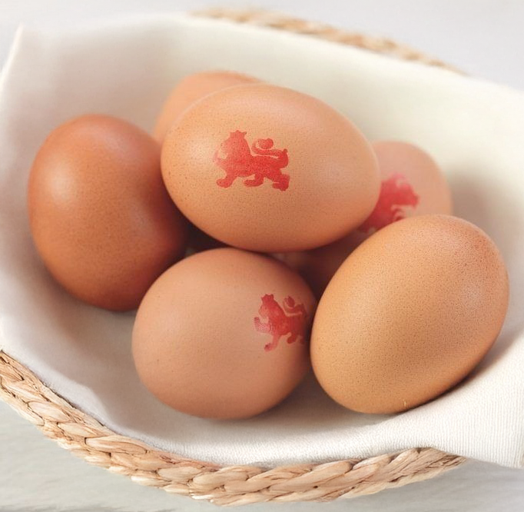
How many eggs?
How many eggs do you think there are in the basket? ​
Let's count them together. ​

Slide 5
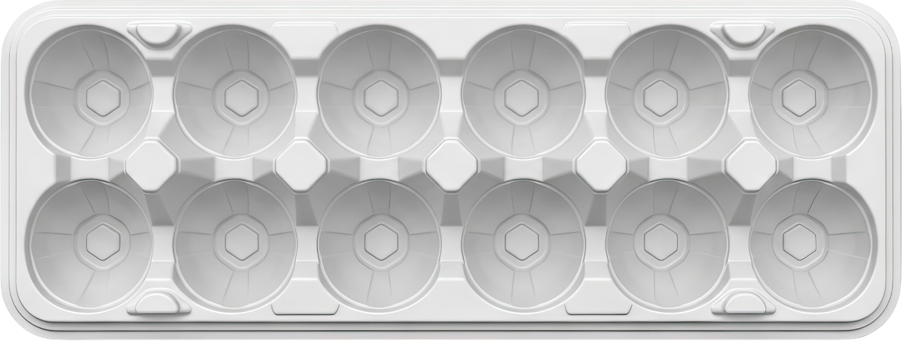
Counting, grouping and sharing​
Using your egg box, place one egg in each section and then count how many you have in total. ​
Challenge:
Can you make two equal groups of eggs?

Slide 6

Counting, grouping and sharing​
I have 8 eggs, and I want to share them fairly between two baskets. ​
Can you explain how this is fair?
Notes:
Click to add eggs to baskets

Slide 7
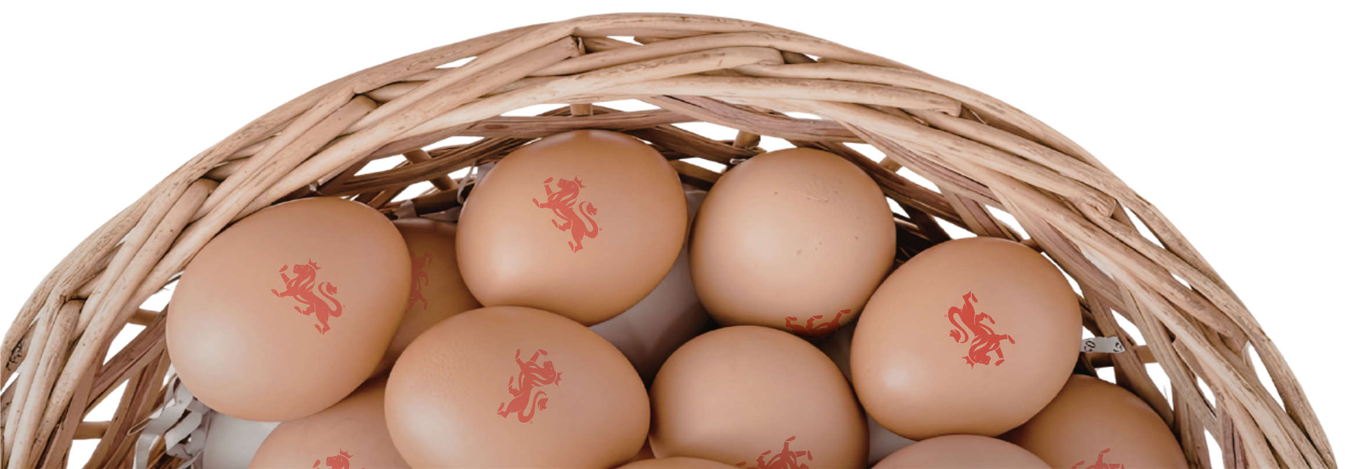
Your turn
Make groups
You are now going to:
Put your eggs into two groups
Do both groups have the same number?
Count the eggs you’ve got
Count out loud
Share them fairly
Touch each egg​
Share one egg at a time
Say the total
Check both groups as you go
Is it fair?

Slide 8
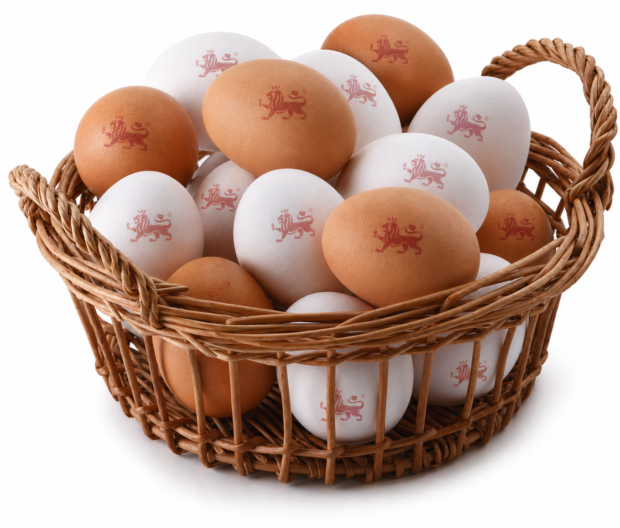
Eggscellent work​
Let's review: ​
What does equal mean? ​
​
? ​​
? ​​
? ​​
What would we do if we had an odd number of eggs? ​​

Slide 9

Brought to you by

