Slide 1

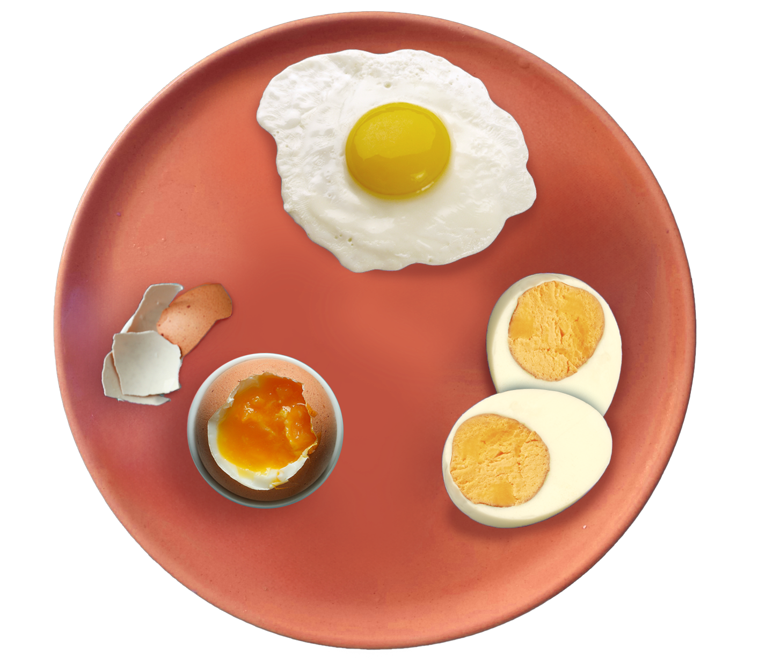
Healthy eating eggsperts

Slide 2
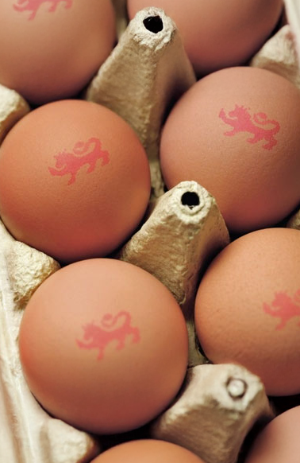
Let’s explore
What food is this?
Have you eaten eggs before?

Slide 3
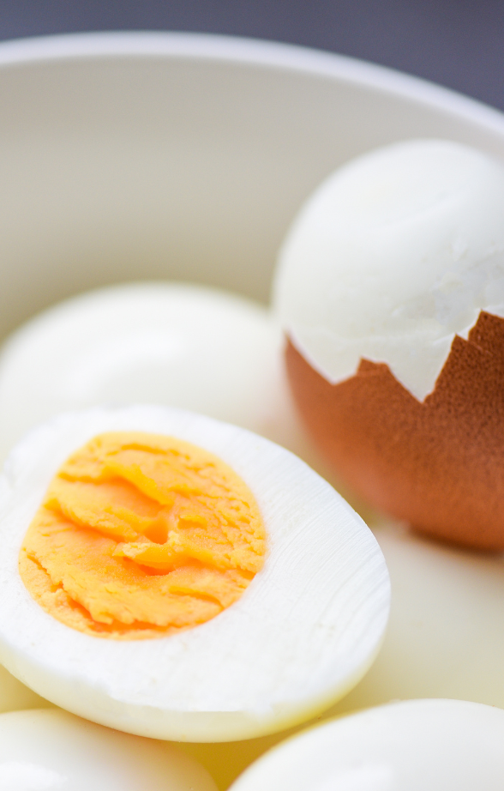

Look inside
Inside, there is the egg white and the egg yolk.
These are the parts of the egg we can eat.

Slide 4
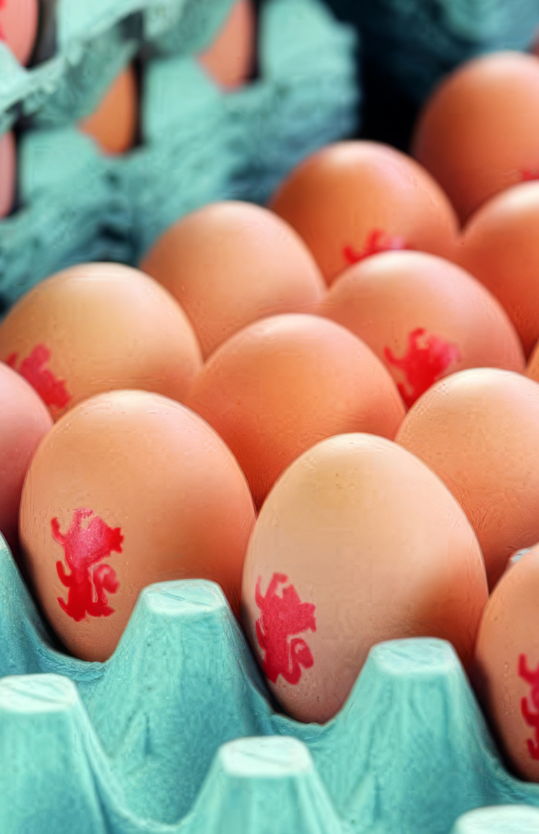
Why eggs are healthy
Why do you think people eat eggs?
Eggs are a healthy food that help us to grow strong and give us energy.

Slide 5

Why eggs are healthy
Eggs contain protein that helps our muscles grow.
Eggs also contain vitamins and minerals that keep us healthy.
Do you know any other foods that help our bodies stay strong?

Slide 6
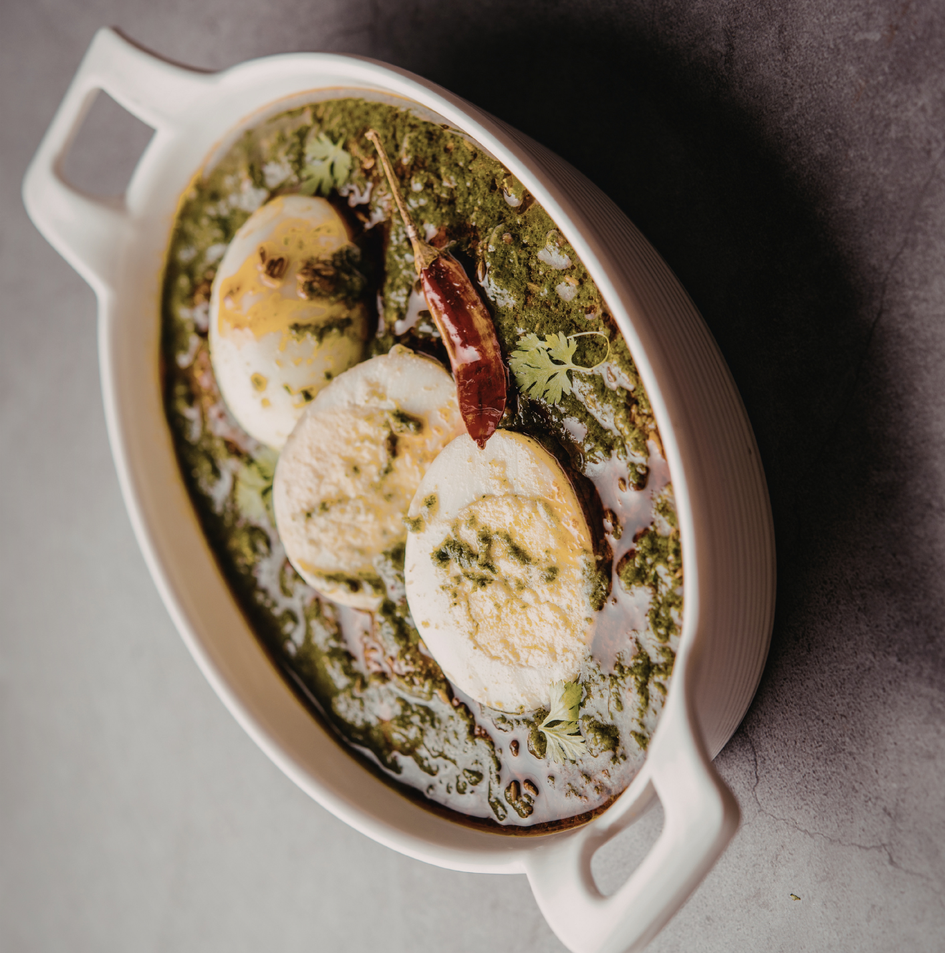
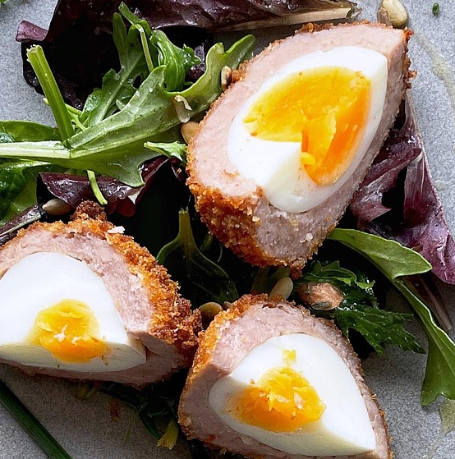
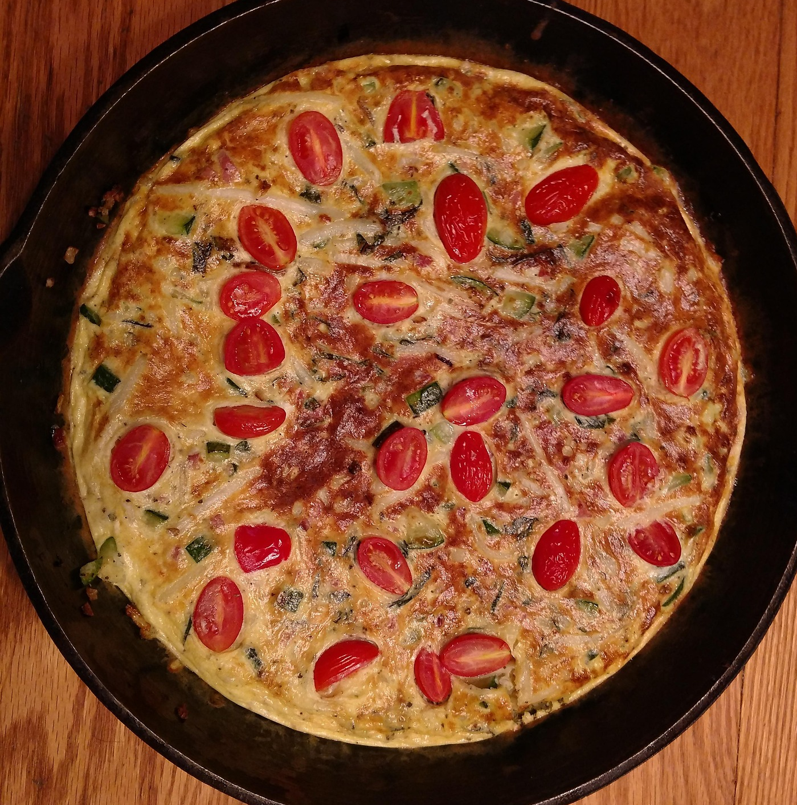
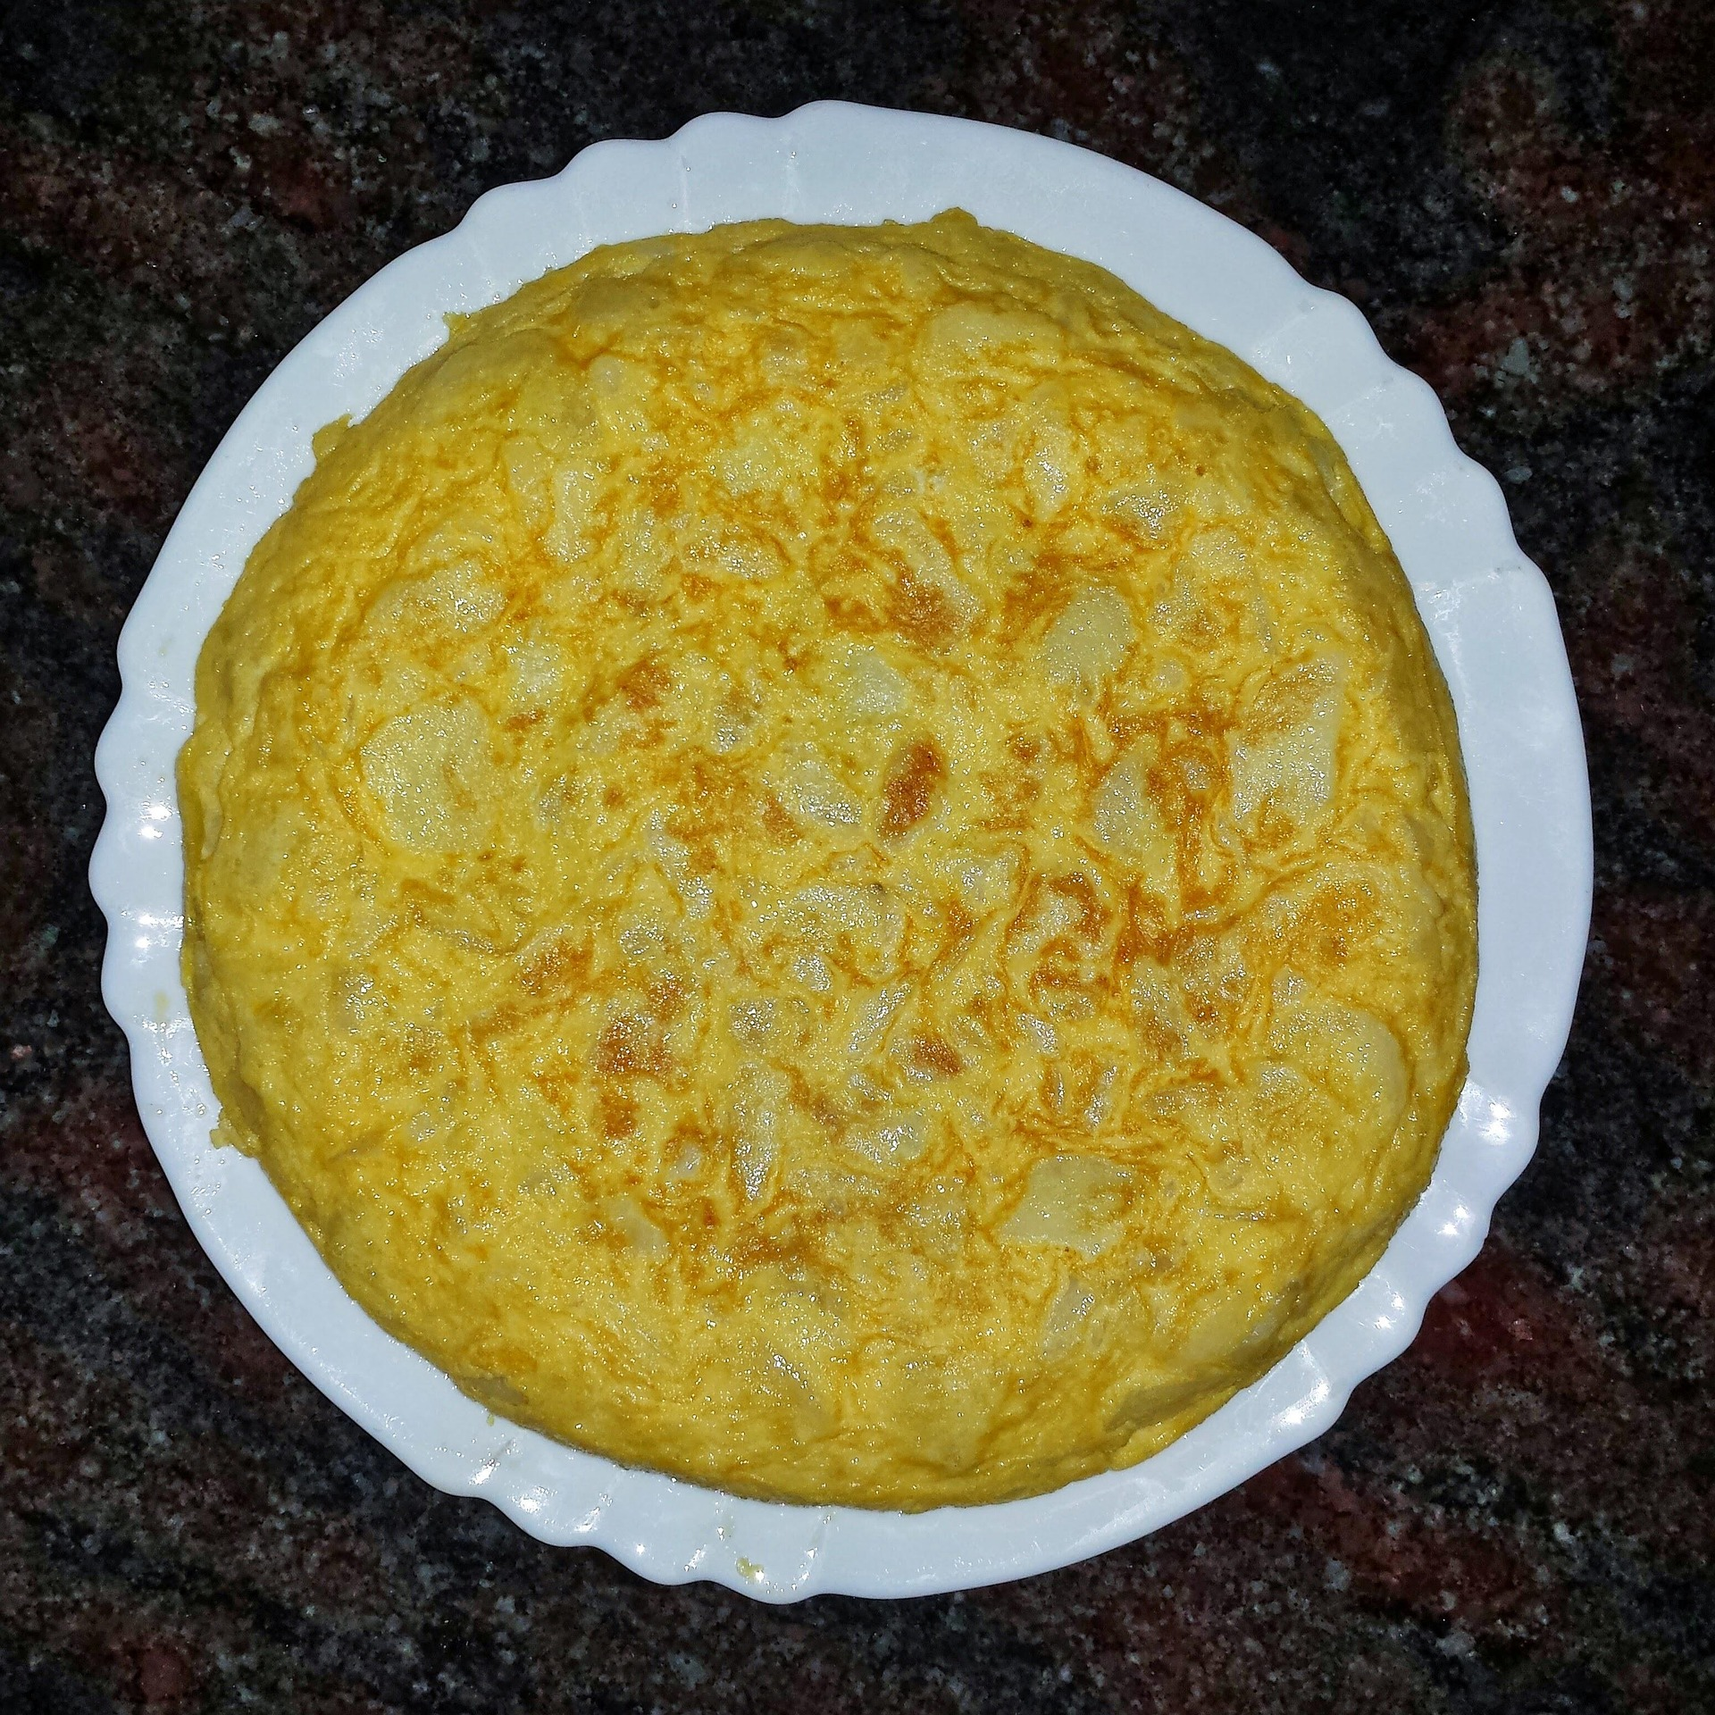
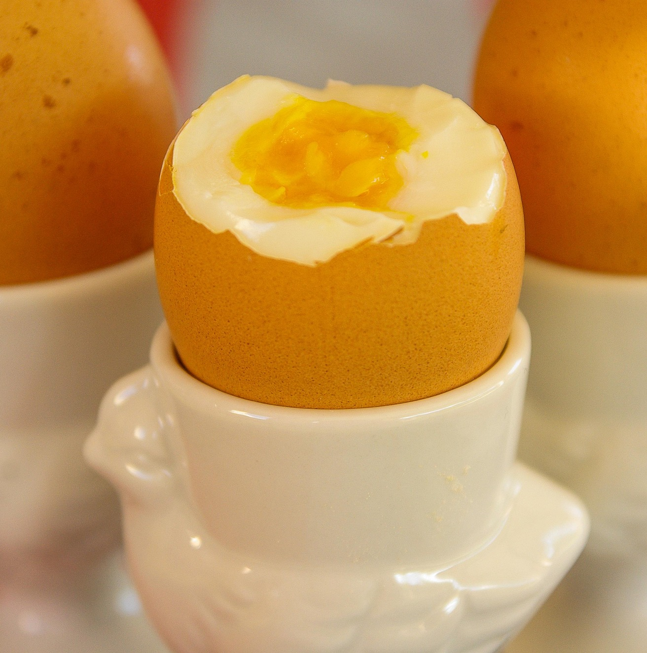
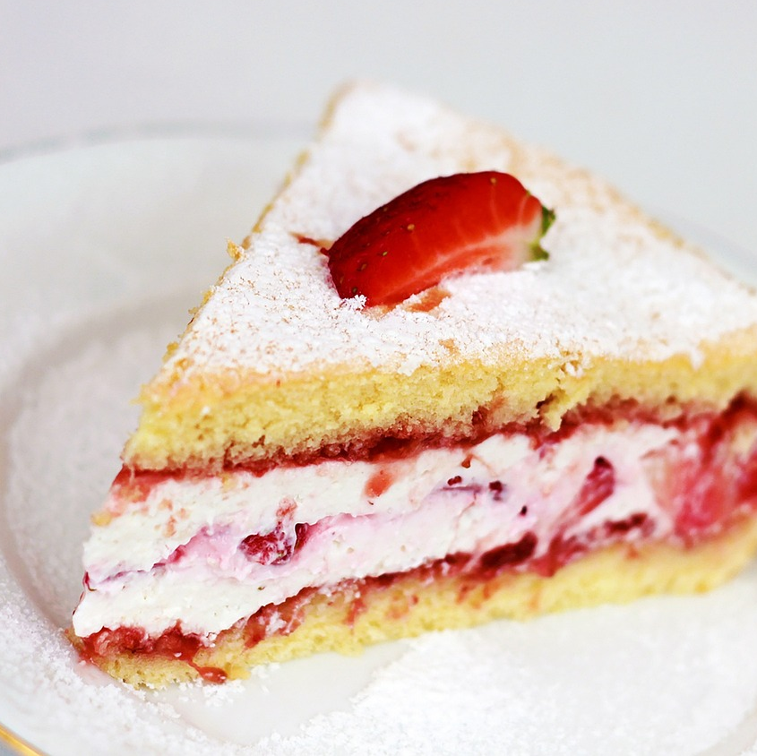
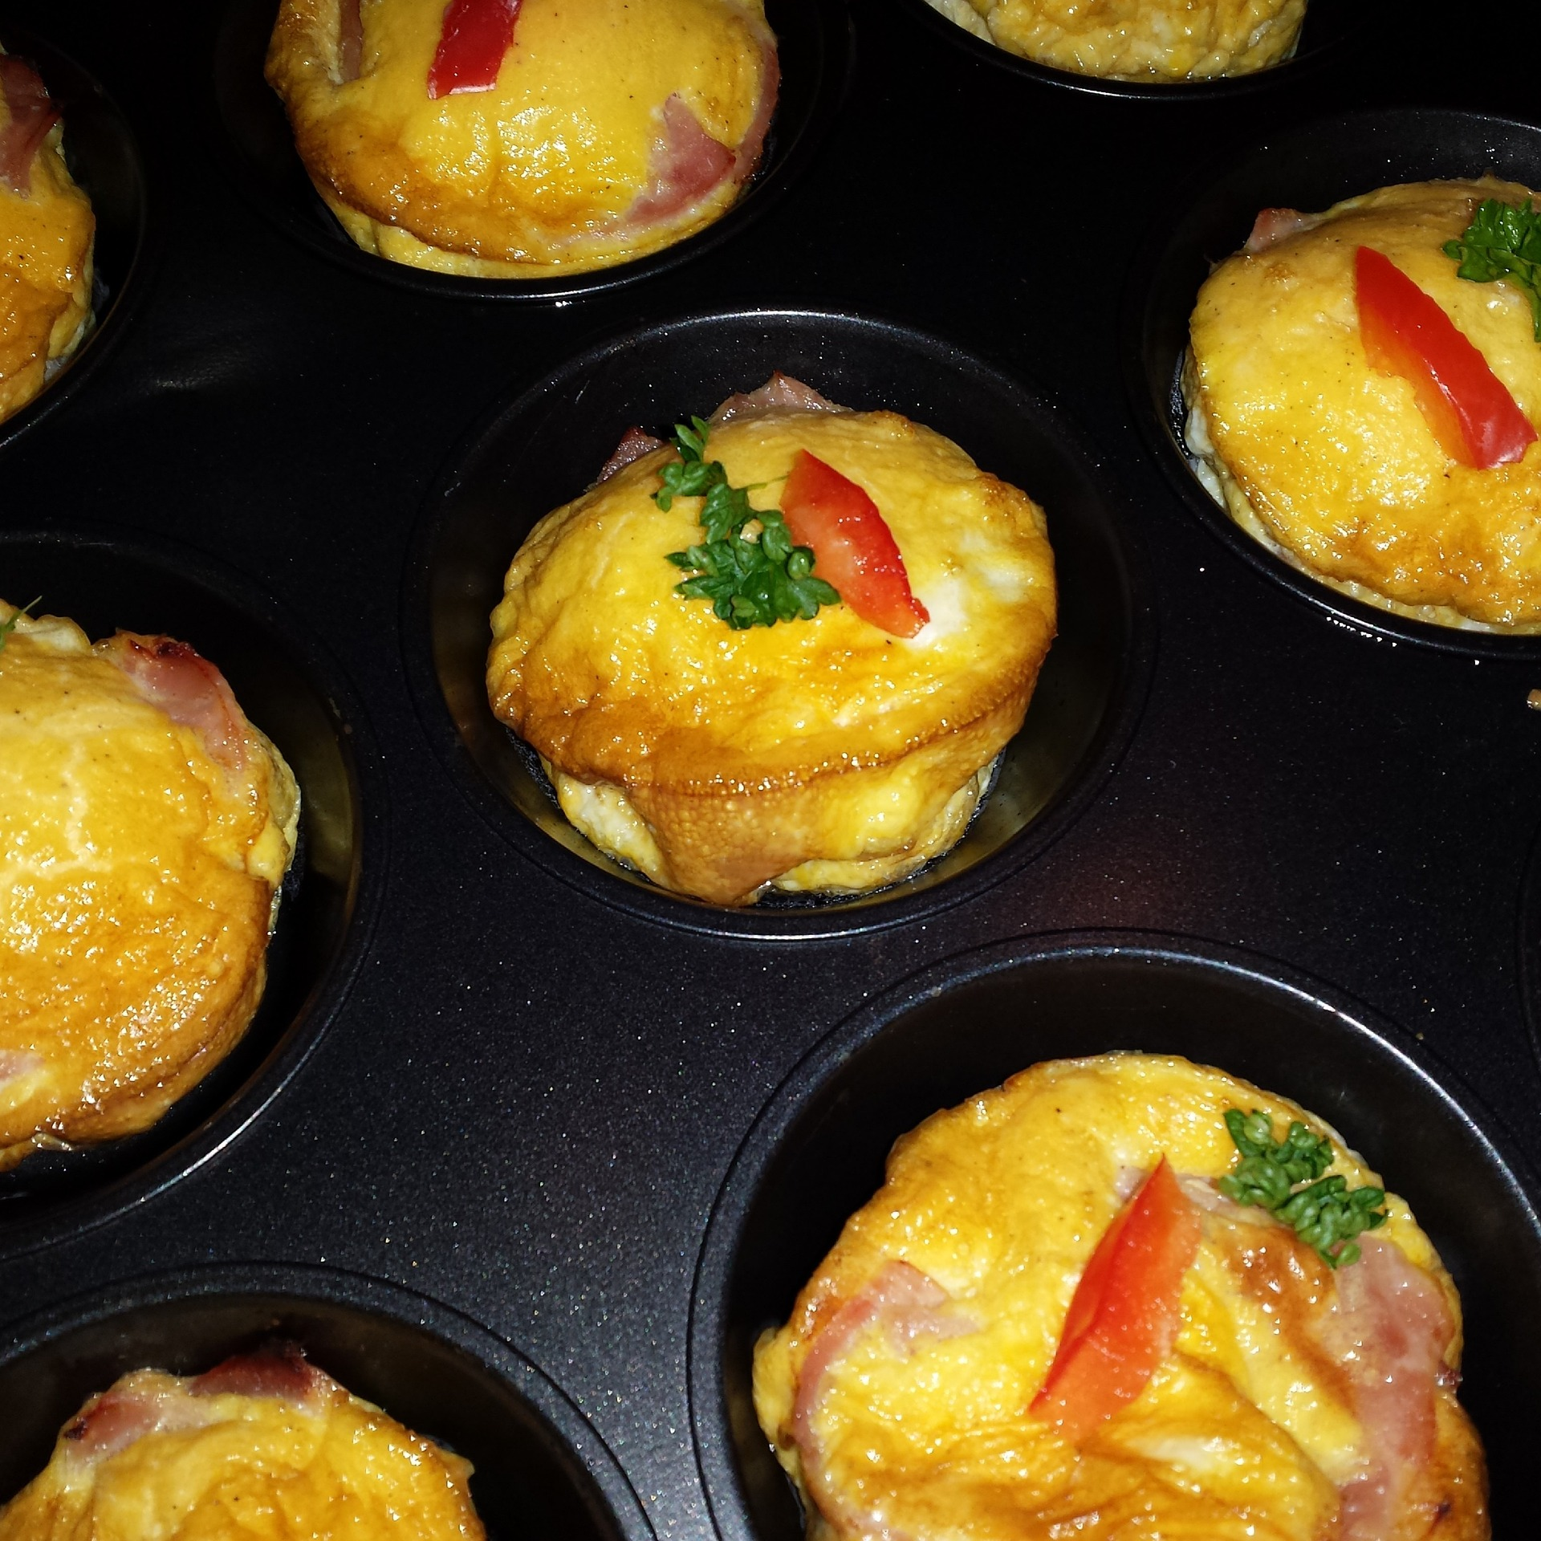
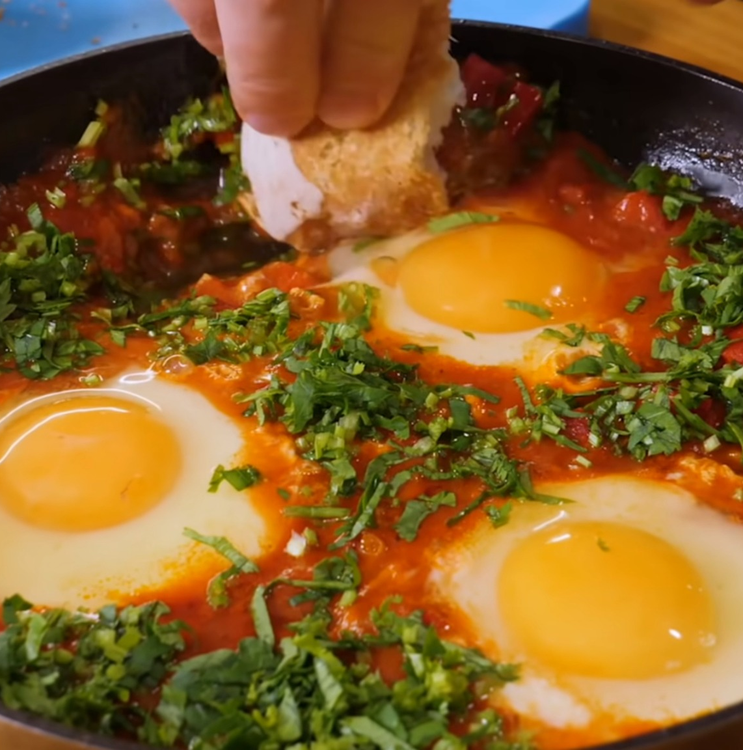
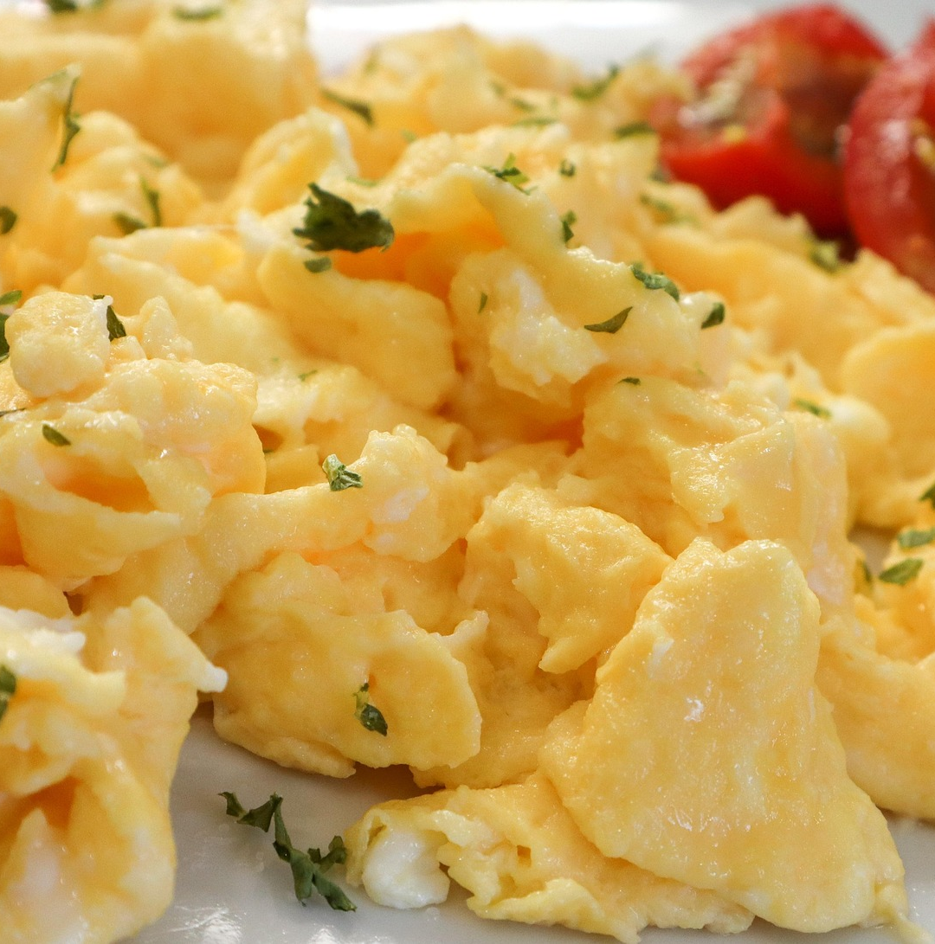
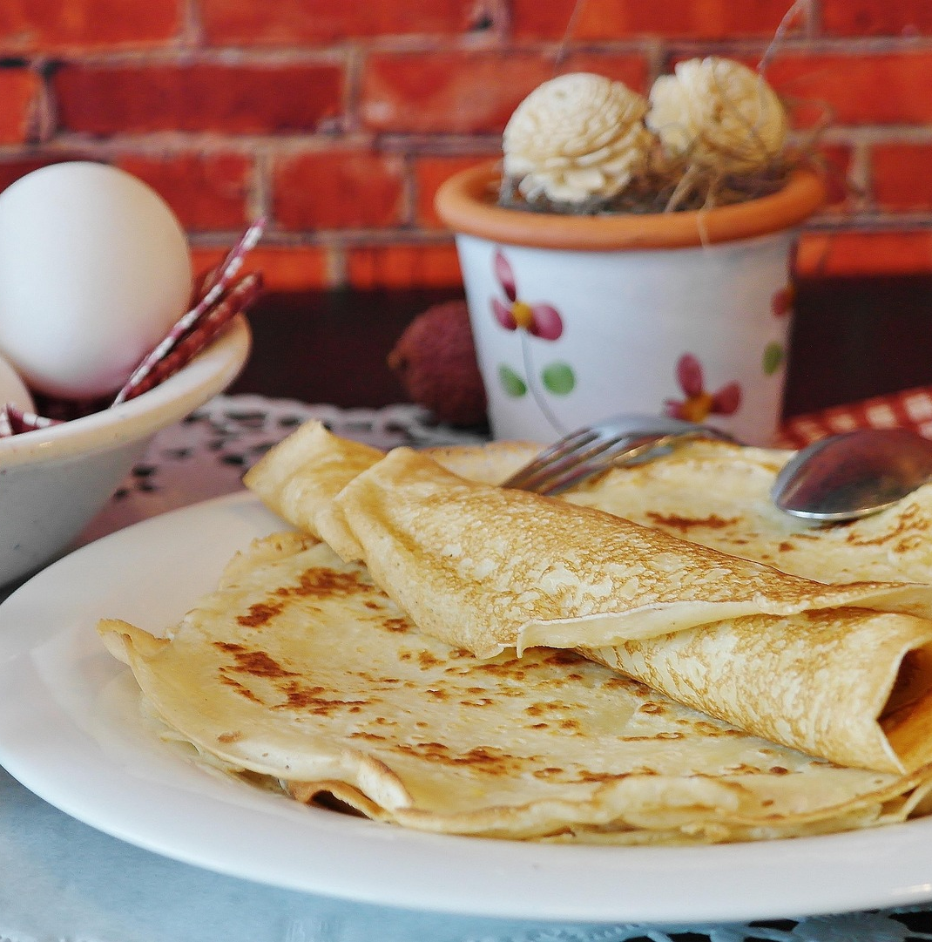
Egg in our food
Lots of foods contain eggs.
Can you think of some?
​​So many meals can be made with eggs! ​
​Which of these do you think are healthy?​​
Notes:
Order of eggs: Hen, Duck, Quail and Ostrich

Slide 7
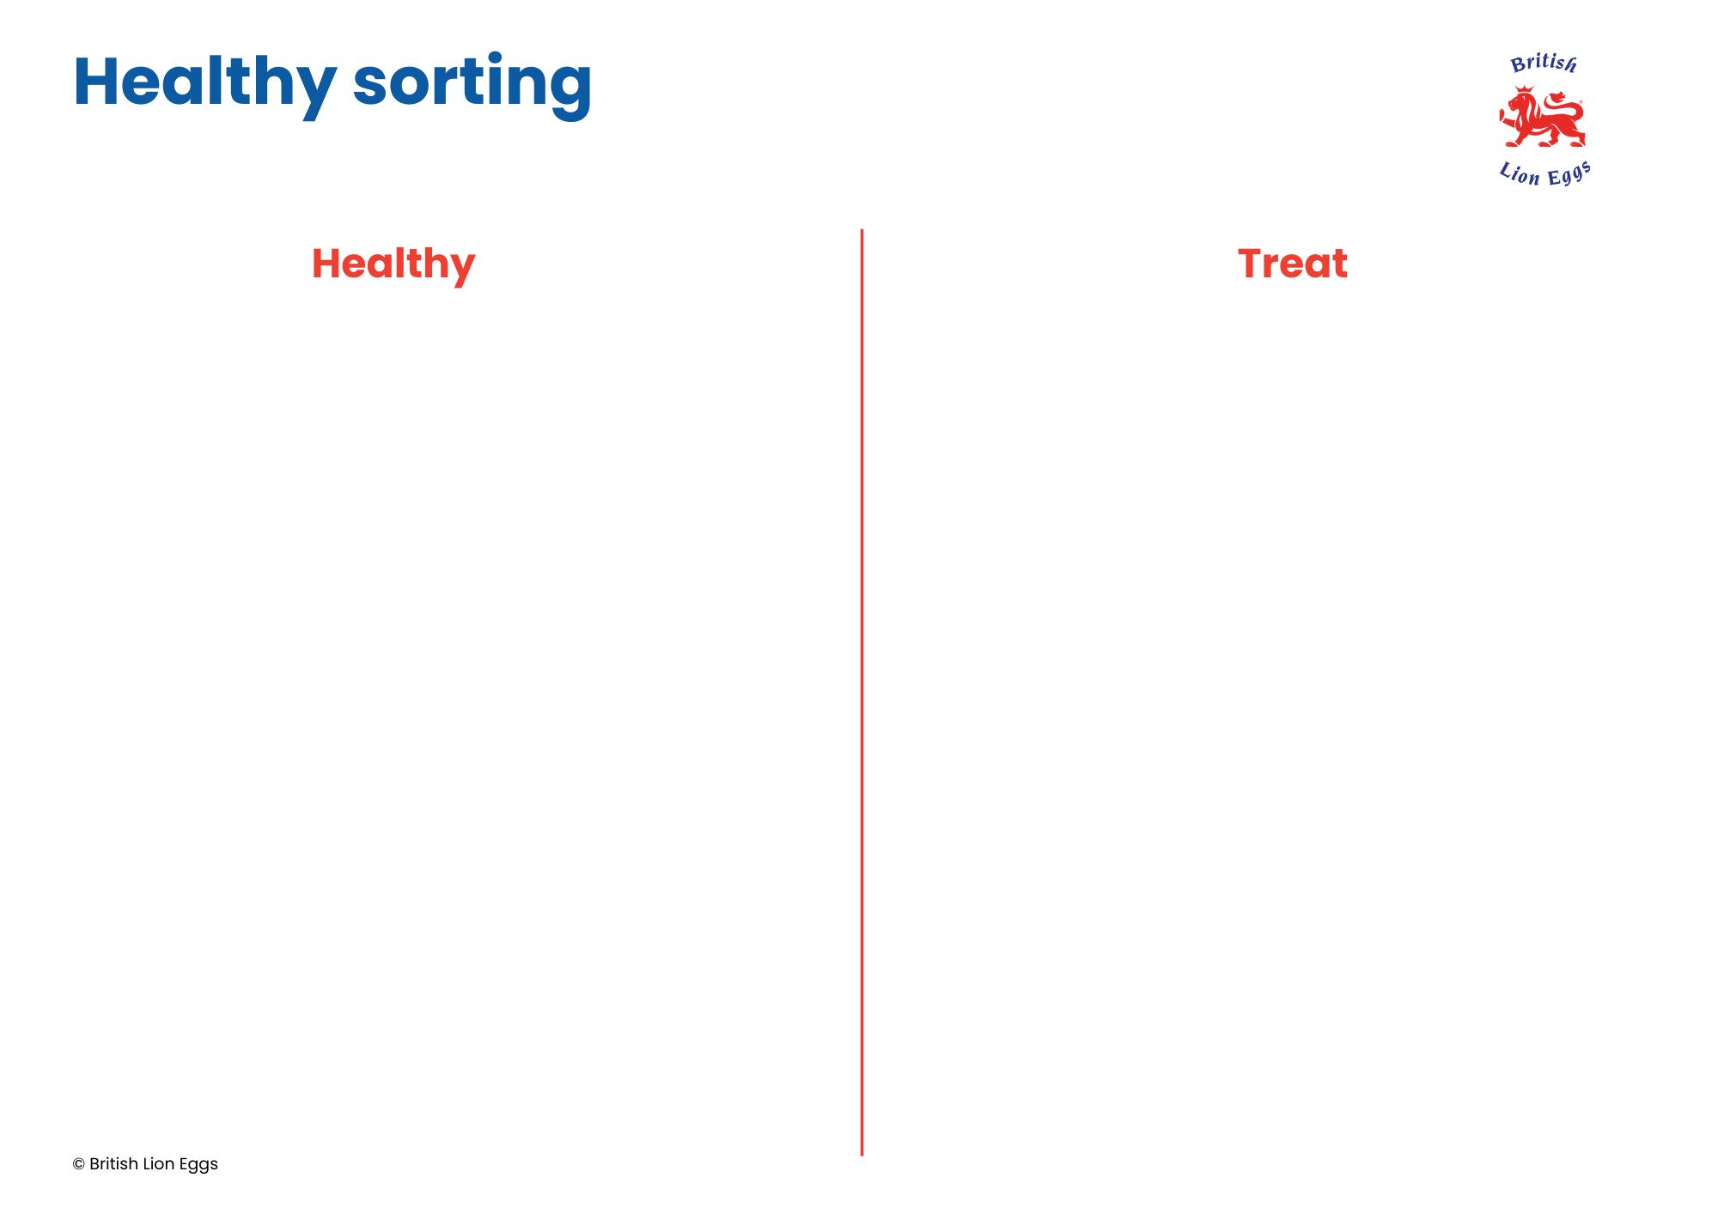
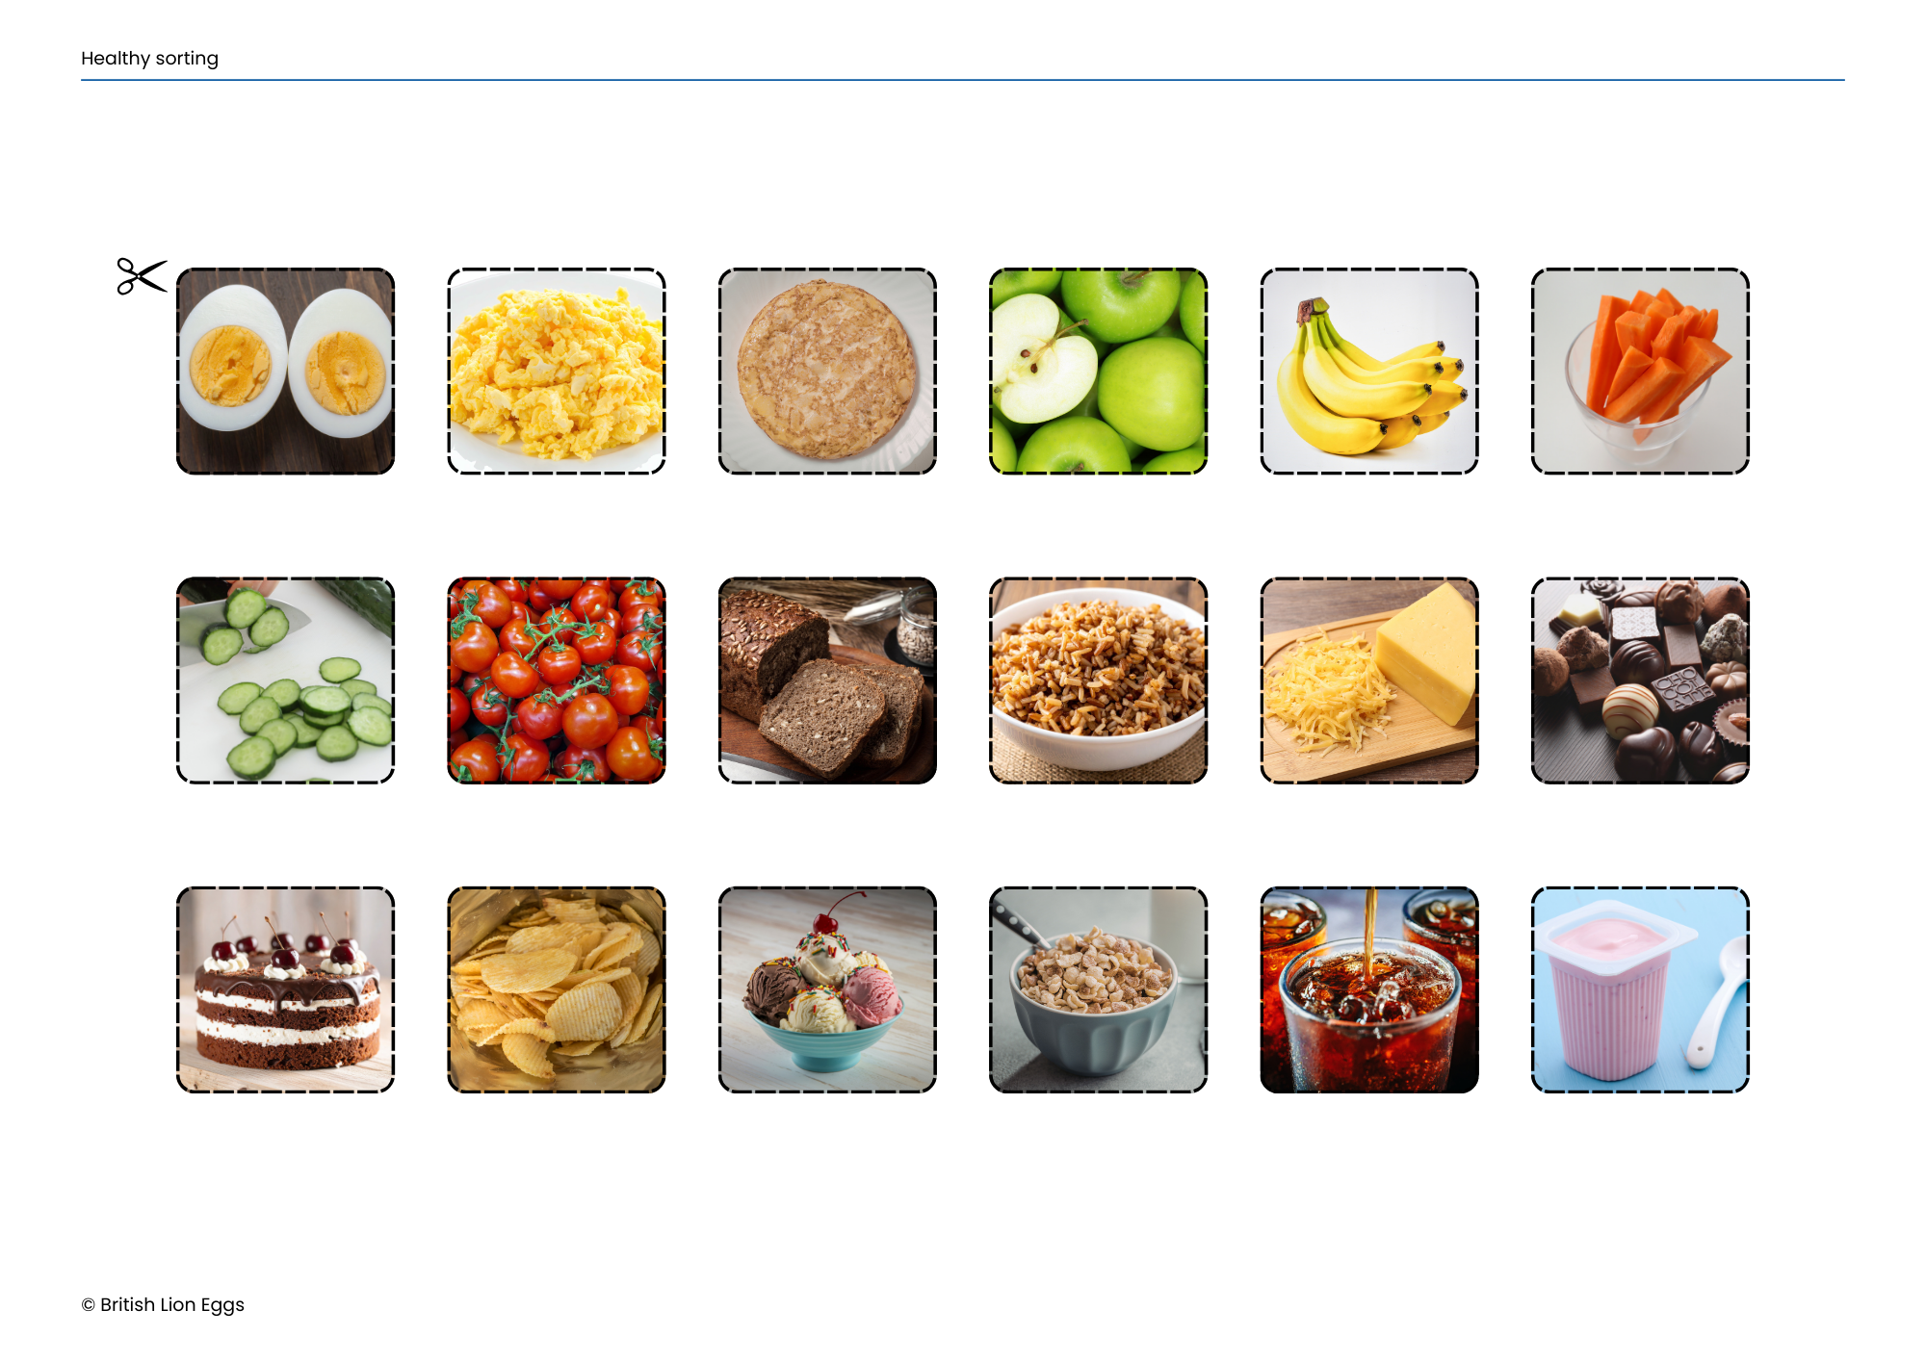
Food sorting
We are now going to take a look at sorting foods into healthy foods and treats (sometimes foods). ​
​
Treats are foods that we shouldn't have all the time, but are OK to have sometimes.

Slide 8
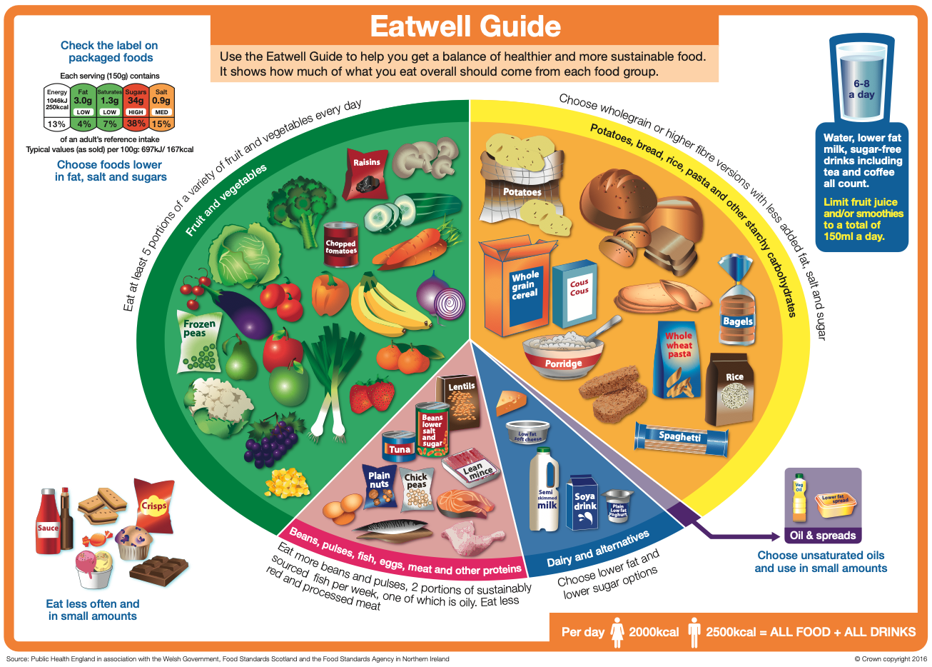
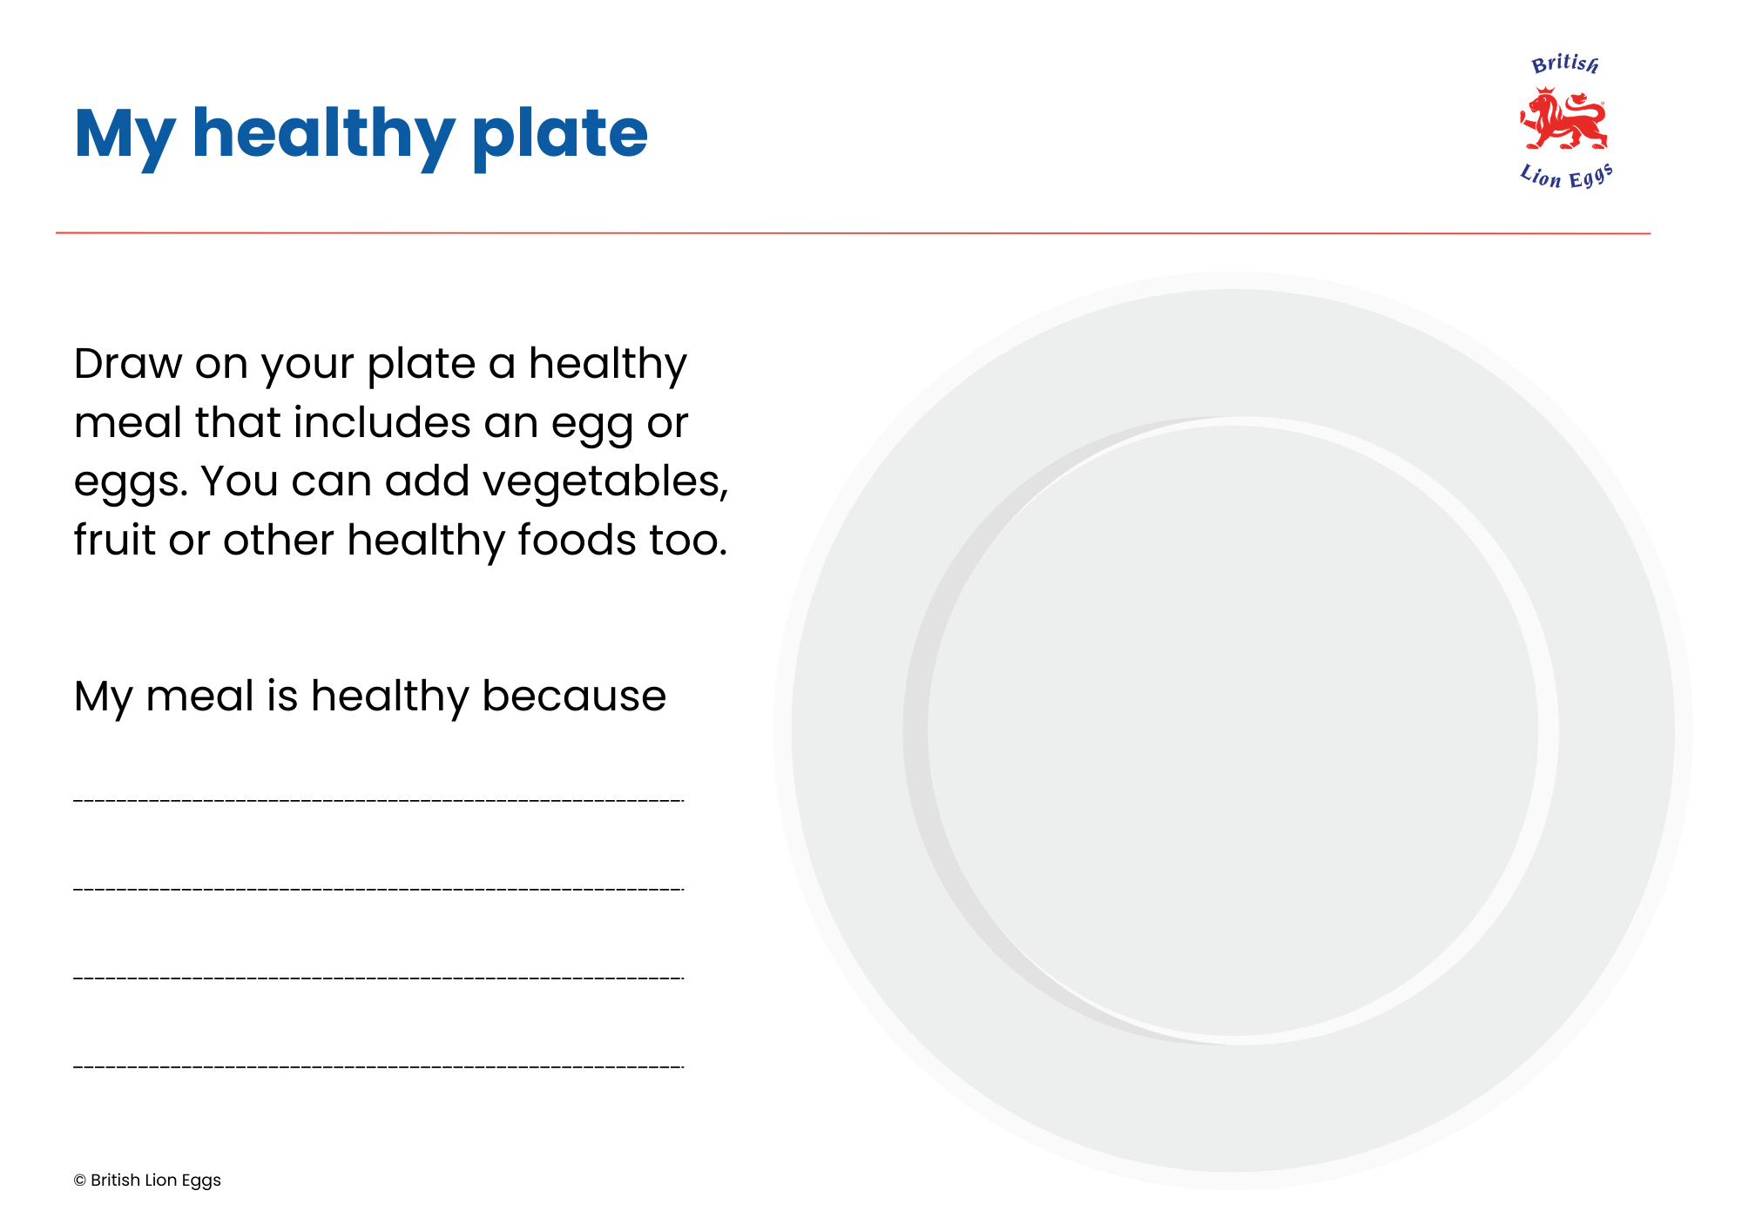
Healthy balance
It is important for us to have a balanced diet. This means eating lots of healthy foods to help us grow.​
​
It is OK to eat treats sometimes. ​
​
What do you think would happen if we only ate treats? ​

Slide 9
Healthy balance
Now we are going to think about creating a healthy meal. ​
​
Think about what foods to put on your plate, making sure it is healthy. ​
​
What type of eggs will you choose? ​​

Slide 10
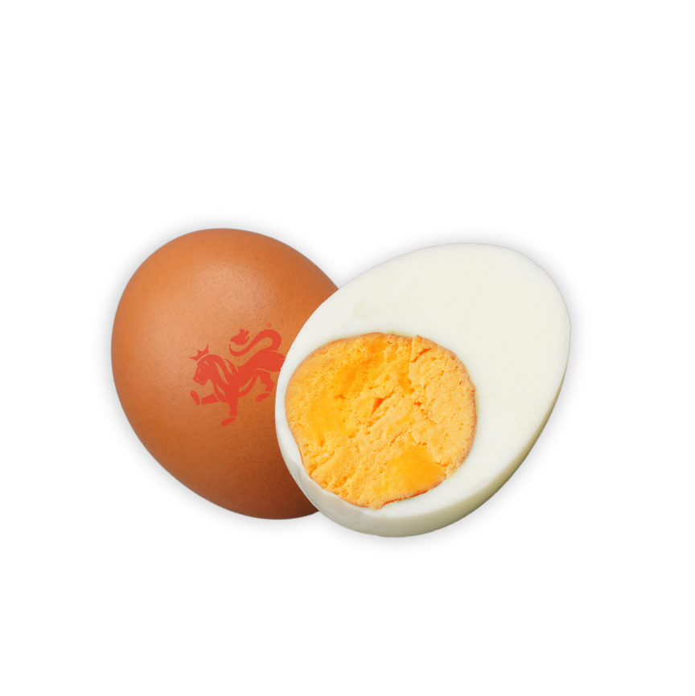
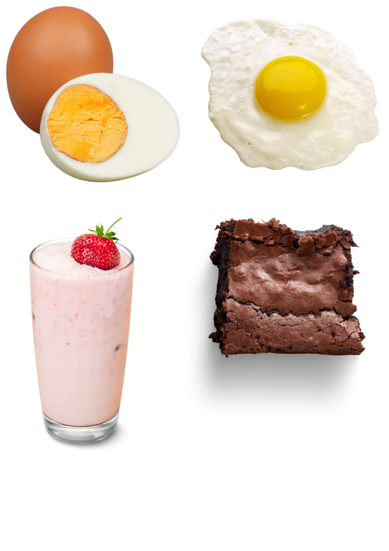
How can we eat eggs?
Eggs can be scrambled, fried, boiled,
or poached.
Some people also use raw eggs in smoothies, cakes or puddings.
If eating raw eggs, you should choose British Lion eggs as these are approved by the Food Standards Agency.
Eggs are yummy in lots of
different ways!
What is your favourite way to eat eggs?

Slide 11
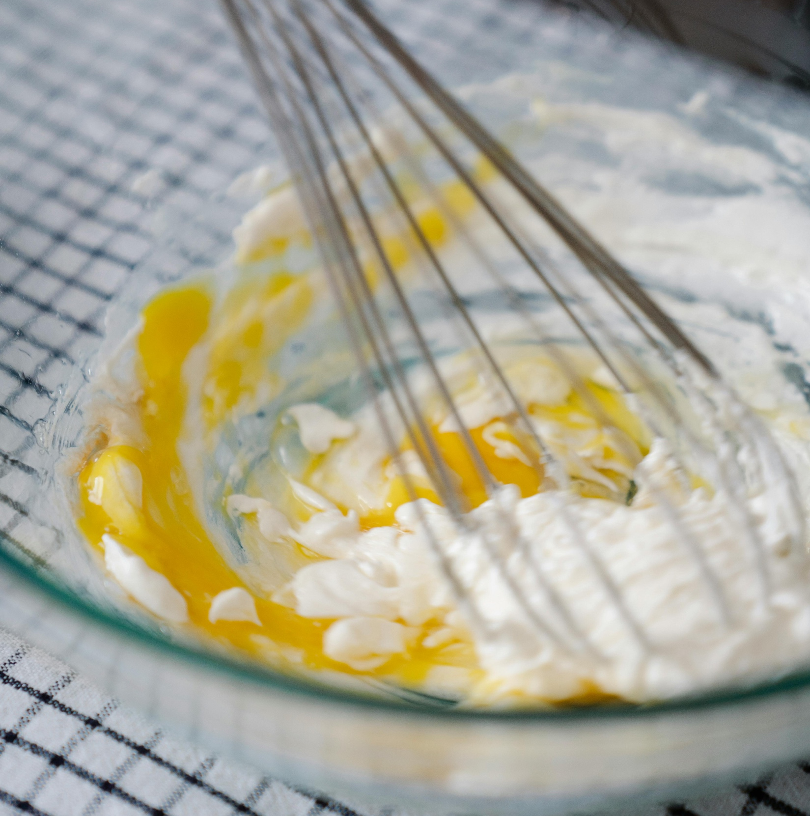
Eggs in recipes
Eggs can be cooked, baked, or even added raw to mix in drinks or desserts.
Do you know any recipe that uses eggs?

Slide 12
Reflection
What is one healthy thing you have learned about eggs today?
Quick quiz!
Name one part of the egg we can eat.
The yolk or the egg white.

Slide 13
Reflection
What is one healthy thing you have learned about eggs today?
Quick quiz!
Why are eggs healthy?
They contain lots of vitamins and protein that help give us energy and grow strong.

Slide 14
Reflection
What is one healthy thing you have learned about eggs today?
Quick quiz!
Can you think of one way we can enjoy eggs?
Boiled, fried, scrambled, poached or in a smoothie. There are so many ways!

Slide 15

Brought to you by

