Slide 1

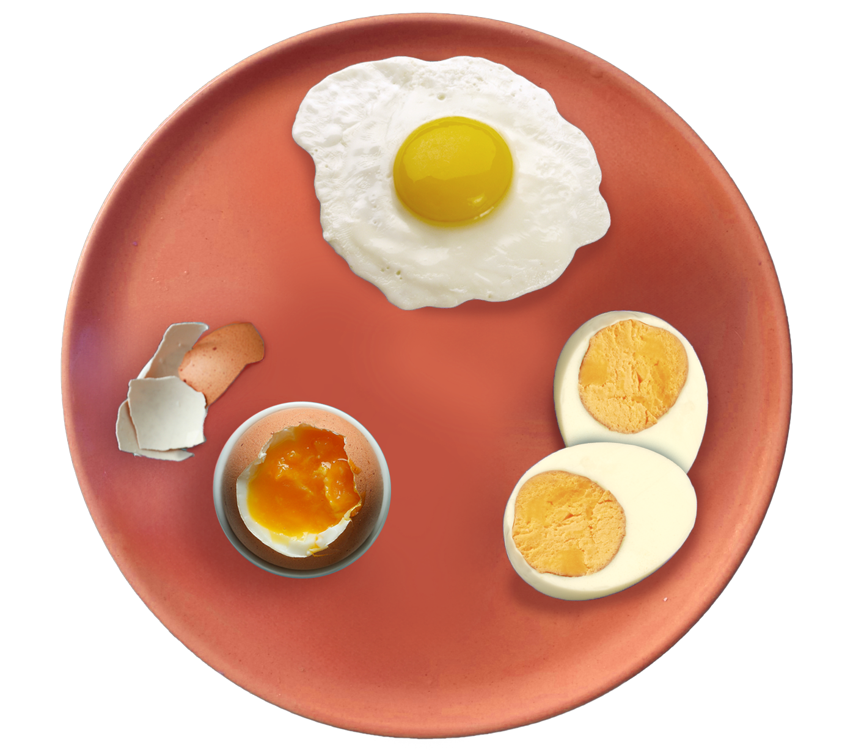
Healthy eating eggsperts

Slide 2
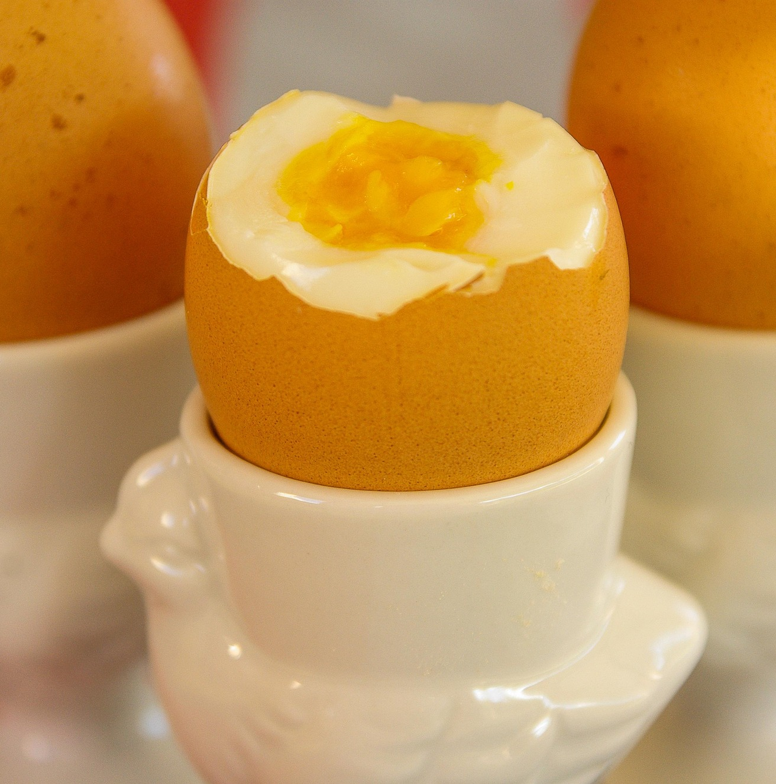

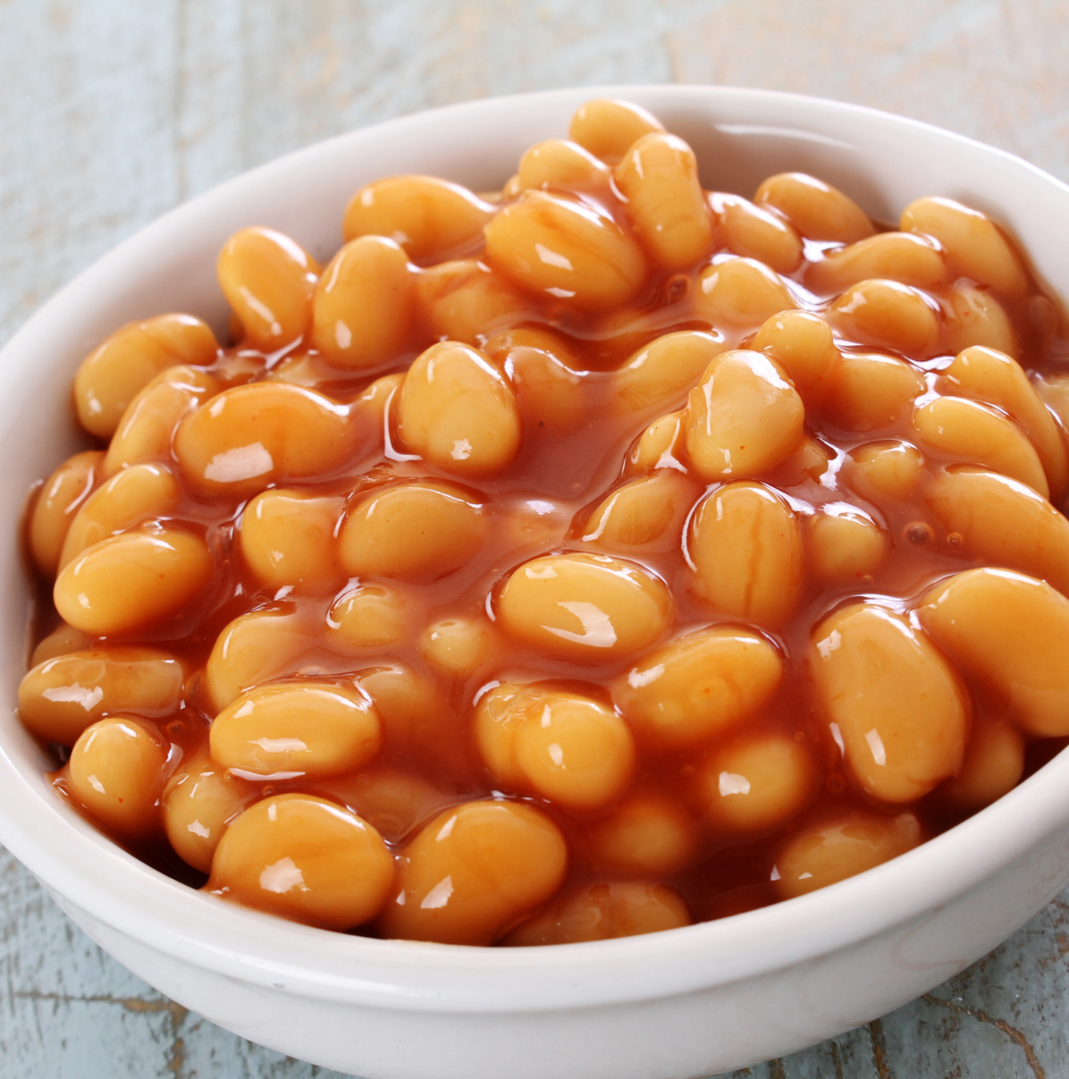
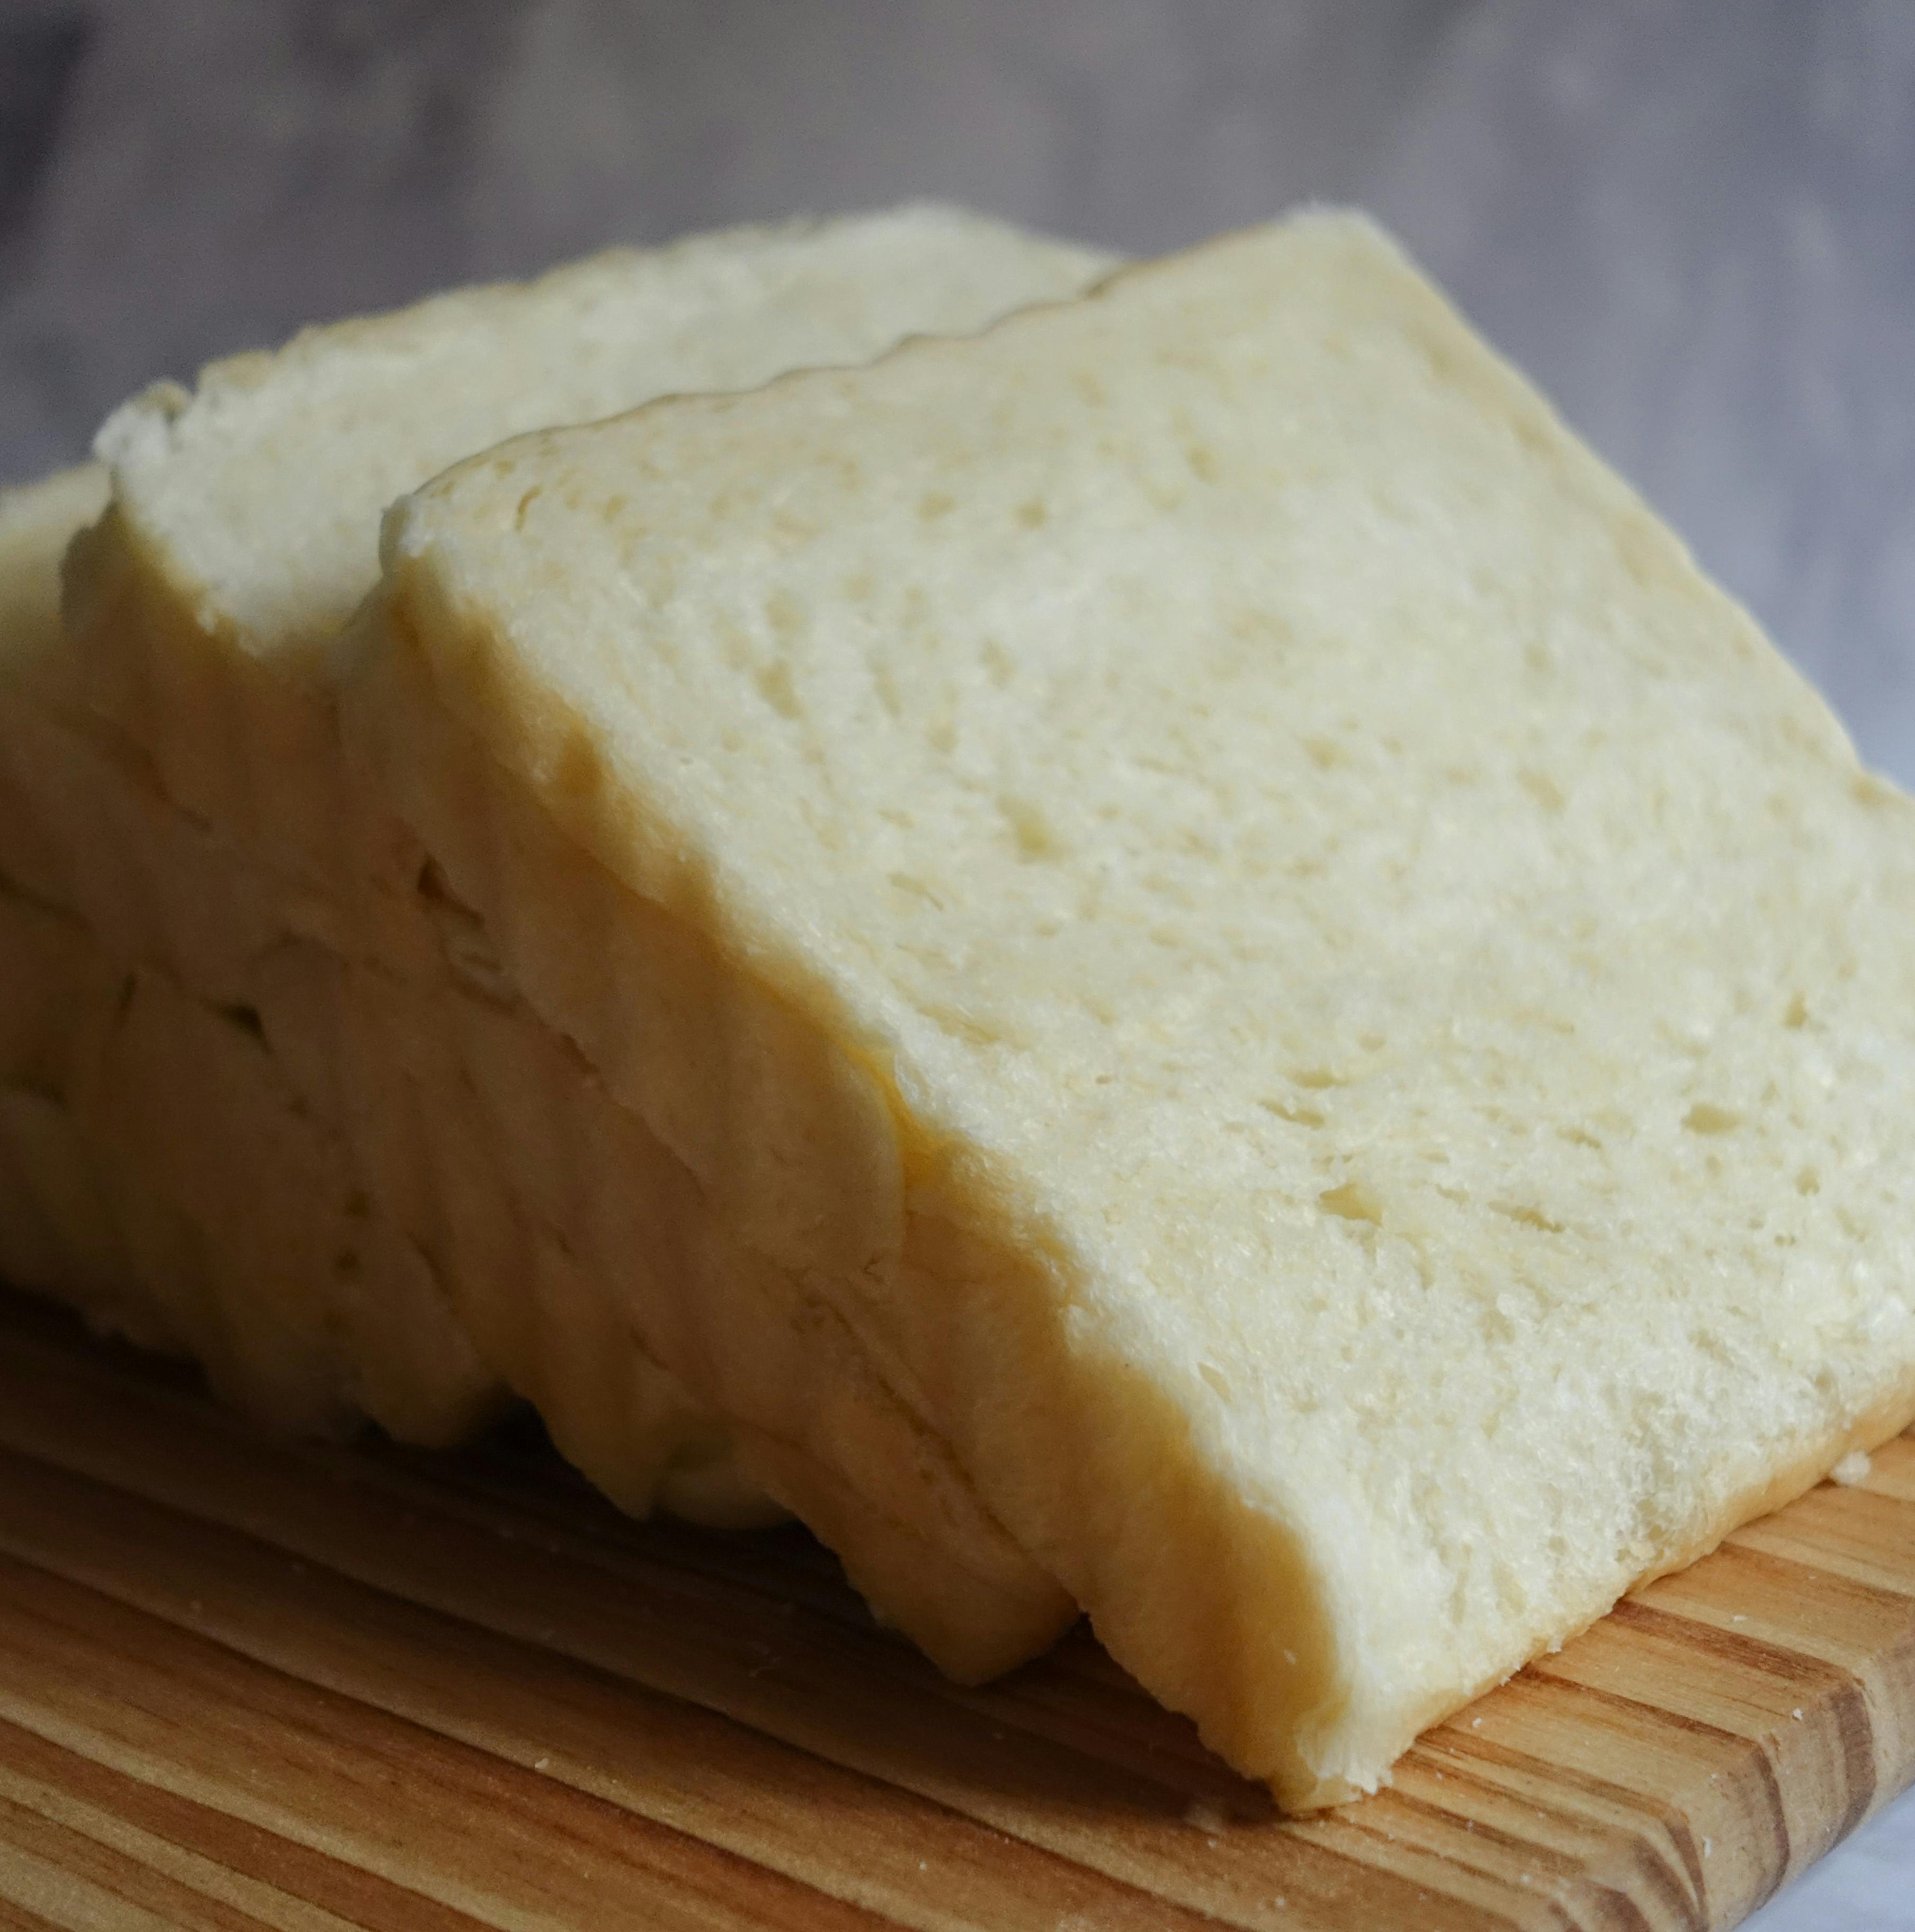
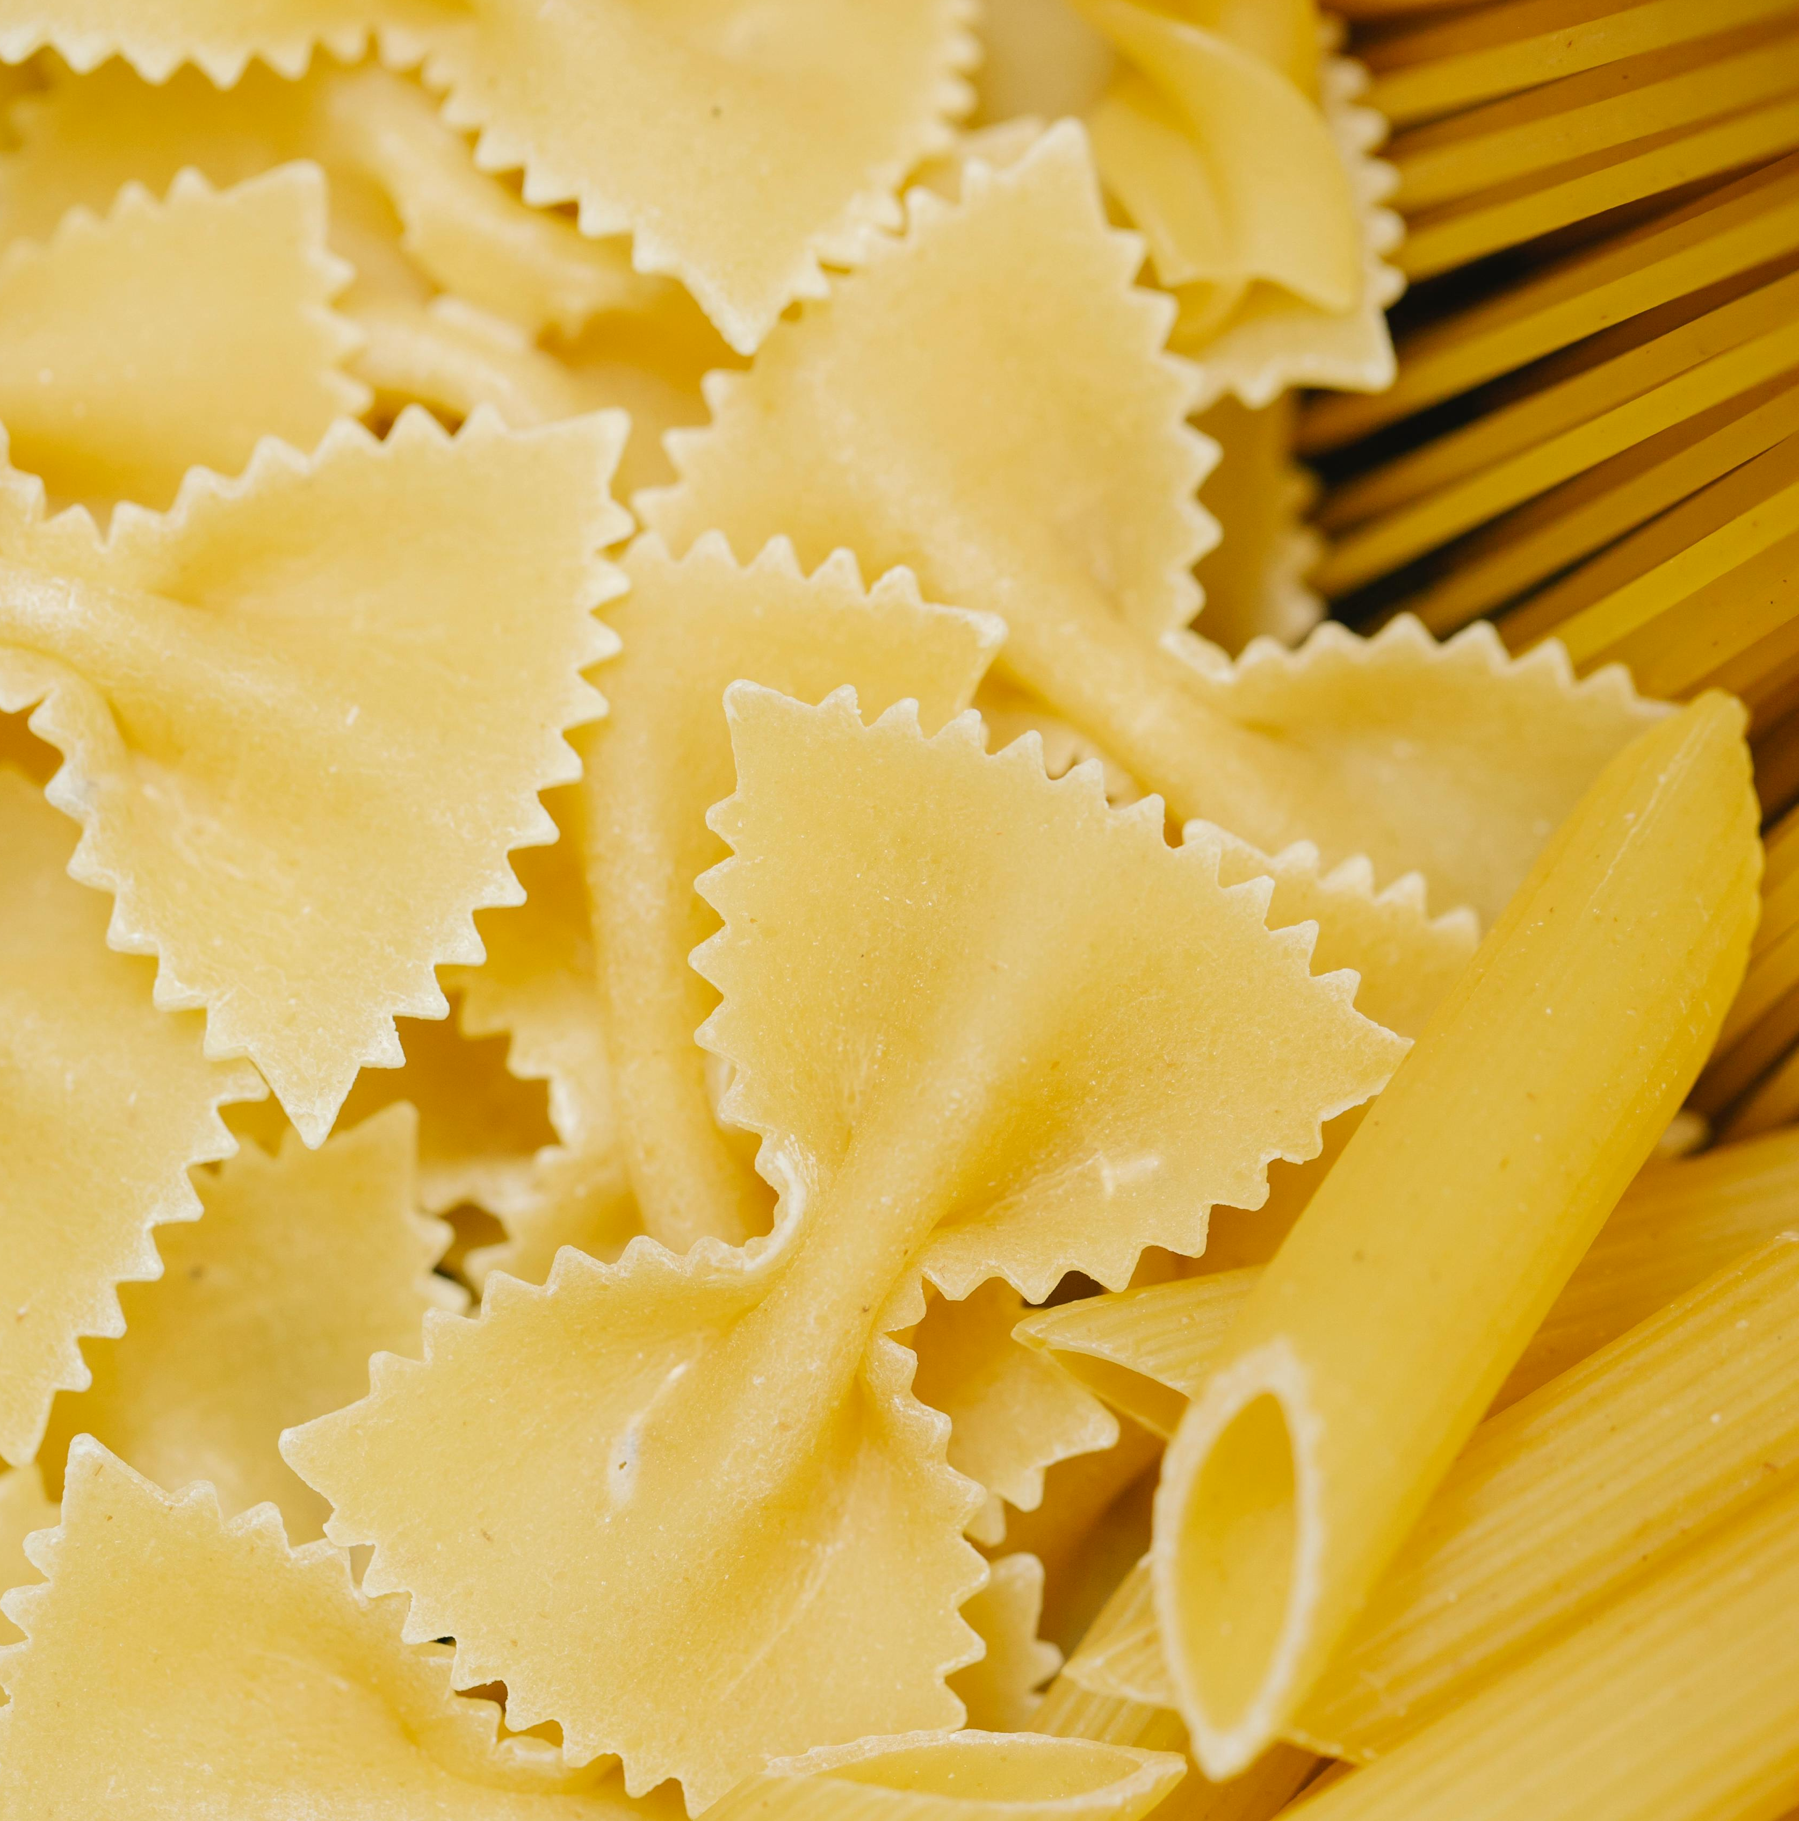
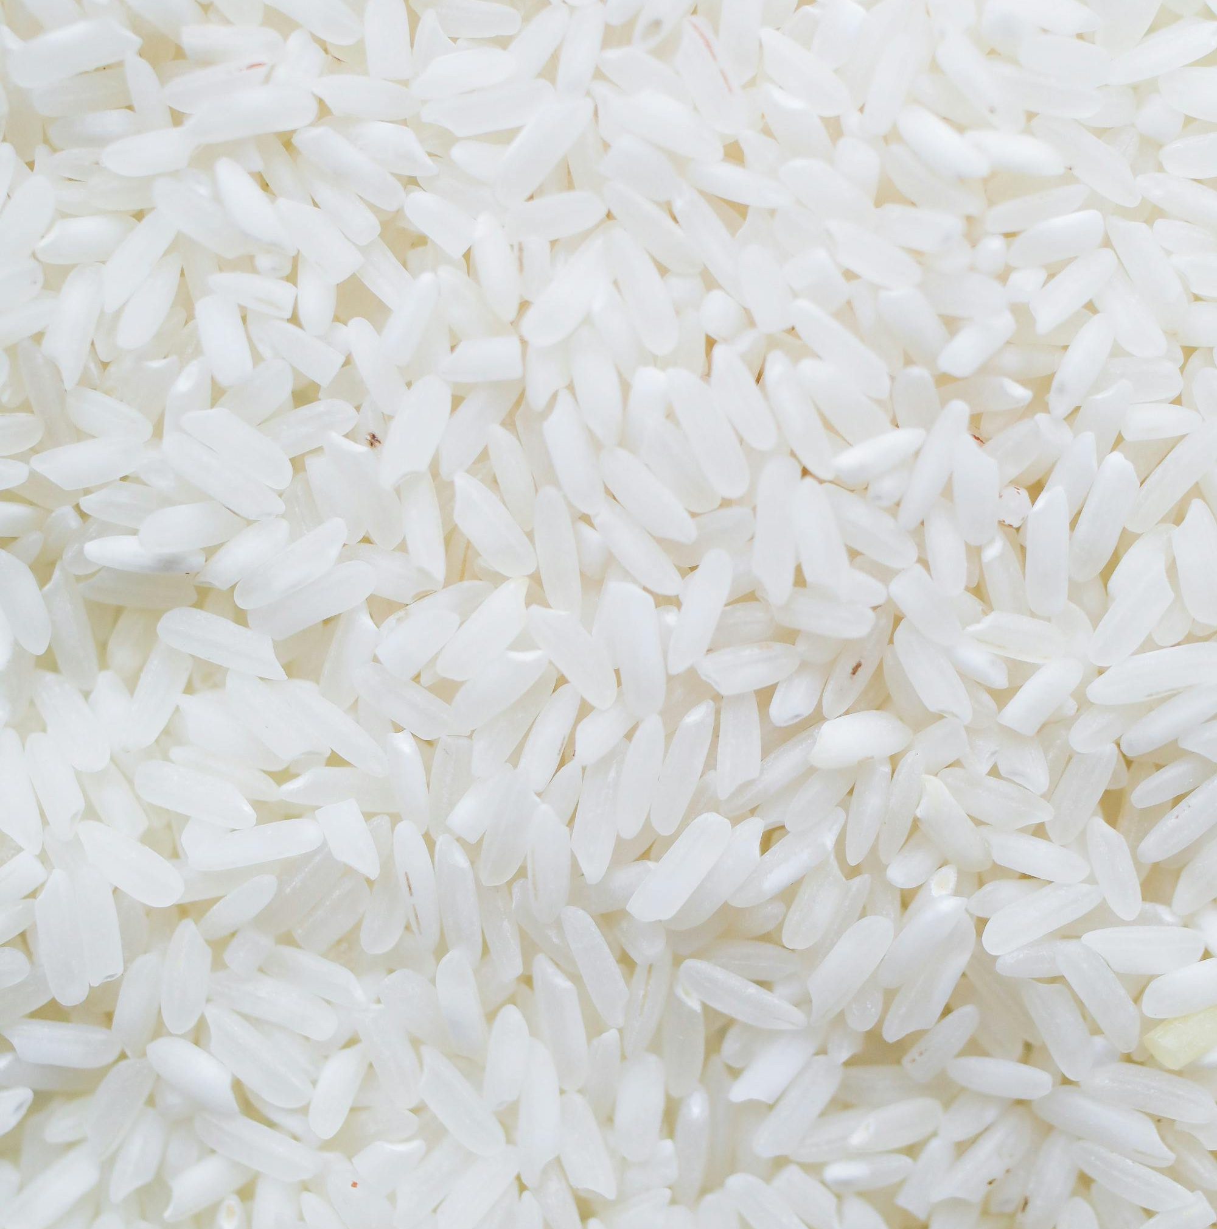

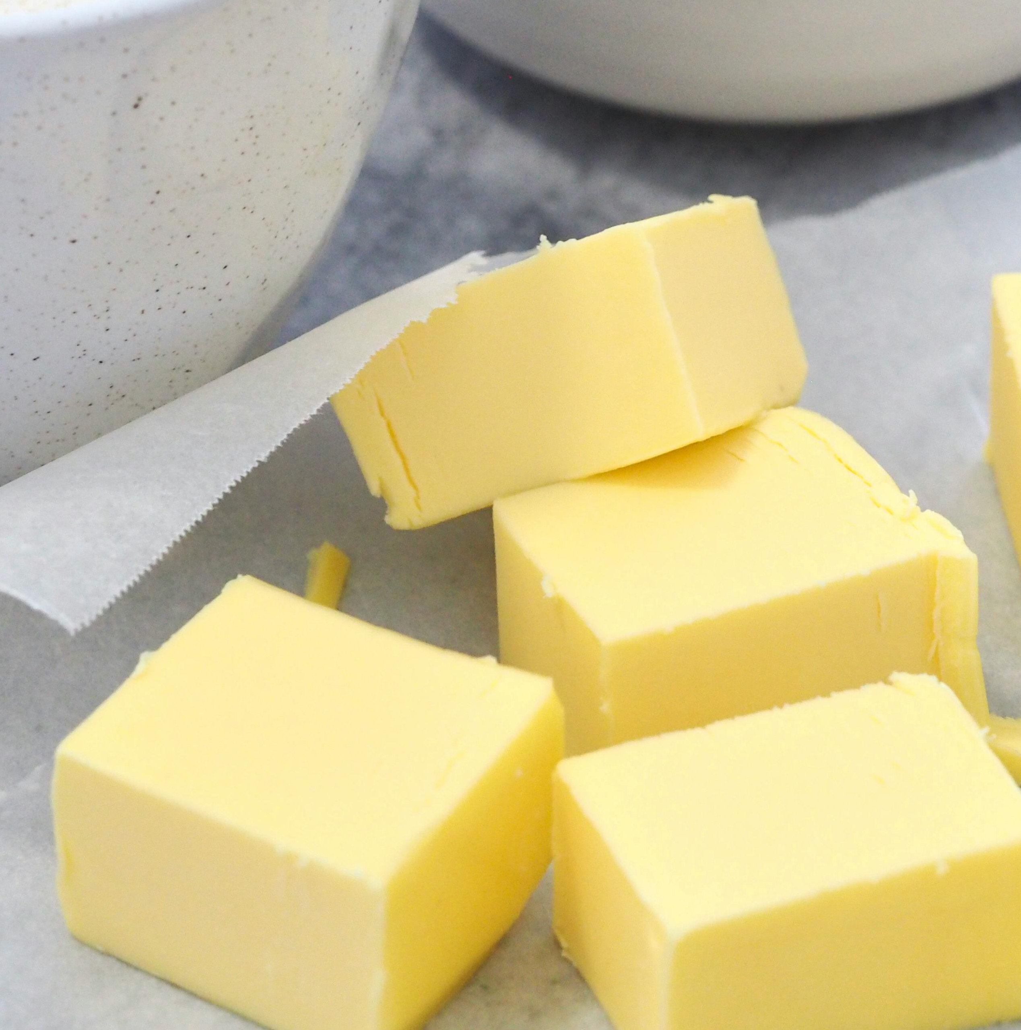

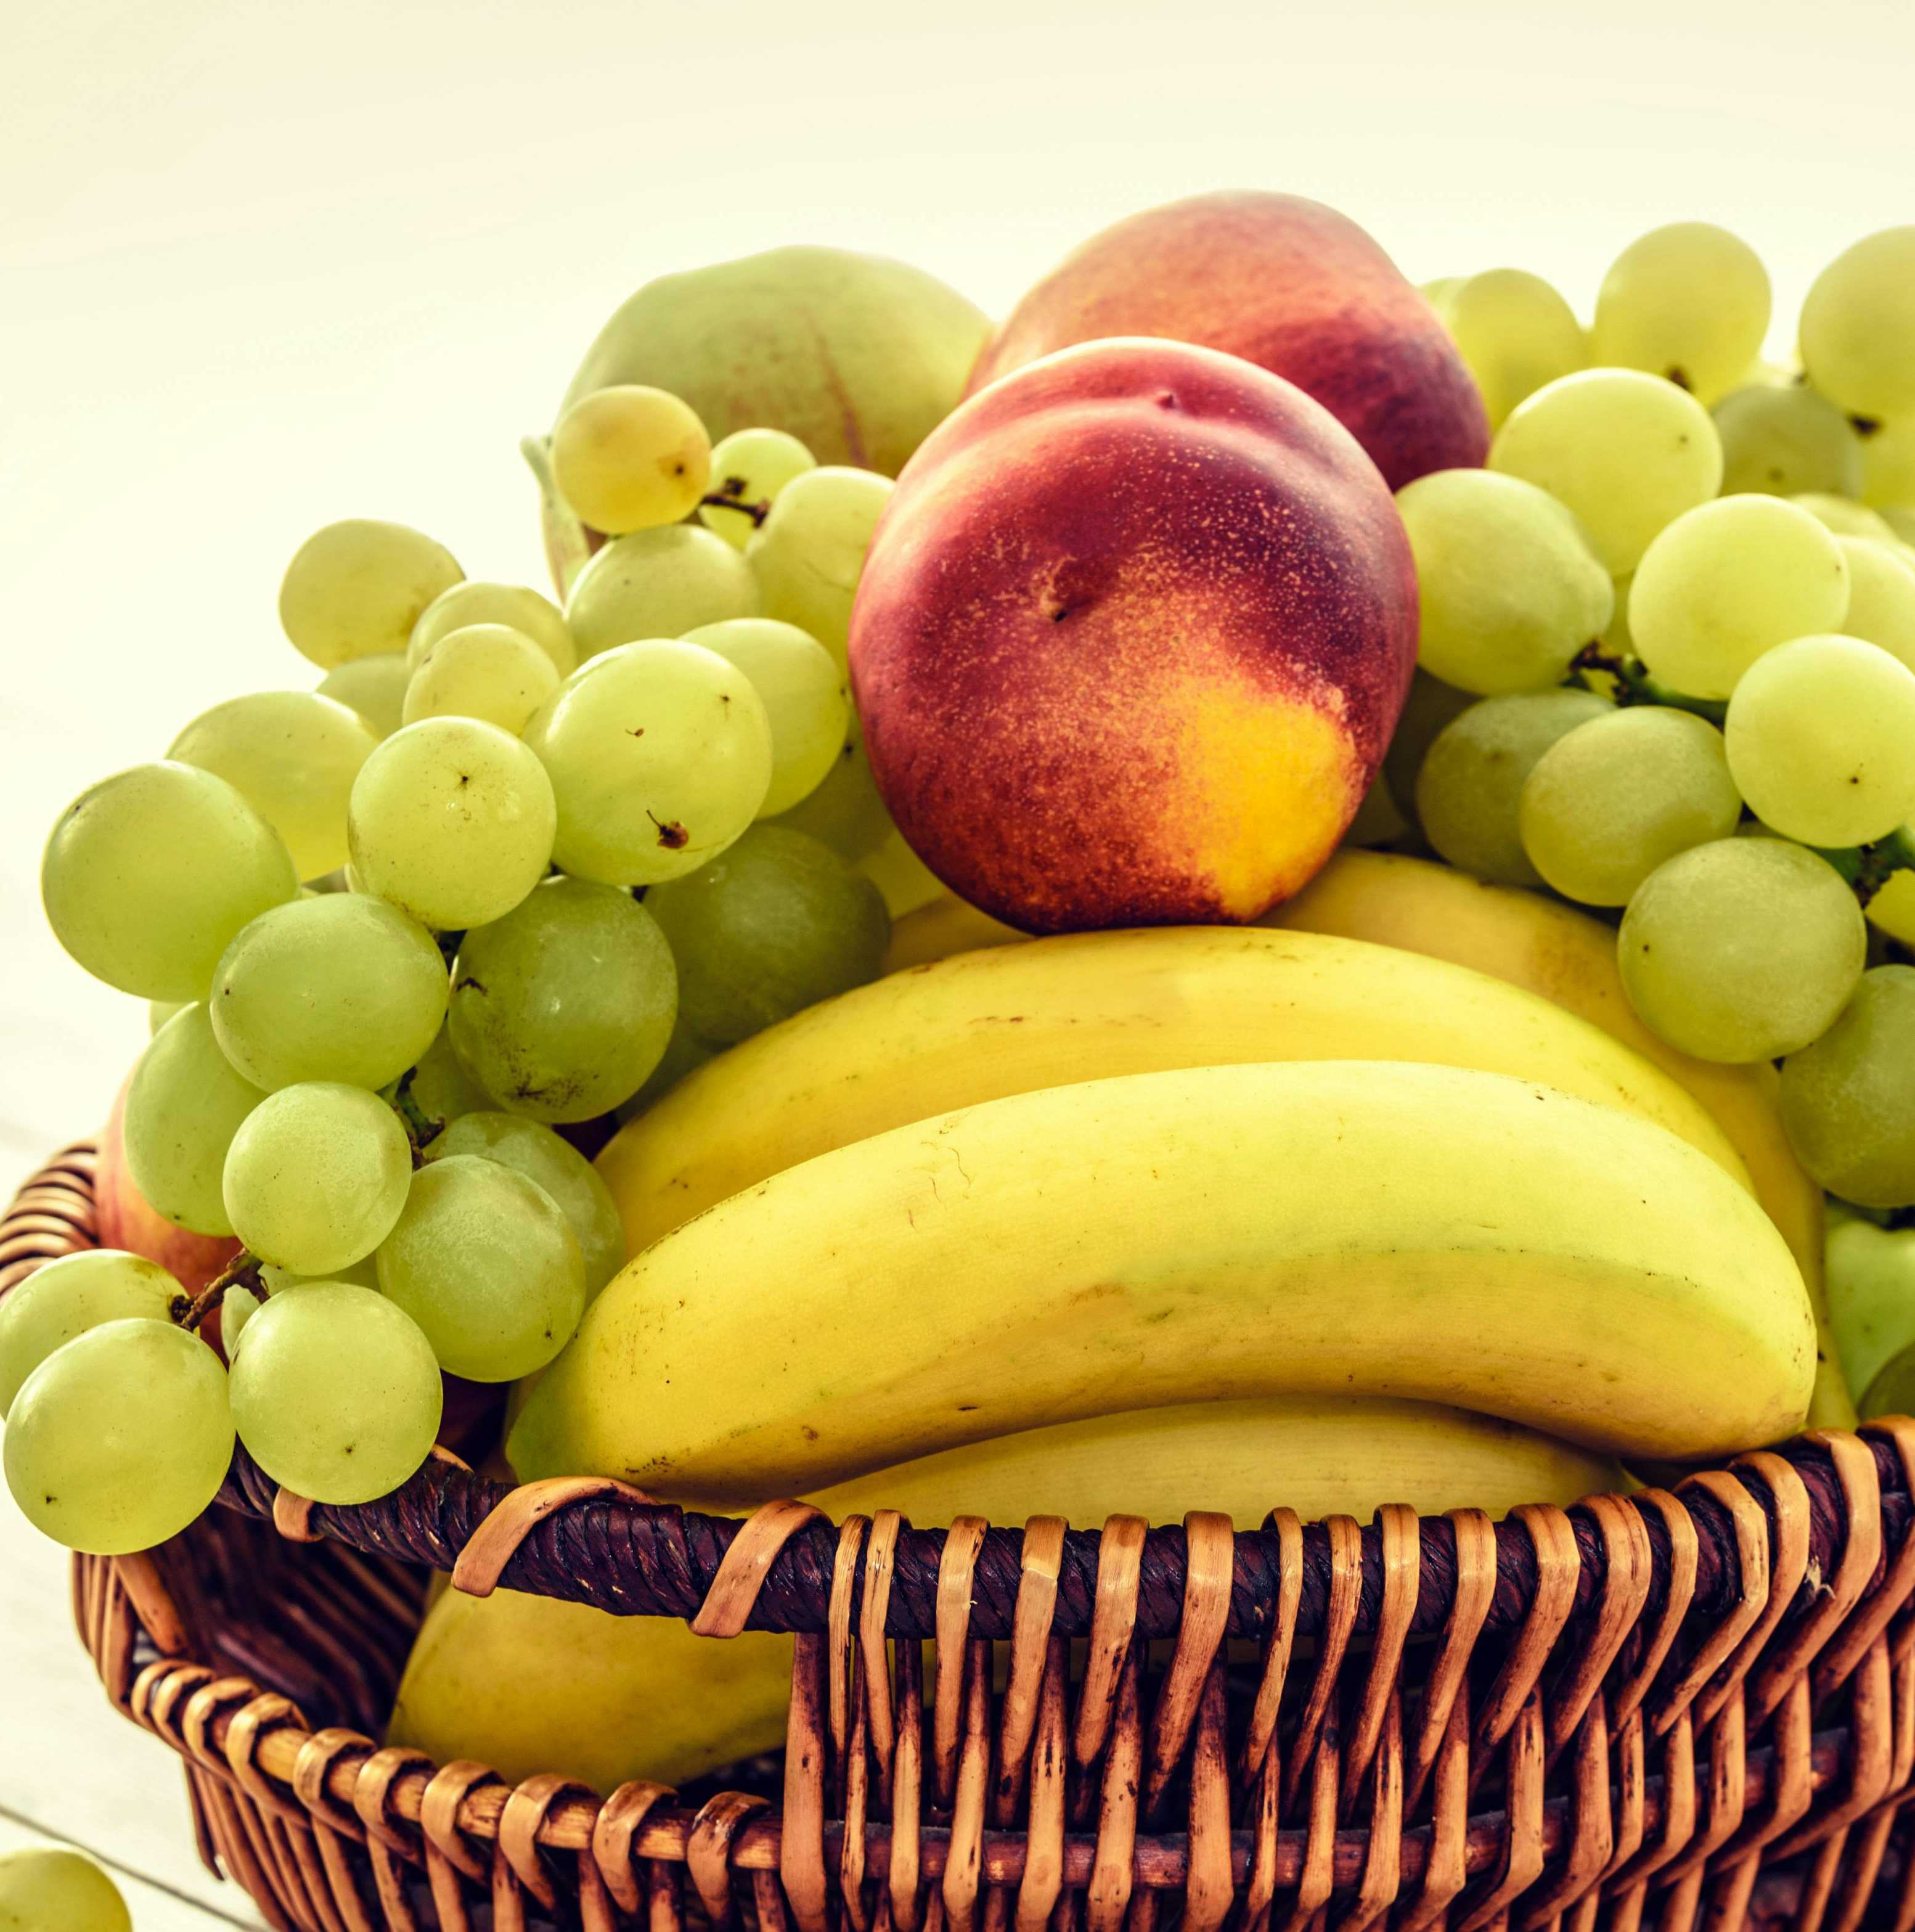
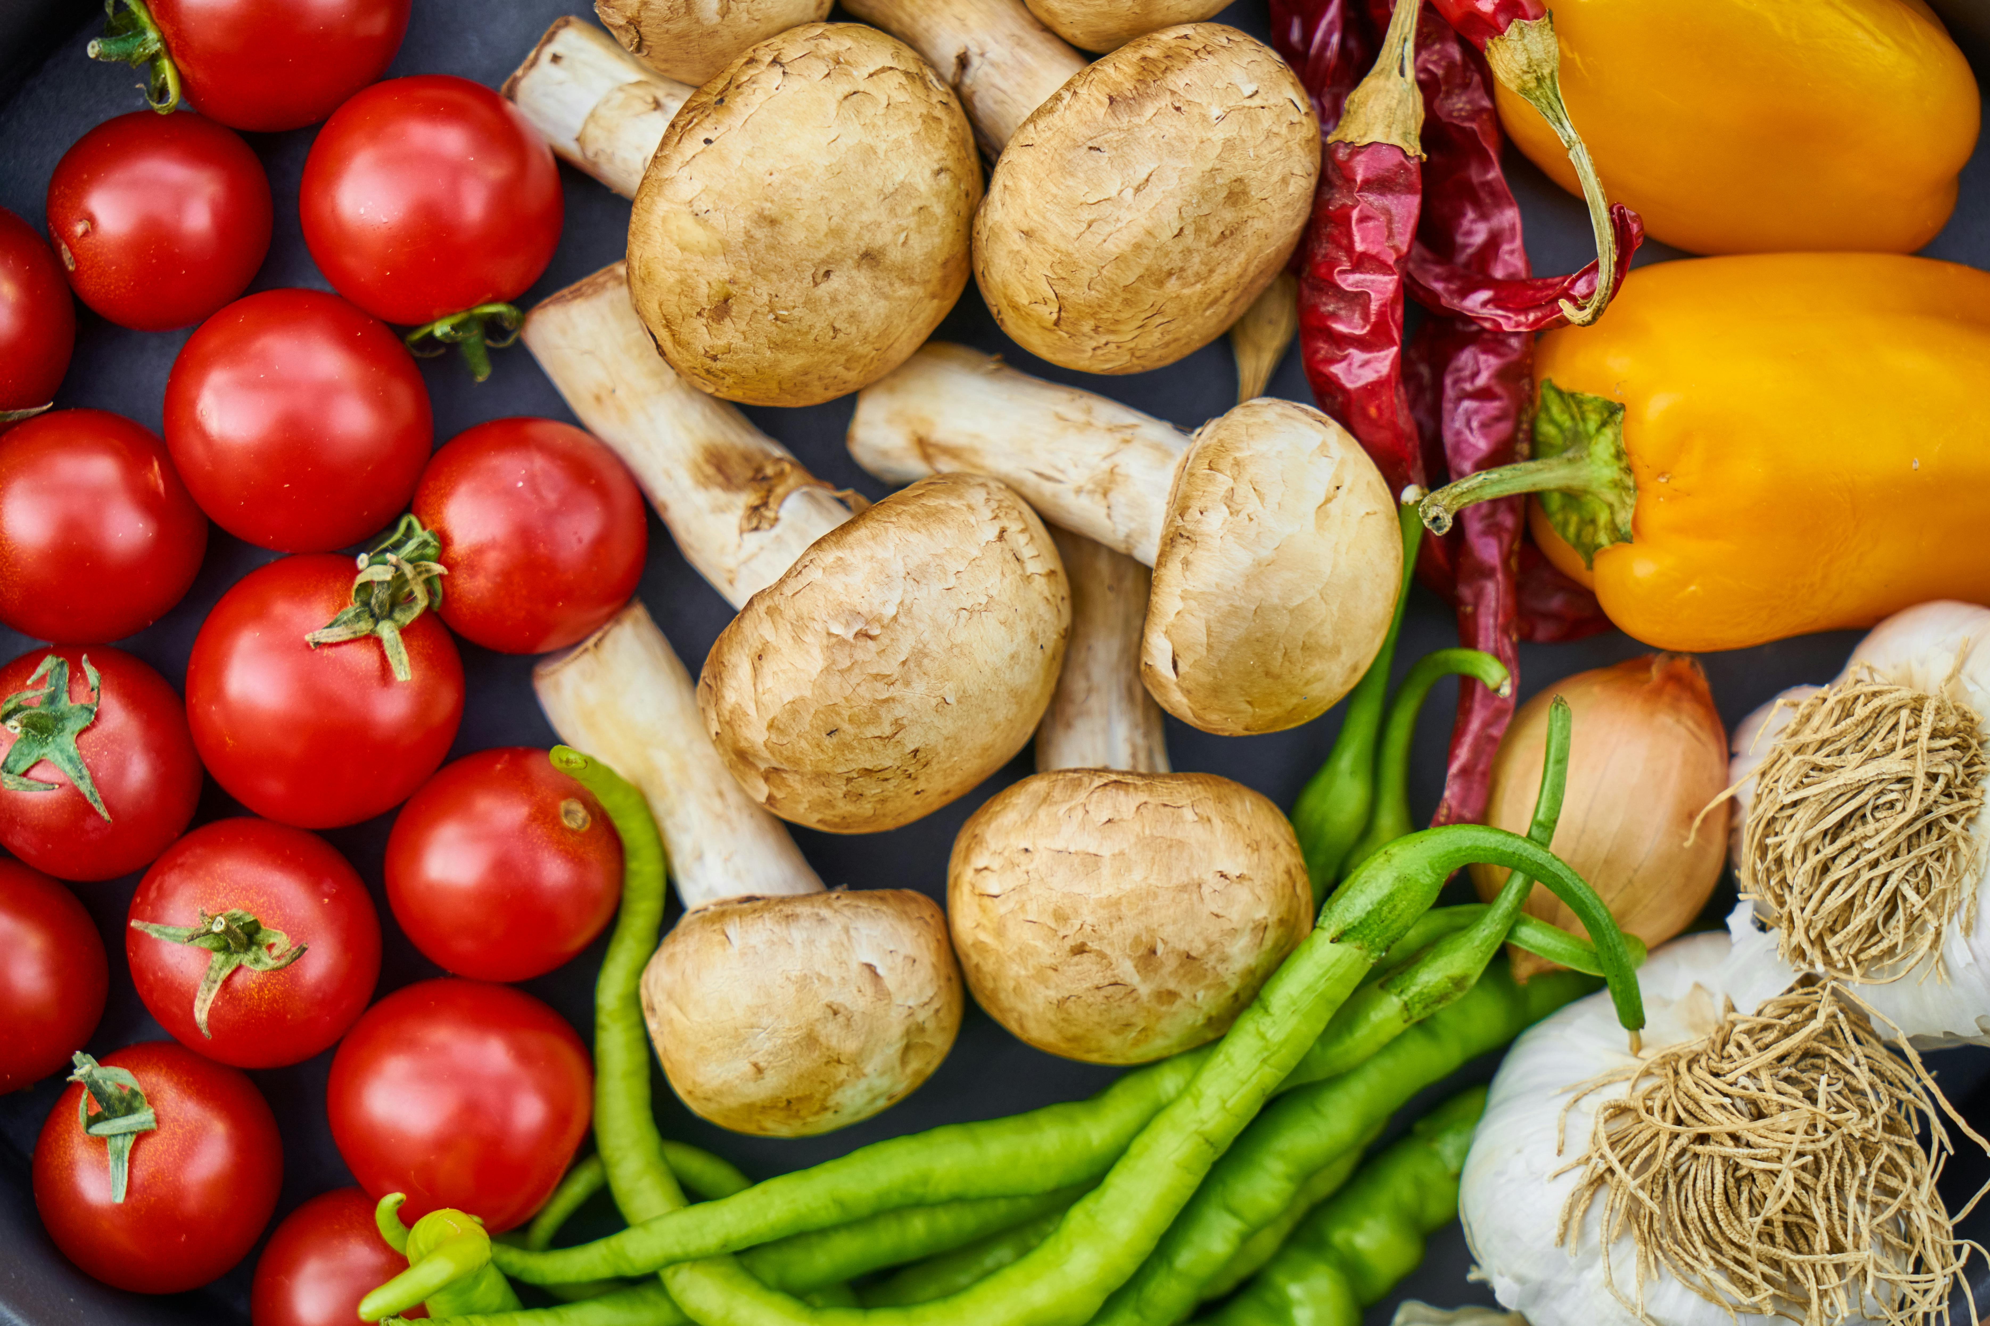
What’s in our food?
Here are some examples of foods that can be part of each nutrient group but there are lots more. Some of these foods can also fit into more than one group. ​
Protein
Carbohydrate
Fat
Vitamins & minerals

Slide 3
What’s in our food?
Protein
Carbohydrate
Do you know how the different food groups affect our bodies?
Proteins help our bodies grow and repair.
Carbohydrates give us energy.
Fat
Vitamins & minerals
Fats give us energy, protect our organs and help the body use vitamins.
Vitamins and minerals help keep us healthy and keep our bodies working properly.

Slide 4
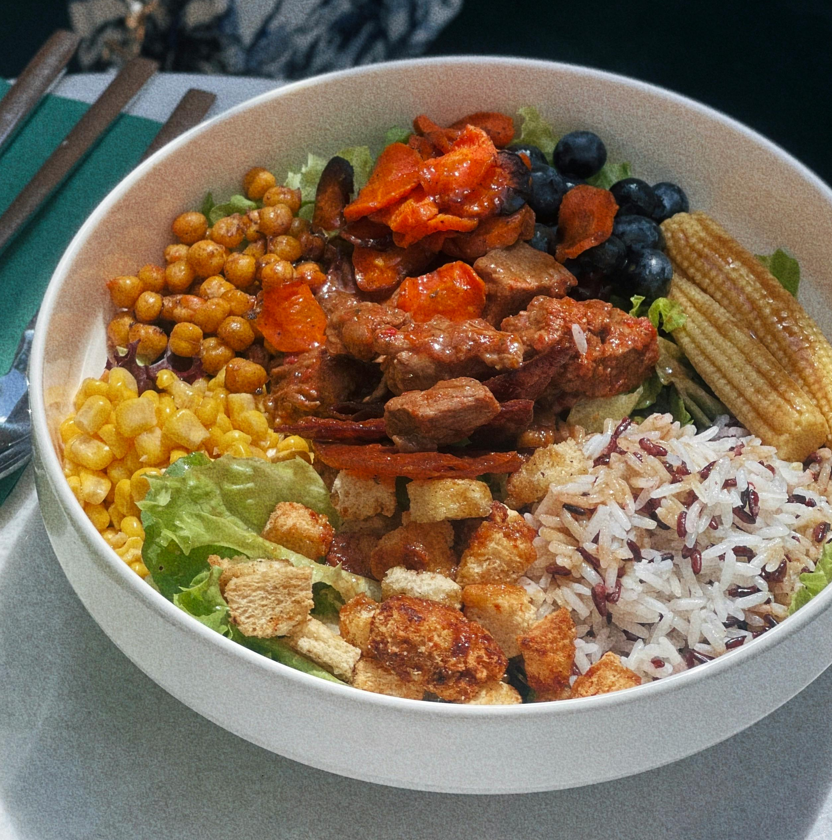





A healthy, balanced diet
Our bodies need lots of different nutrients to stay healthy.
A healthy diet includes foods from all the nutrient groups: protein, carbohydrate, fat, vitamins and minerals.
If we only eat one type of food, we might not get everything our body needs to grow, have energy and stay strong.
Notes:
Order of eggs: Hen, Duck, Quail and Ostrich

Slide 5
A healthy, balanced diet
Some fats are healthy, but too much of a particular type of fat called saturated fat (in butter, cheese, pastries and fried food) isn't good for our hearts. We should only eat foods high in saturated fat sometimes, not every day. ​​
Eating a variety of foods keeps us healthy, helps us concentrate on our learning and gives us energy to play and have fun. ​​
Notes:
Order of eggs: Hen, Duck, Quail and Ostrich

Slide 6
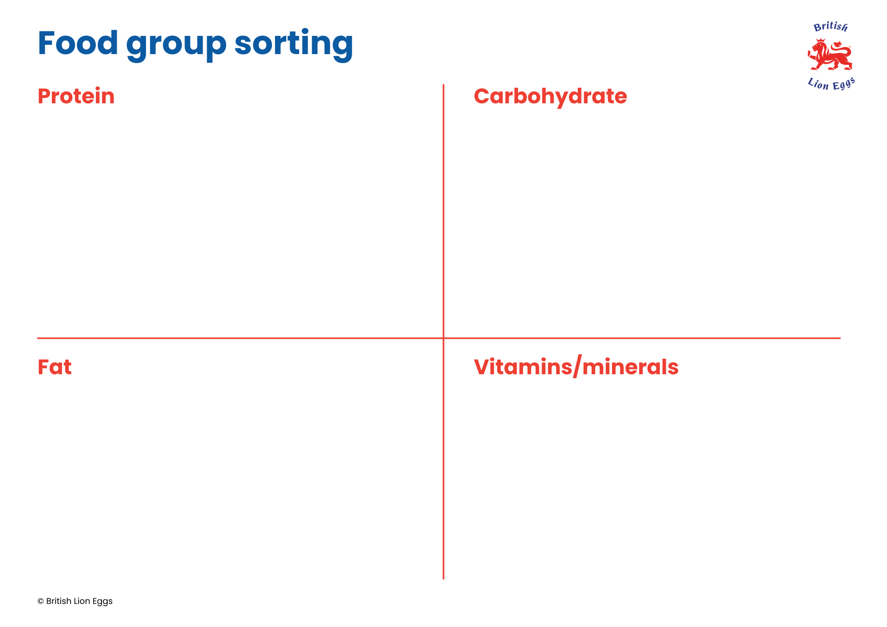
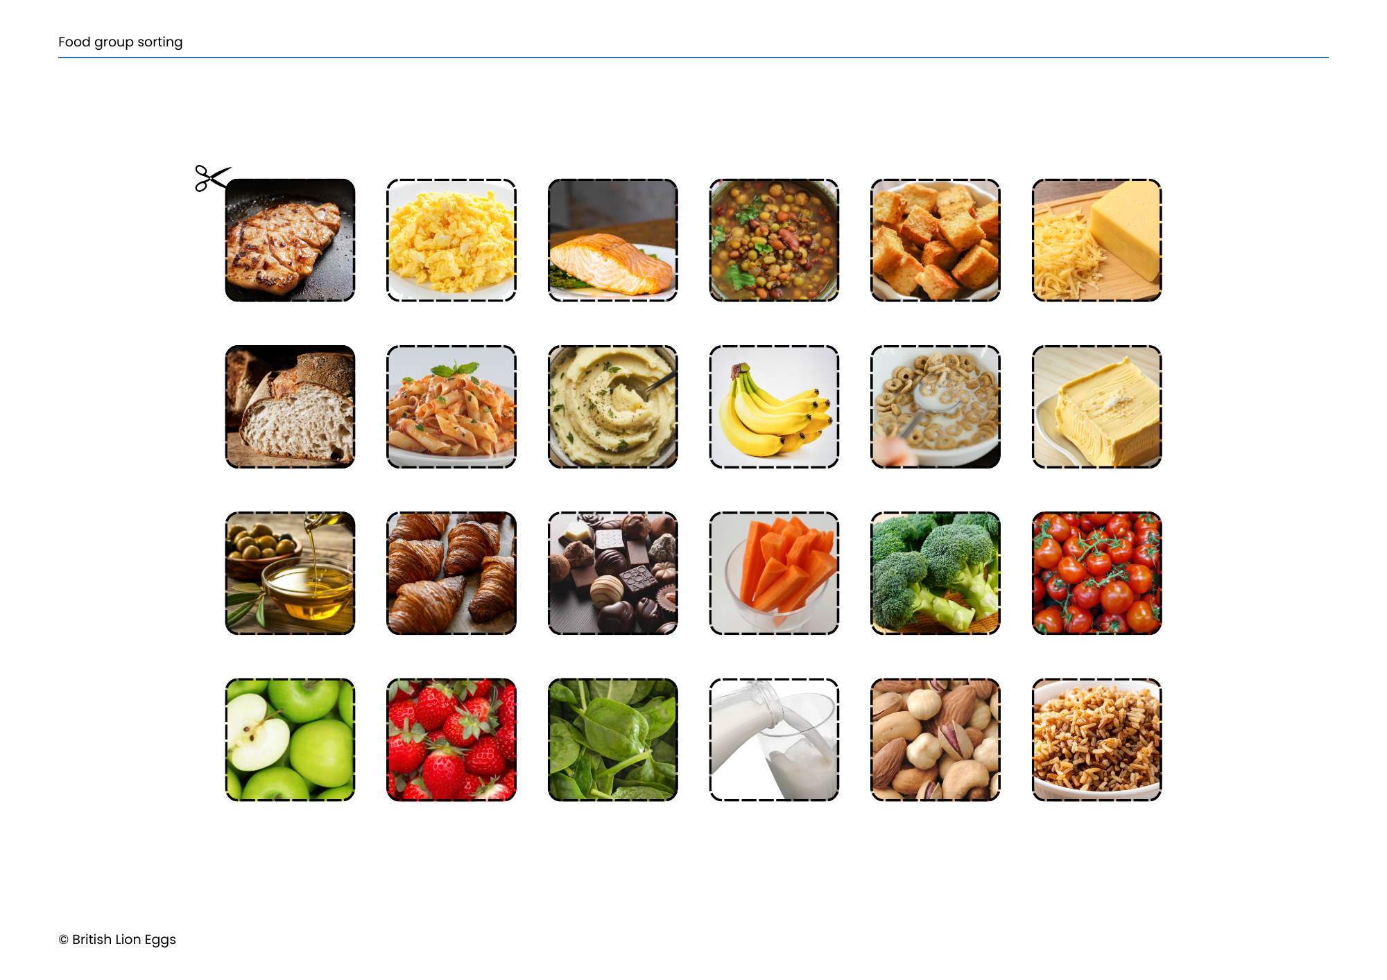
Food group sorting
In your group, sort the food cards into their nutrient groups.
Some foods might fit into more than one group.
See if you can work out why.

Slide 7
Protein
Carbohydrate
Fat
Vitamins/minerals

Slide 8
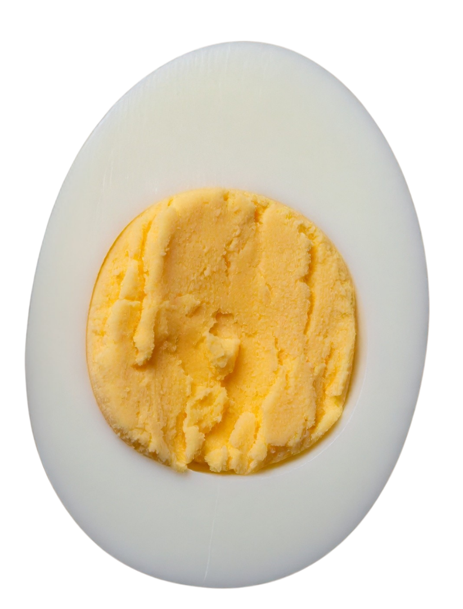
Healthy balance
Did you notice that eggs were in three of the four food groups? They are a great source of nutrients.
The yolk provides lots of nutrients – vitamin D, vitamin B12, iron and healthy fat.
Protein comes from the egg white.

Slide 9


The superpowers of eggs
Each nutrient in eggs gives us a different benefit.
​Protein​
Helps our muscles grow strong.​
​Iron​
Helps us to concentrate.​
​Vitamin B12​
Helps our bodies get energy from food.
Vitamin D
Keeps our bones and teeth strong.
​Fat
Gives us energy and helps protect our organs.
Which part of the egg has protein?
Why do our brains need iron?

Slide 10
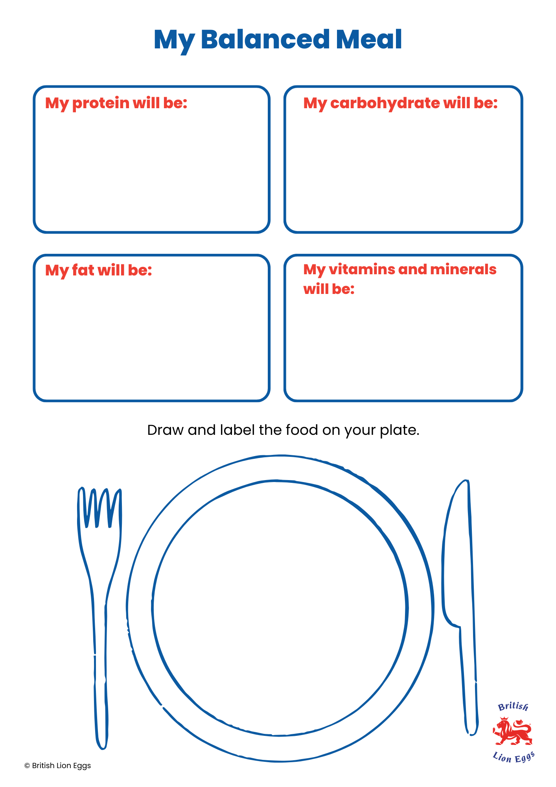
Create an eggsciting meal
Design a balanced meal that includes eggs. Think about what type of egg you would like to eat. ​
​
Include a type of food from each nutrient group. ​
​
Once you have decided which nutrients will be included, draw and label the food on your plate. ​

Slide 11
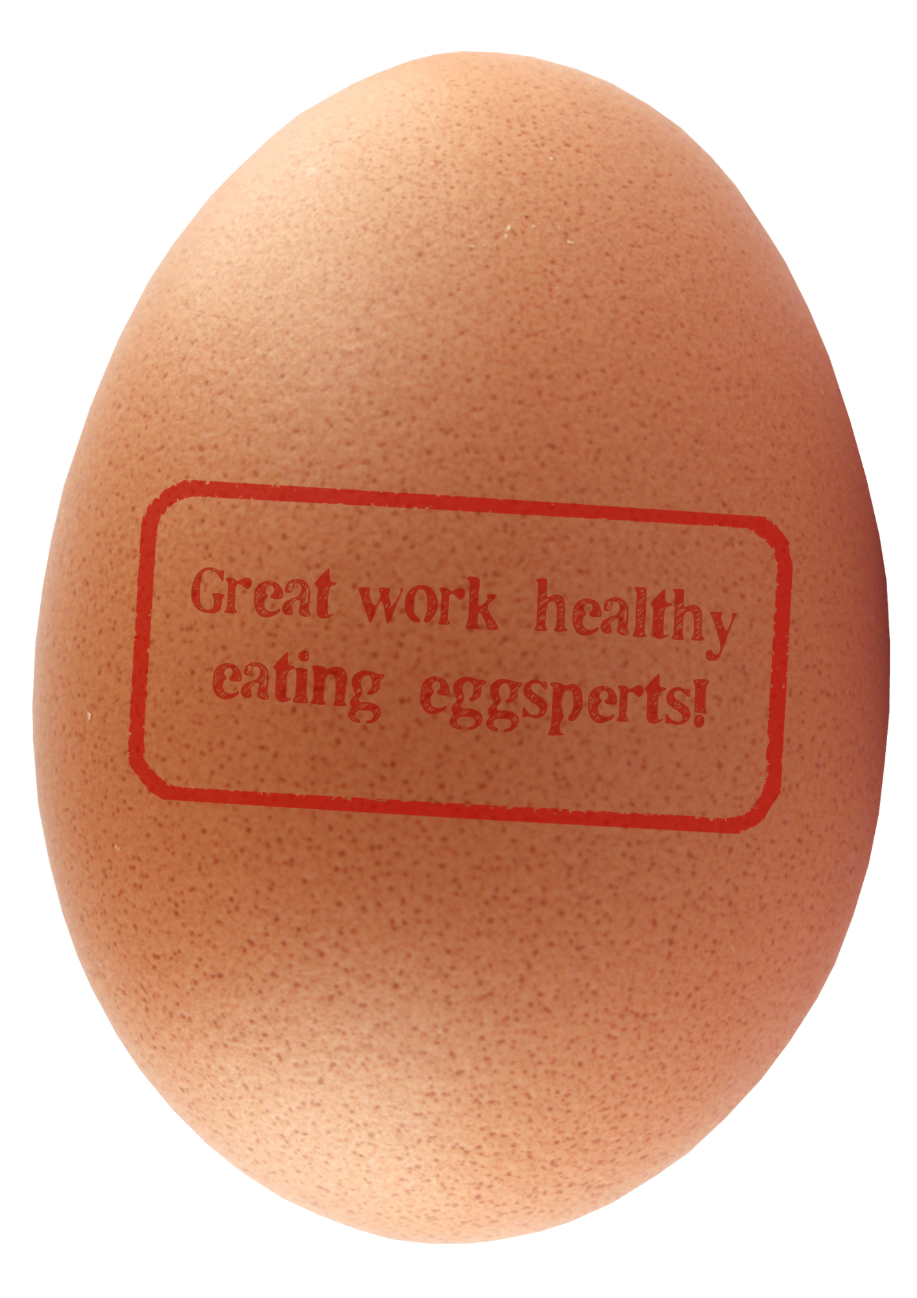
Eggsperts
Eggs are very versatile. They can be part of breakfast, lunch or dinner. ​
What role does the protein in eggs have in our body?
Carbohydrates mainly supply us with what?

Slide 12

Brought to you by

