Slide 1

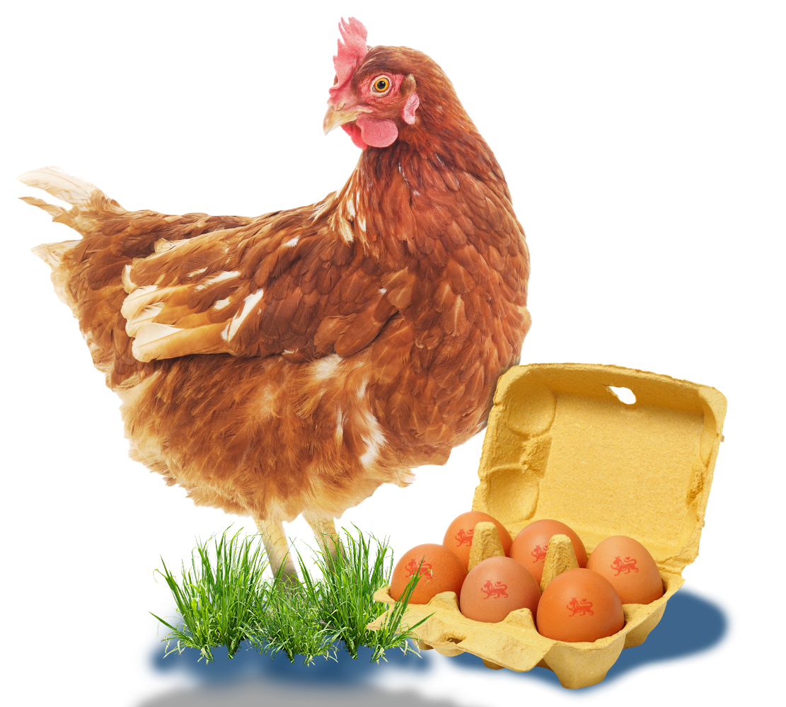
The supermarket supply chain

Slide 2
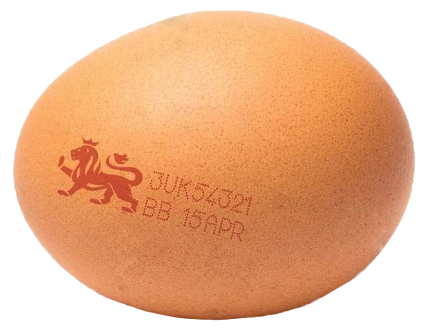
Supermarket eggs supply chain
Today, we are going to use maths to explore how eggs travel from a farm to the supermarket.
We will discover how important maths is at every step! ​​ ​

Slide 3
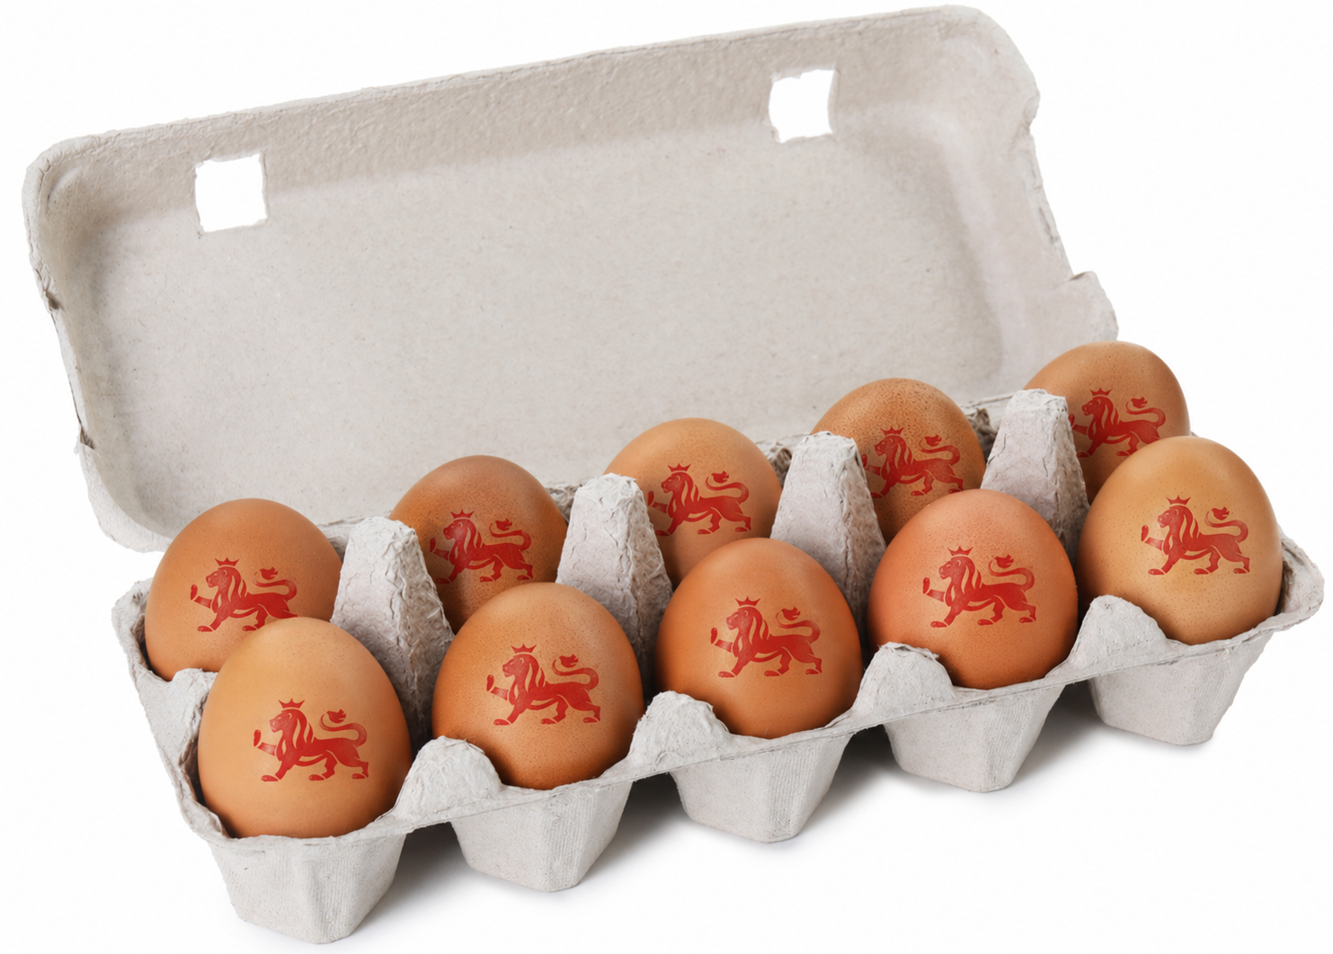
What will we be learning?
By the end of this lesson, you will be able to: ​
​
Use maths to solve real-life problems. ​
Explain what a supermarket egg supply chain is.​
Calculate totals, groups, and costs of eggs. ​

Slide 4
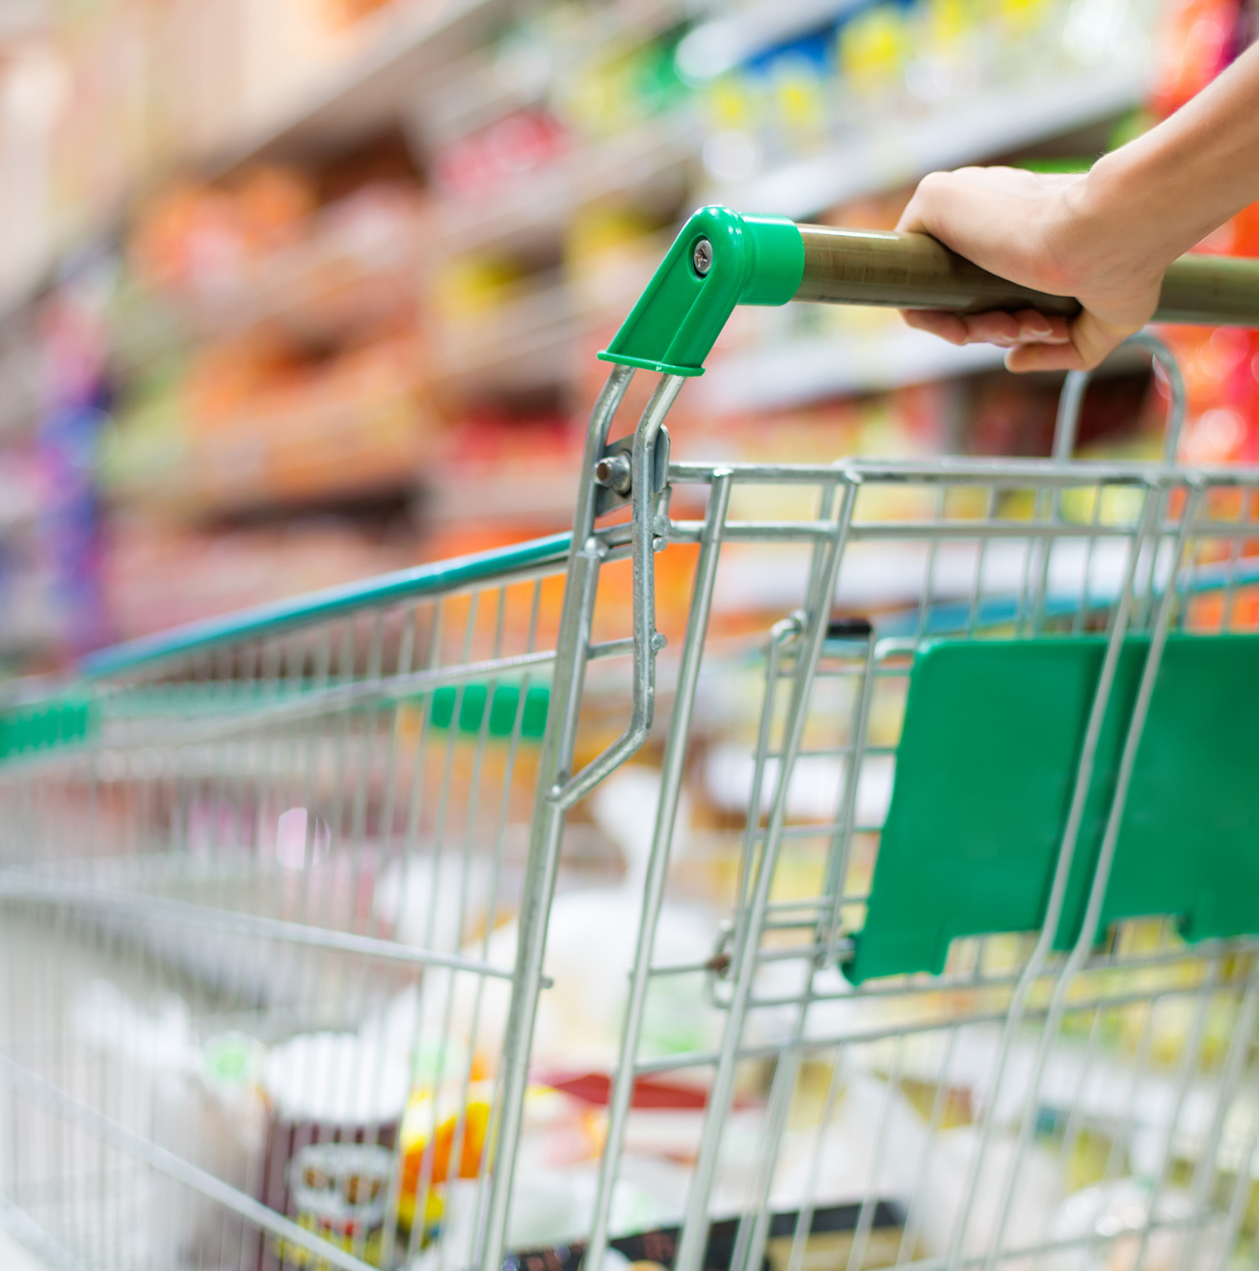

Where do eggs come from?
Talk to your partner: ​
​
Where do eggs come from?​
What happens before we by them in a shop?​
Who might be involved? ​

Slide 5
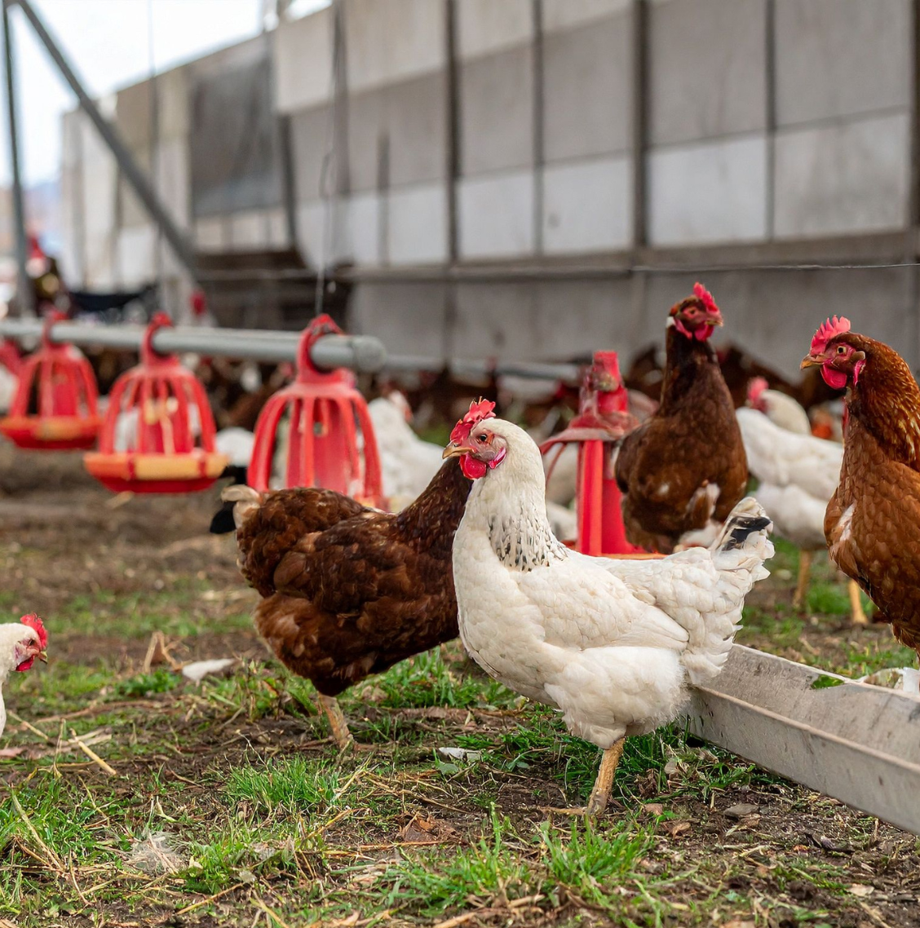
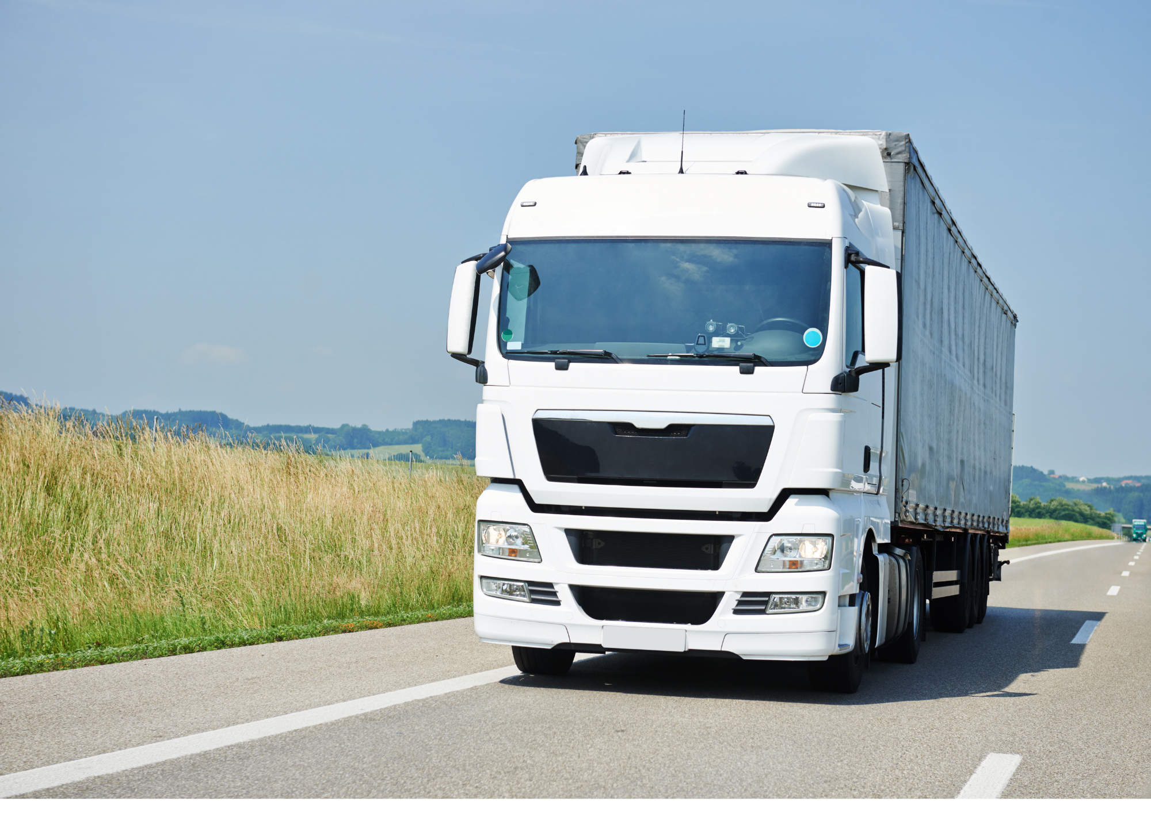
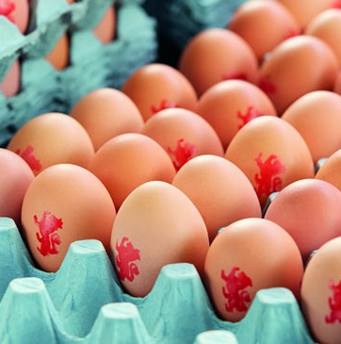
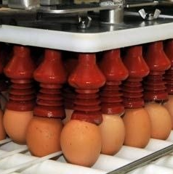
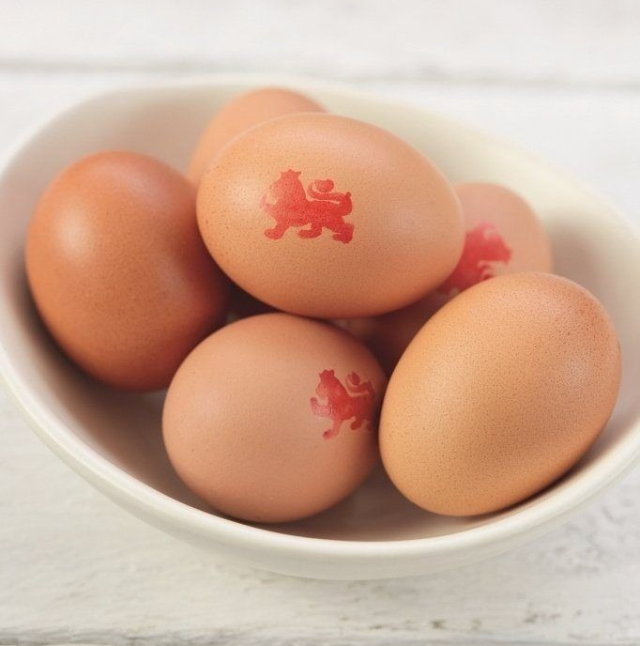
Key vocabulary
Producer
Supply chain – the journey a product takes​
Producer – where something is made or who by
​
Consumer – the person who buys it​
Transport – moving goods from place to place​
Quantity – how many there are​
Transport
Shop
Consumer

Slide 6
What is a supermarket supply chain?
A supermarket supply chain shows how eggs travel:
​The farm has the hens that produce the eggs. ​
​The eggs are then taken to a packing centre to be put into cartons ready to sell. ​
​The eggs are then transported to the place they will be sold. ​
​They are then stocked in a supermarket for customers to buy. ​

Slide 7
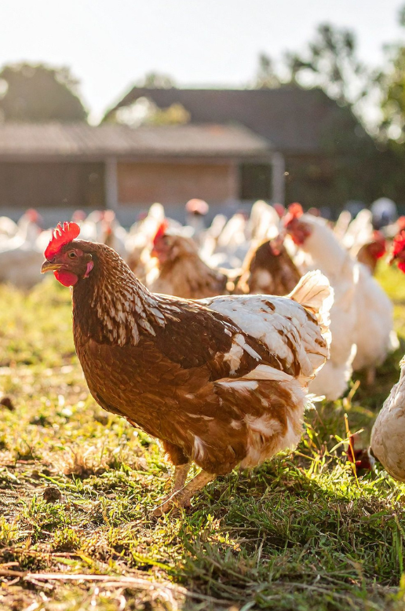
Where eggs begin
Hens lay eggs on farms. ​
​
The farmers need to use maths to: ​
​
Count eggs​
Track the daily totals​
Plan how many eggs can be sold ​

Slide 8
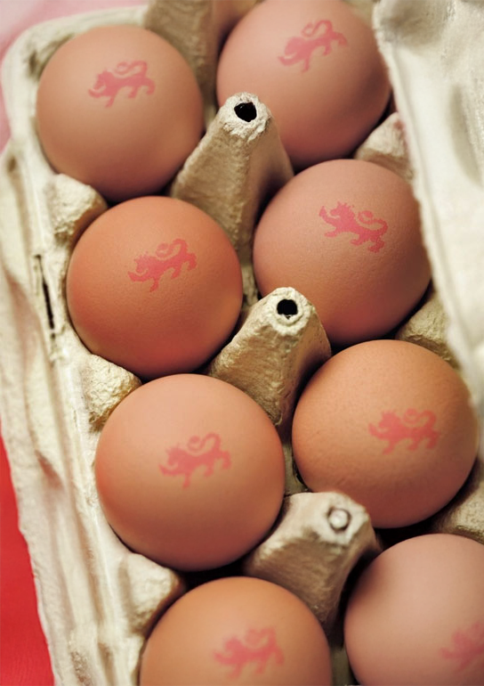
Packing the eggs
Eggs are checked, stamped and packed.
Eggs are packed in boxes of 6 and boxes of 12.

Slide 9
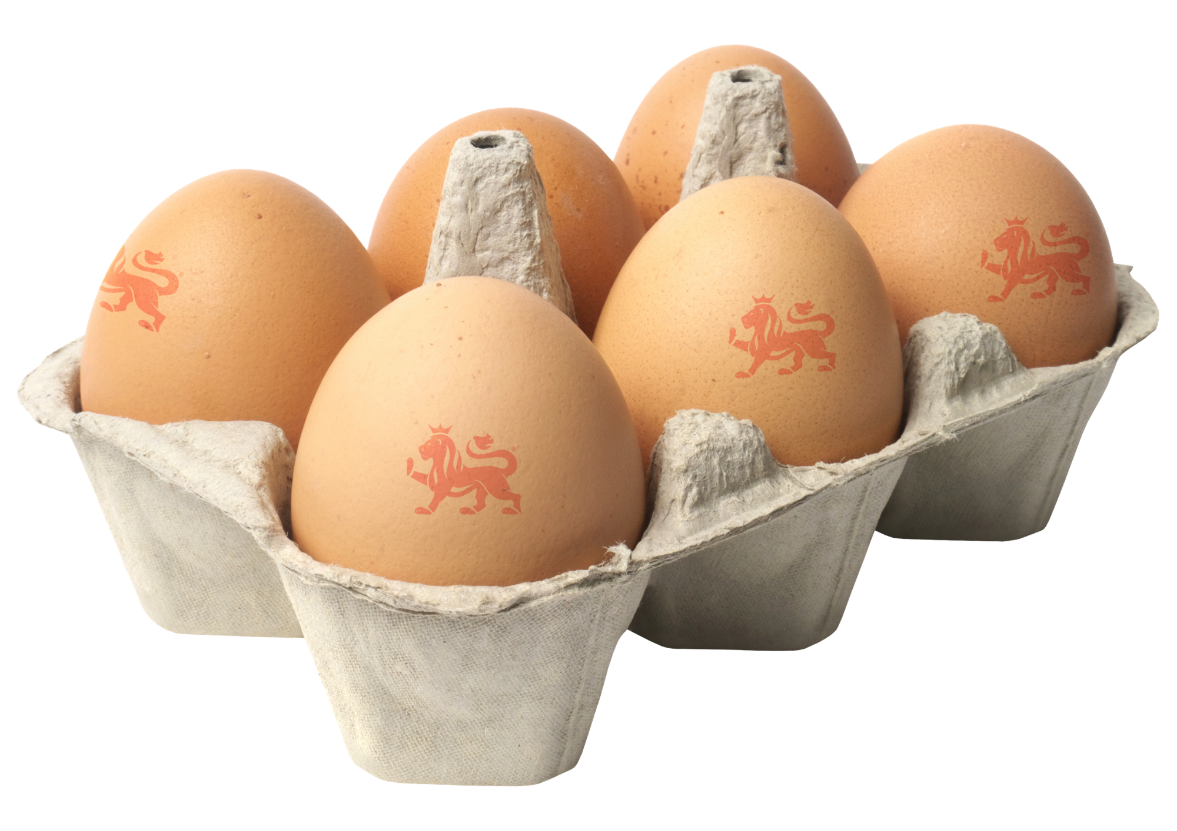
Let’s calculate
A farm collects 1,200 eggs. ​
​
The eggs are packed into boxes of 6. ​
​
How many boxes of eggs are made?​
​
Now try the rest of the questions yourself. ​

Slide 10
Moving eggs safely
Eggs are transported to shops by lorries. ​
​
Maths helps to: ​
​
Work out how many boxes fit on a lorry.​
Plan deliveries.​
Reduce waste.​

Slide 11
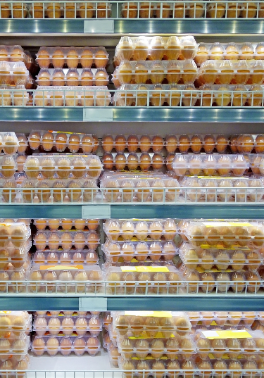
Selling the eggs
Supermarkets use maths to:
Set prices.
Count stock.
Make sure there are enough eggs for the customers.

Slide 12

Can you manage an egg supply chain?
Remember to use your maths skills:
Read the question carefully.​
Highlight important numbers.​
Show your working. ​
Check your answers. ​
You are going to:​
​
Solve egg supply chain problems.​
Use multiplication and division.​
Explain your mathematical thinking.​

Slide 13
Eggscellent maths
What maths do farmers use? ​
​
What maths do shops use?​
​
What could happen if the maths was wrong?​

Slide 14

Brought to you by

