Slide 1

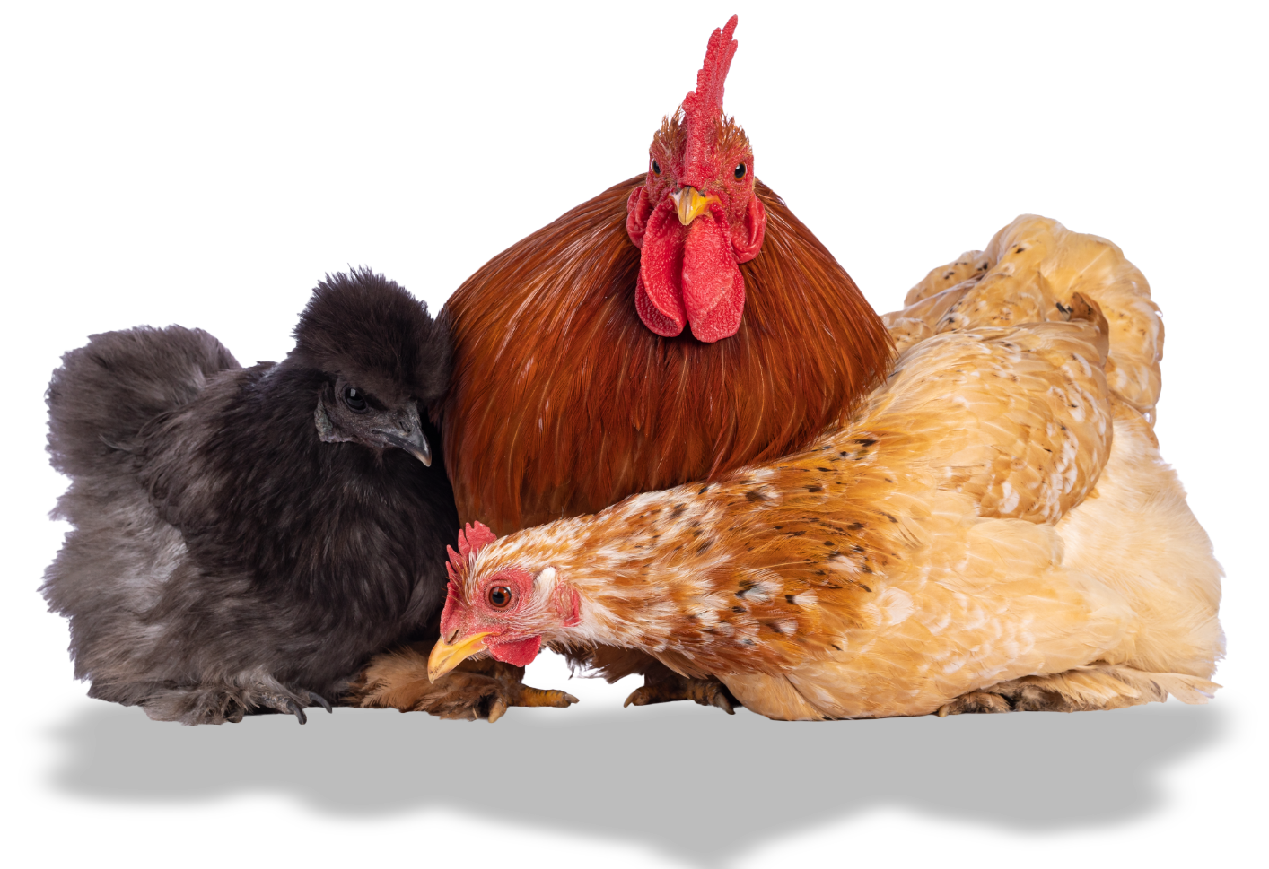
Taking care of our feathered friends

Slide 2
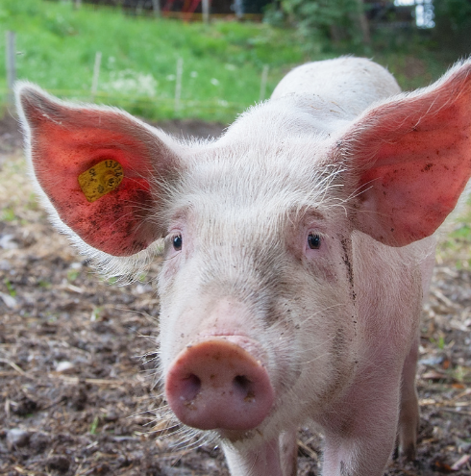
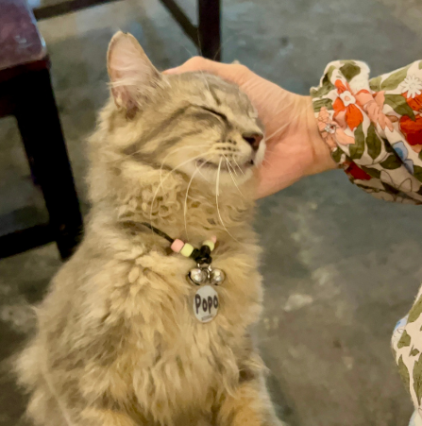
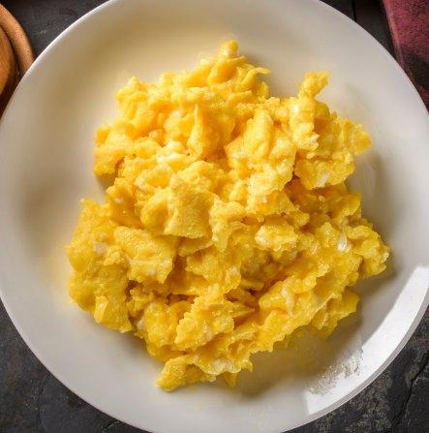

What do animals need?
What do animals
need to stay alive?
Who looks after animals?
Have you eaten eggs before?

Slide 3
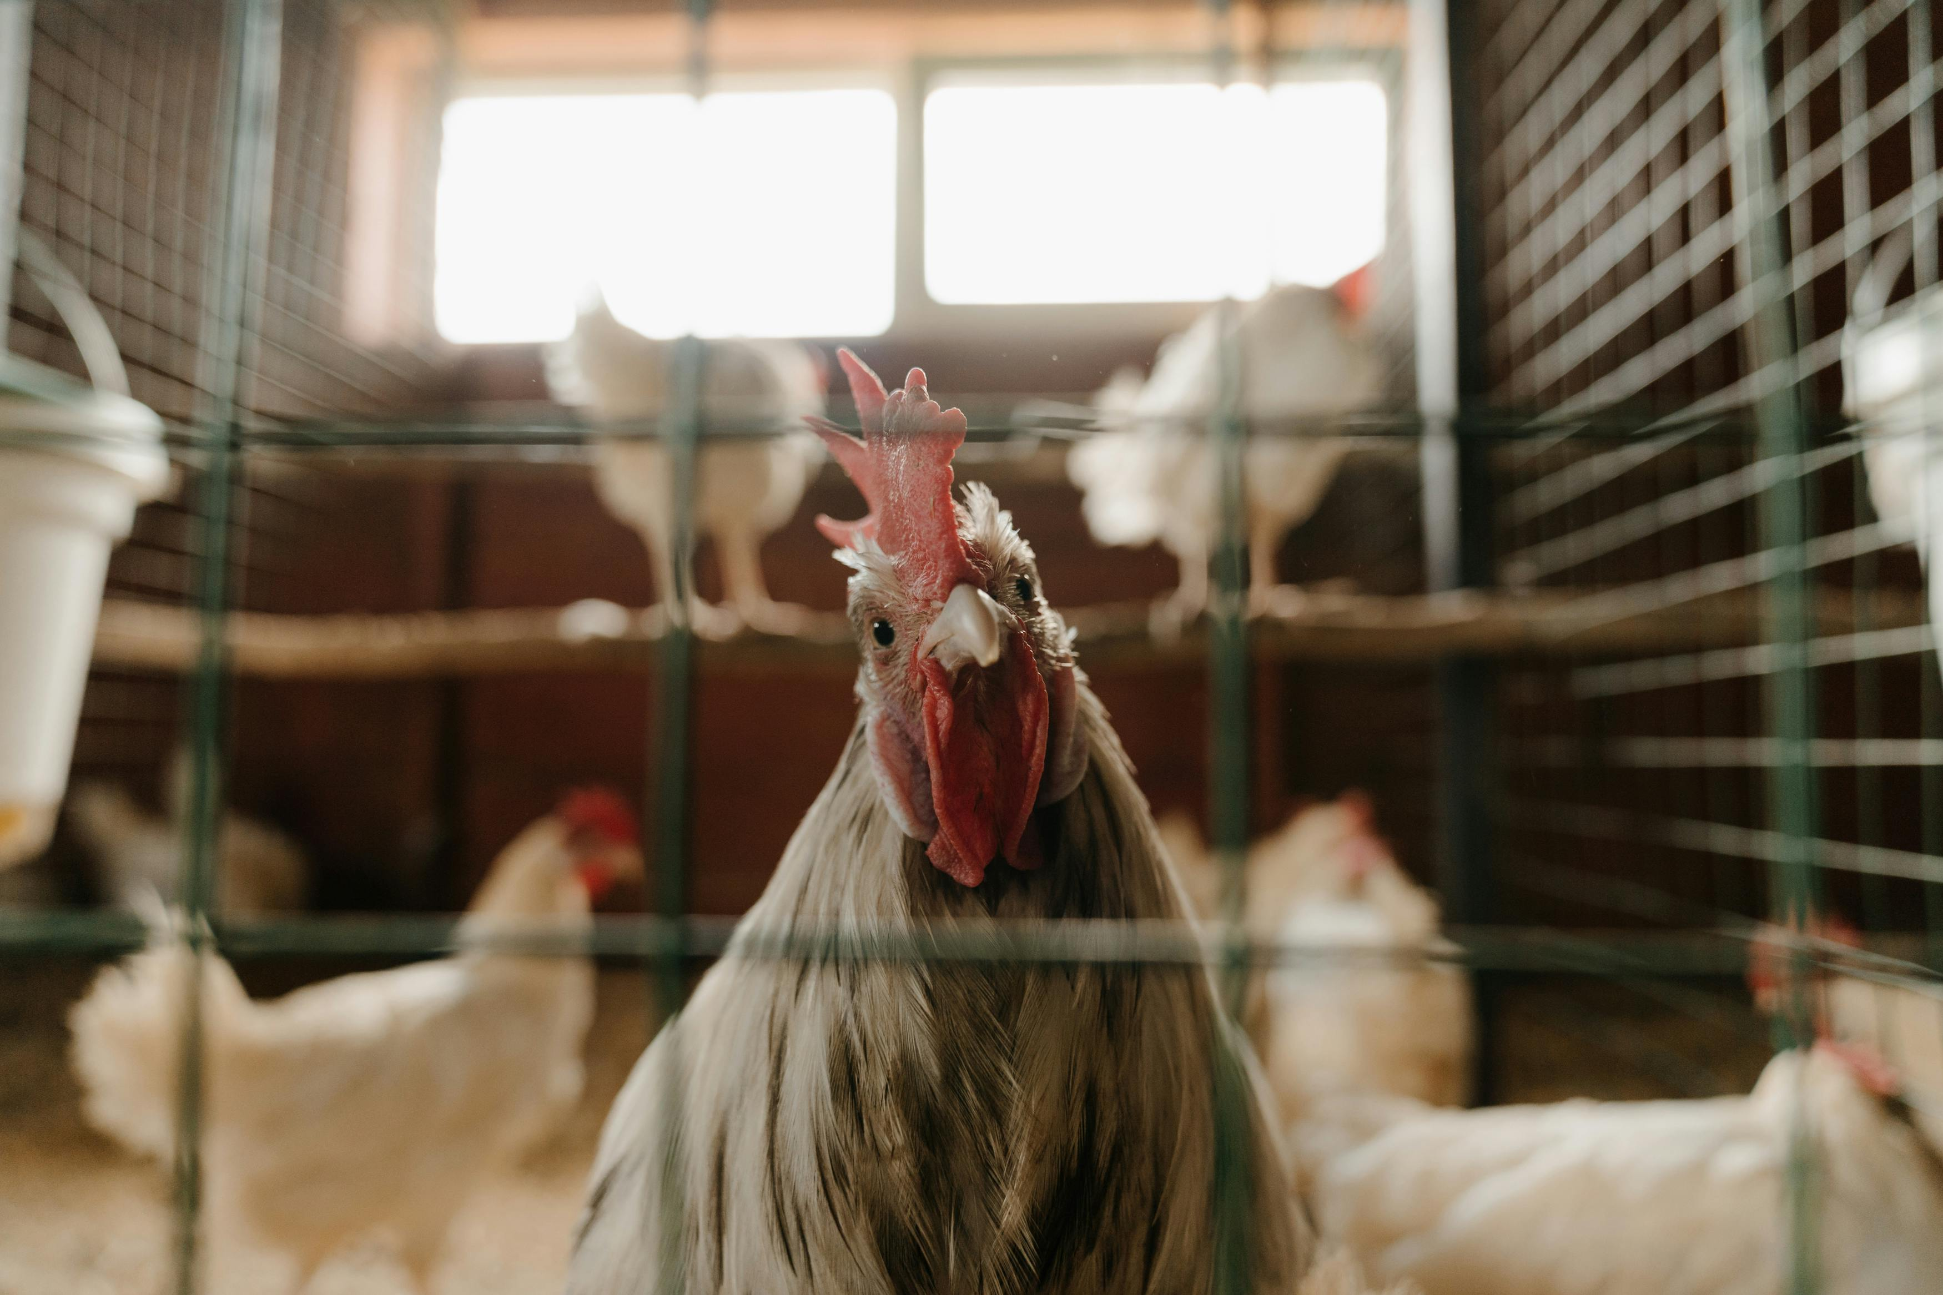
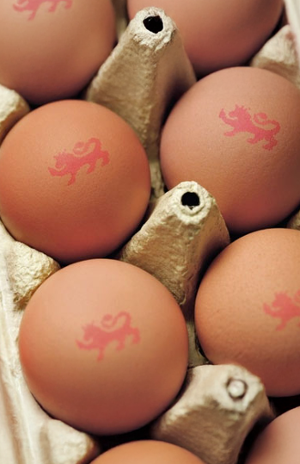
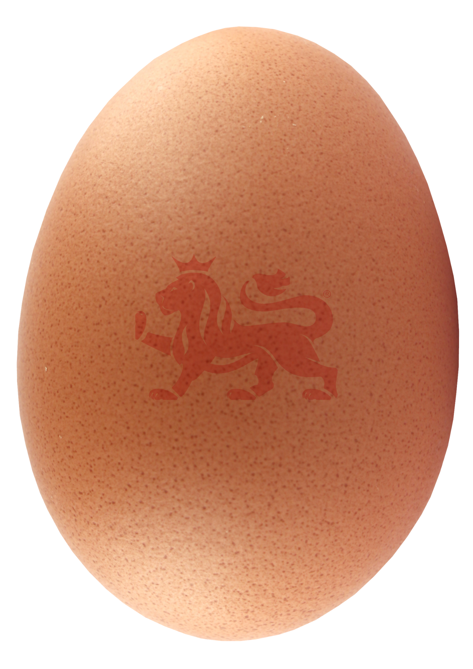
Where do the eggs we eat come from?
Where do eggs come from?
Many of the eggs we eat come from hens. Other animals lay eggs too, but today we are learning about hens.

Slide 4
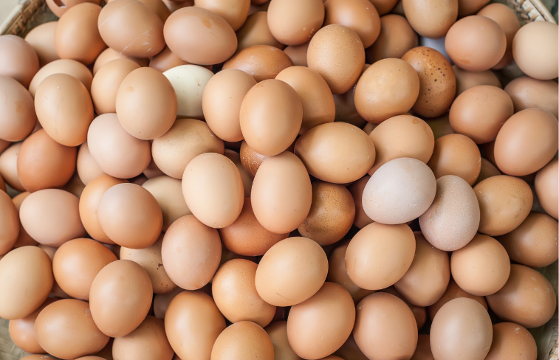
Where do the eggs we eat come from?
Eggs with the British Lion mark are produced to very high safety standards.
The hens are vaccinated, and the eggs are carefully checked to keep them safe to eat.

Slide 5
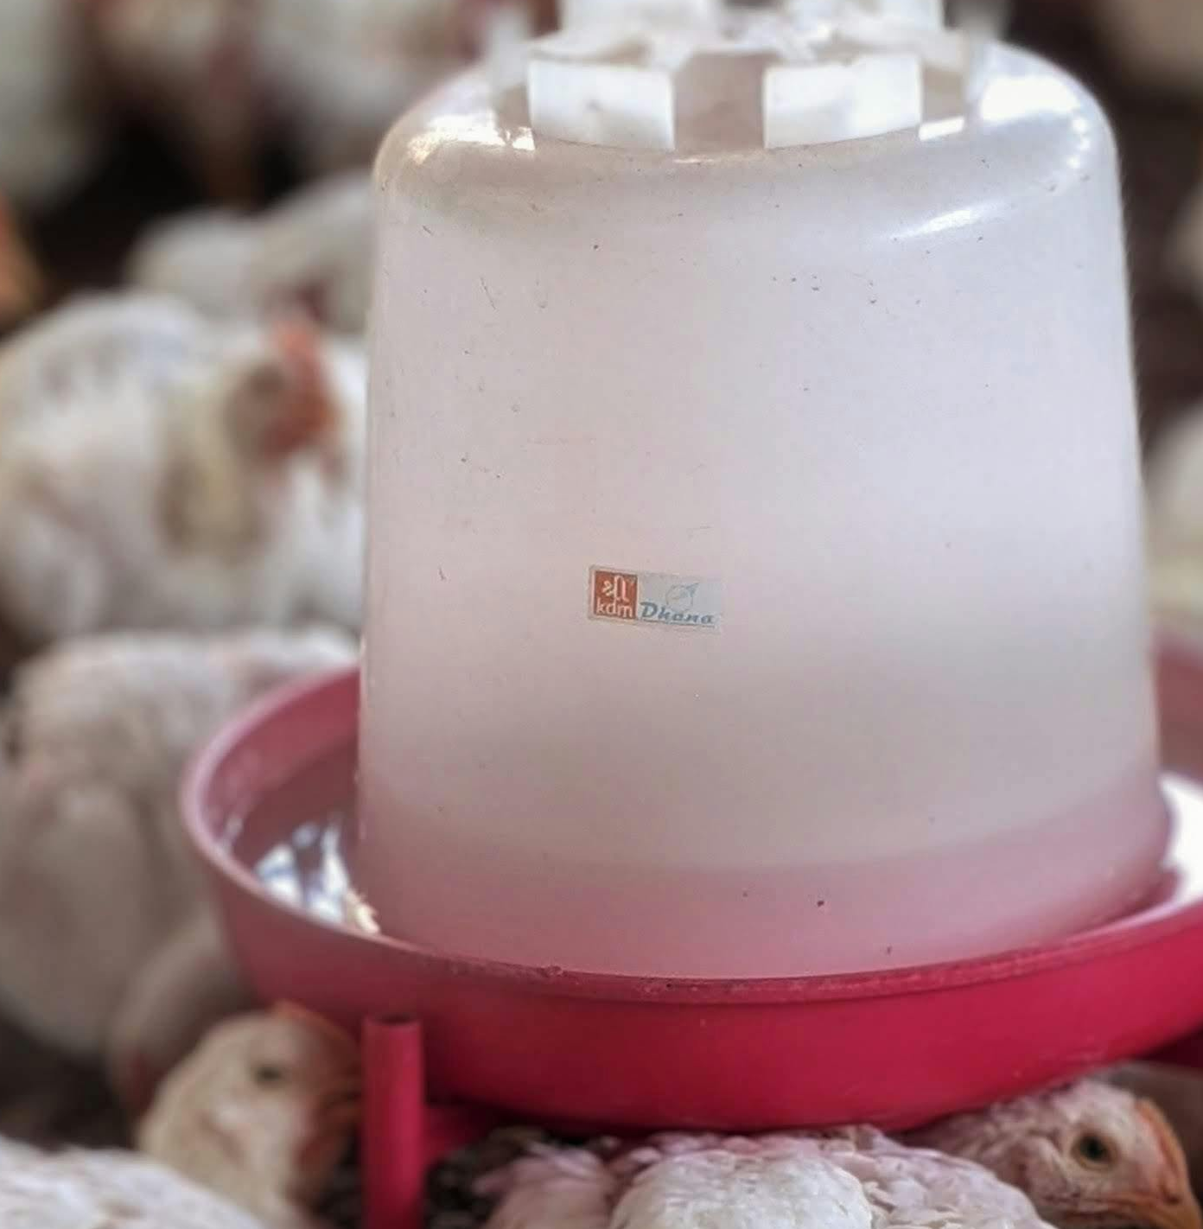
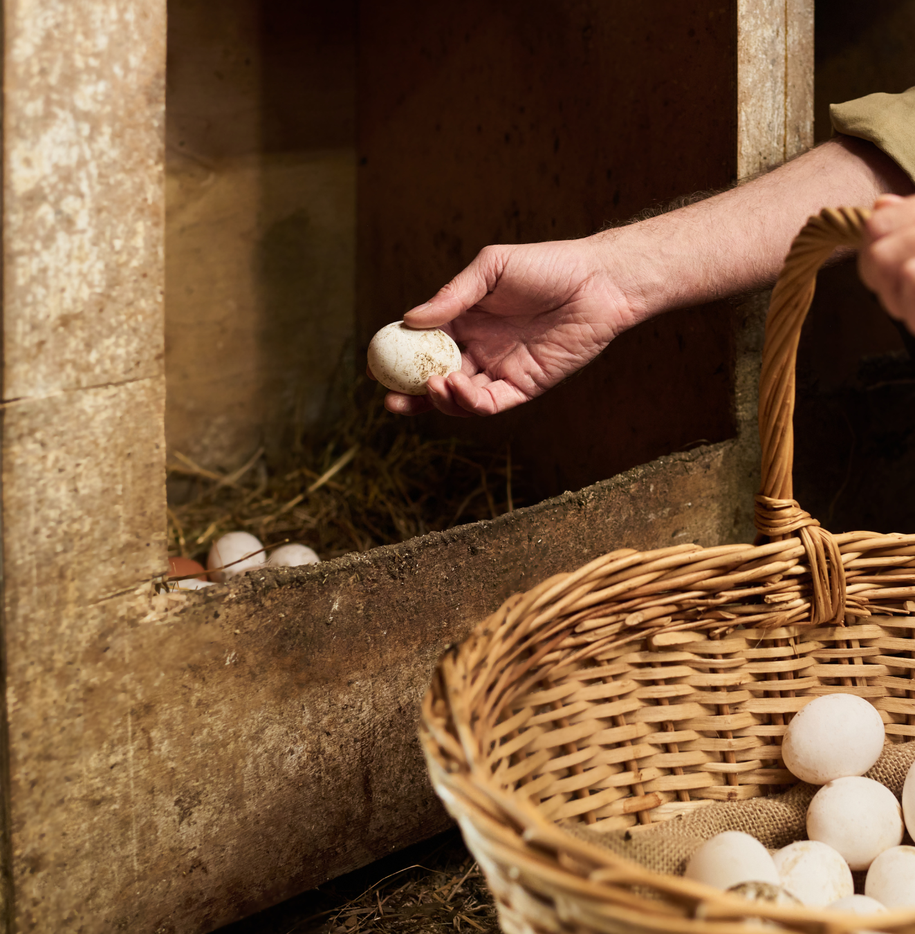
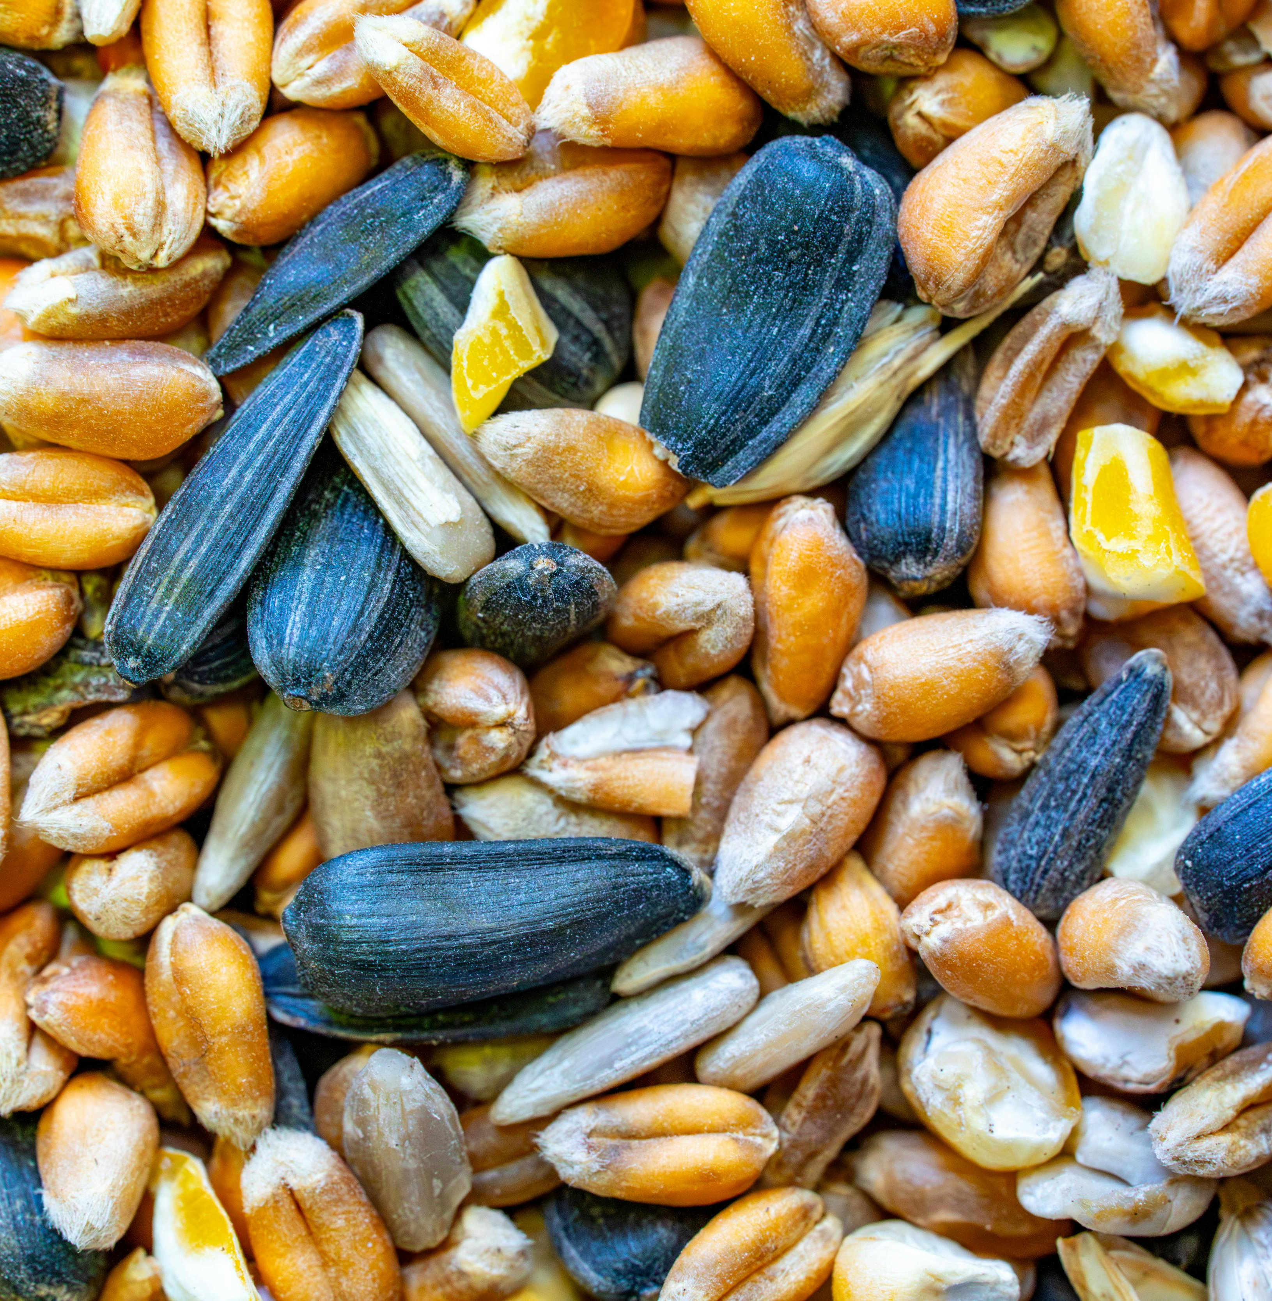
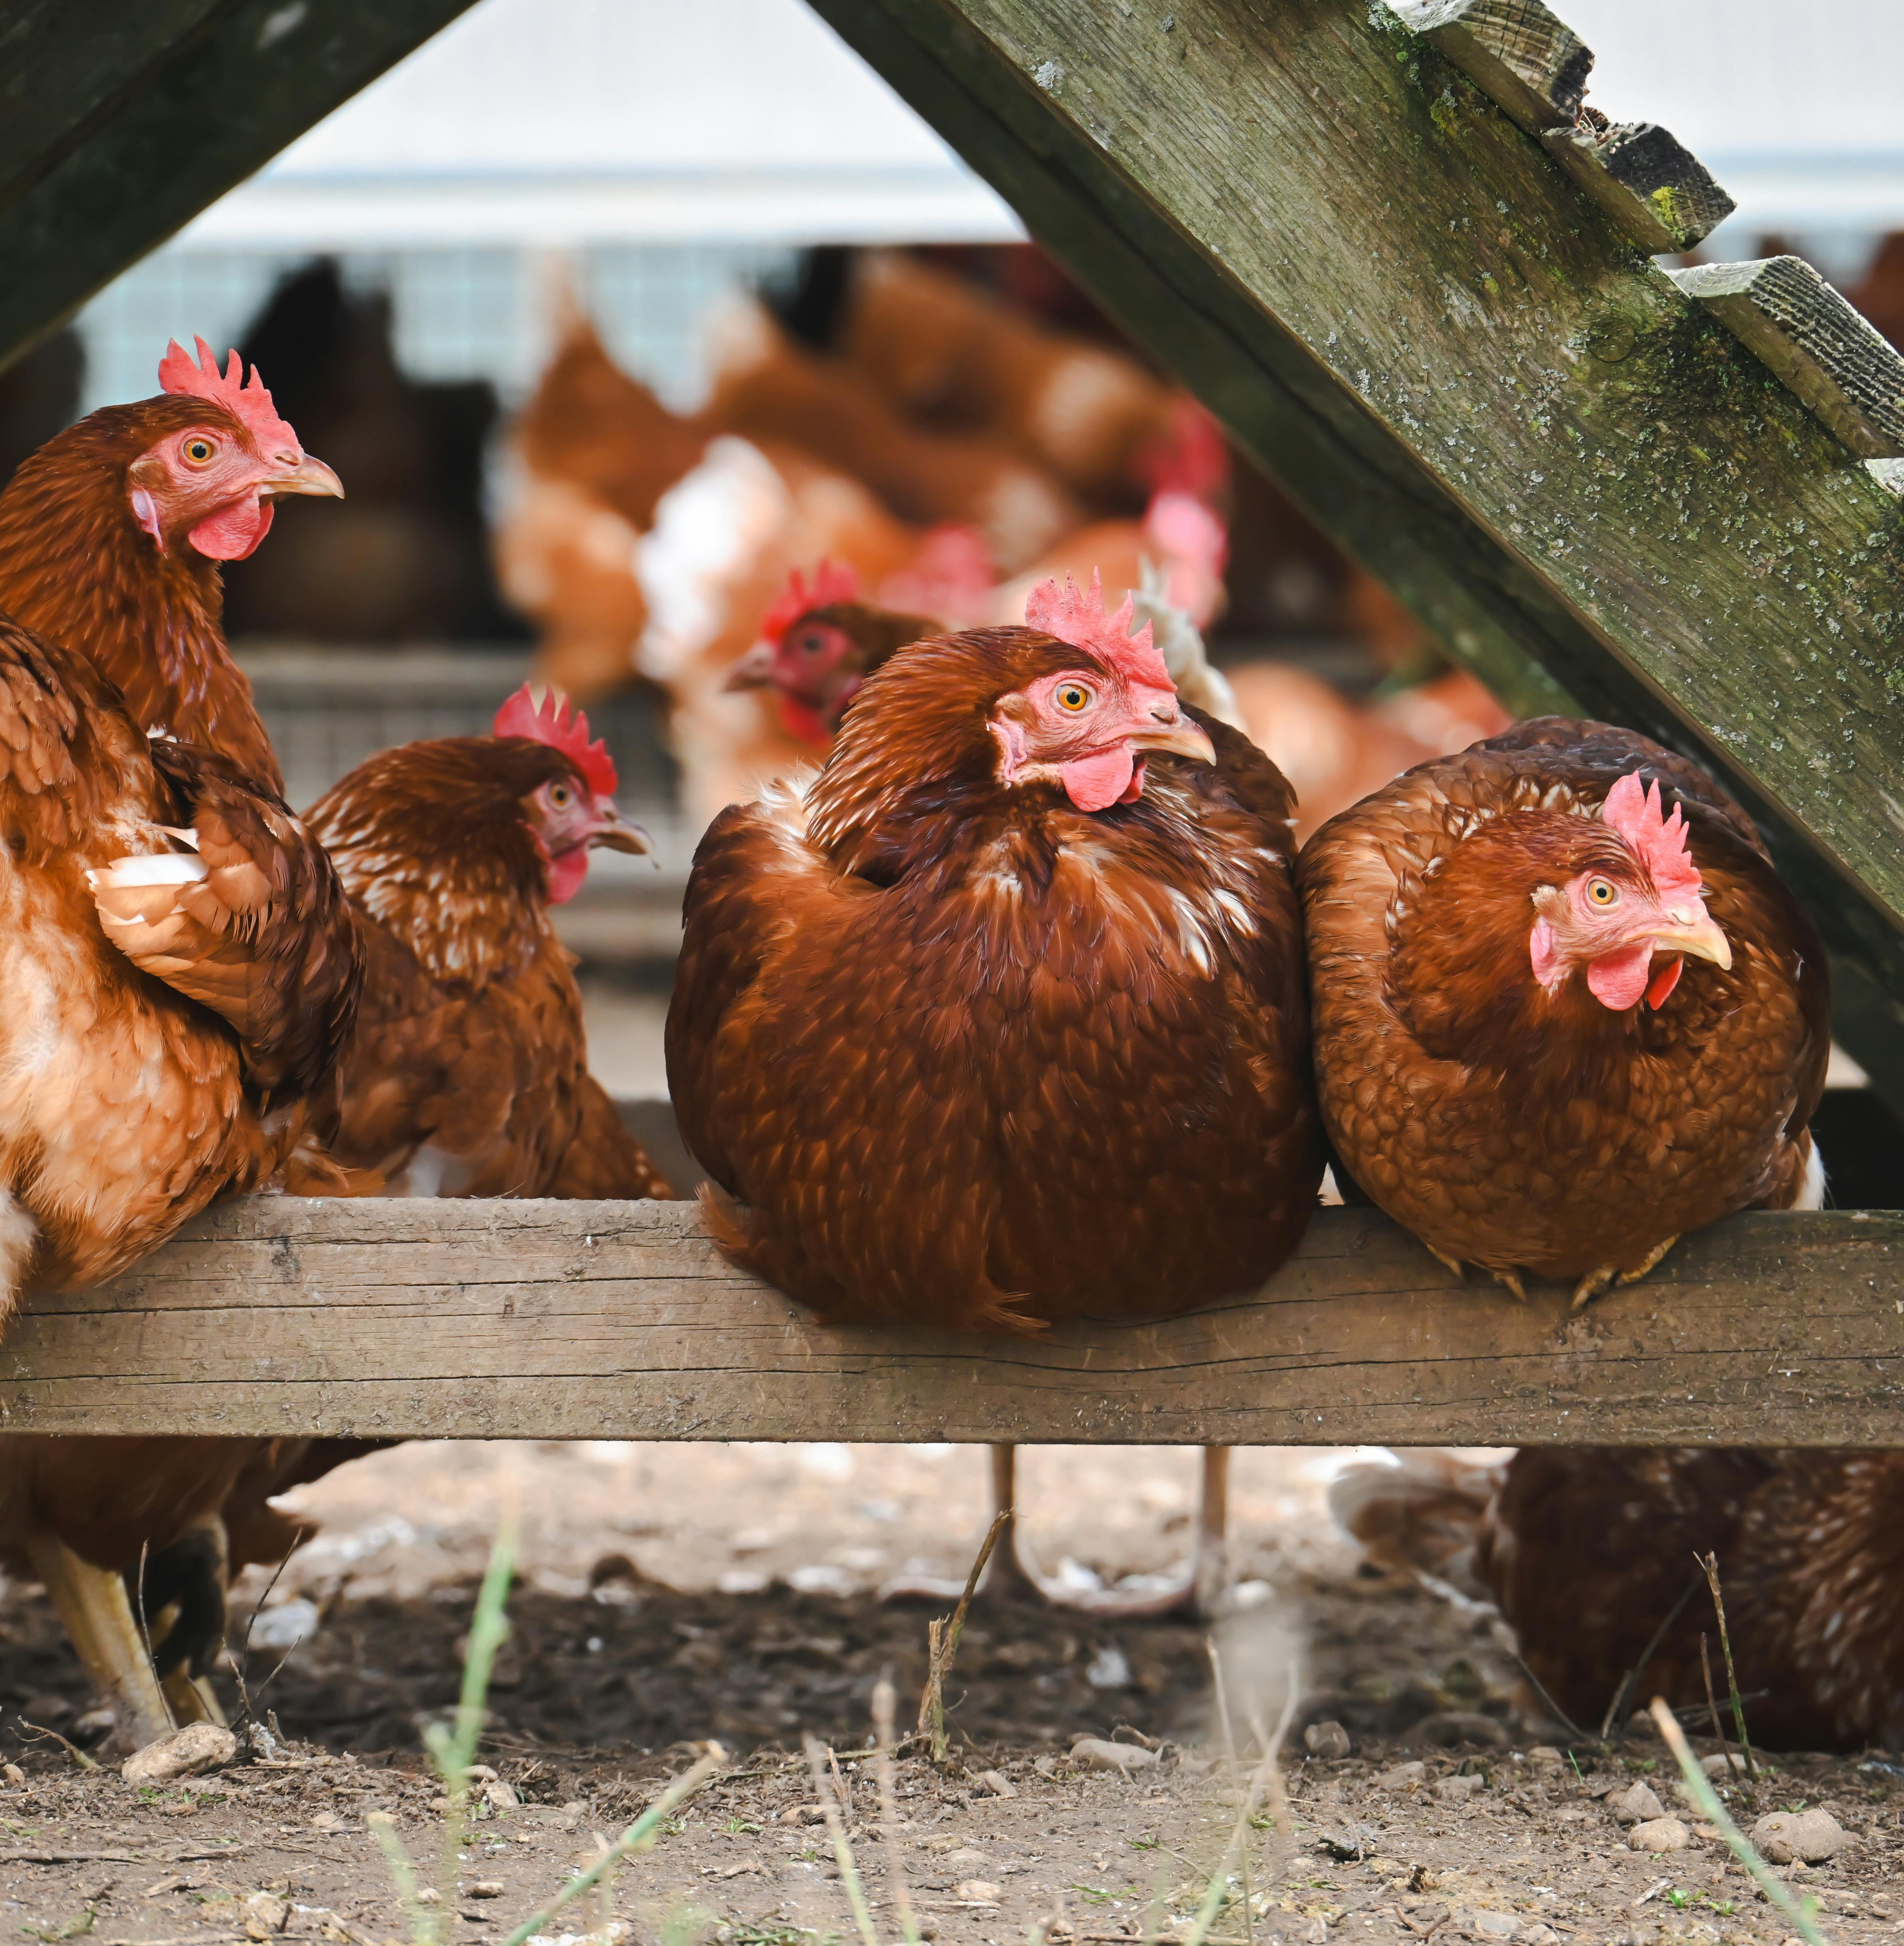
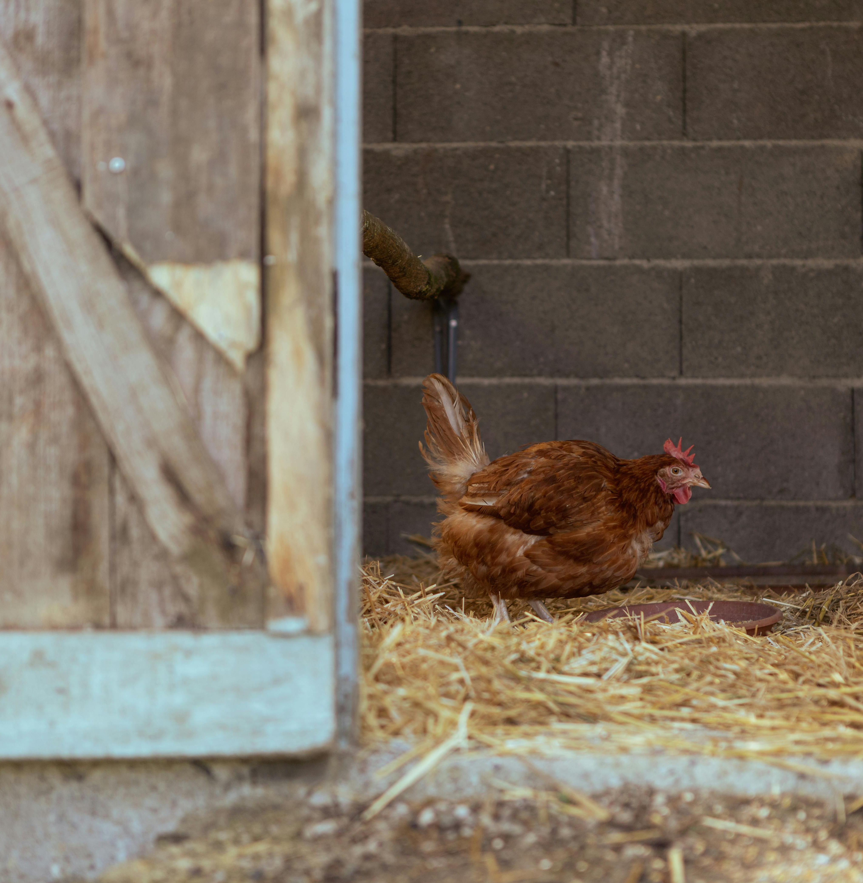
What do hens need to live well?
To live well, hens need…
Water
Shelter
Food
Space
Care
Healthy food helps keep them strong. ​
Clean, fresh water every day.
Room to walk and stretch their wings.
A safe place to rest and lay eggs. ​
People who look after and care for them. ​

Slide 6
What do hens need to live well?
To live well, hens need…
Healthy food helps keep them strong. ​
Clean, fresh water every day.
Room to walk and stretch their wings.
A safe place to rest and lay eggs. ​
People who look after and care for them. ​

Slide 7
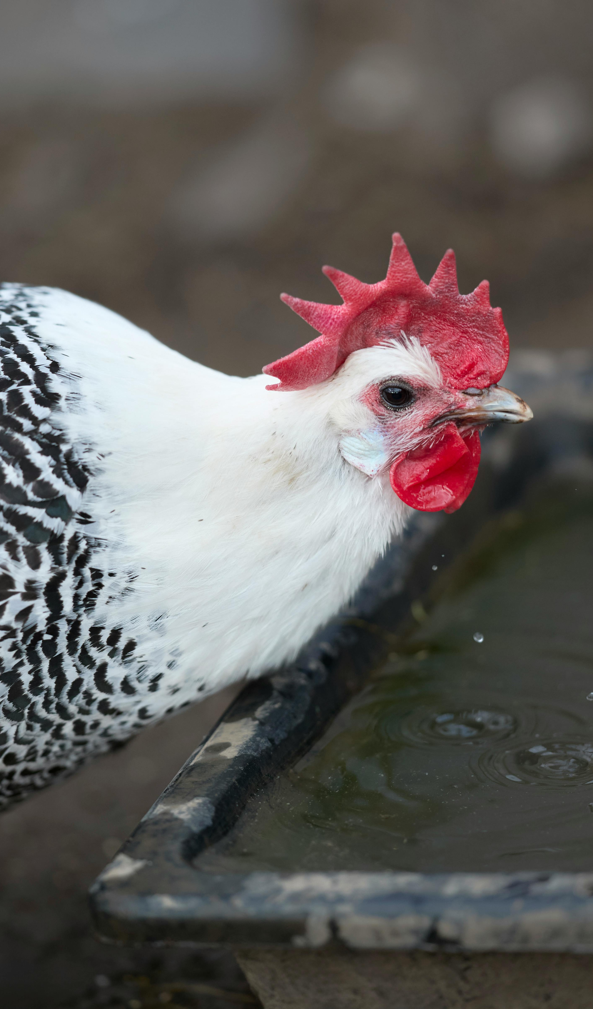
Welfare can be different
Most farmers want to look after hens well, but sadly some hens haven't always had enough space or the right care. When hens don't get enough space, food or care, they can't live as well as they should.
Why is it important that hens have enough space and care?

Slide 8
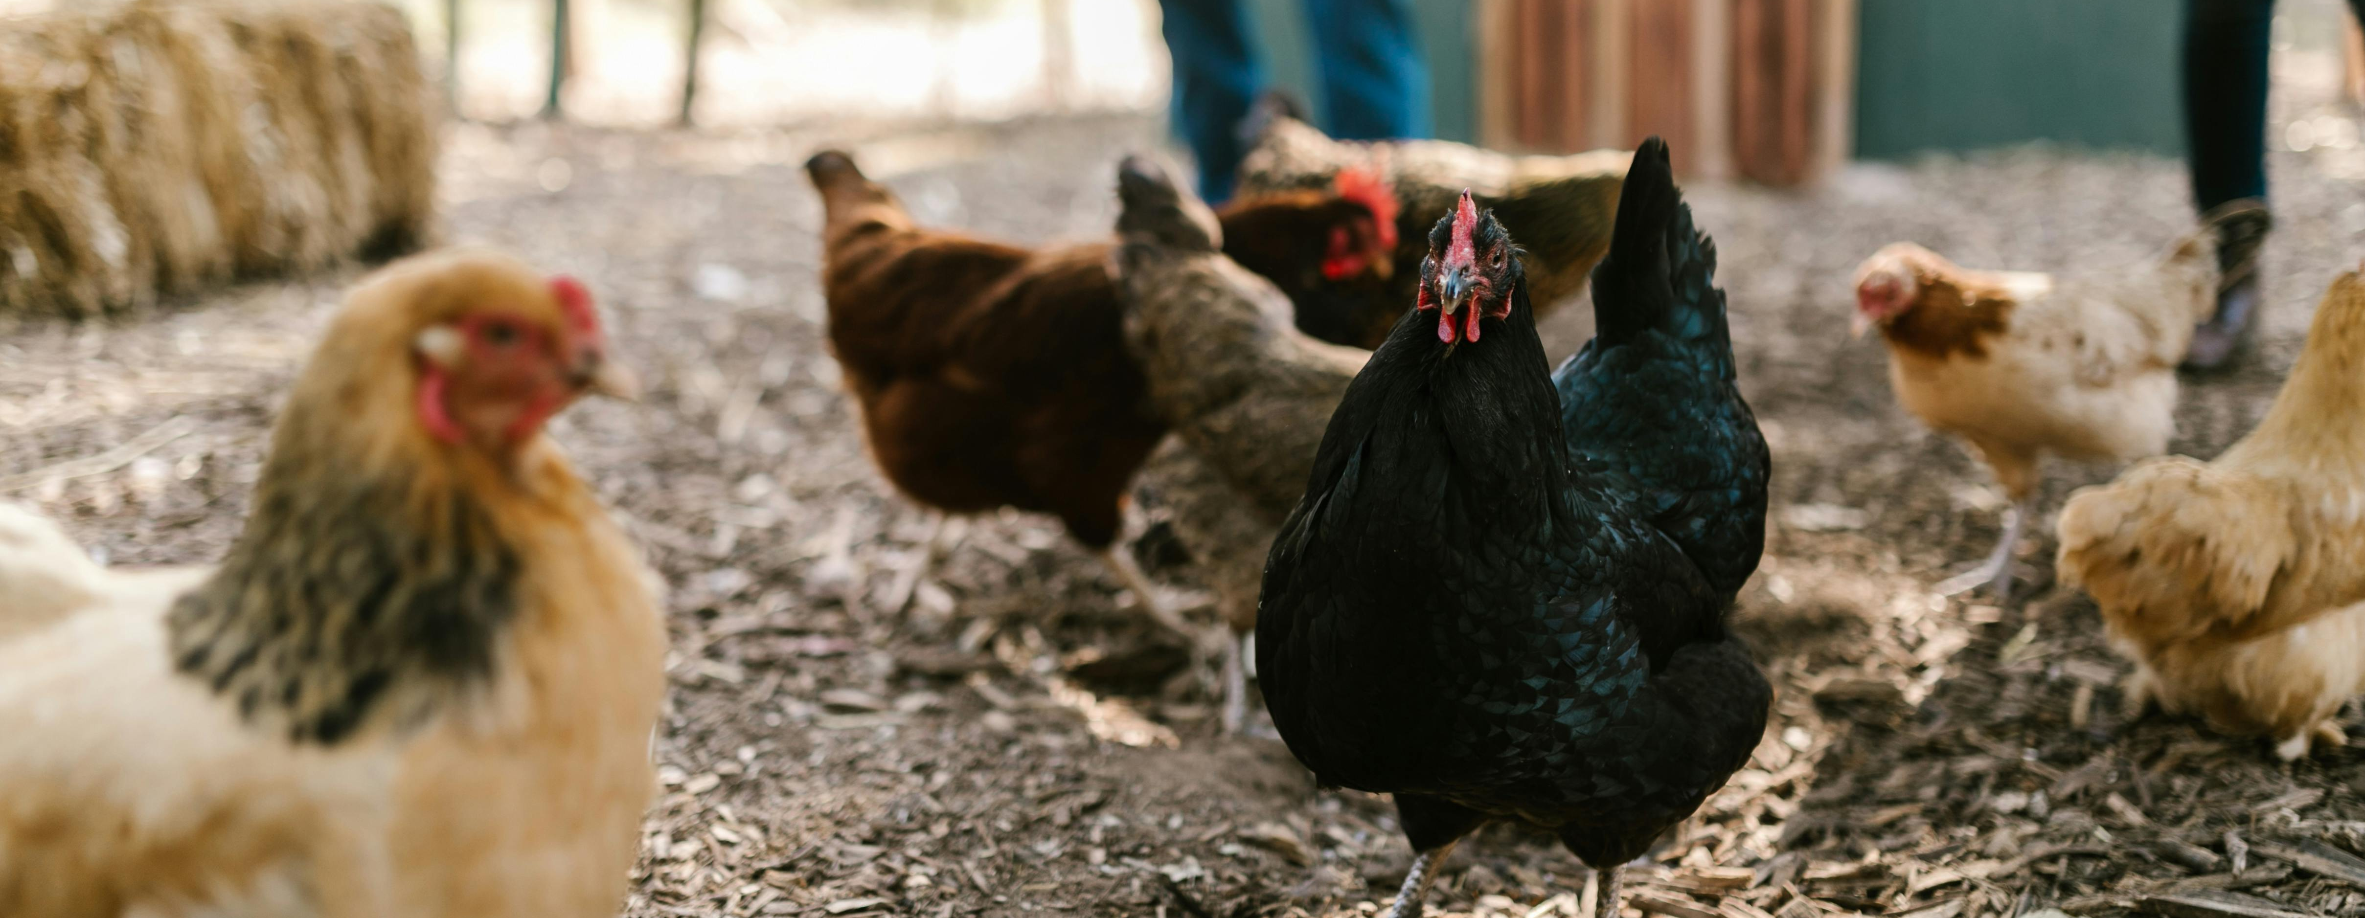
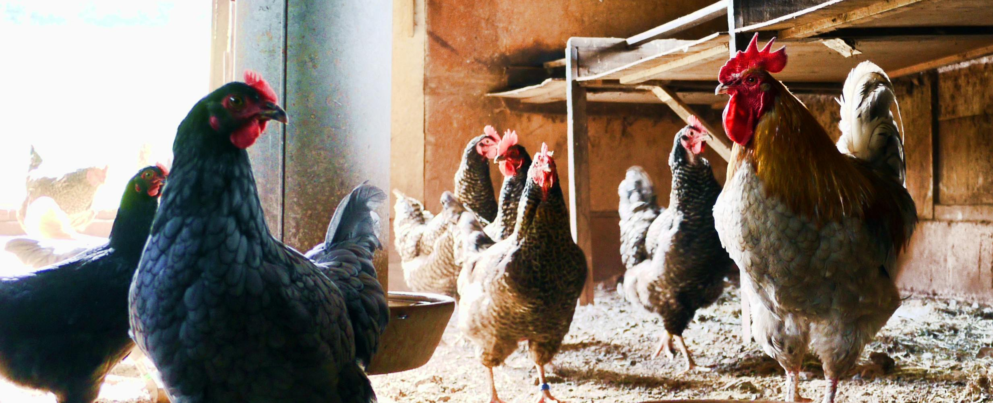
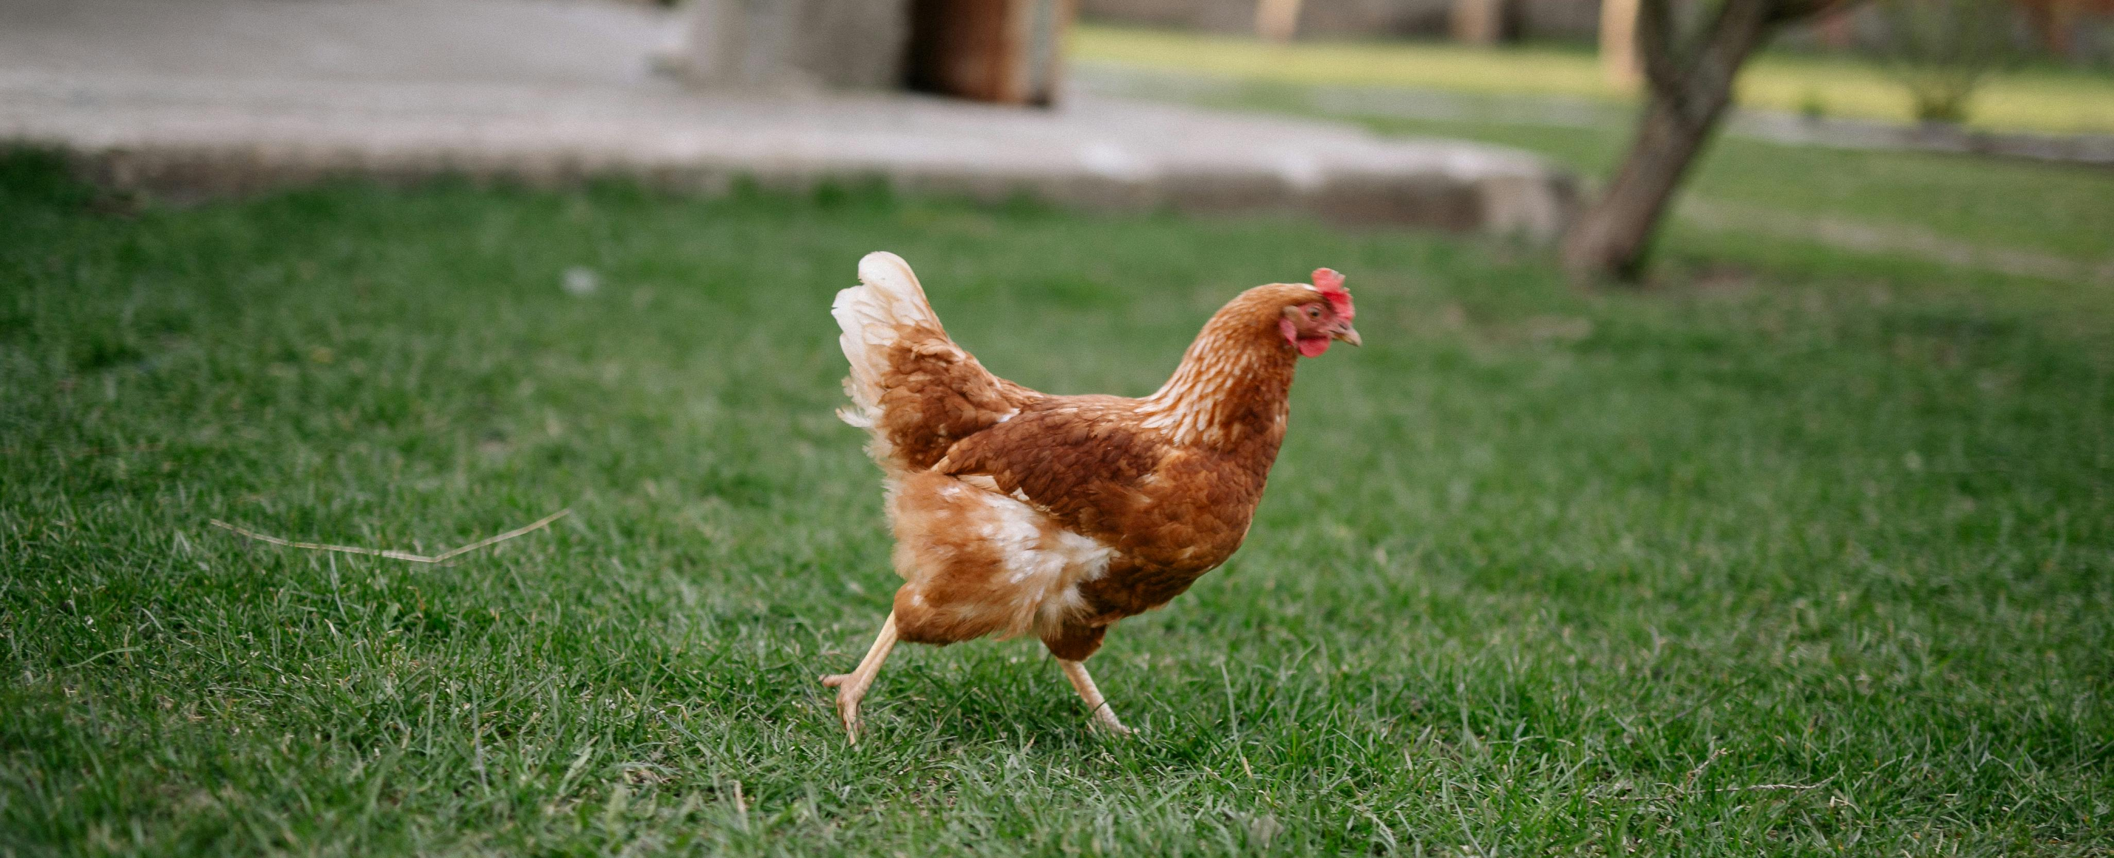
What makes a good hen home?
Hens need food, water, shelter, space to move and places to rest.
A good hen home keeps hens safe, healthy and comfortable.
Different approved farming systems meet these needs in different ways.

Slide 9
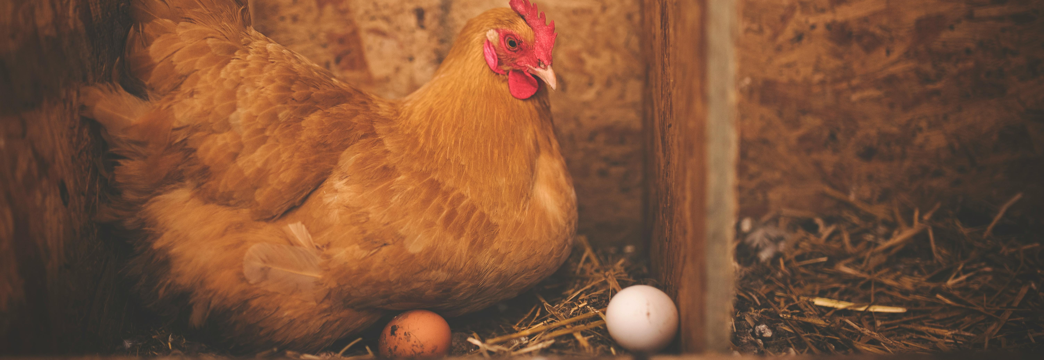
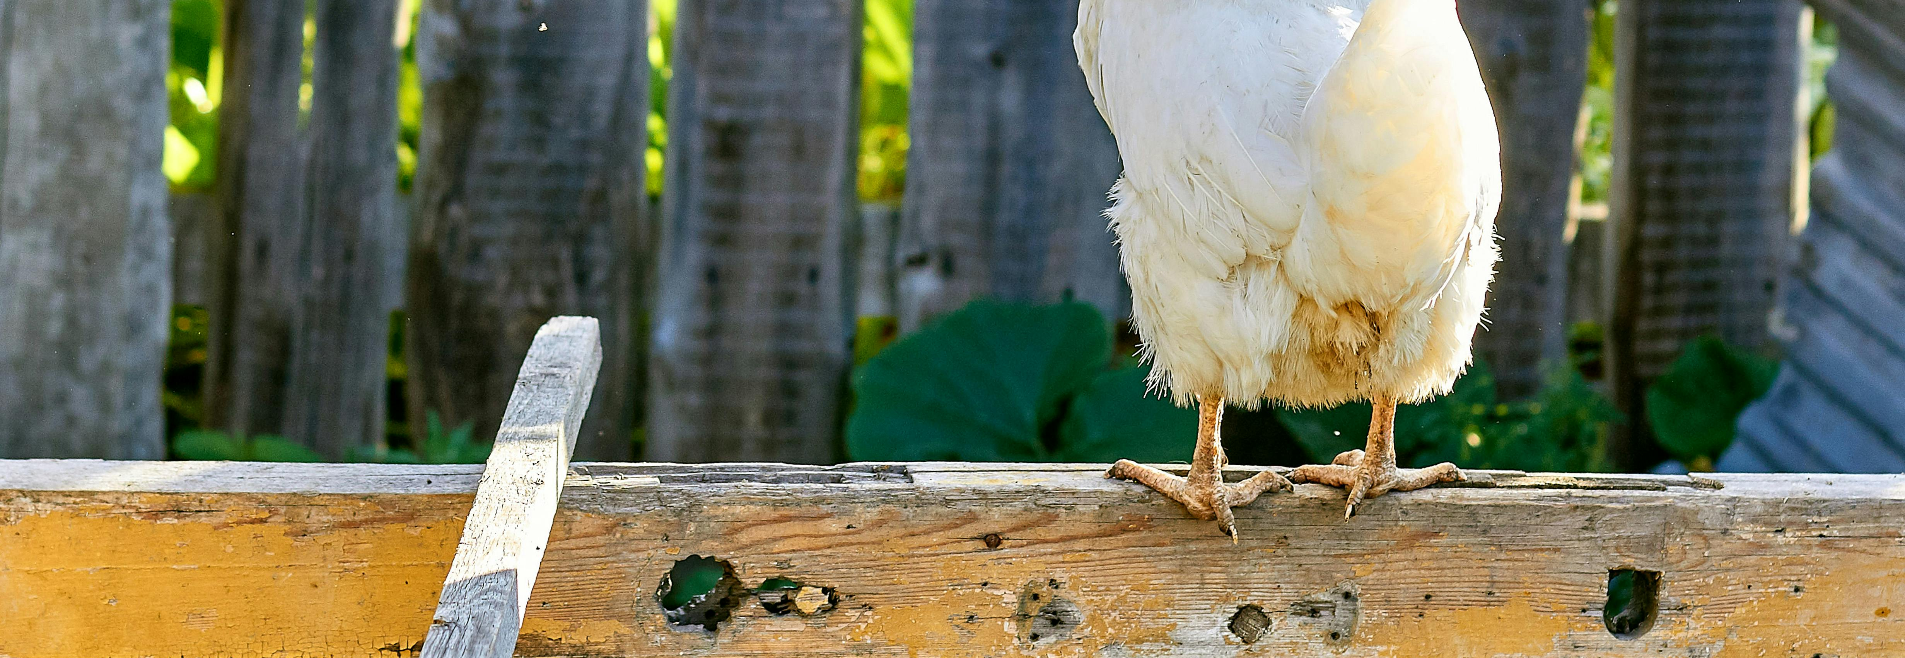
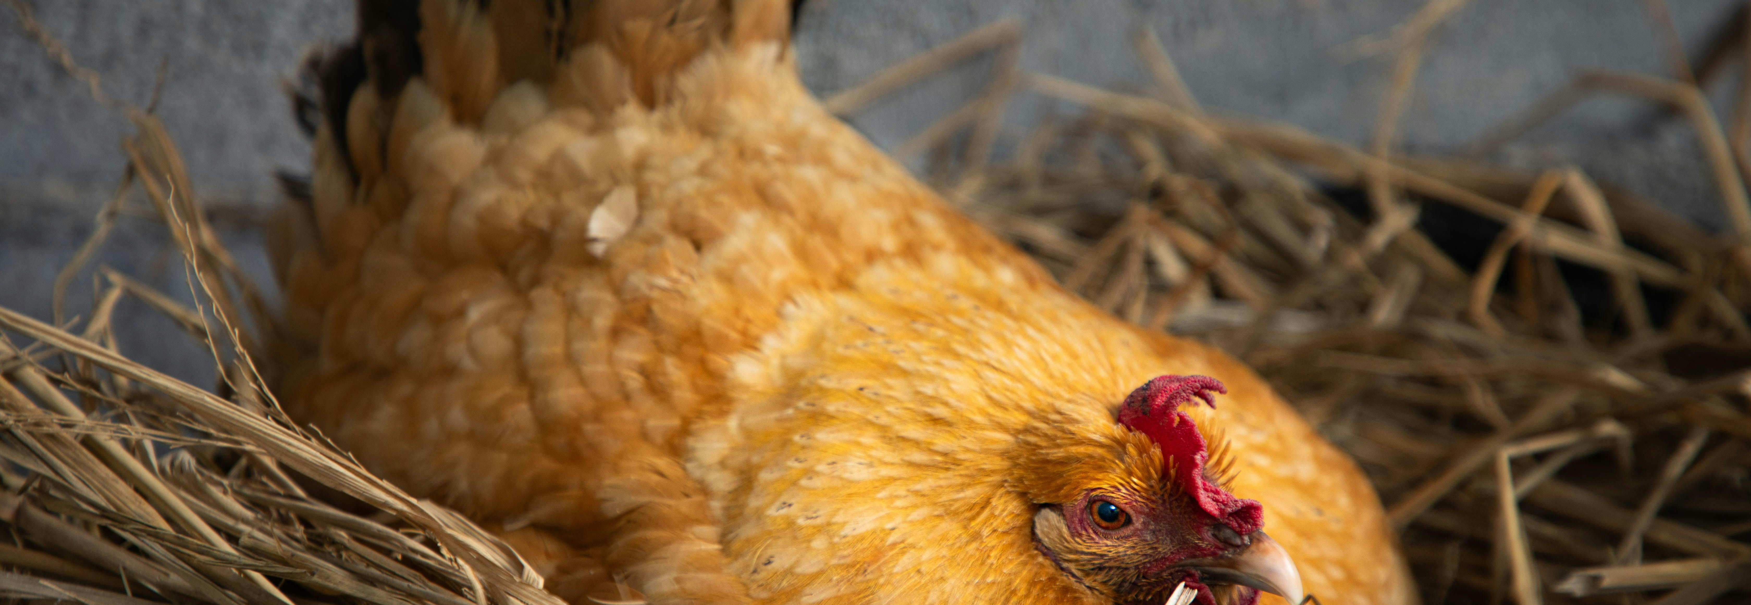
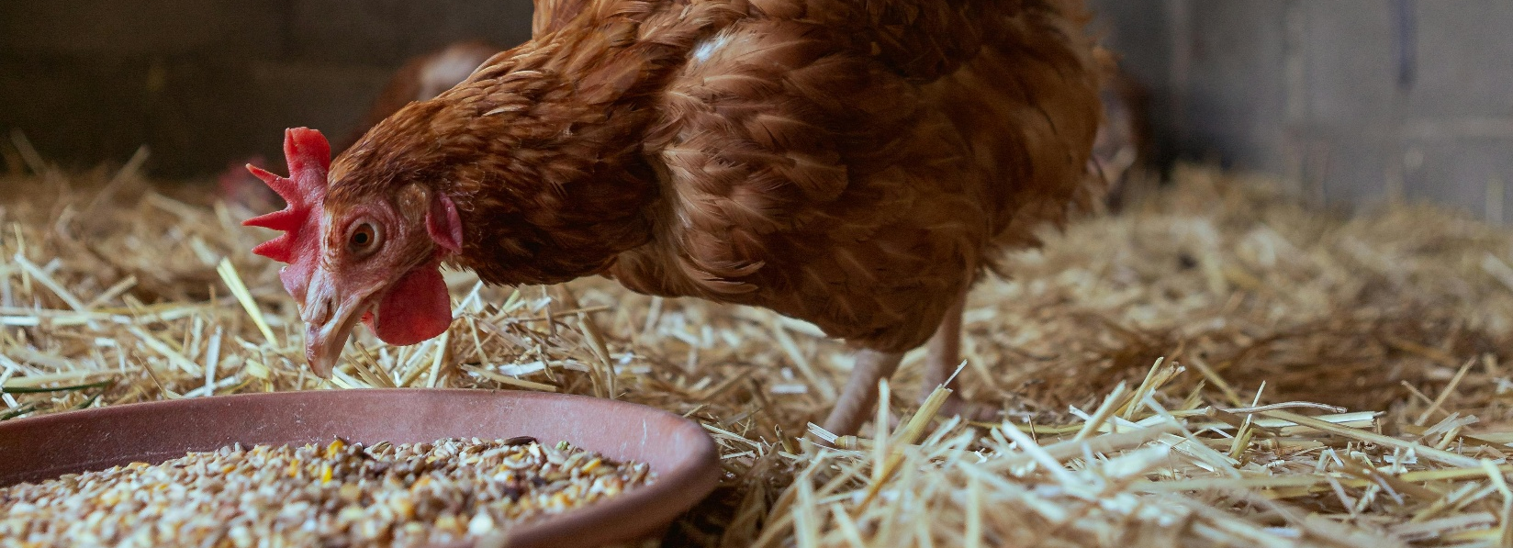
What makes a good hen home?
Inside the hen home there should be:
Nest boxes
Nest boxes are quiet, cosy spaces where hens can lay their eggs comfortably.
Perches
Hens like to sleep off the ground. Perches give them a place to rest safely at night.
Clean litter for scratching and dust bathing
Materials like straw or wood shavings let hens scratch, explore and clean their feathers by dust bathing.
Access to fresh food and clean water
Hens need clean water to drink and nutritious food every day to stay healthy and have energy.

Slide 10
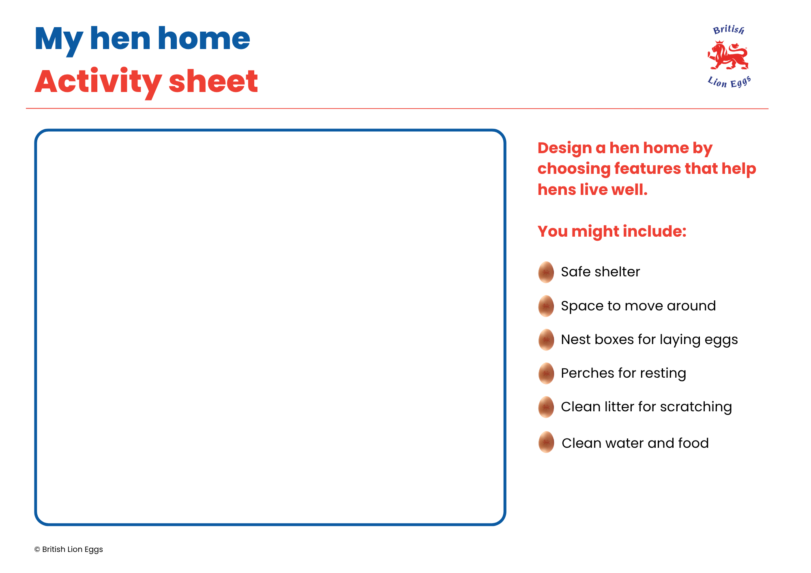
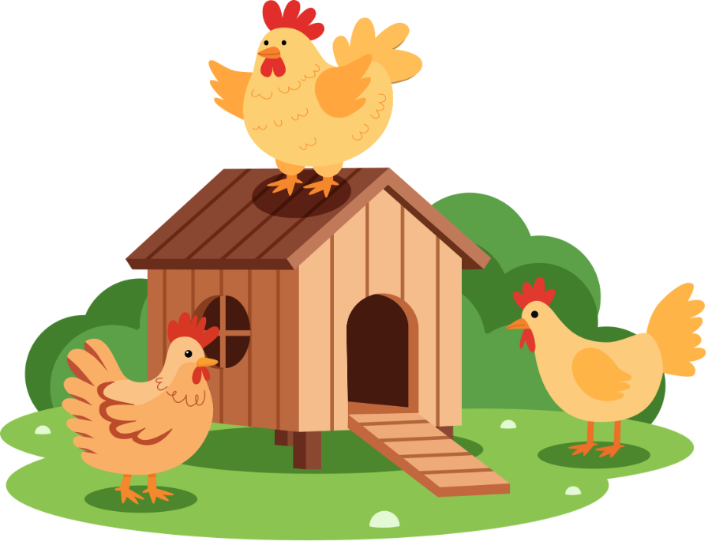
Design a hen home
All approved farming systems meet hens’ welfare needs, but they do this in different ways.
Include features that help hens stay healthy, safe and comfortable, such as food, water, shelter, space to move and places to rest.
Some systems also provide outdoor areas, but not all do.
Design a place where hens can live. Make sure to include the things we have said help hens to live well.
Reptiles​
Reptile eggs all come in different shapes and sizes. Some reptiles lay their eggs in snd or soil, but some hide them underground to keep them safe. Crocodiles guard their eggs fiercely, unlike other reptiles!

Slide 11
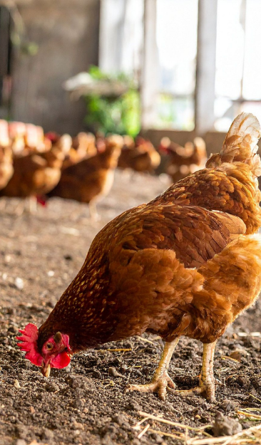
Why hen welfare matters
Why is it important to care for hens?
How does the British Lion mark show hens are treated well?
What choice can we make when buying eggs?
Caring for all animals is part of being responsible.

Slide 12

Brought to you by

