Slide 1

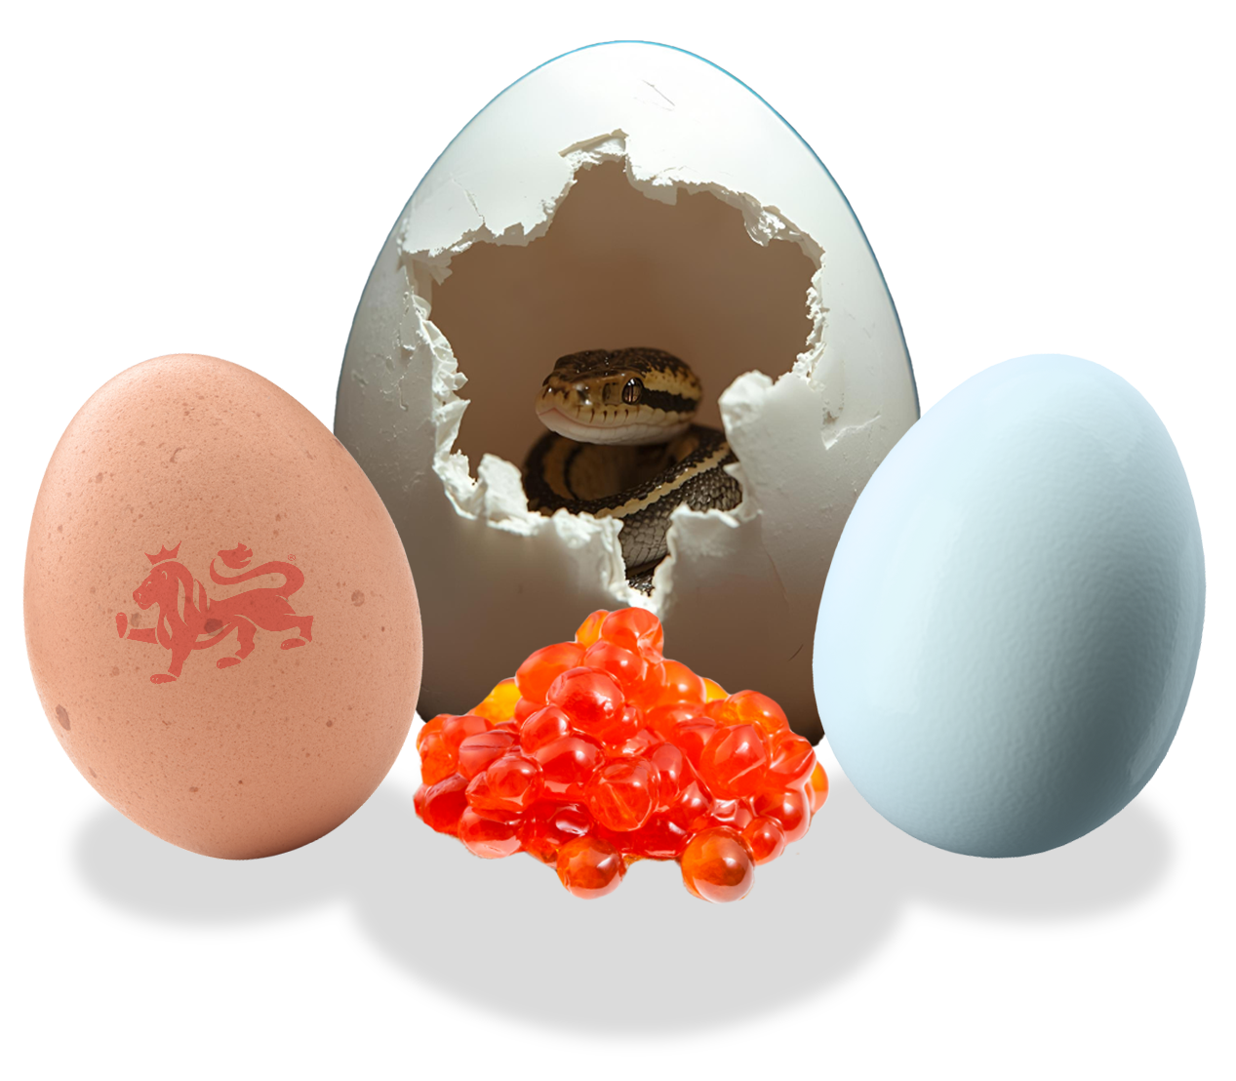
Meet the Egg-layers

Slide 2
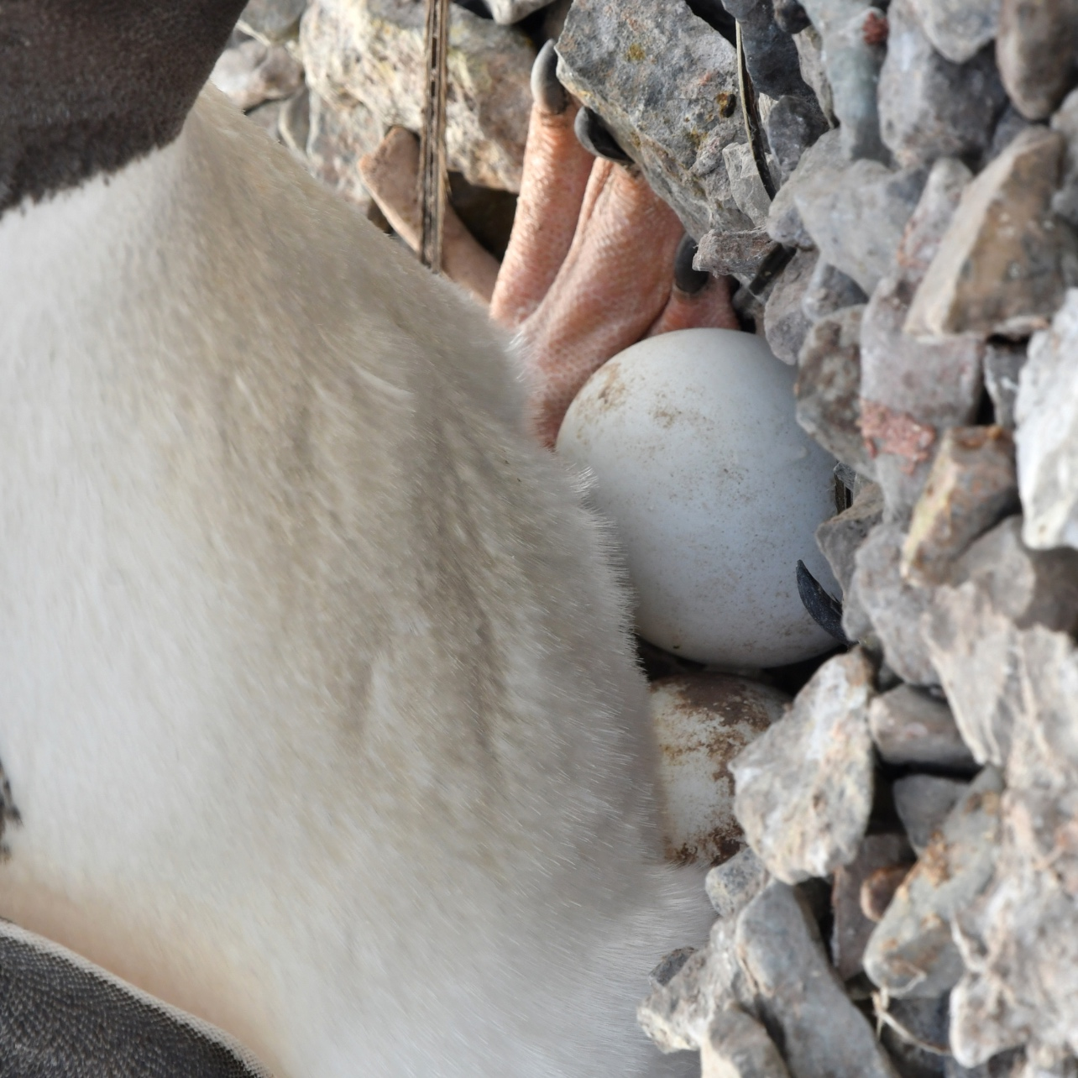
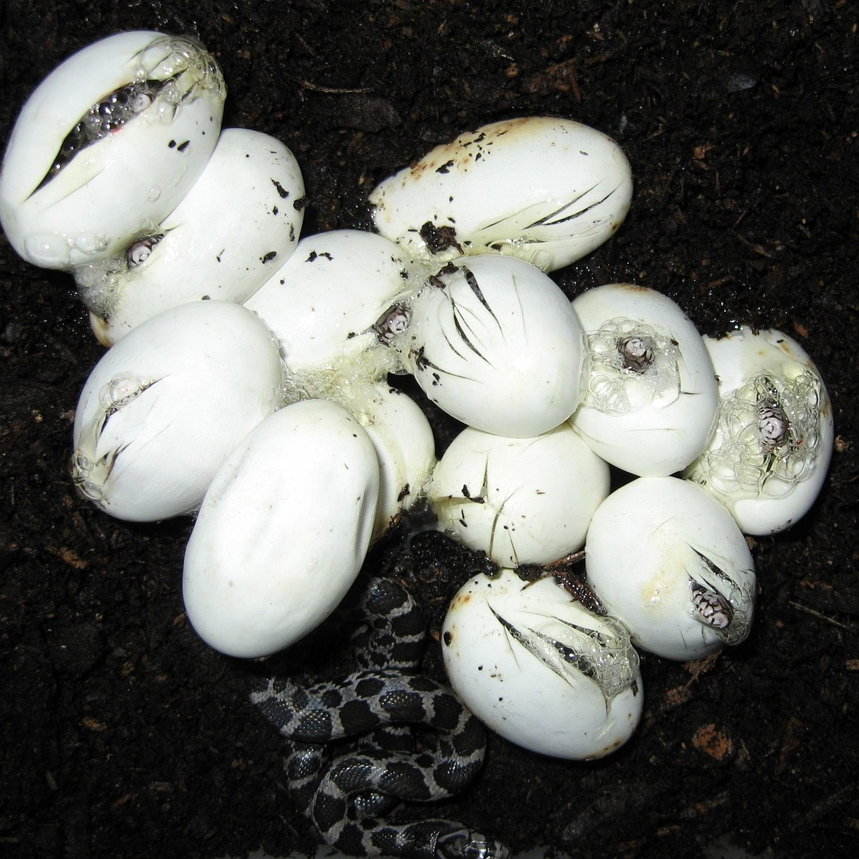
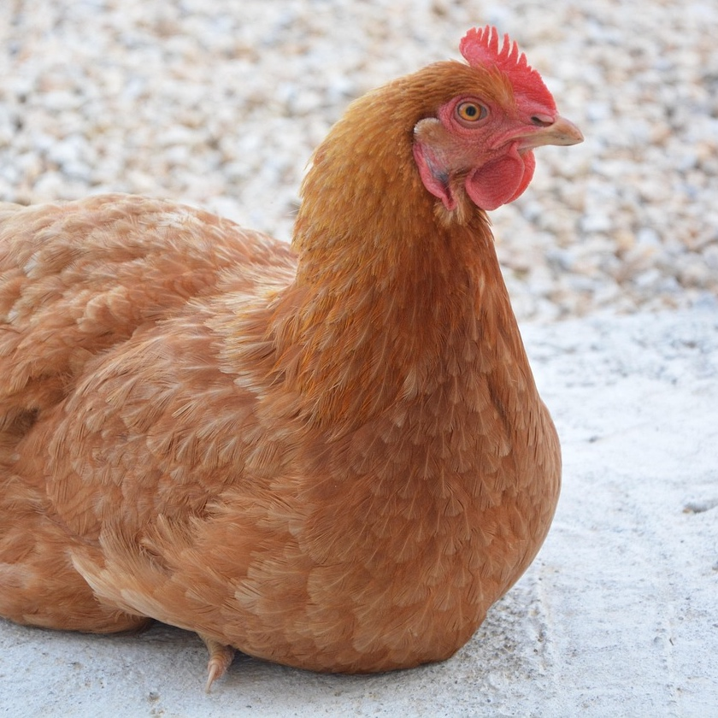
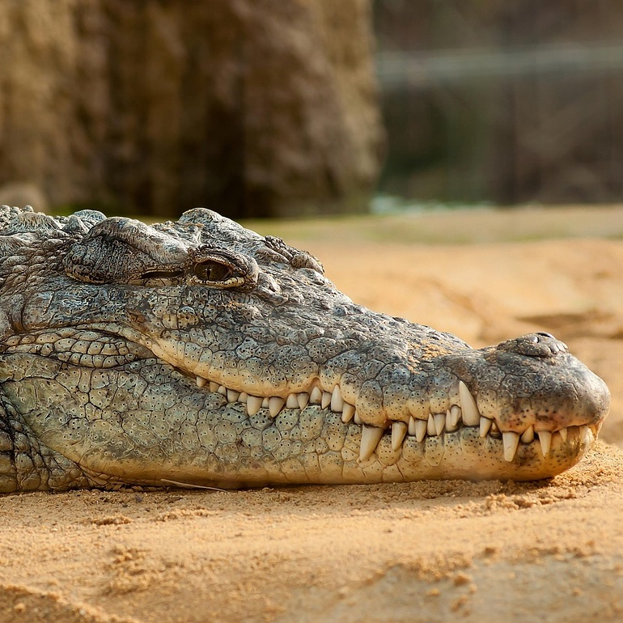
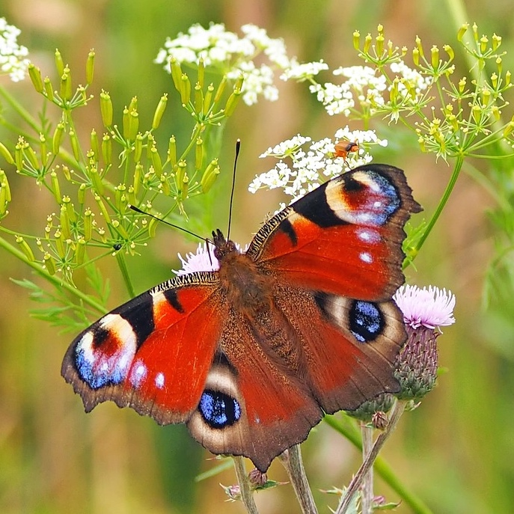
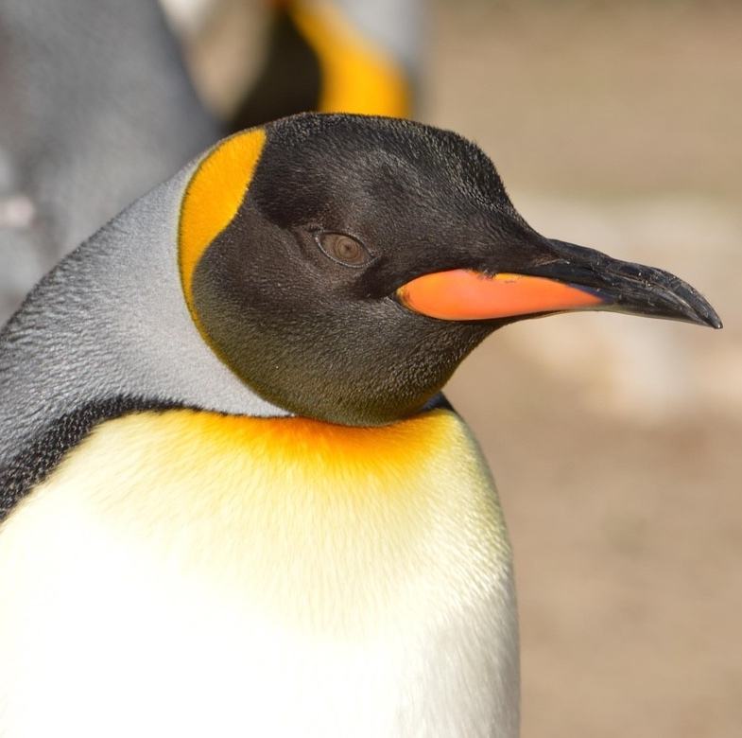
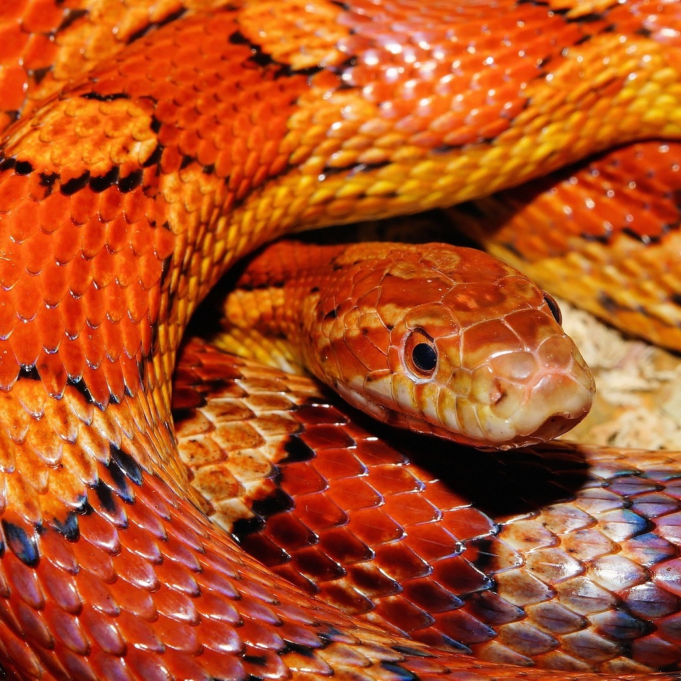

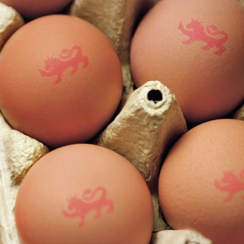
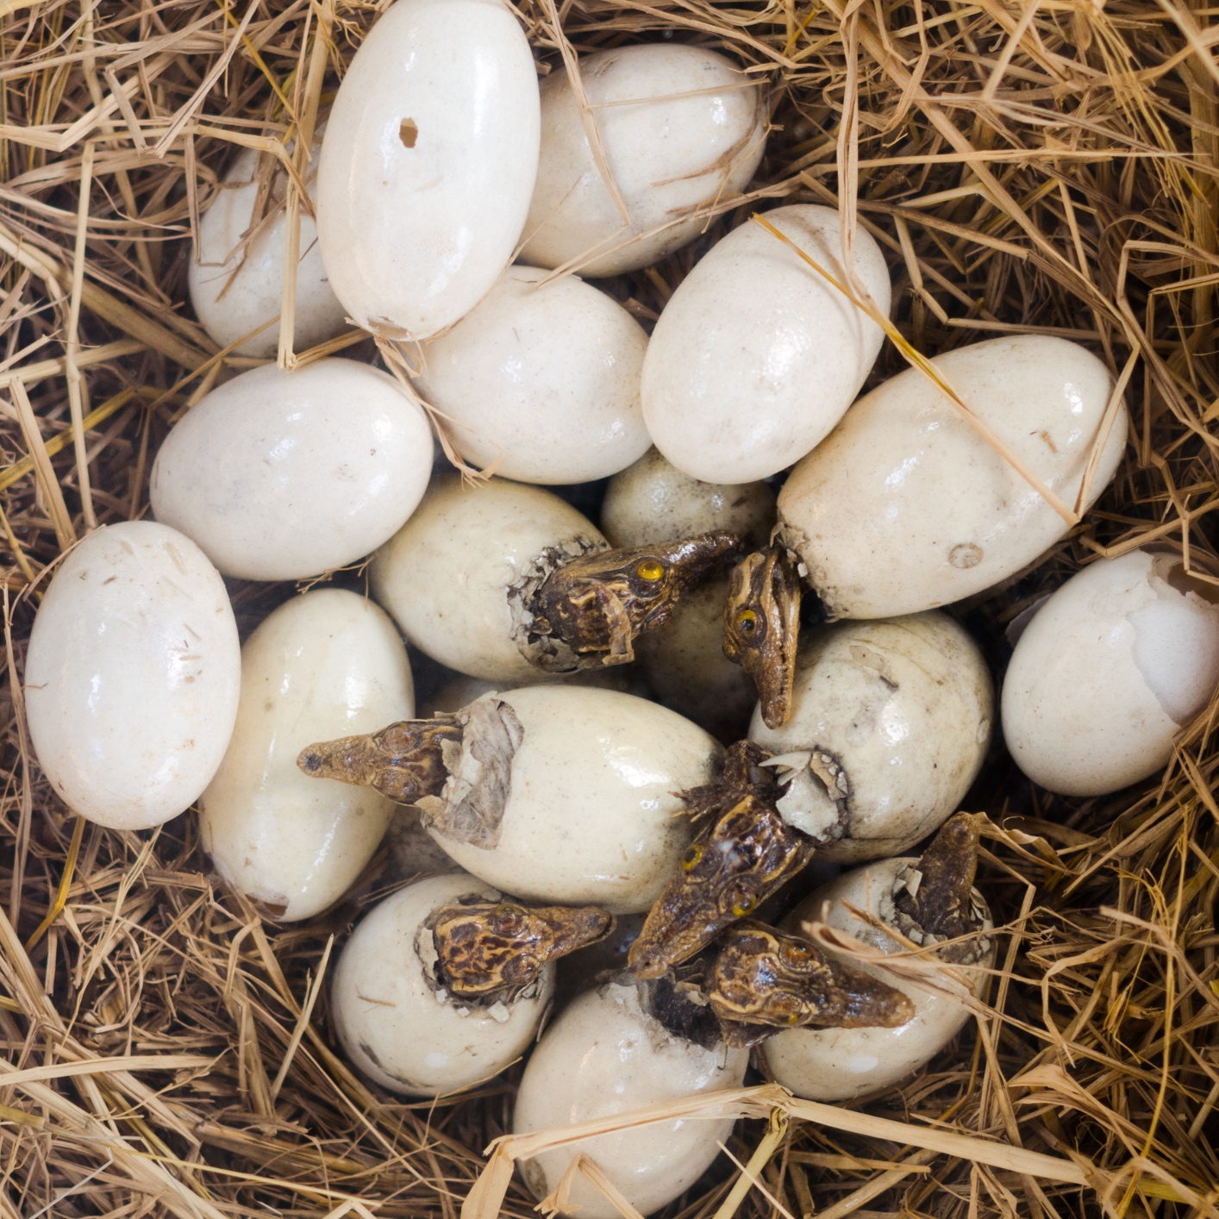
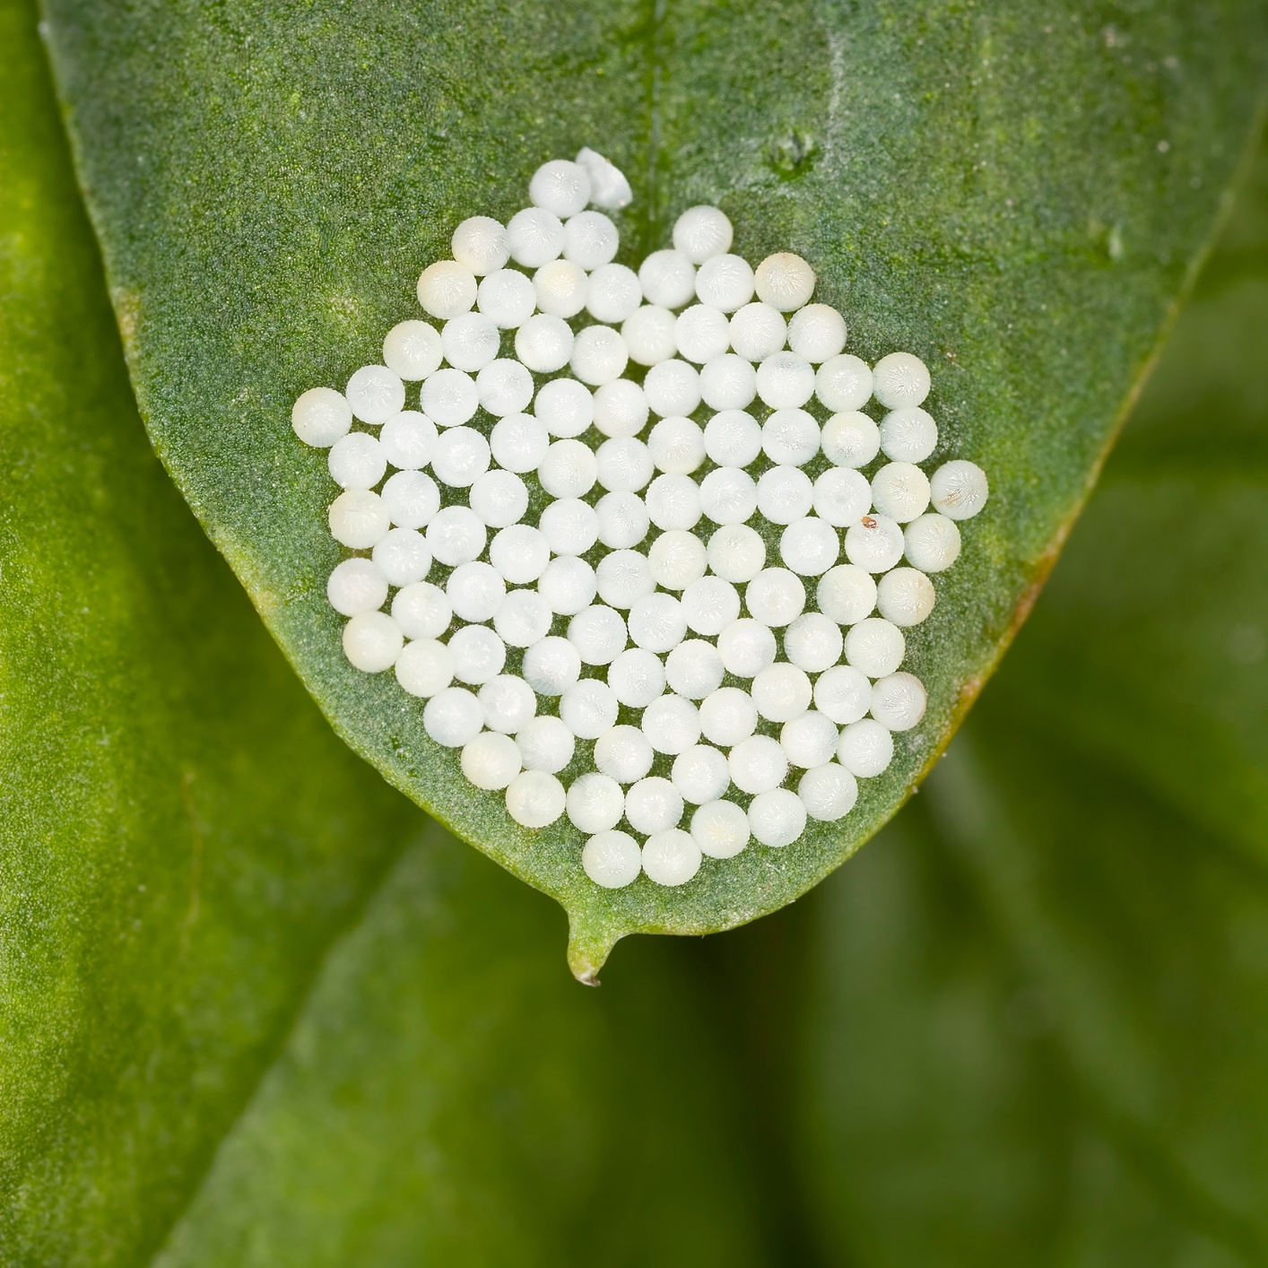
What do all these animals have in common?
Hen
Crocodile
Butterfly
Penguin
Snake

Slide 3
They all lay eggs!
Hen eggs
Crocodile eggs
Butterfly eggs
Penguin egg
Snake eggs

Slide 4
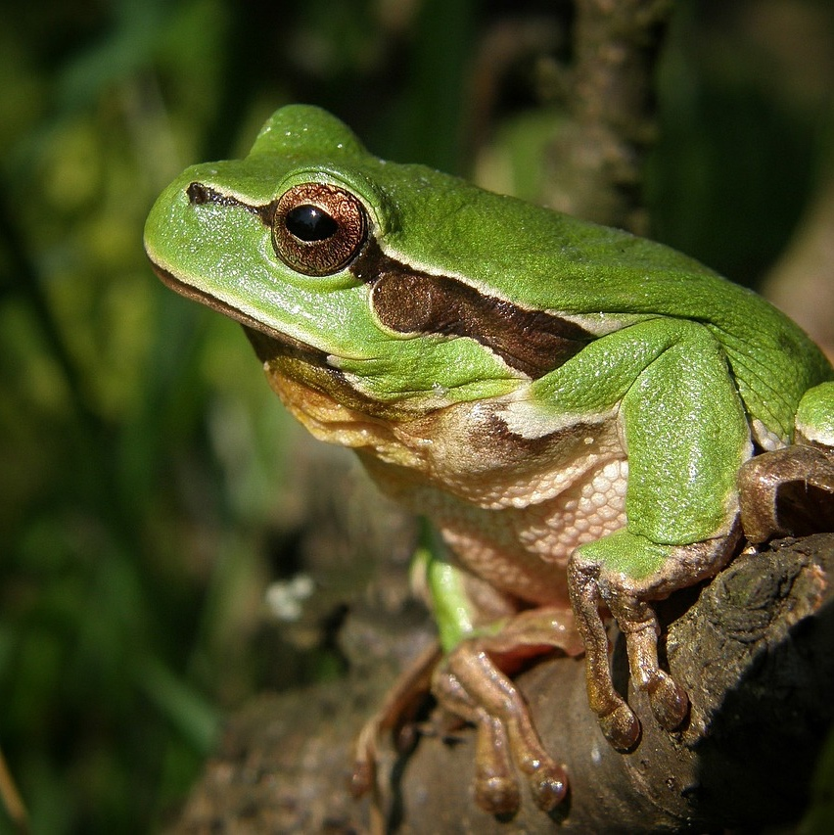
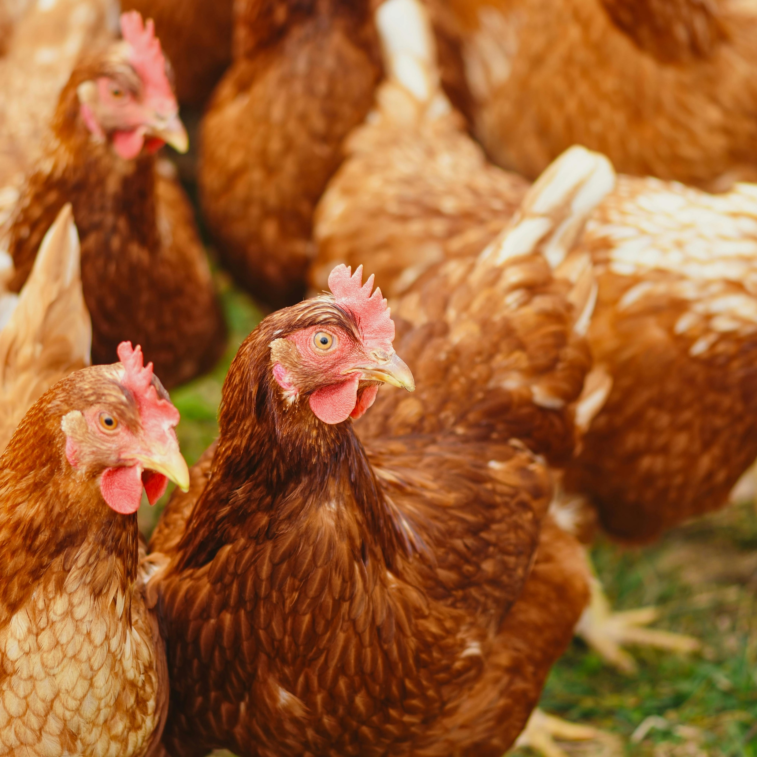
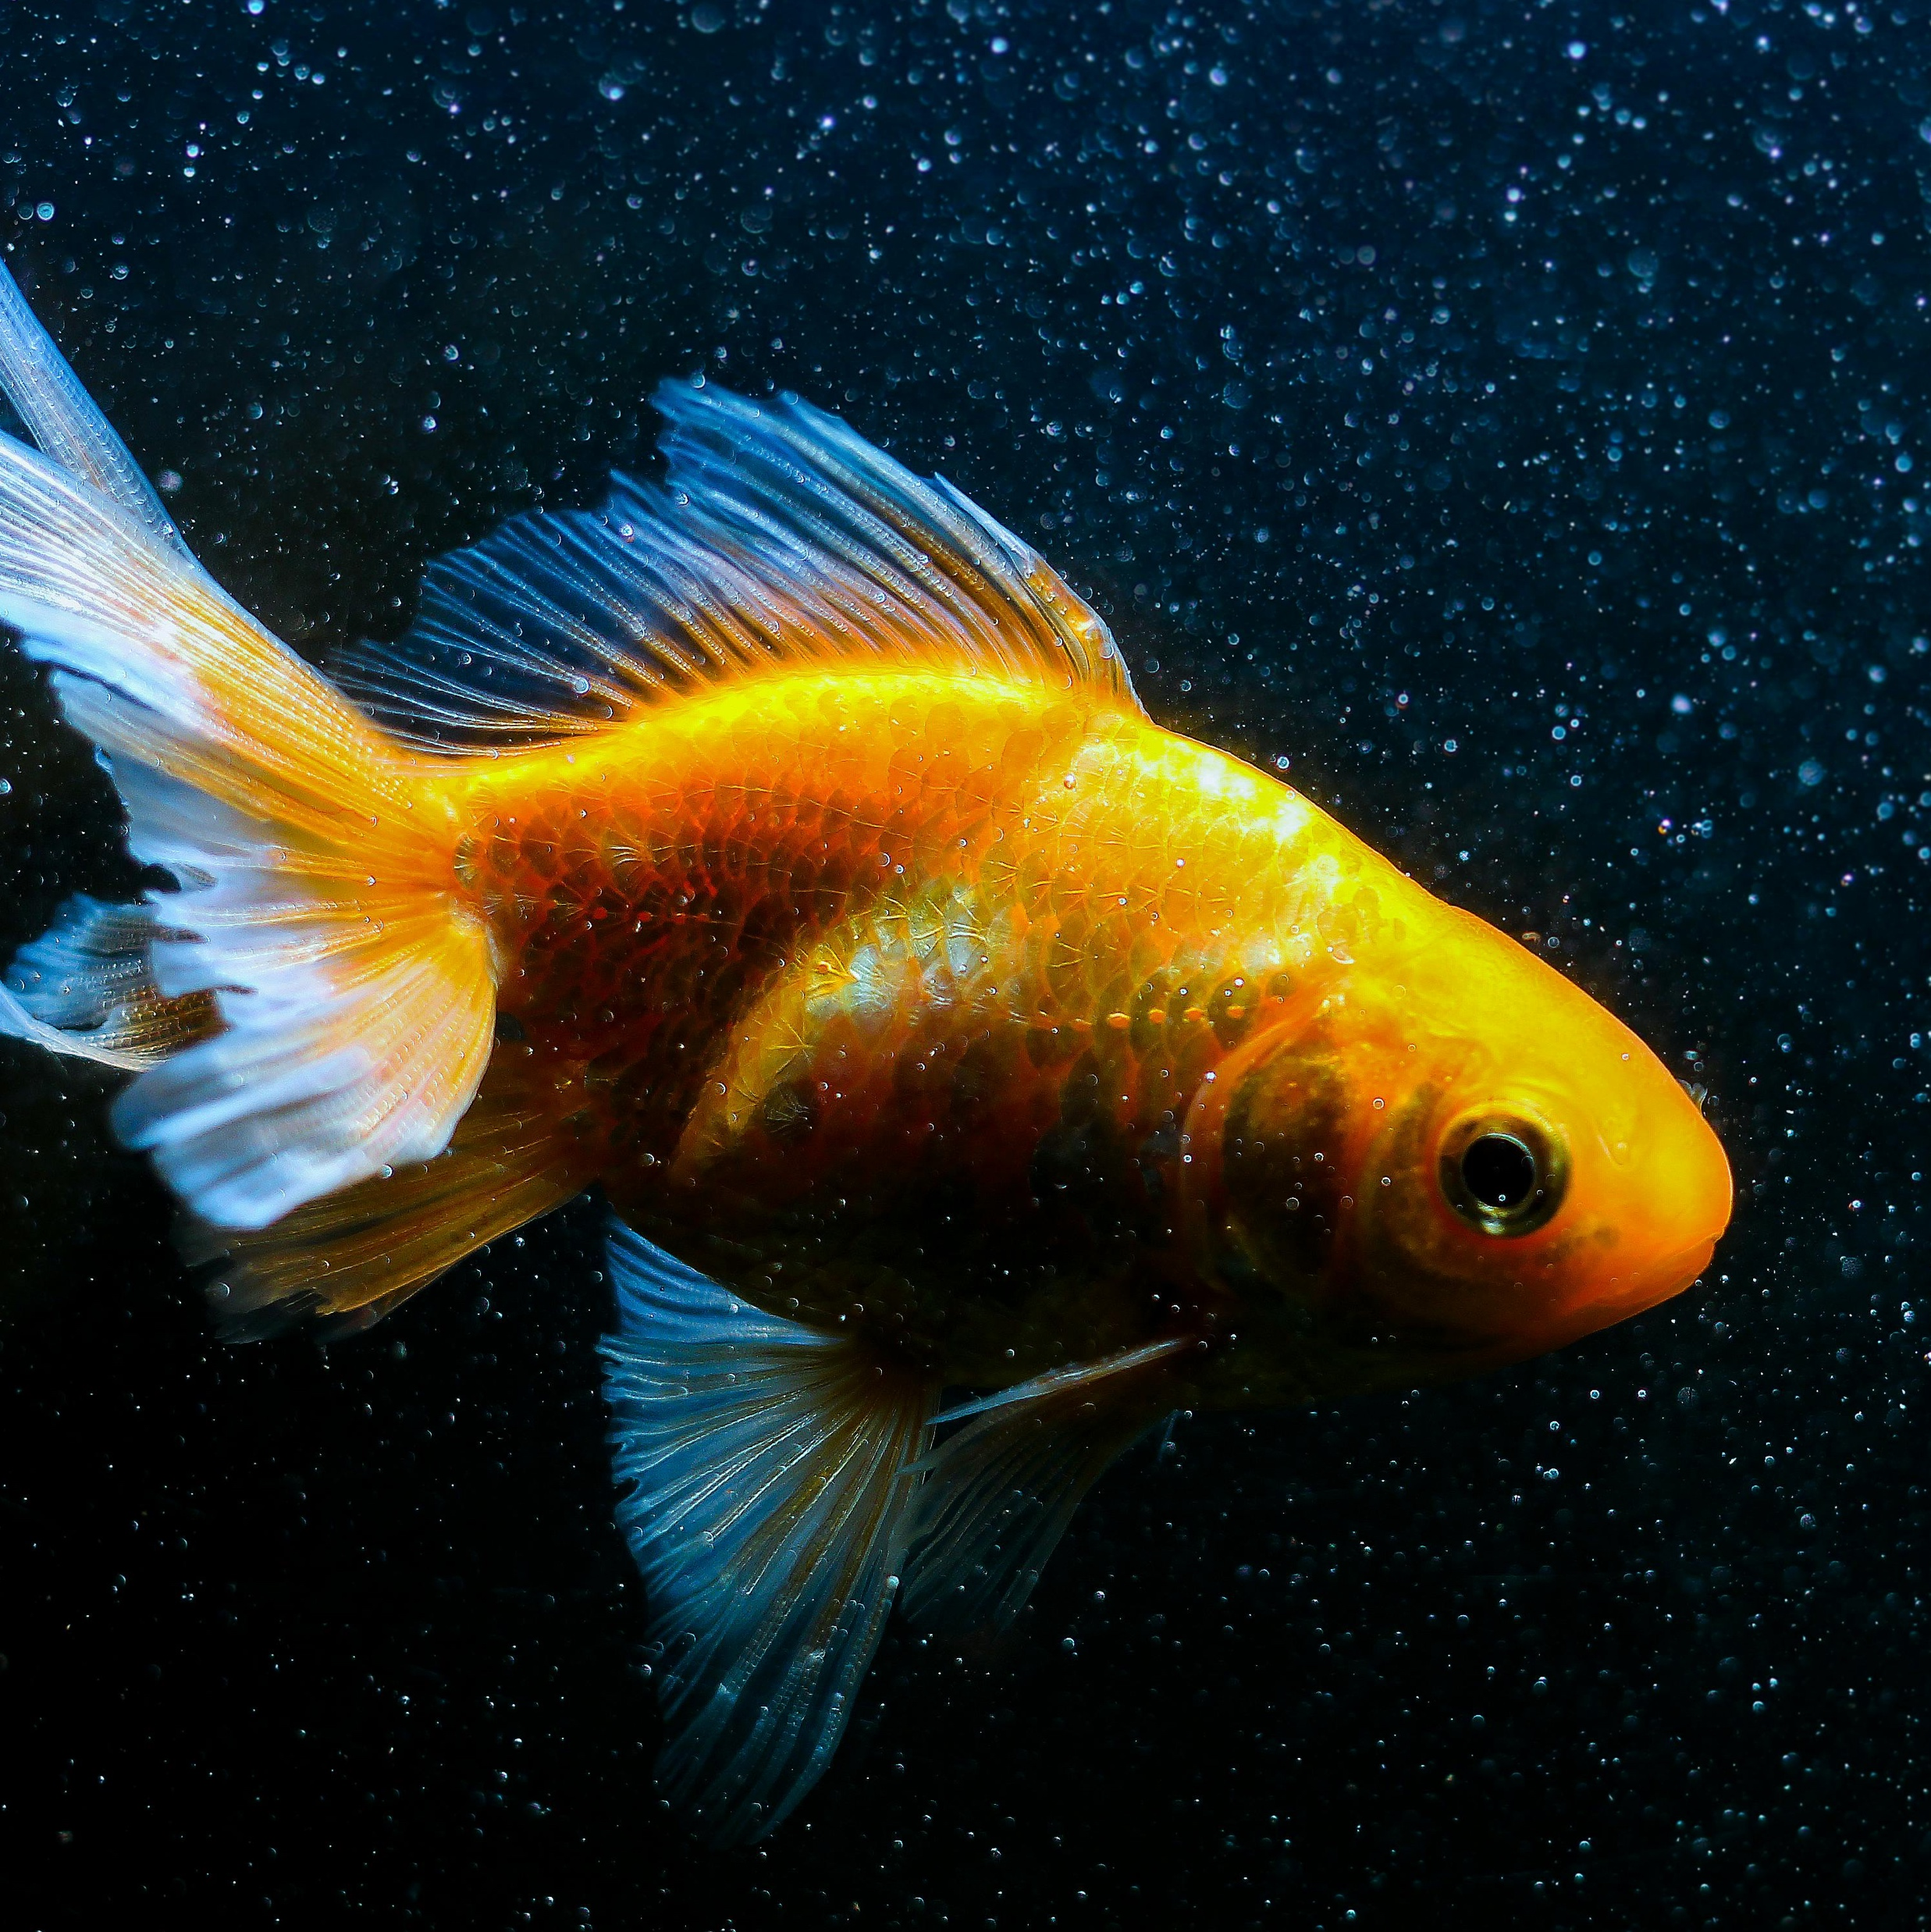
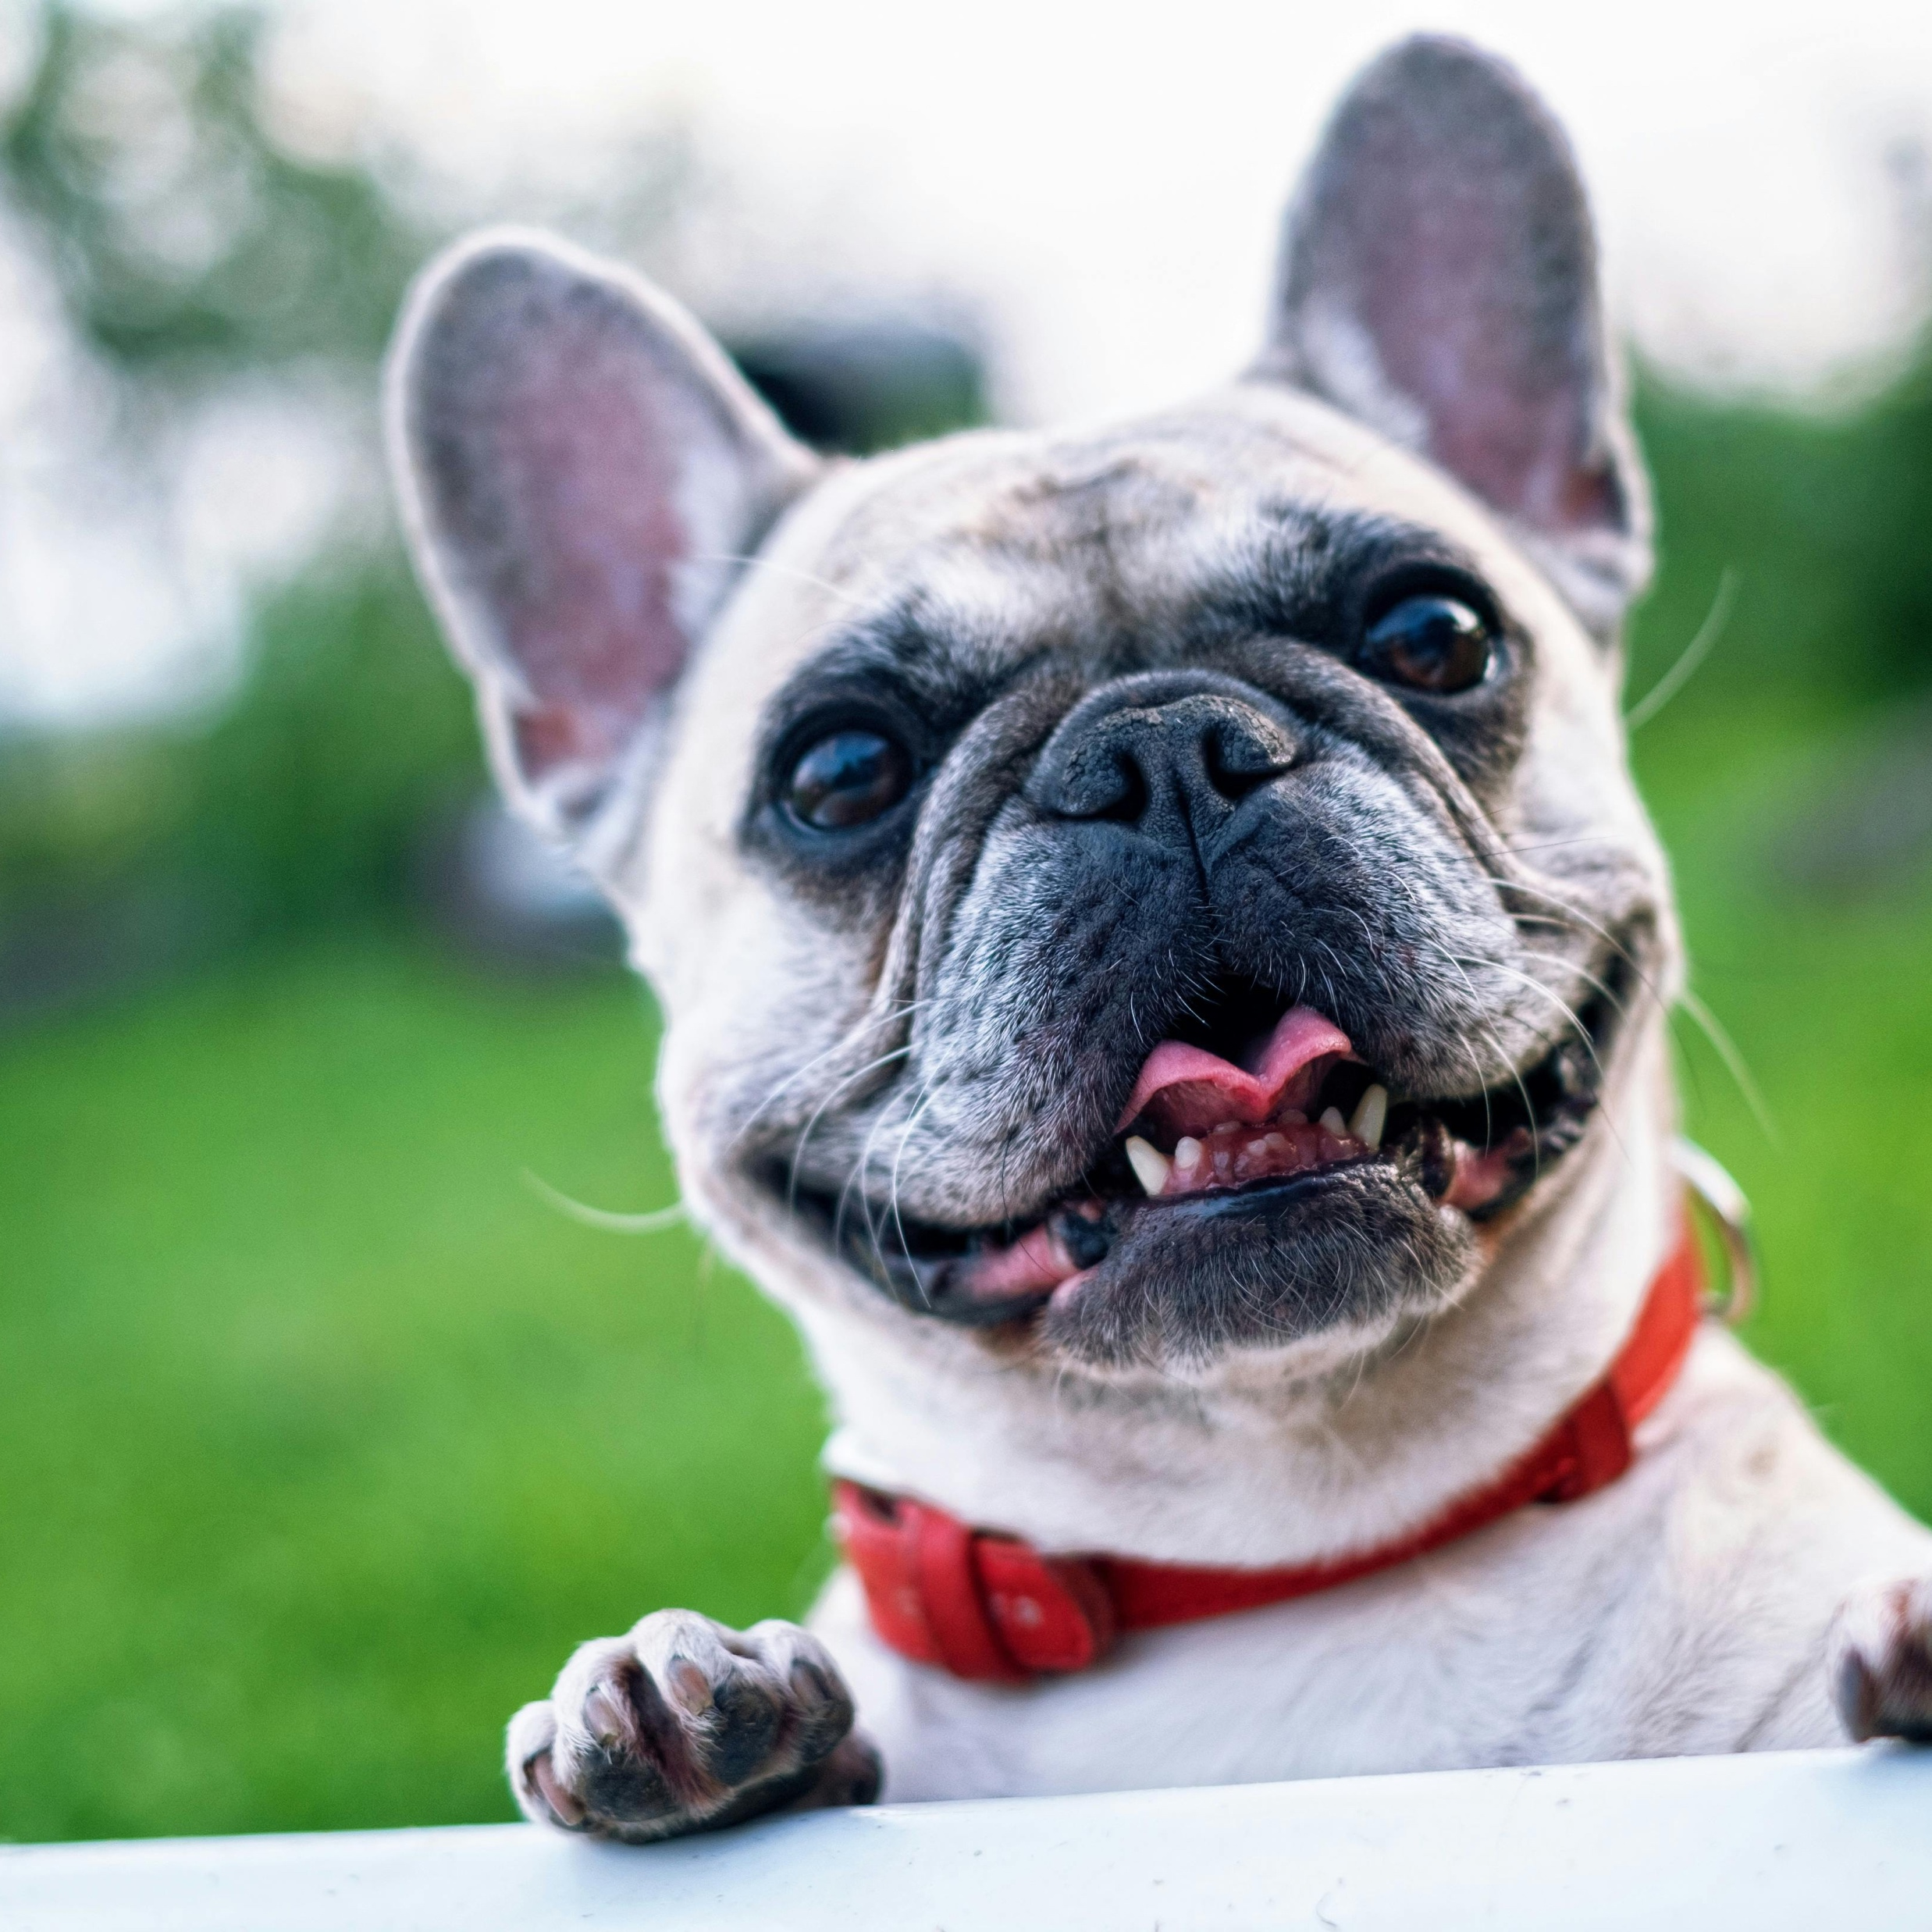
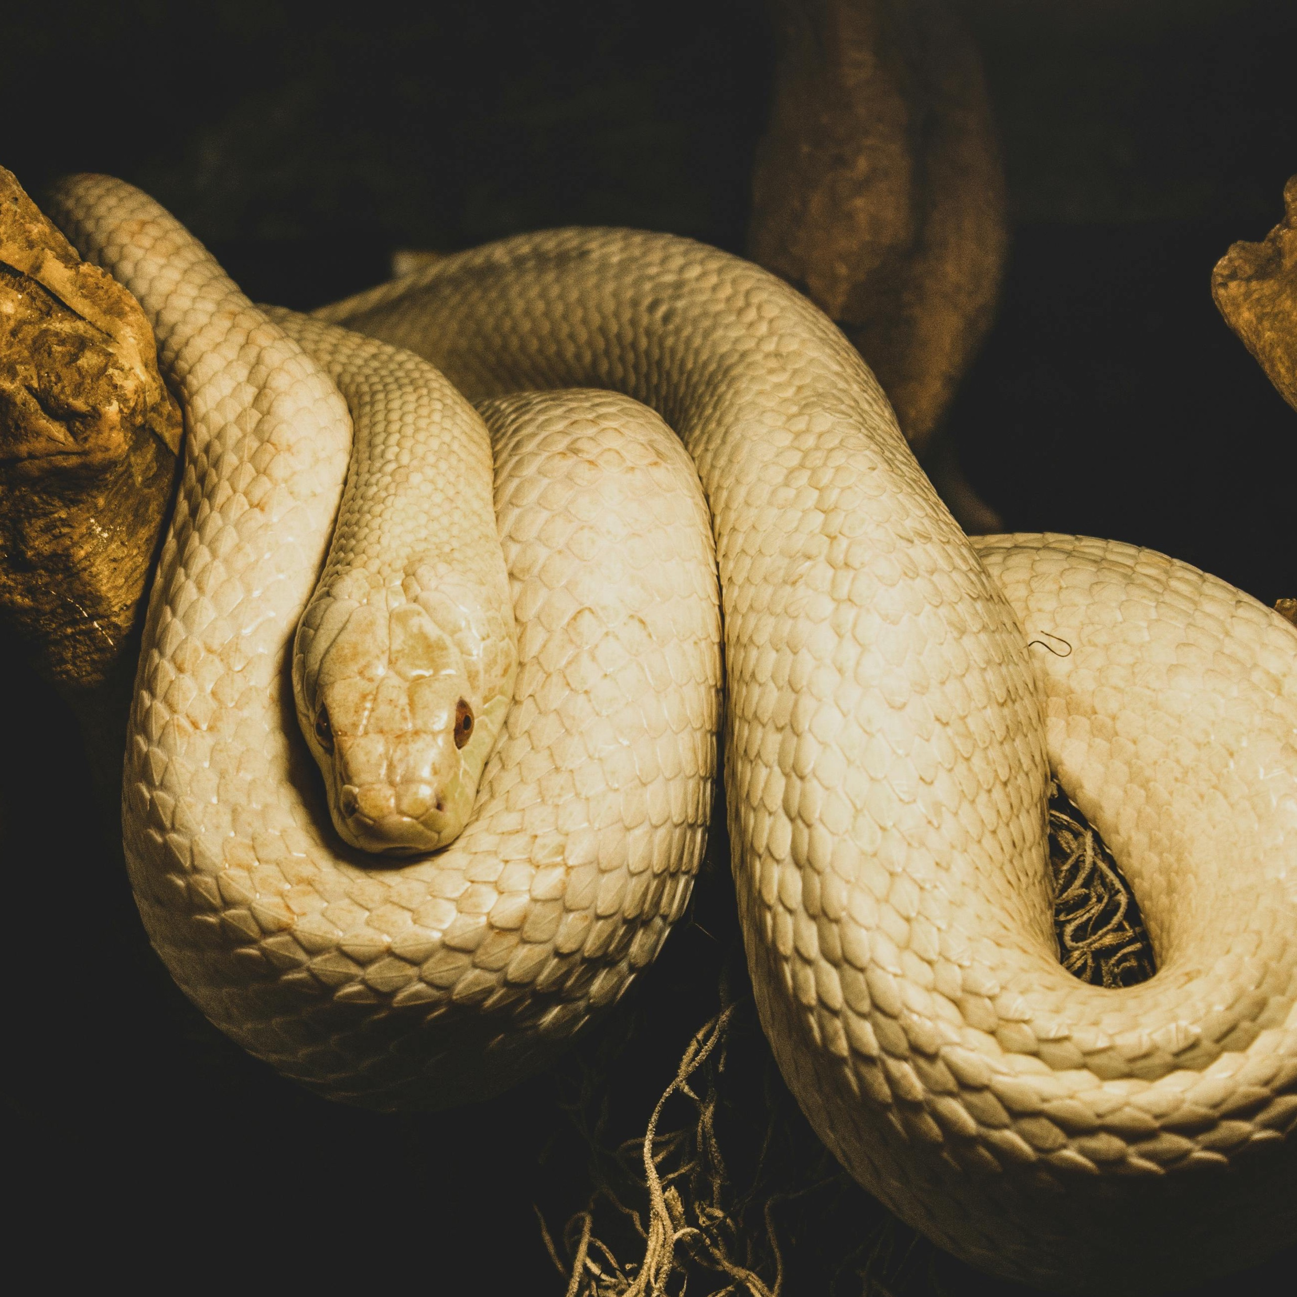
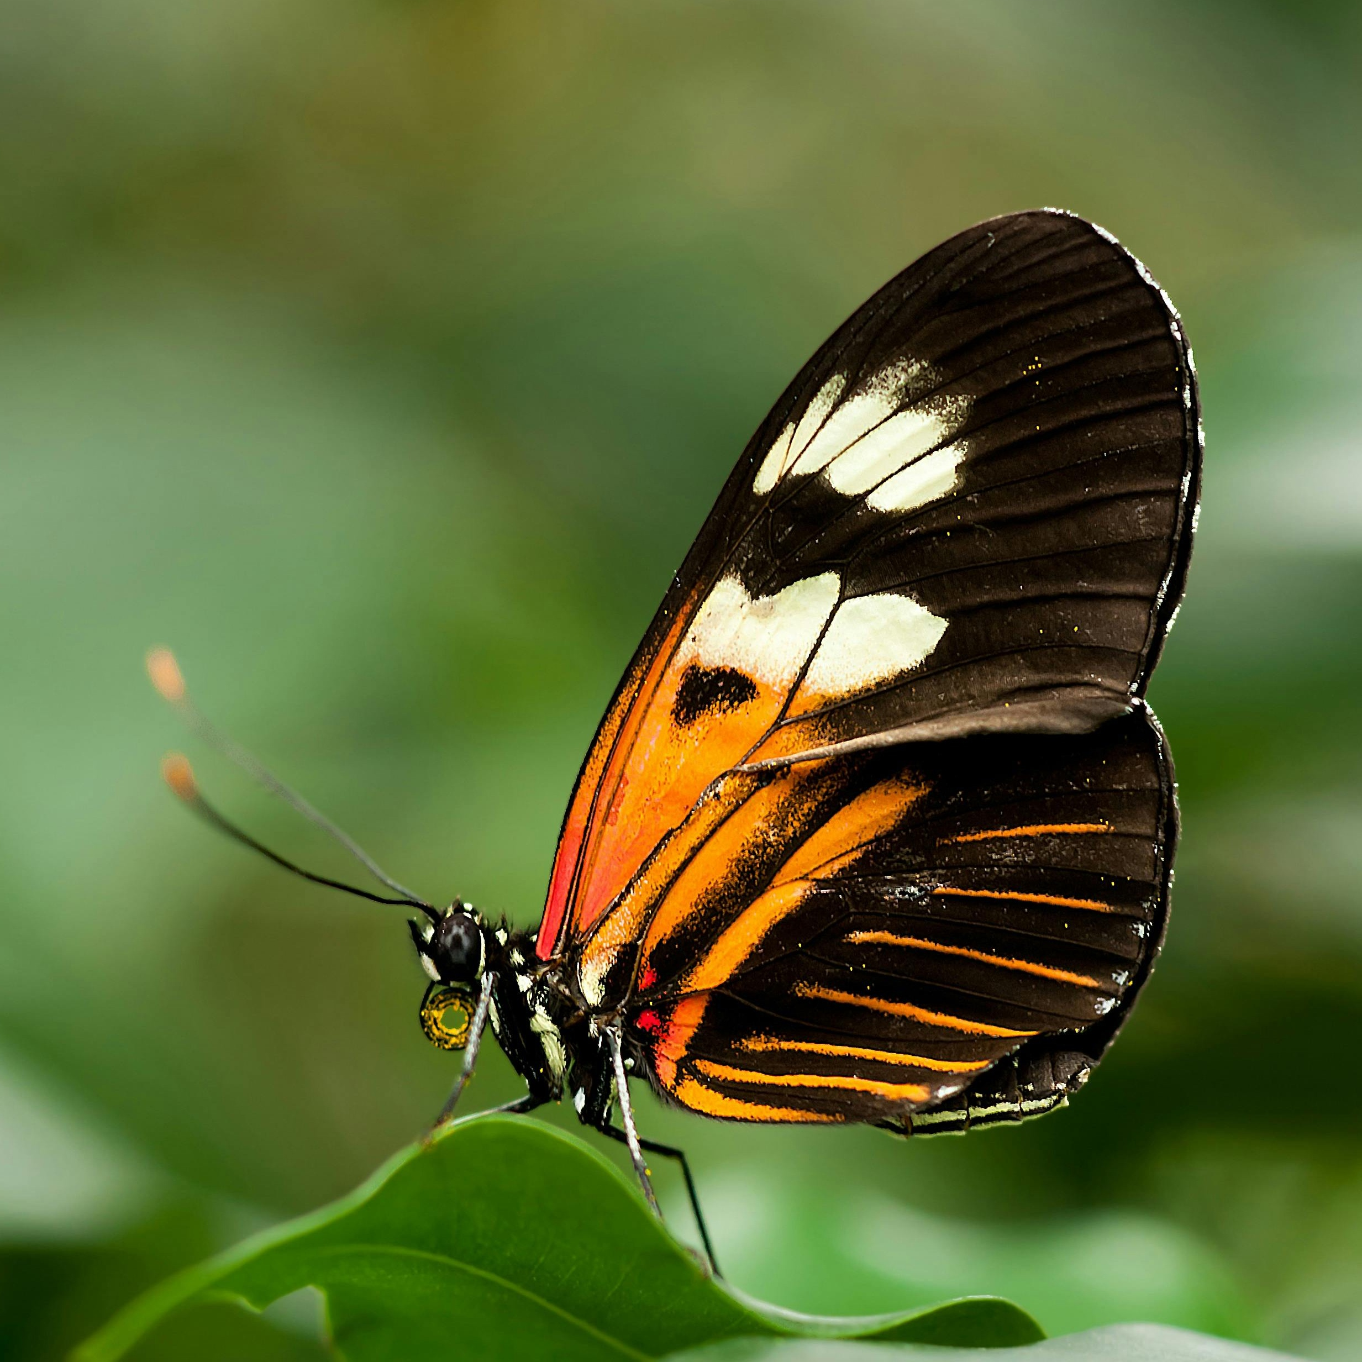
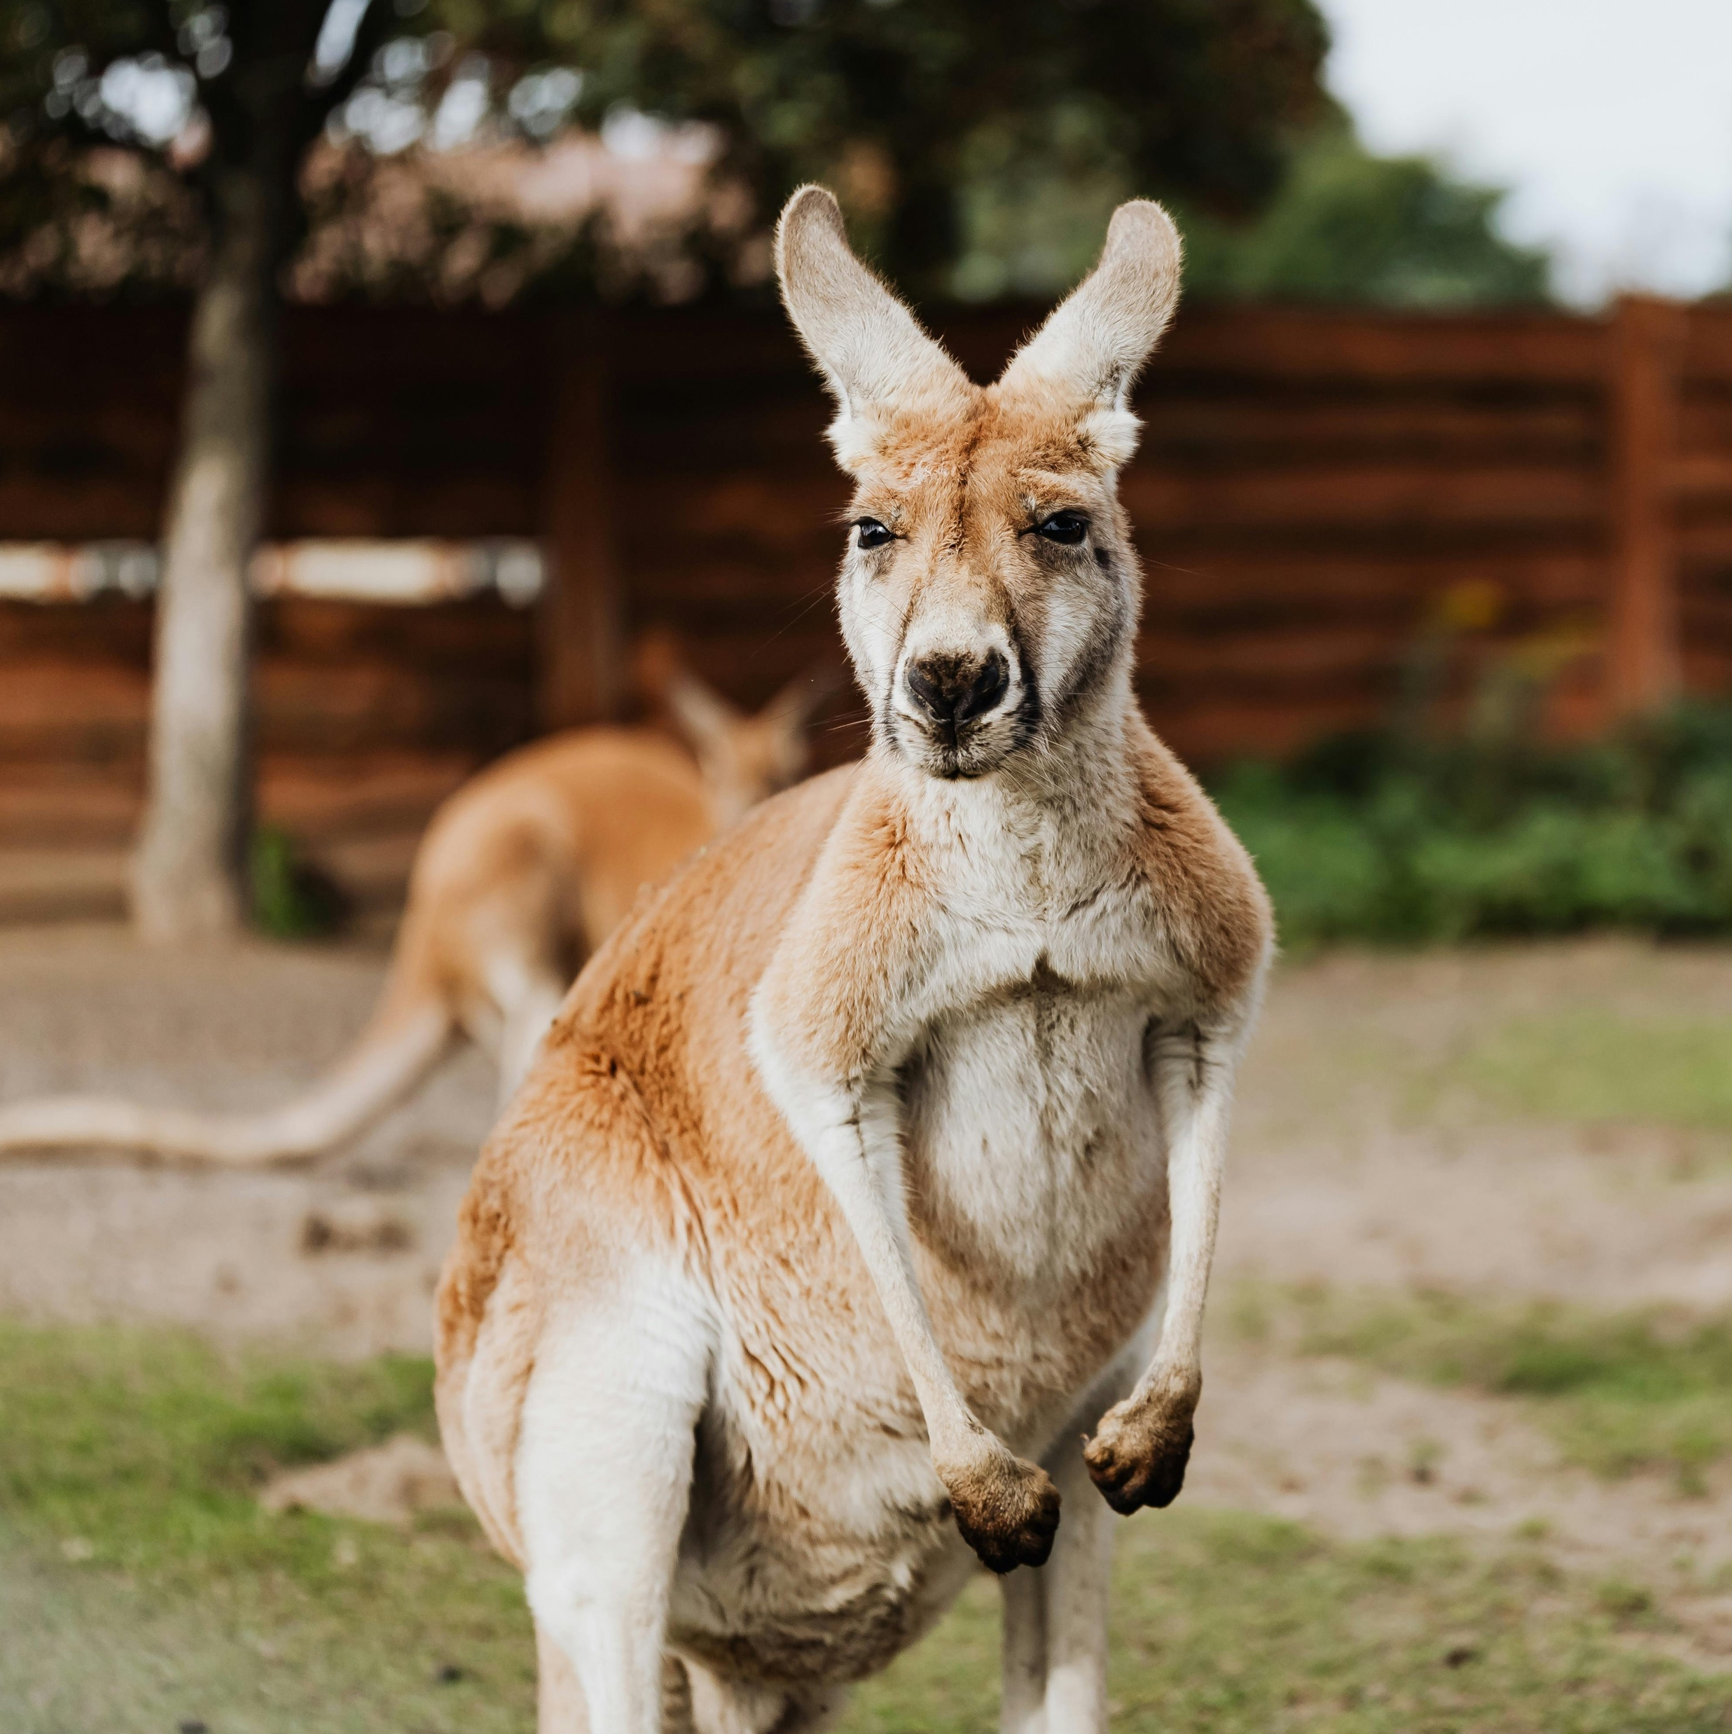
Types of Animals
Amphibians
Birds
Fish
Animals reproduce (have babies) in different ways. ​
Many animals lay eggs. ​
What types of animals do you know?
Mammals
Reptiles
Insects
Marsupials

Slide 5
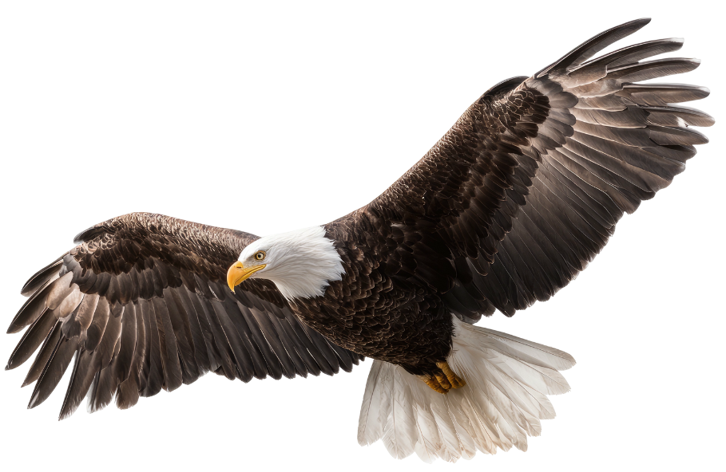
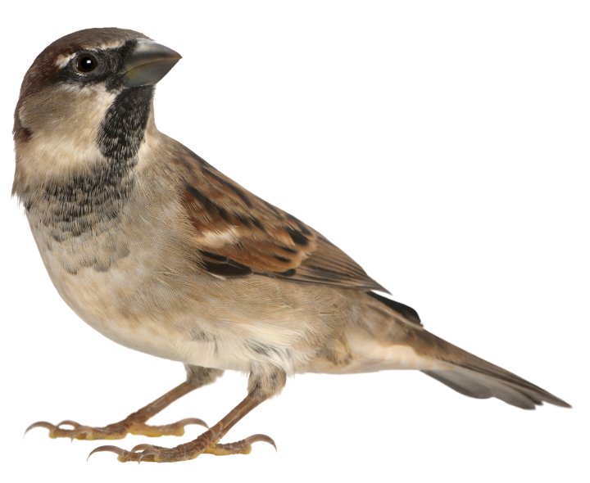
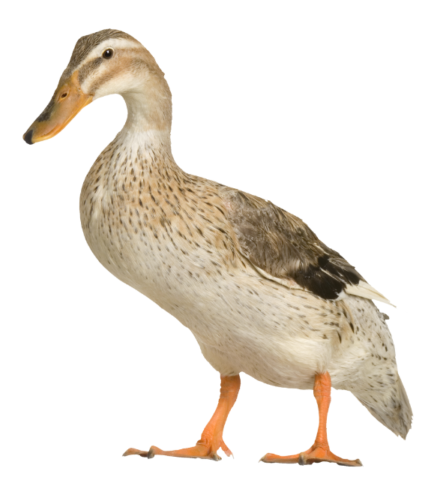
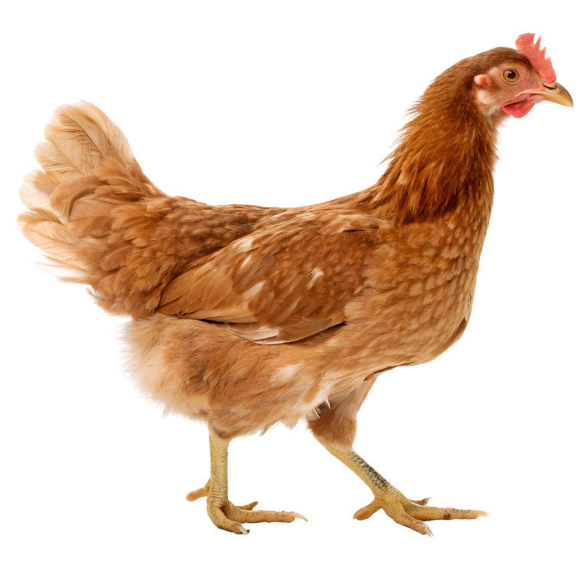
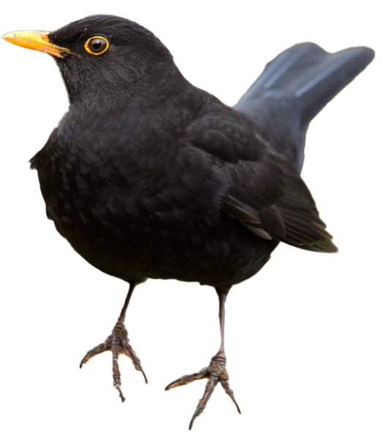
Animals That Lay Eggs
All birds lay eggs.

Slide 6
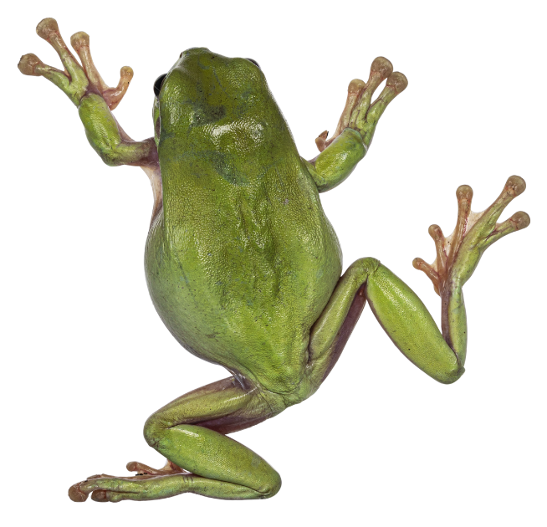
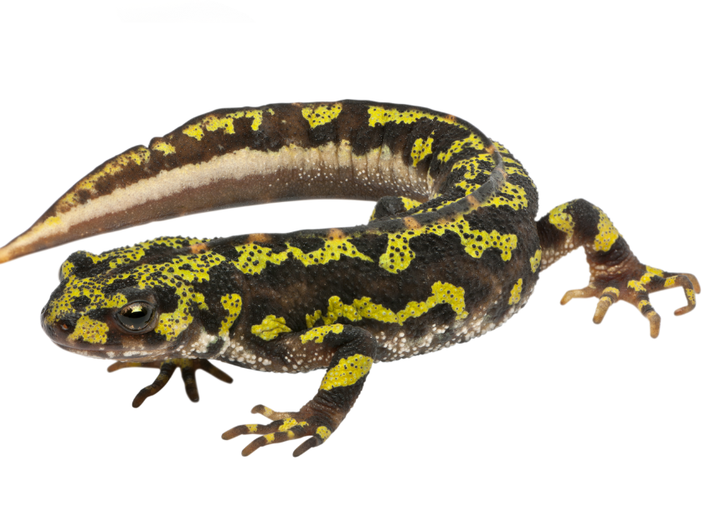

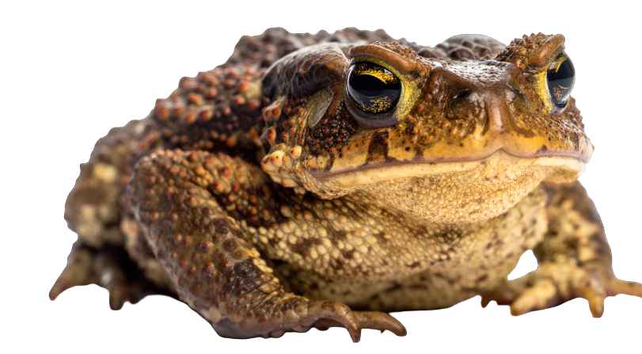
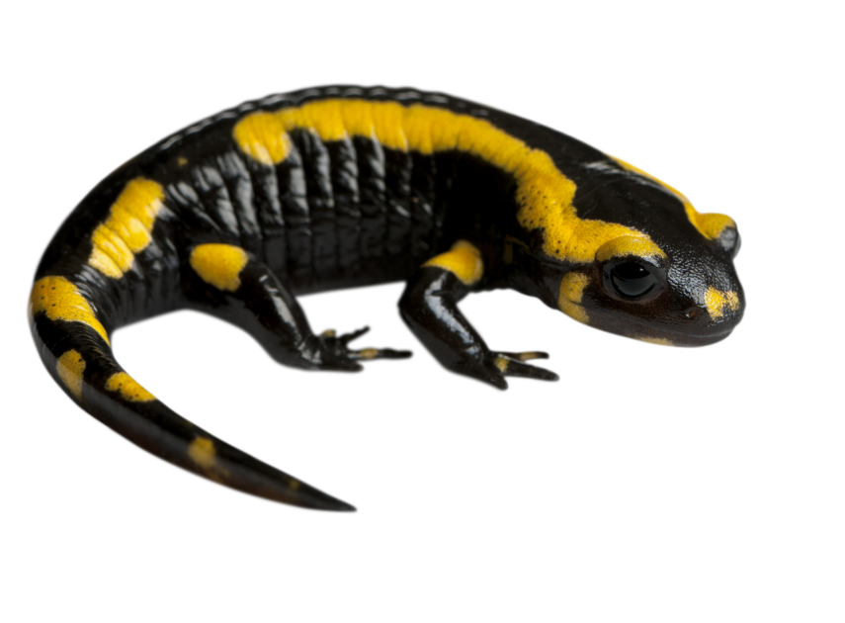
Most amphibians lay eggs

Slide 7
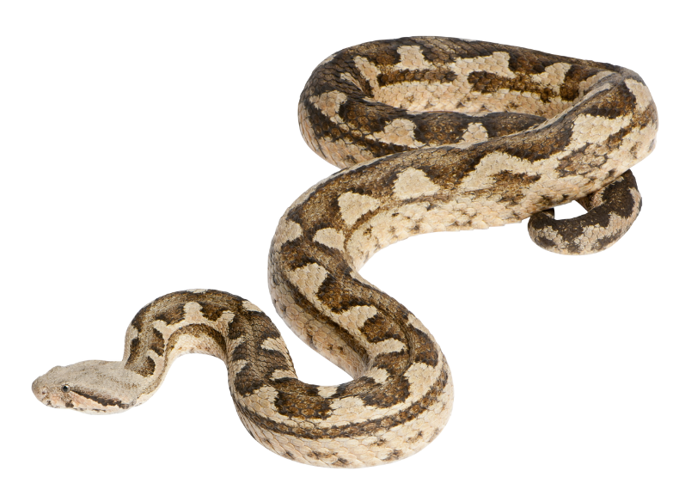
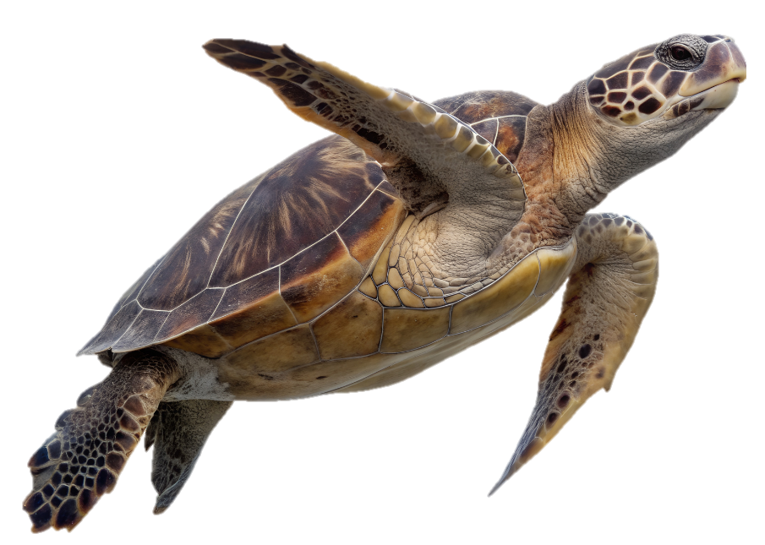
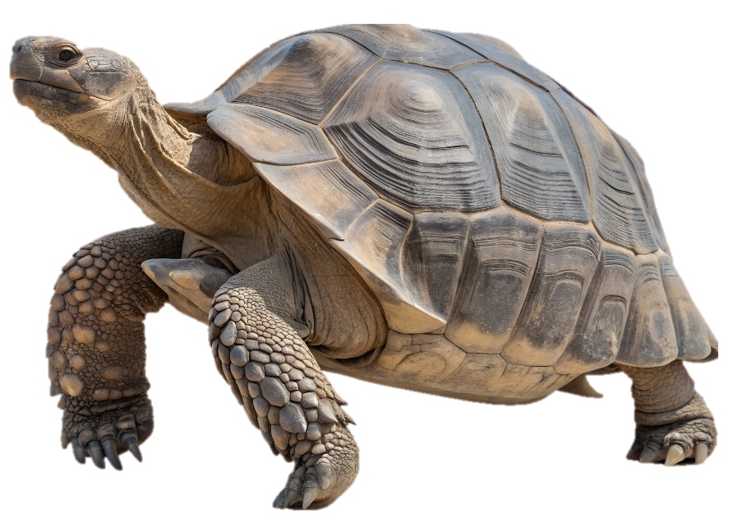
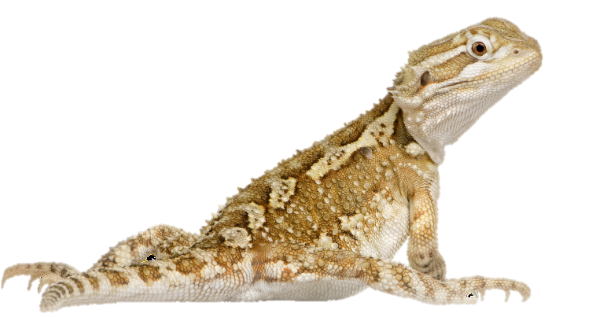
Most reptiles lay eggs

Slide 8
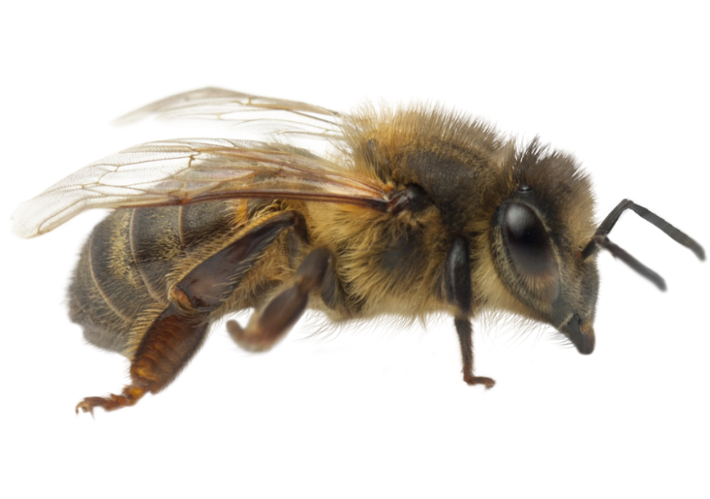
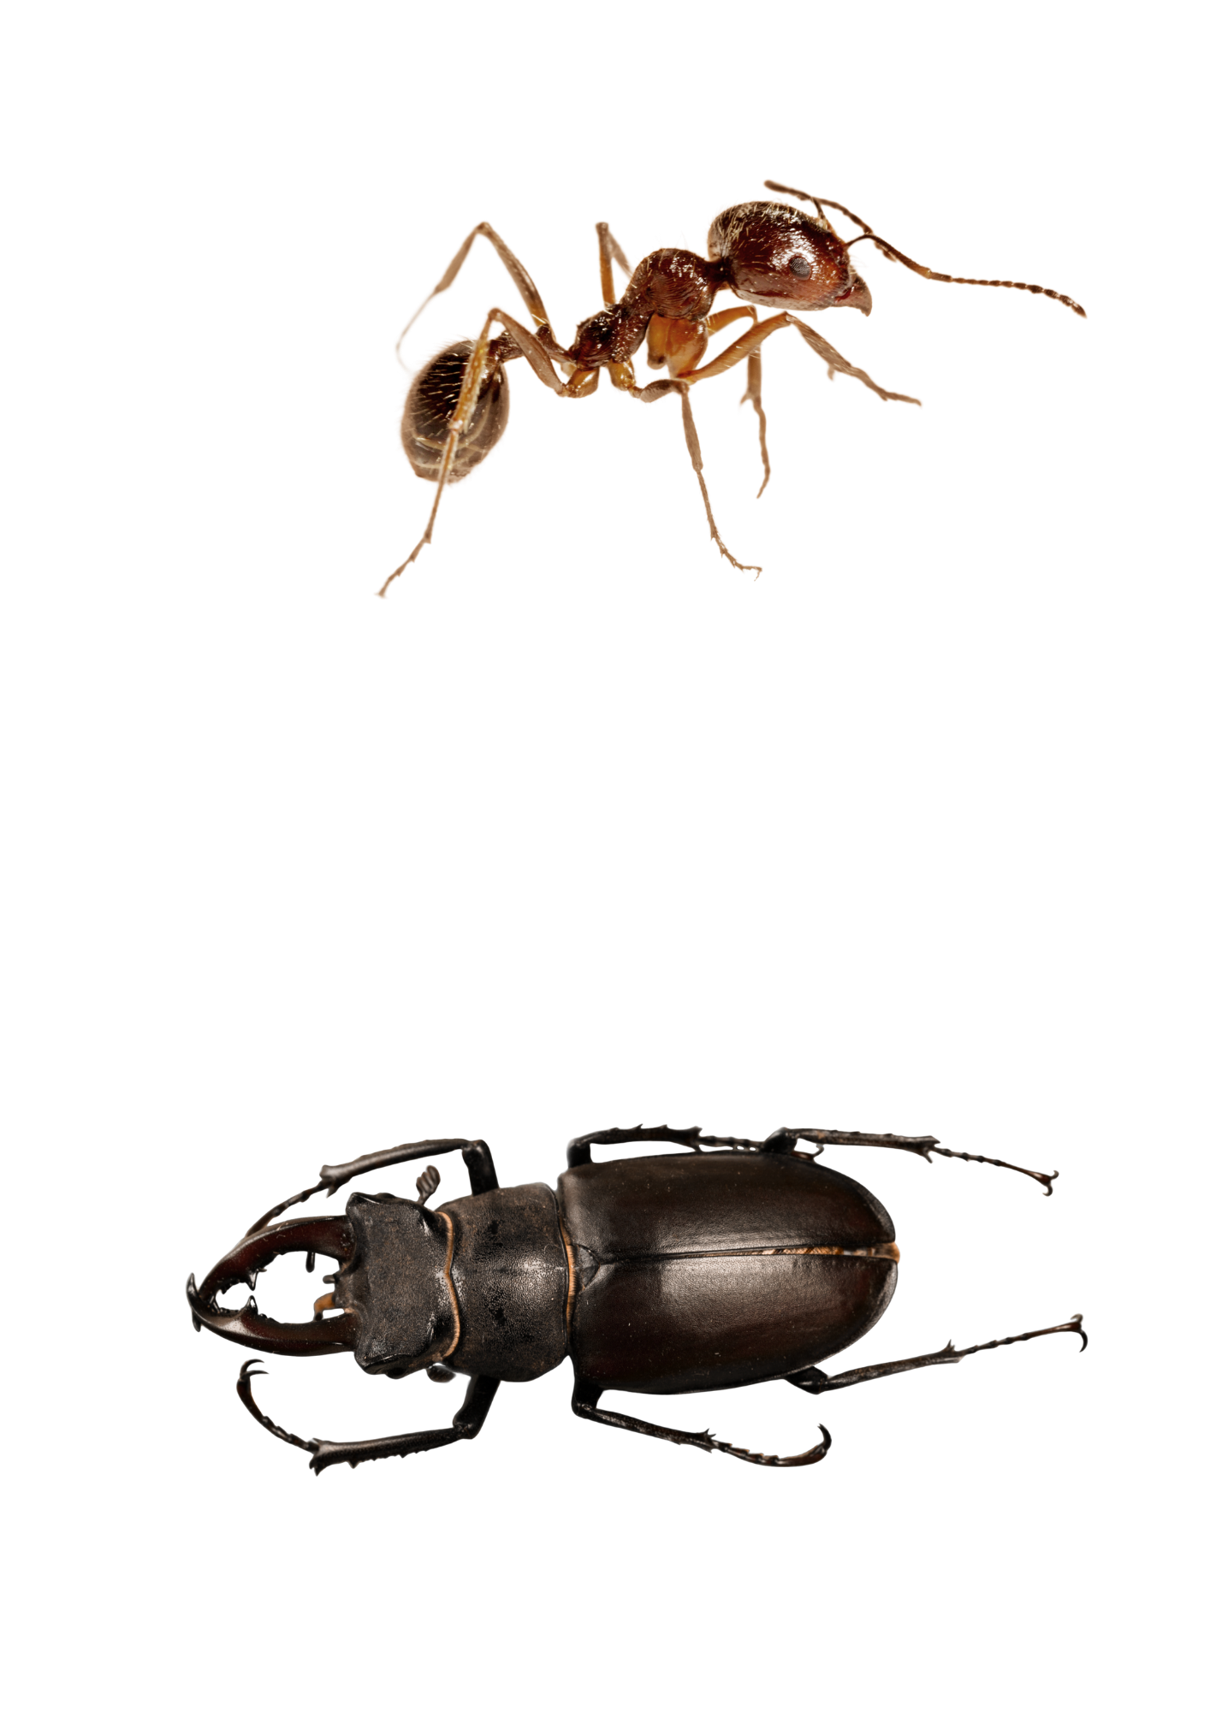
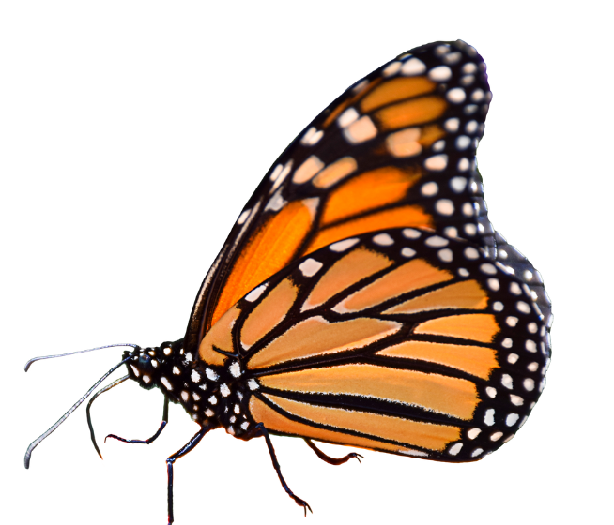
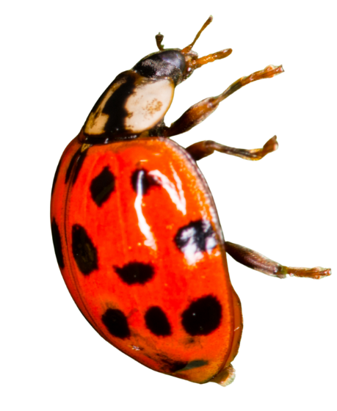
Most insects lay eggs

Slide 9
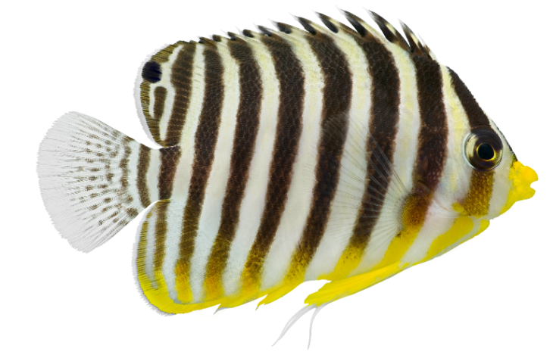
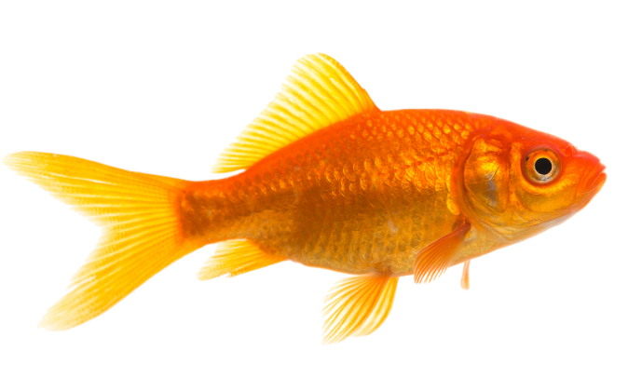
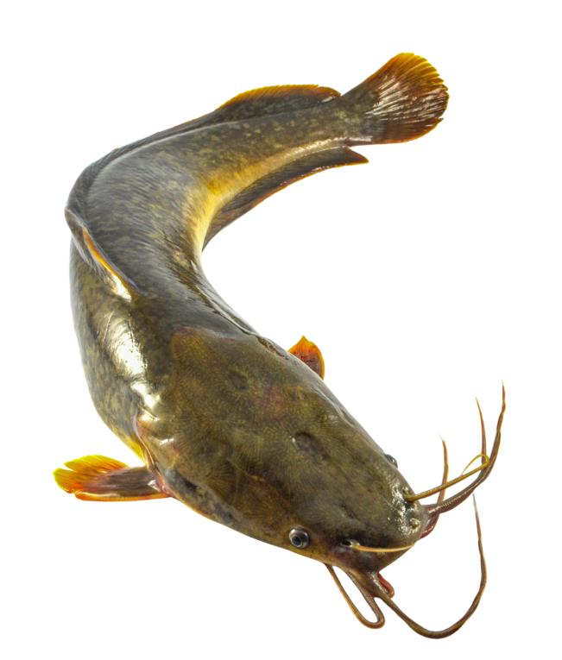
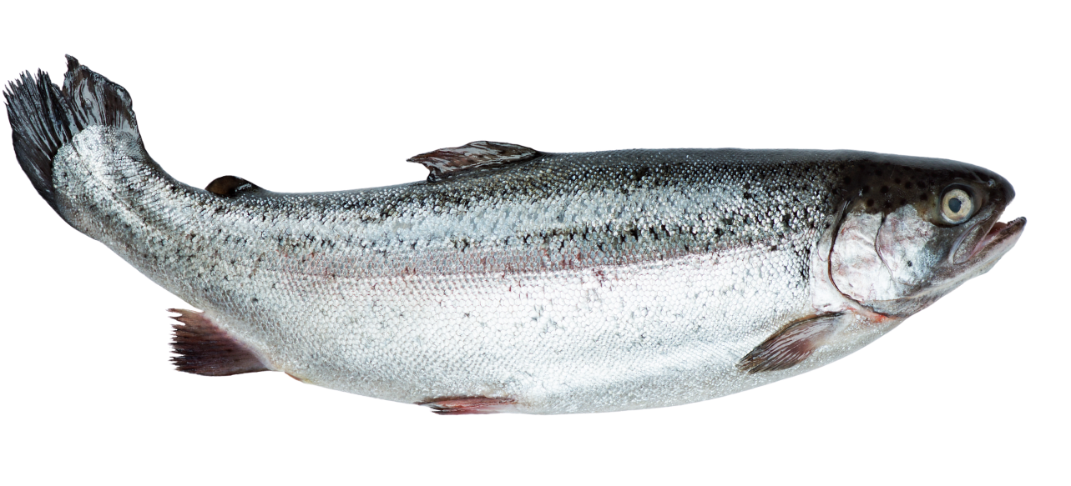
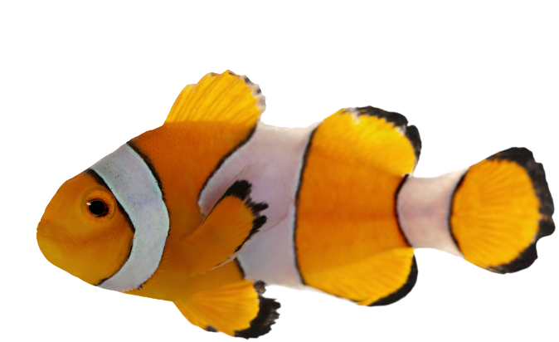
Most fish lay eggs

Slide 10
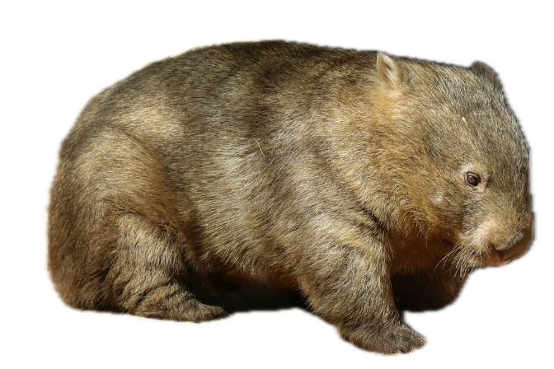
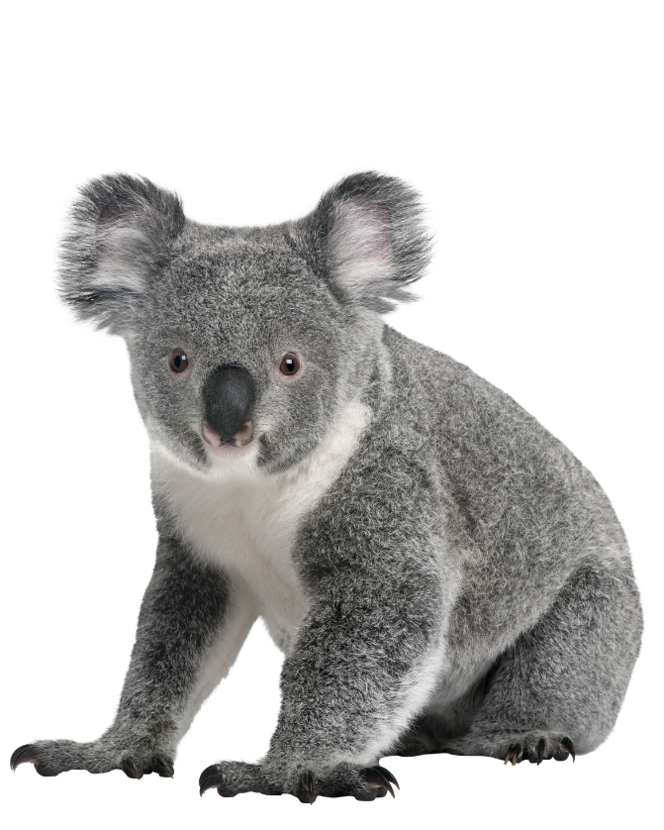
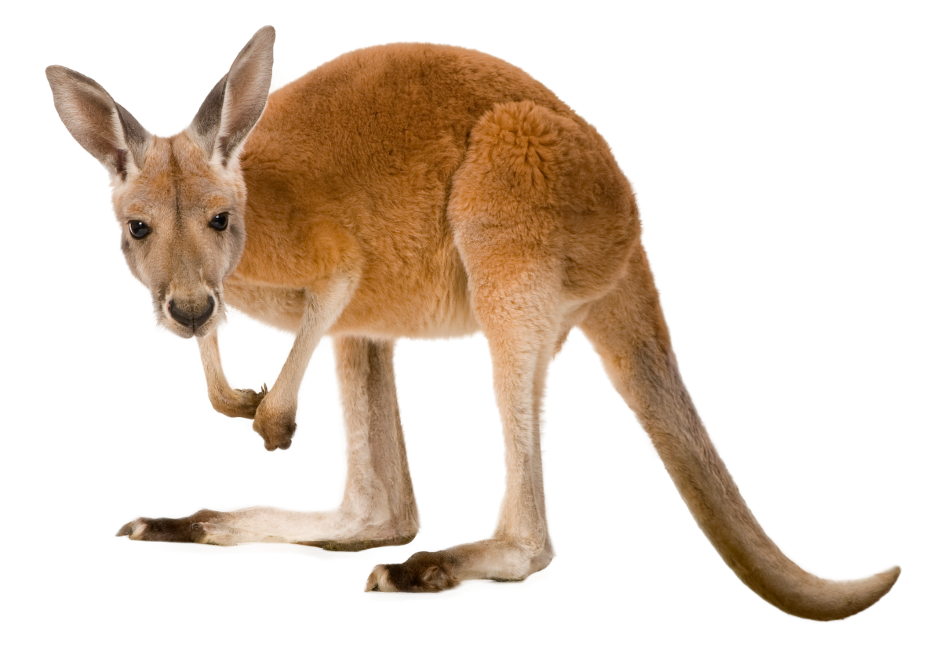
Most marsupials do not lay eggs

Slide 11
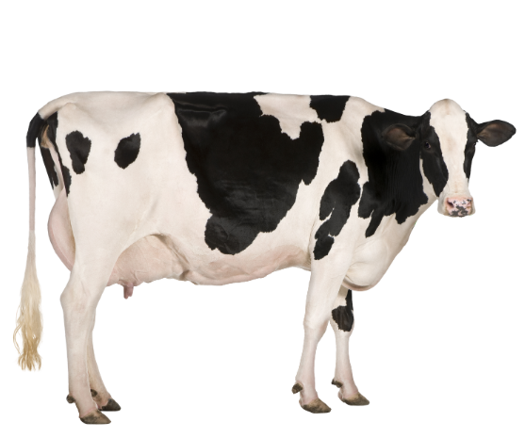
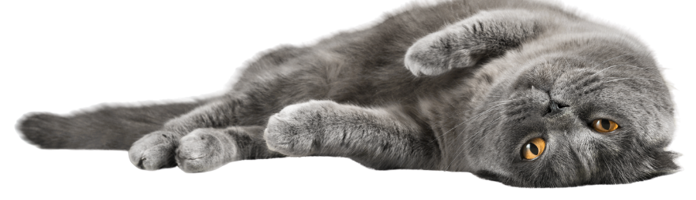
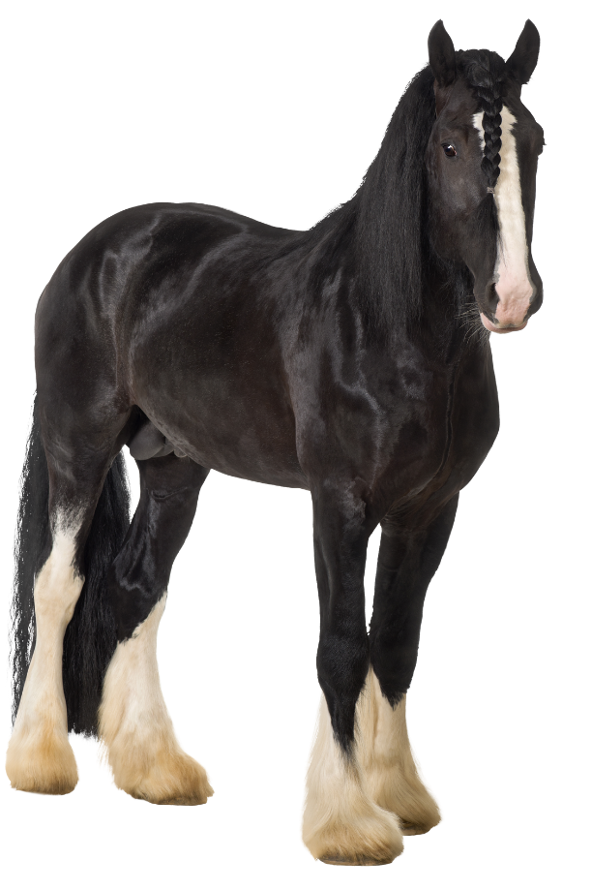
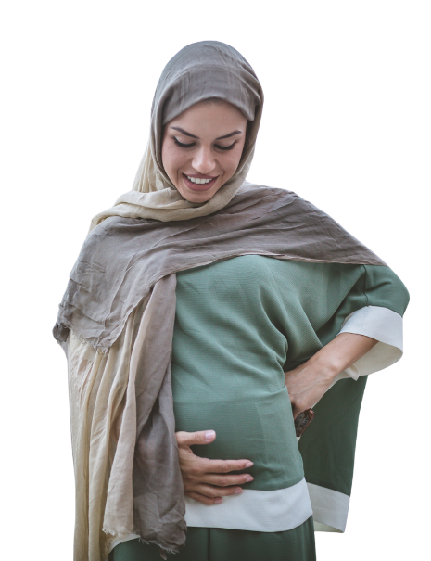
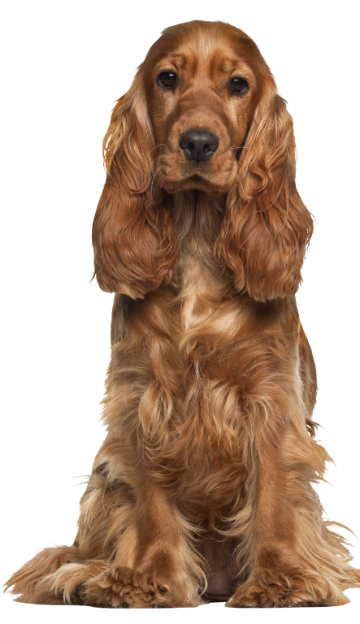
Most mammals do not lay eggs

Slide 12
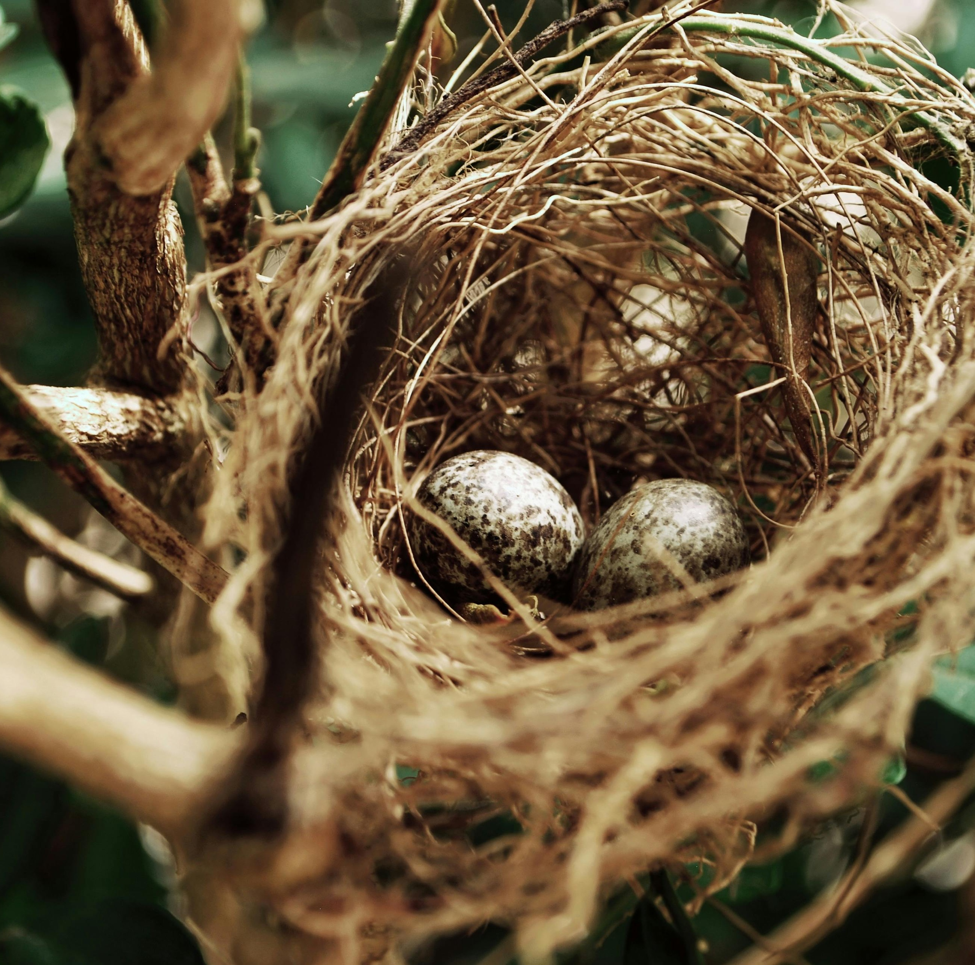
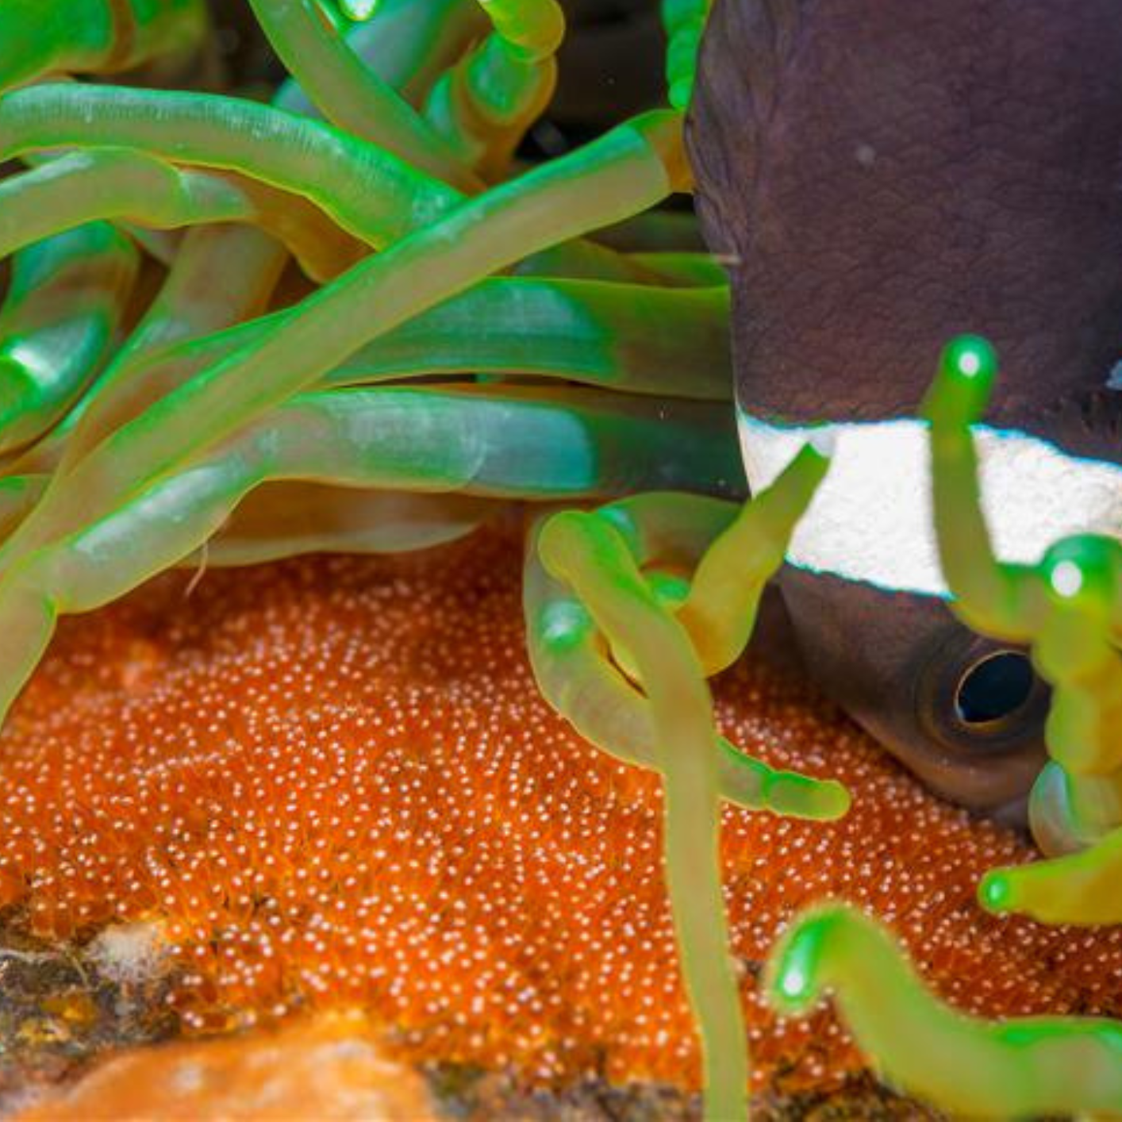


Egg-layers
Different animals all lay different types of eggs.
Some animals lay their eggs in nests, some on the ground, some in water and some underground!
Bird's nest
Fish eggs underwater
Turtle egg
Snake egg ​
The egg protects the baby animal until it is formed and ready for the world.

Slide 13


Invest-egg-ate
Use your sorting cards to place animals into the categories ‘lays eggs’ or ‘doesn't lay eggs’.

Slide 14

Sorting Review
Which animals did you find easy to sort?
Which did you find trickier?

Slide 15
















Lays eggs
Doesn't lay eggs

Slide 16
Surprising Animals
?
Did you know? ​
Even though sharks are fish, most sharks give birth to live young.
Bats and whales are types of mammal. Most mammals do not lay eggs.
But some do!

Slide 17



Surprising Animals
?
Did you know? ​
The Platypus and Echidna are the only mammals in the world to lay eggs.
Ostrich eggs are around 24 times bigger than hen eggs. That’s huge!

Slide 18
Egg or Not?
Let's do a quick quiz to see what you have learnt.
Thumbs up or thumbs down to show if the animal does or doesn't lay eggs.
Lays eggs
Doesn't lay eggs

Slide 19


Not egg!
A cat is a mammal that does not lay eggs.

Slide 20


Egg!
A goldfish is a fish that lays eggs. These eggs are laid underwater.

Slide 21


Not egg!
A cow is a mammal that does not lay eggs.
A cow is a mammal that does not lay eggs.

Slide 22


Not egg!
A kangaroo is a marsupial and does not lay eggs. Kangaroos carry their young in a pouch on the front of their body.

Slide 23


Can you remember the name of the other mammal that lays eggs?
Egg!
A platypus is a mammal that lays eggs.

Slide 24


Egg!
A ladybird is an insect that lays eggs.

Slide 25


Not egg!
Humans are mammals that do not lay eggs. ​

Slide 26


Egg!
A snake is a reptile that lays eggs.

Slide 27

What Have We Learned Today?
We have learned about lots of different types of animals and those that lay eggs.
Some animals surprised us.

Slide 28

Brought to you by

