Slide 1
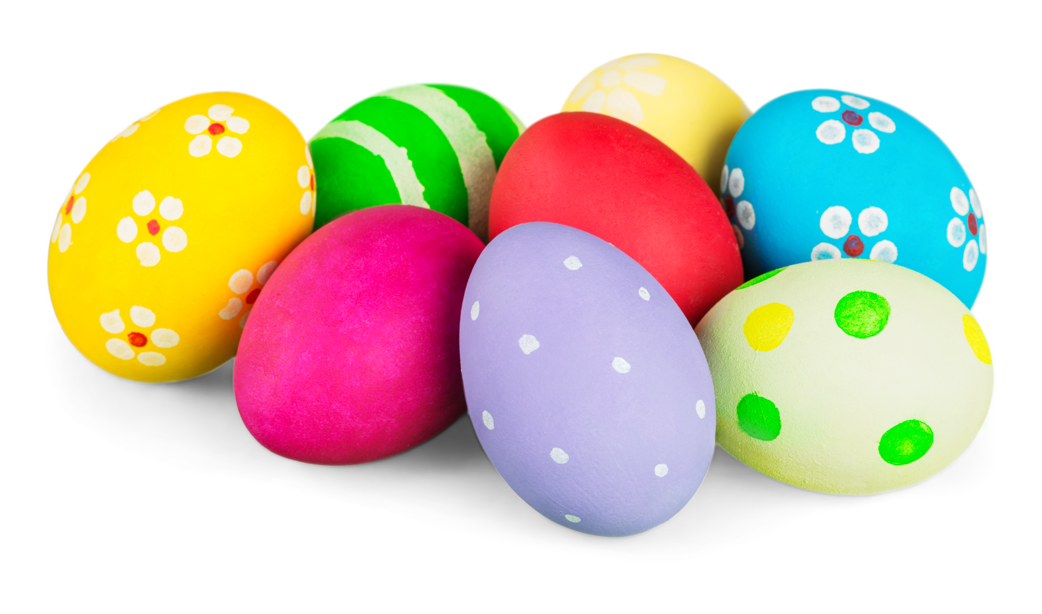

Art eggspression

Slide 2
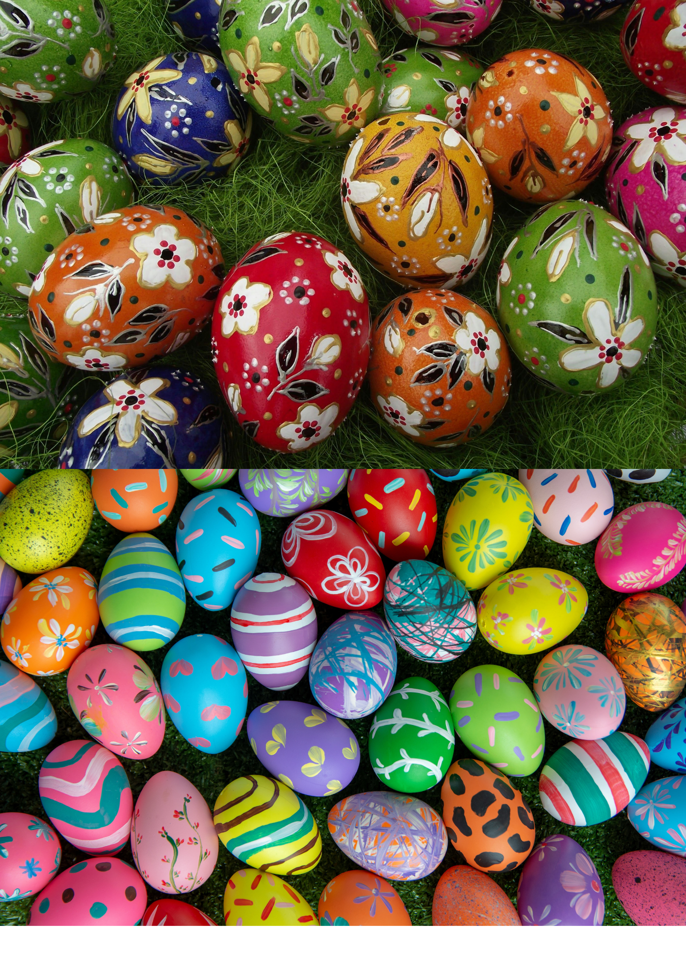
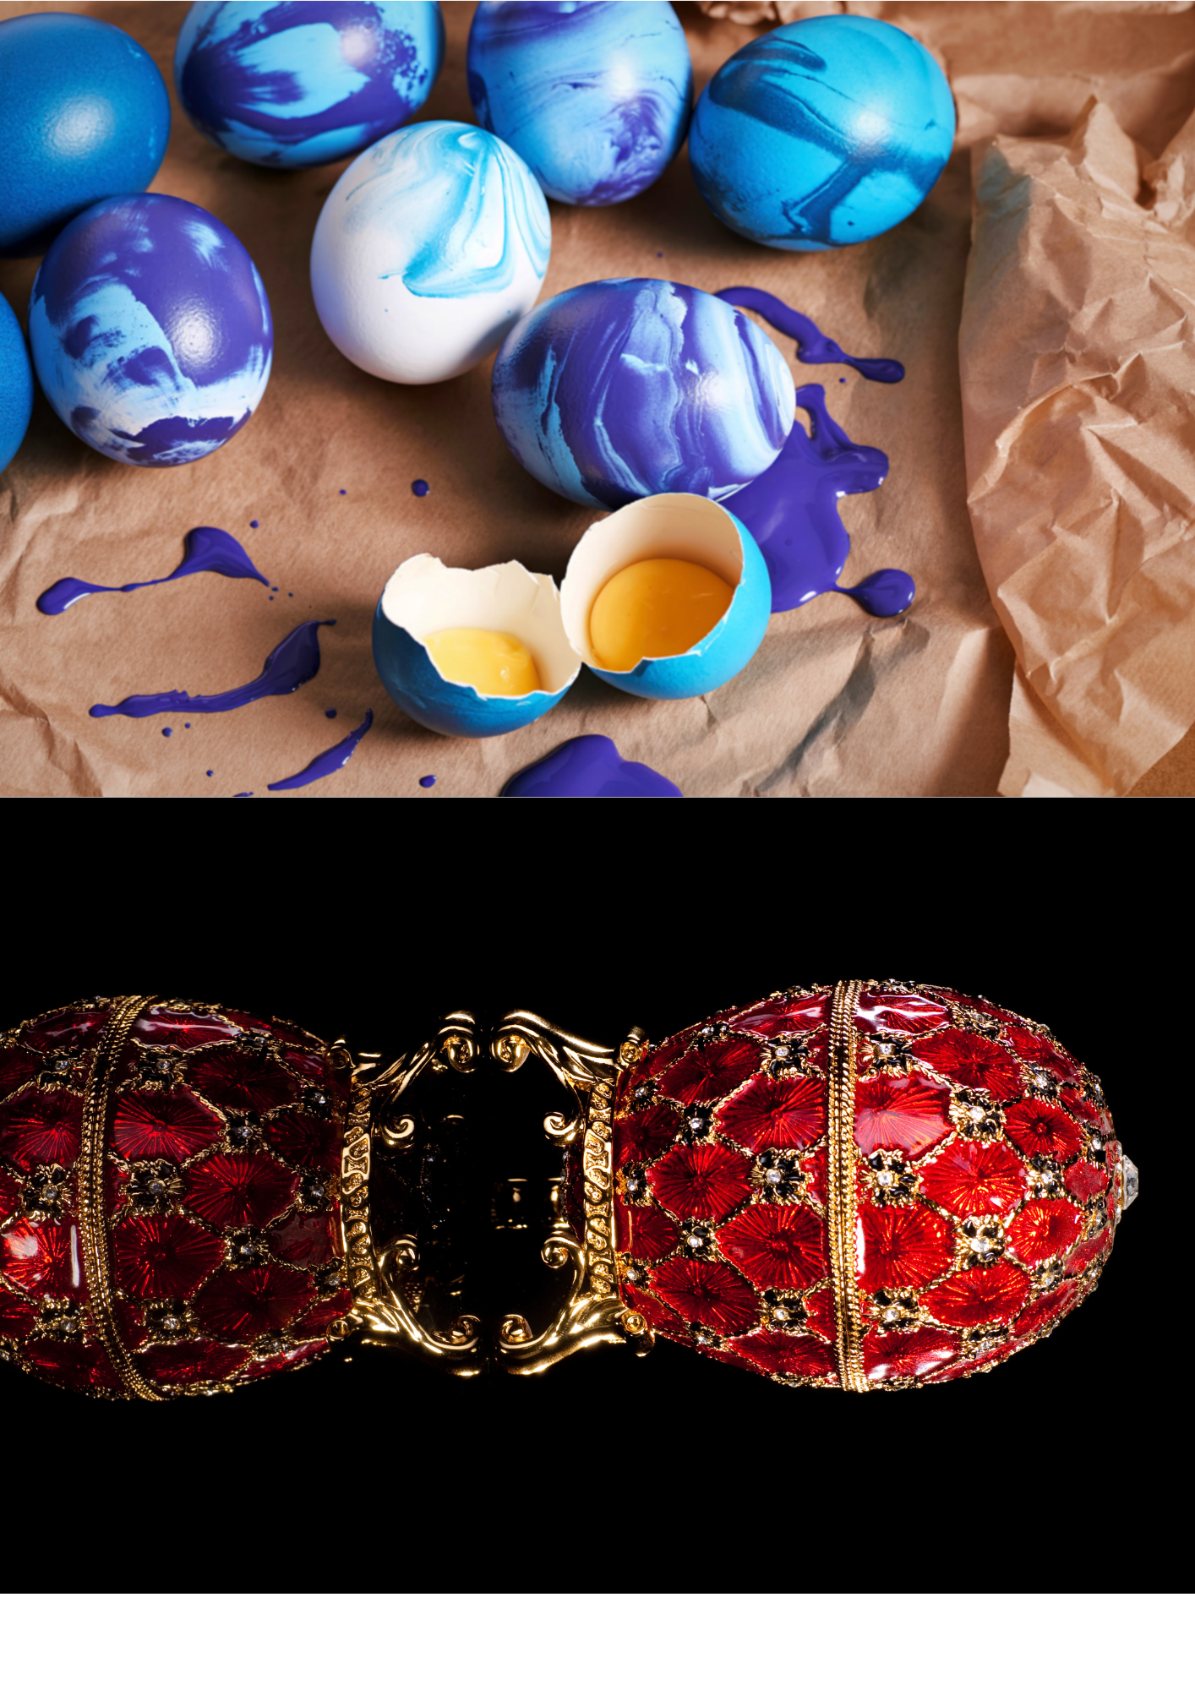

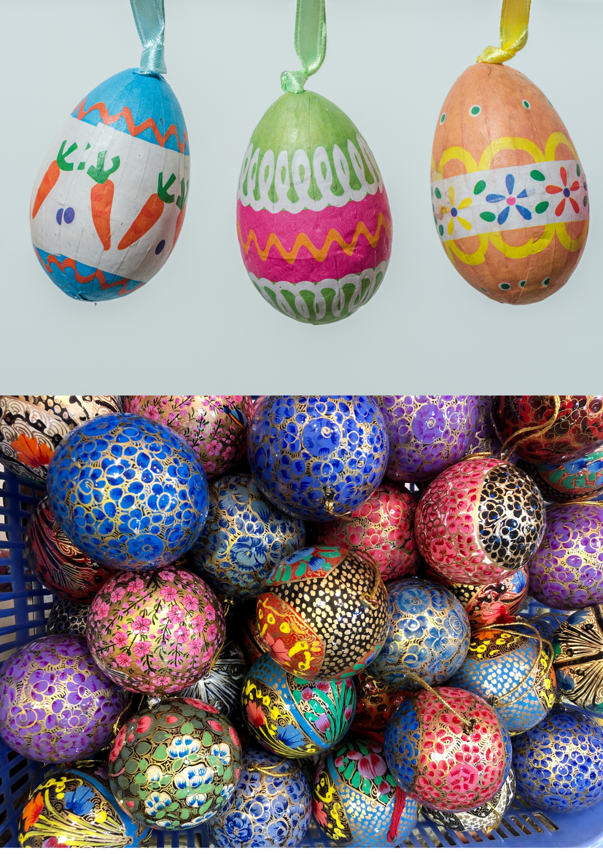
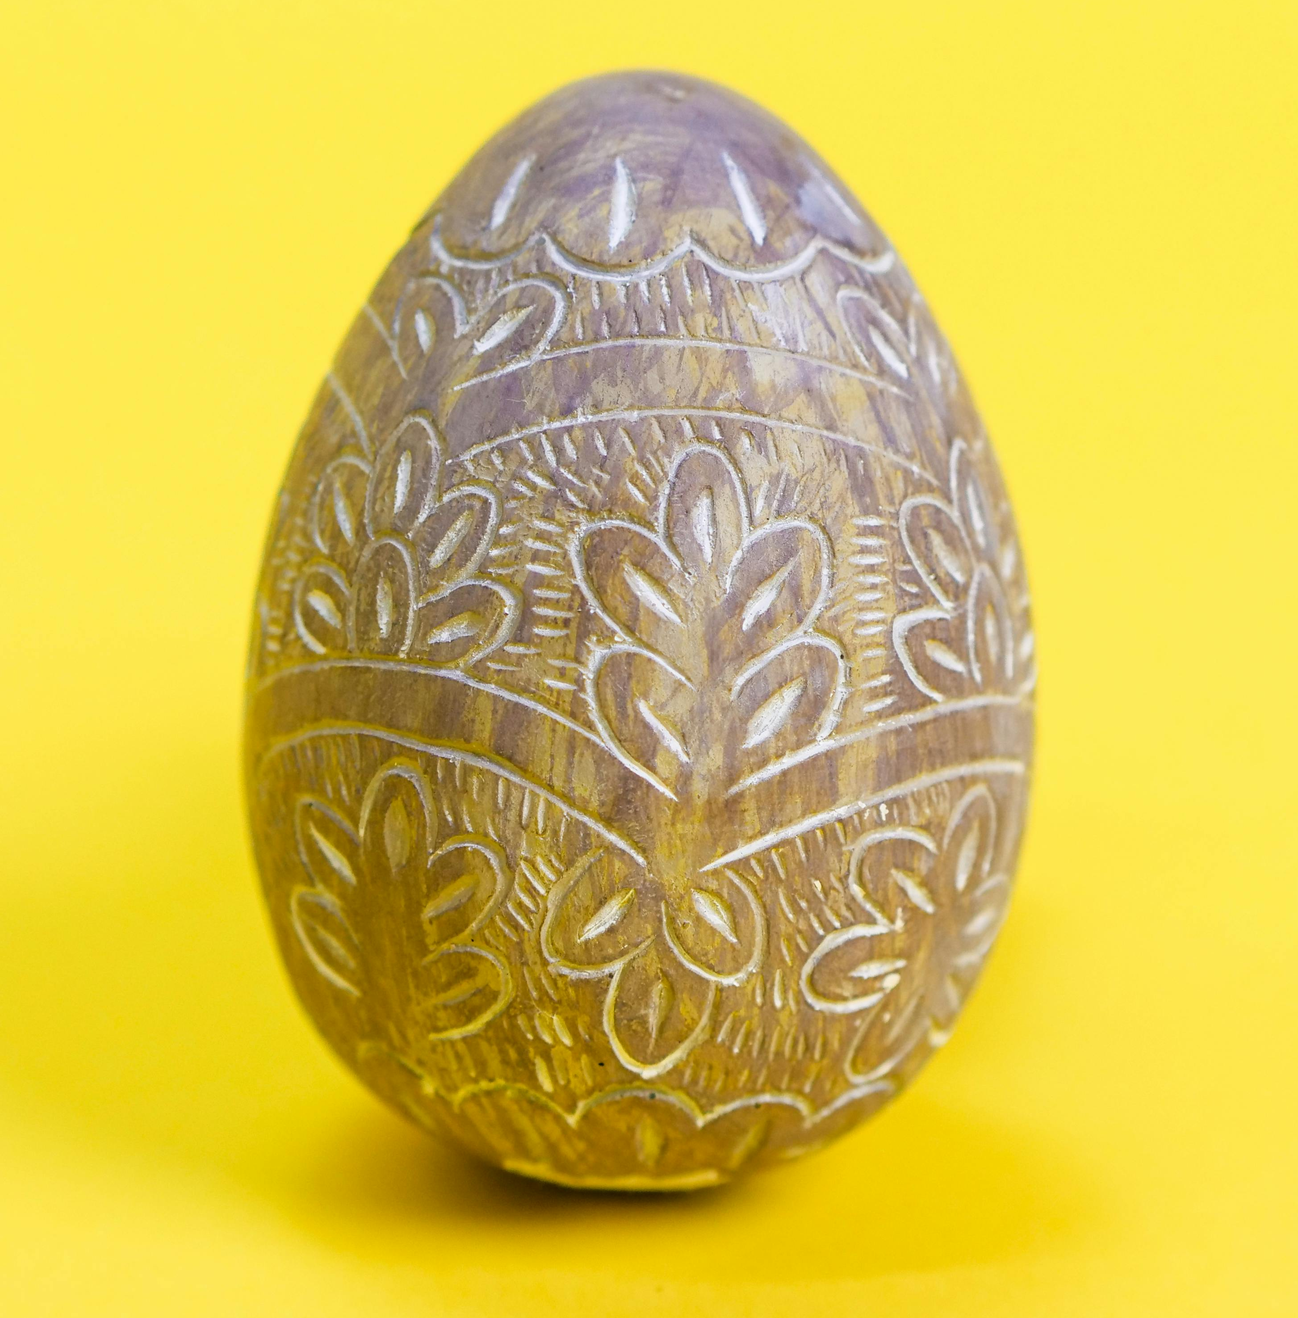
Eggstraordinary designs
People have been decorating eggs for hundreds of years. In many countries, eggs are painted at Easter as part of spring celebrations.
Decorating eggs is also a way to be creative and celebrate new life and the changing seasons. ​
​
Different cultures also decorate eggs for festivals, family celebrations or just for fun!​

Slide 3
Eggstraordinary designs
What colours can you see? ​​
What shapes or patterns do you notice?​​
Do any of the designs tell a story or have meaning? ​
Today we are going to decorate an egg.
Here are some different designs.

Slide 4
Key skills
Artists usually plan their designs before they begin creating.
Think about:
Patterns
Meaning
Shapes
Colours

Slide 5

Thinking like an artist
Let’s look at our work!
What are you proud of?​
​
What patterns or colours worked well?​
​
What would you change next time?

Slide 6

Brought to you by

