Slide 1
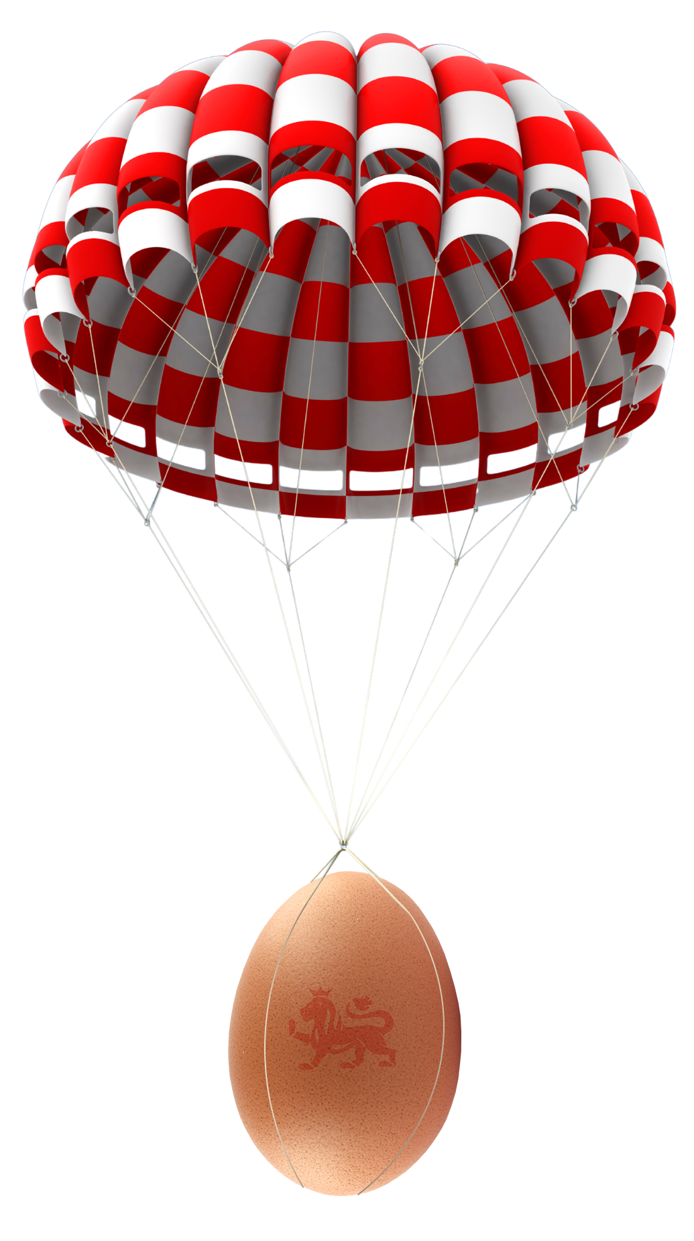

The great egg drop challenge

Slide 2
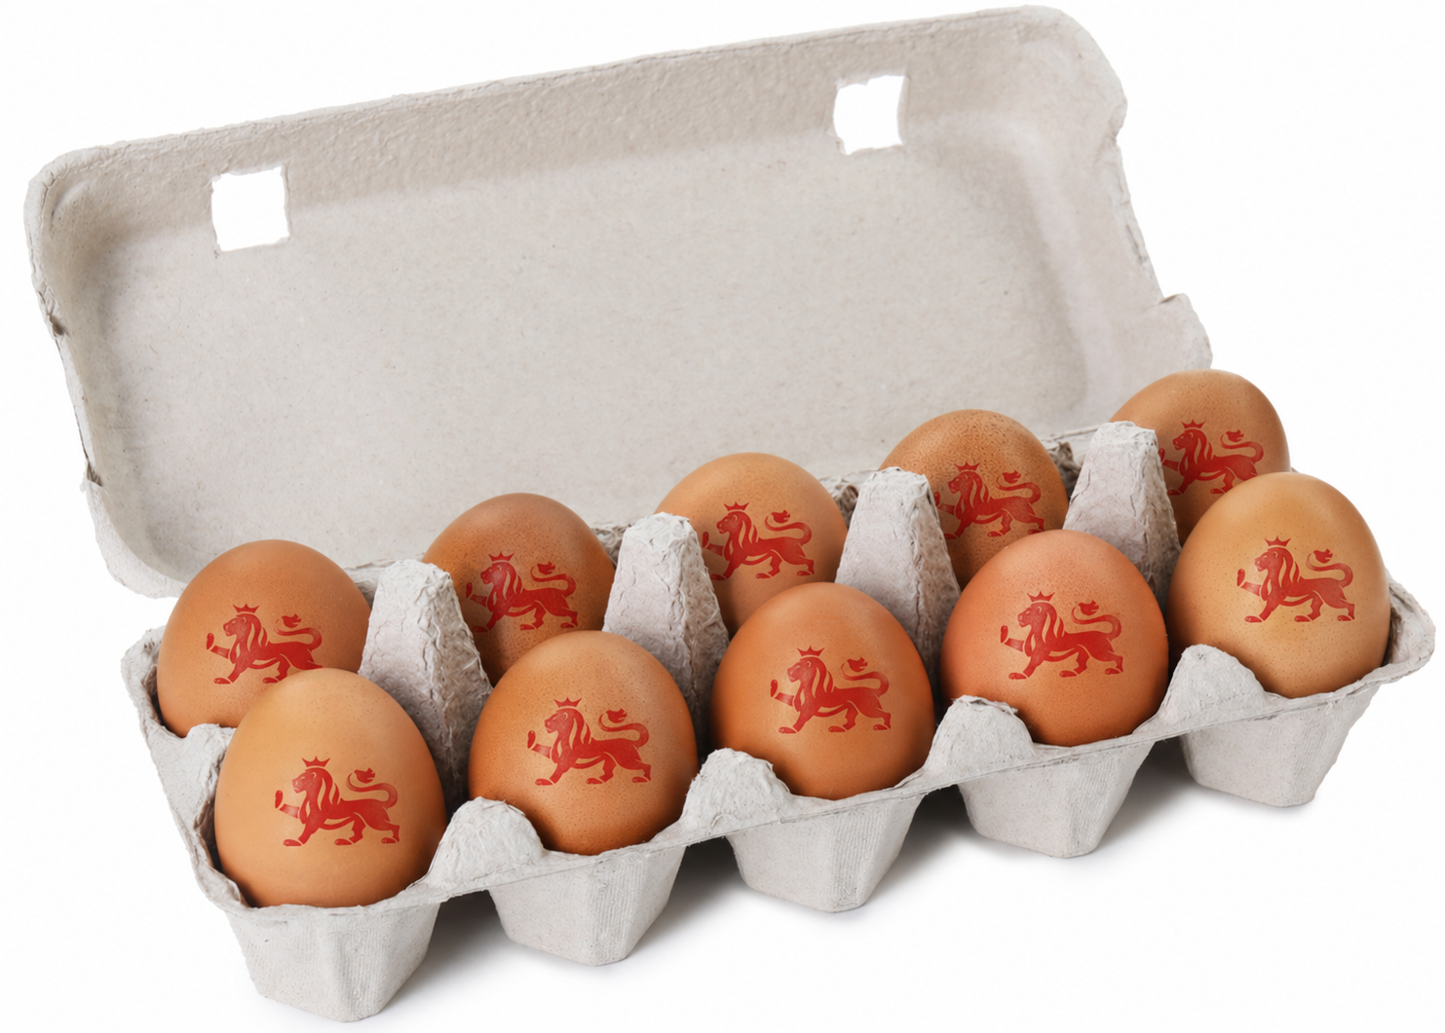

The challenge
Welcome to the great egg drop challenge!
What might happen if we drop an egg?
Will it break? Why?
Your mission is to design a device that will protect an egg when dropped from a height.

Slide 3

Why are we doing this?
Eggs are an amazing food, but they are fragile. ​
Engineers often need to protect fragile things. ​They design packaging for eggs, glass, electronics and more. ​
​
Today, you will be engineers. Your job is to keep your egg safe! ​​

Slide 4
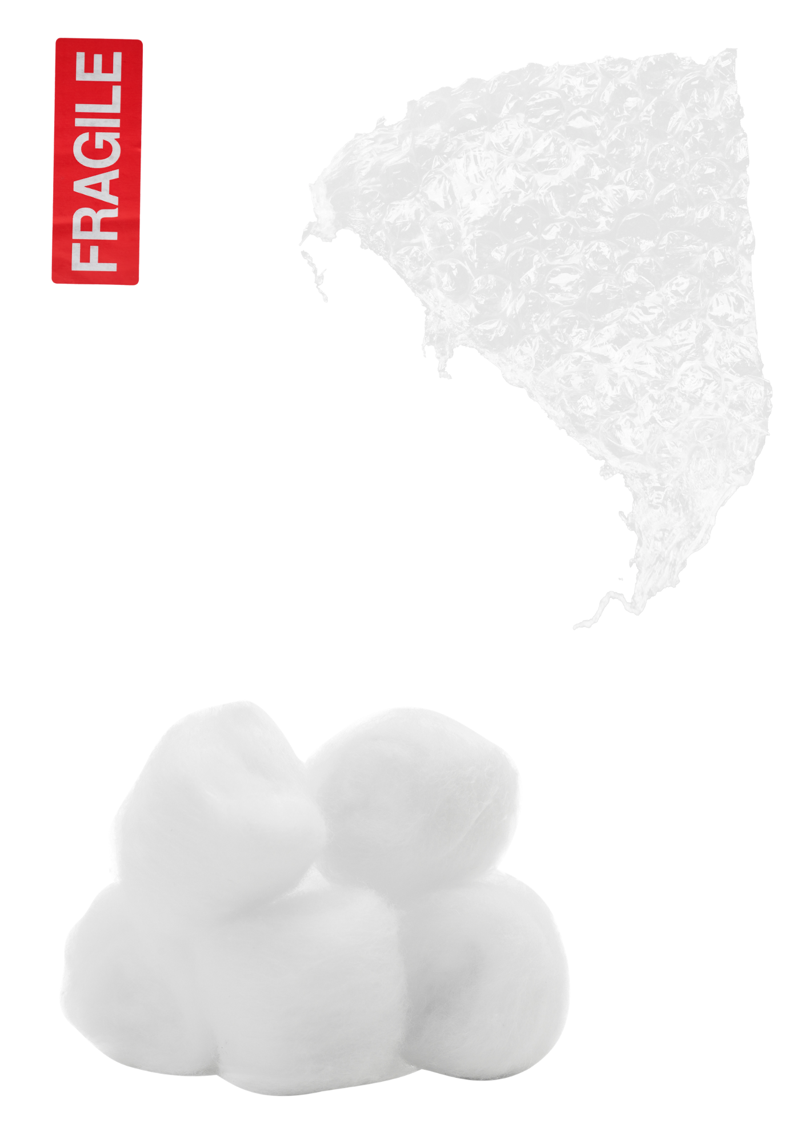
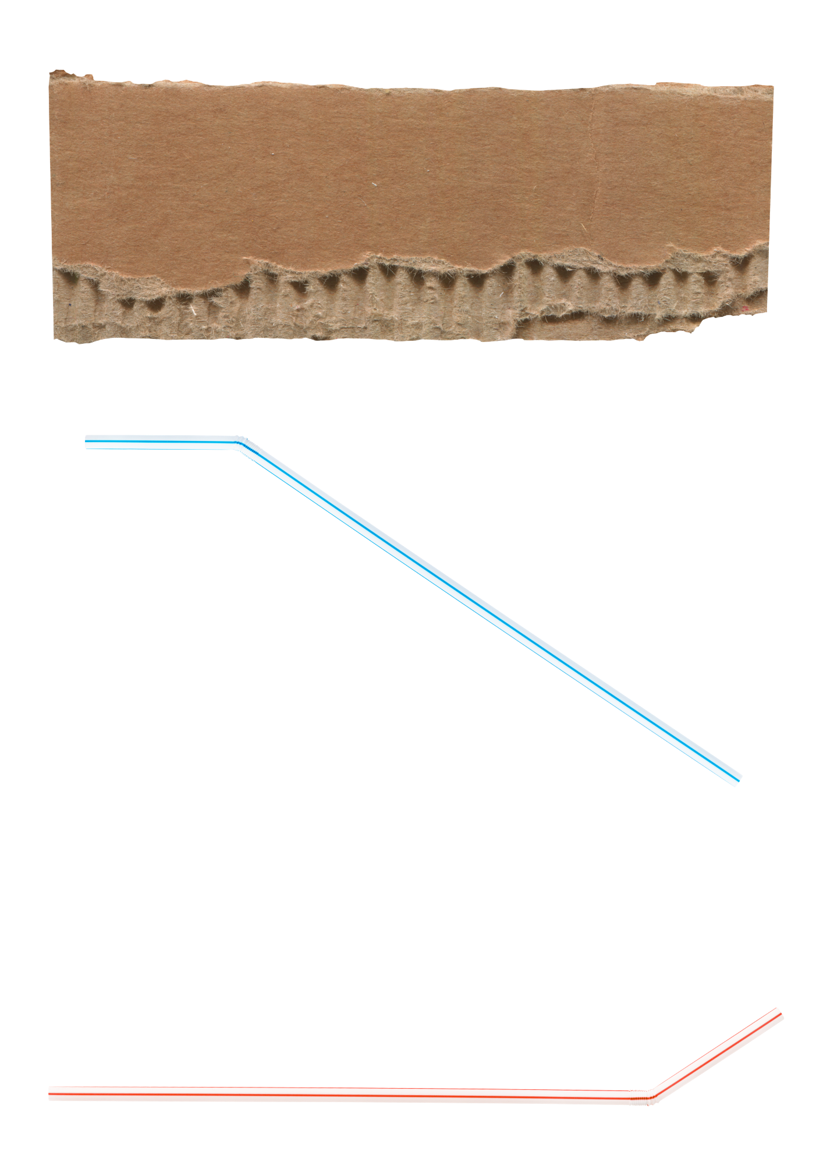
How will we do it?
Let's explore how to stop the egg breaking. ​
​
Think about these questions before designing:​
​
What materials will you use?​
​
How can you cushion the egg?​
​
How can you stop it from moving too much? ​

Slide 5

Marvellous materials
Different materials have different properties. ​
​
Soft materials absorb impact. ​
​
Hard materials are strong but may not protect fragile eggs. ​
​
The harder the egg hits the floor, the more likely it is to break. ​

Slide 6
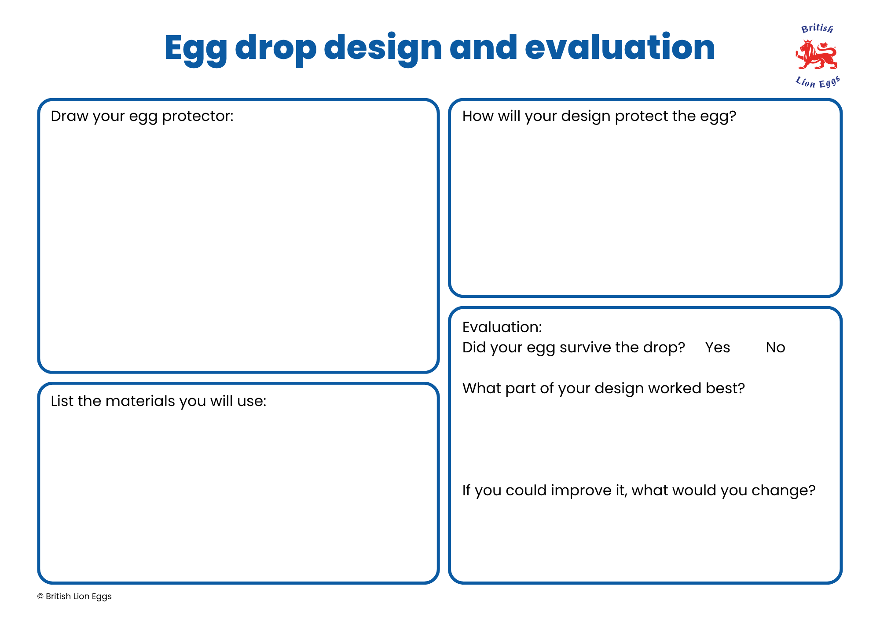
Plan your design
Draw your egg protector and list the materials you will use.
What do you think will protect the egg the most?

Slide 7

Building your device
Using your plan, build your egg protector. ​
​
You could try different materials to see what works best. ​
​
Work carefully and safely. ​

Slide 8
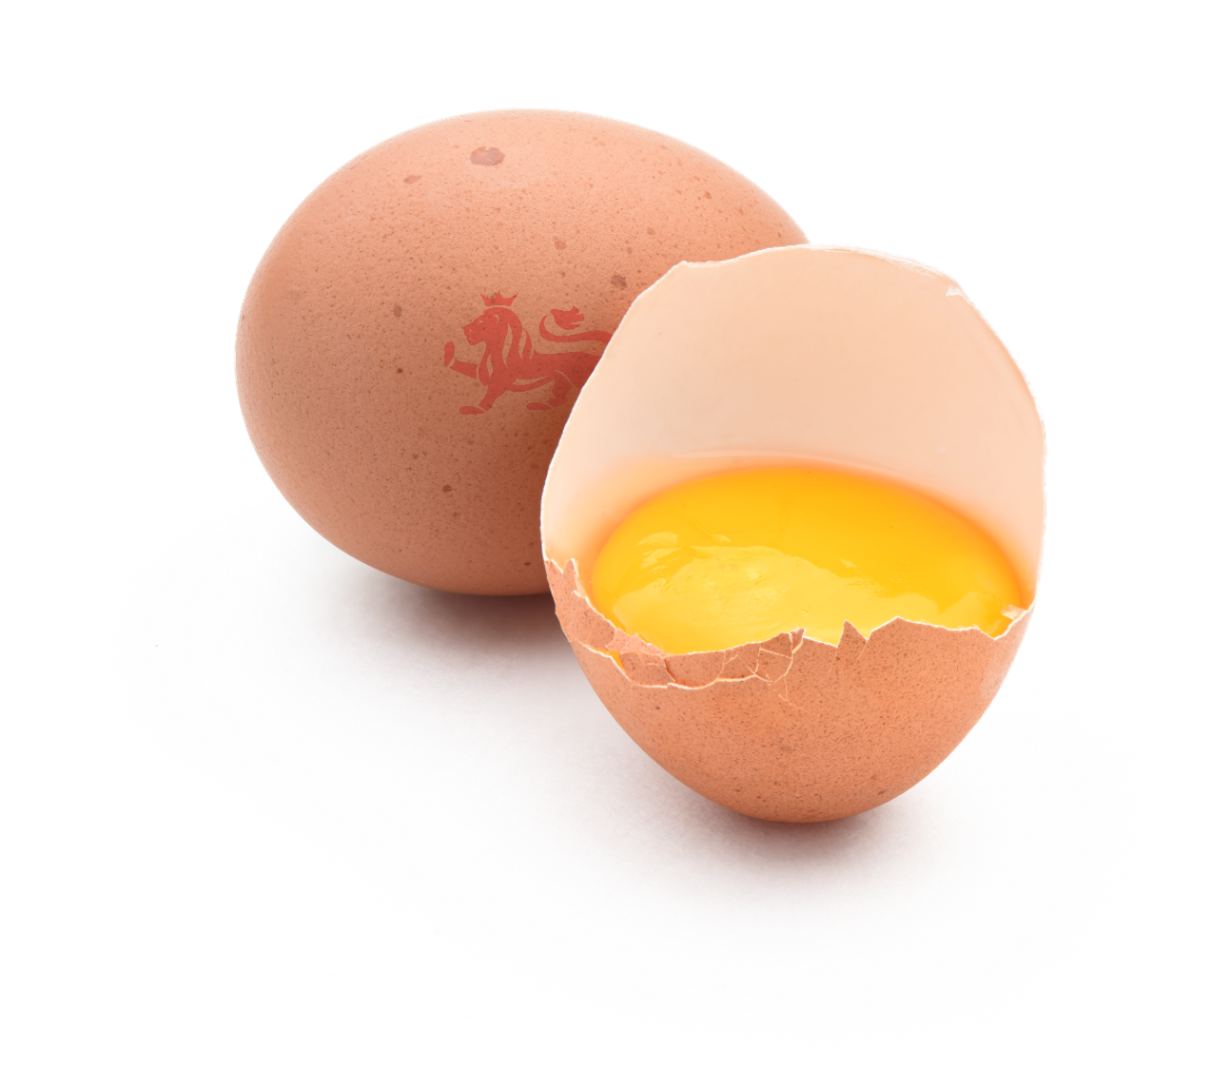
Time to test
Time to see if your egg survives the drop. ​
​
Make sure that each group's egg is dropped from the same height for a fair test. ​
​
Watch carefully. What happens? ​​

Slide 9
Evaluate your design
Did your egg survive? ​
​
What part of your design worked best?​
​
If you could improve it, what would you change? ​​

Slide 10

Share your results
Share your egg protector with the class.​
Explain your reasons for choosing the materials and design you did.​
​
Compare your ideas with the other groups. What can we learn from the different designs? ​

Slide 11

Brought to you by

