Slide 1

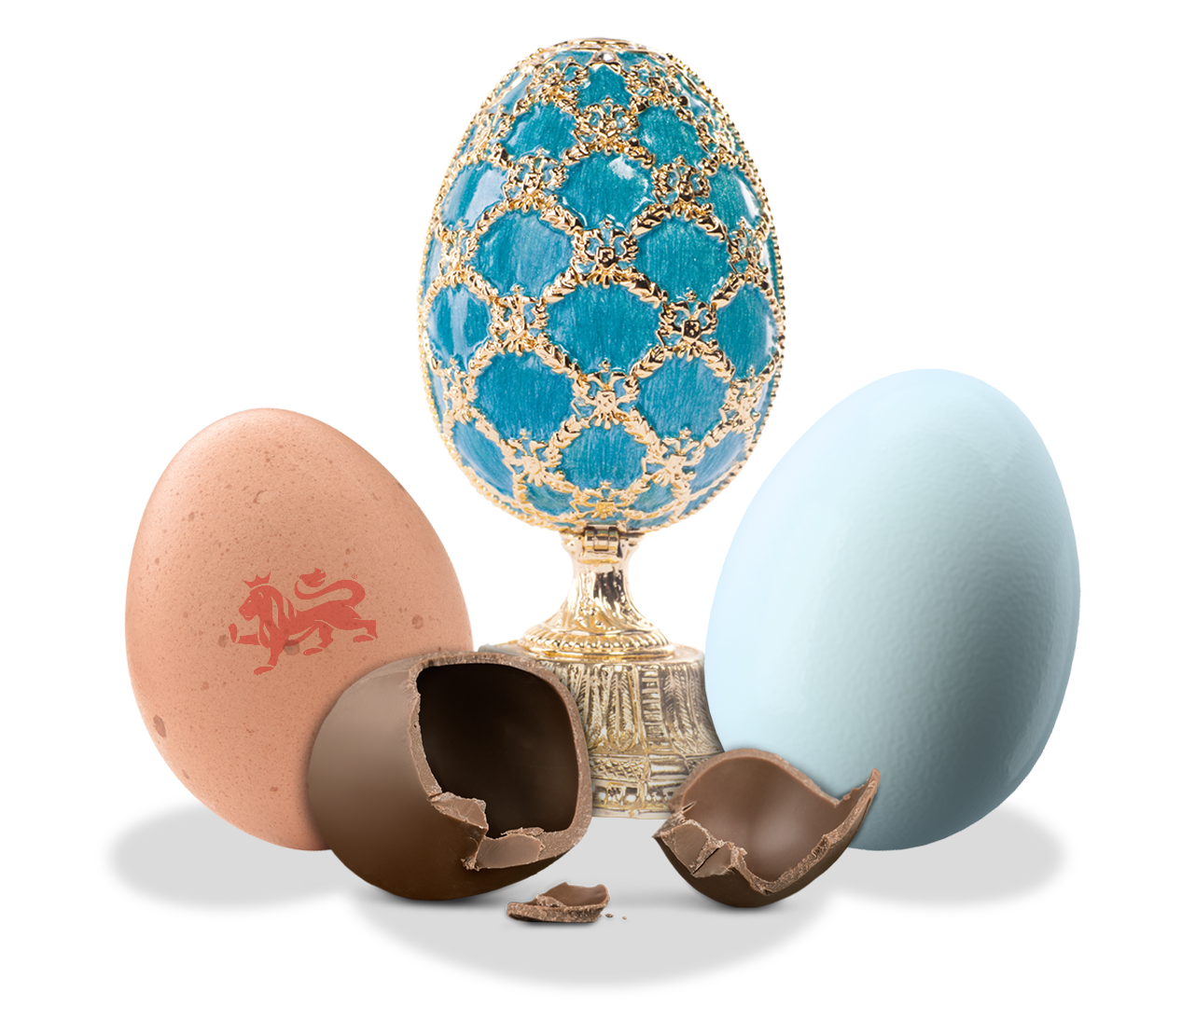
The great egg debate

Slide 2
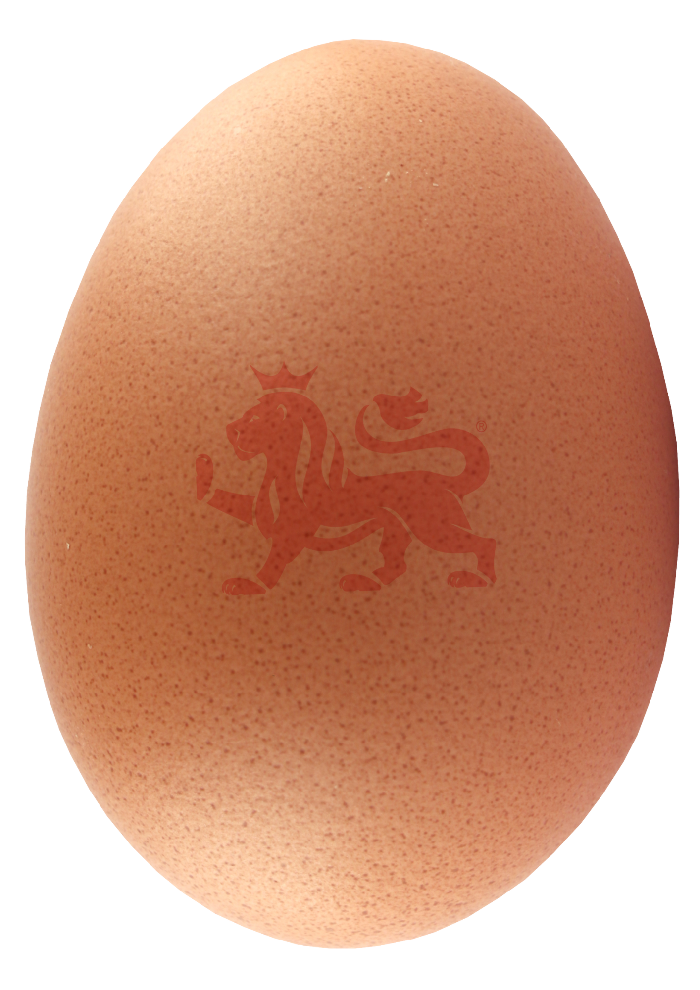
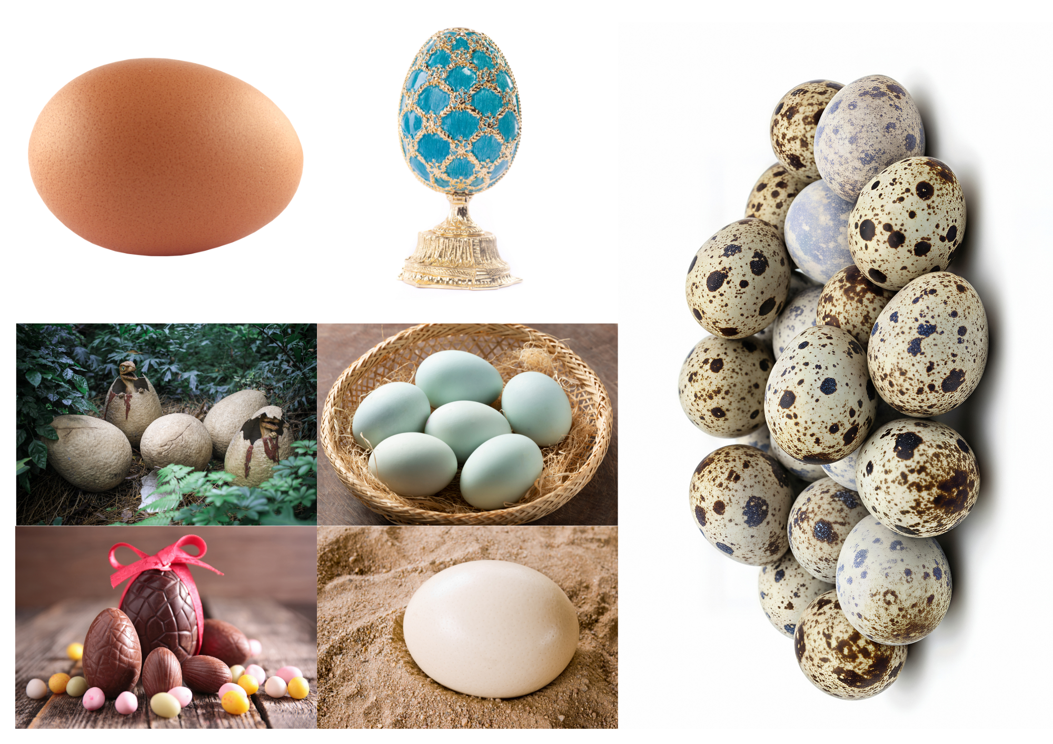

Eggstraordinary opinions
Which egg do you like best?

Slide 3
What is an opinion?
An opinion is what you think about something. It is not usually based on fact or knowledge.
For example:
My opinion
I think the chocolate eggs are the best because I think they would taste nice.
My reason
Let’s build an opinion together.

Slide 4
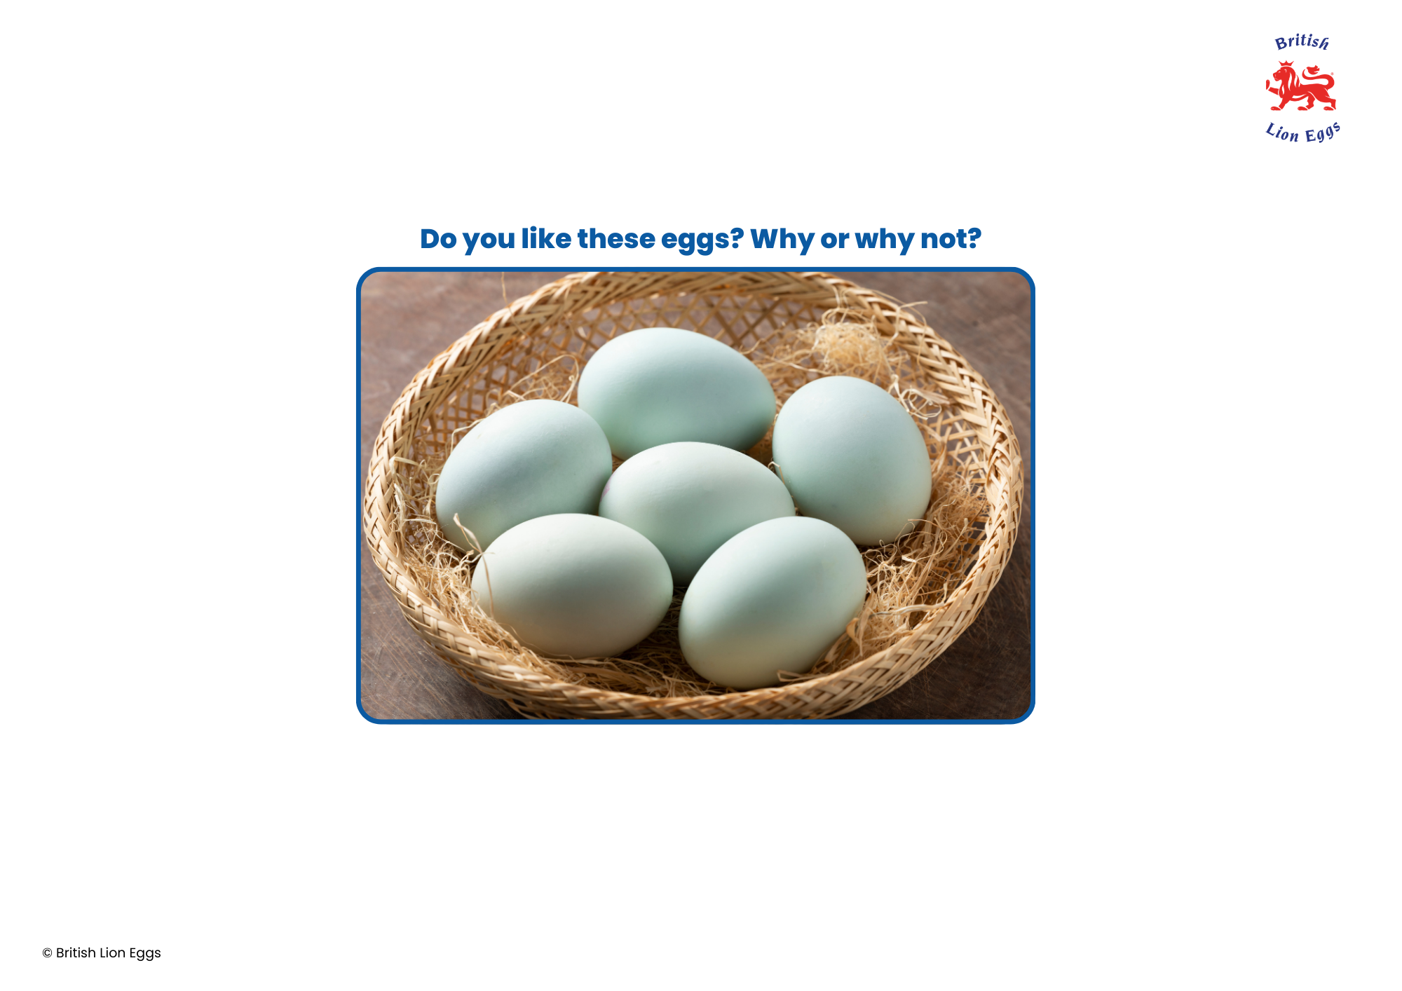
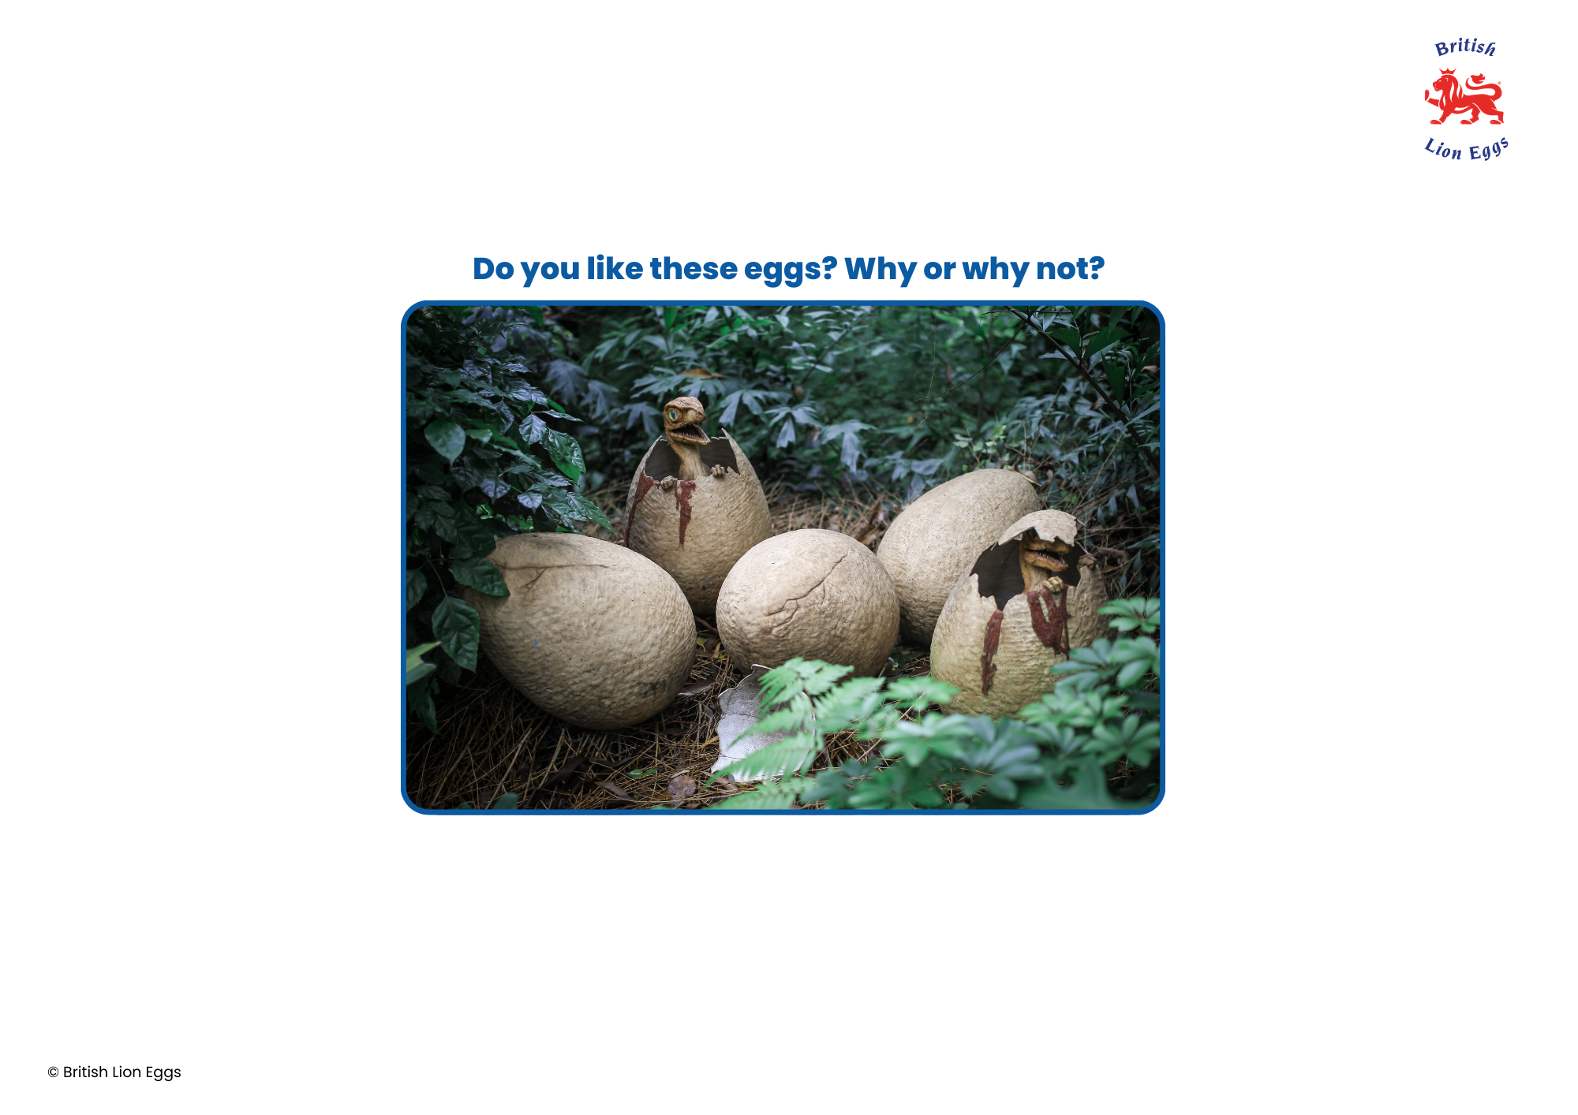
Thinking together
In your pairs, look at your egg picture and talk about:
Whether you like it or not, and at least one reason why.
Write your thoughts around your picture.

Slide 5
Egg debate
Present your opinions.​
​​
As each pair presents, we are going to listen and support them, even if we don't agree with their opinion. ​
​
If you don't agree, you can politely say and explain why.

Slide 6
What do you think now?
Which egg do you like best now?
Has your opinion changed?

Slide 7

Brought to you by

