Slide 1
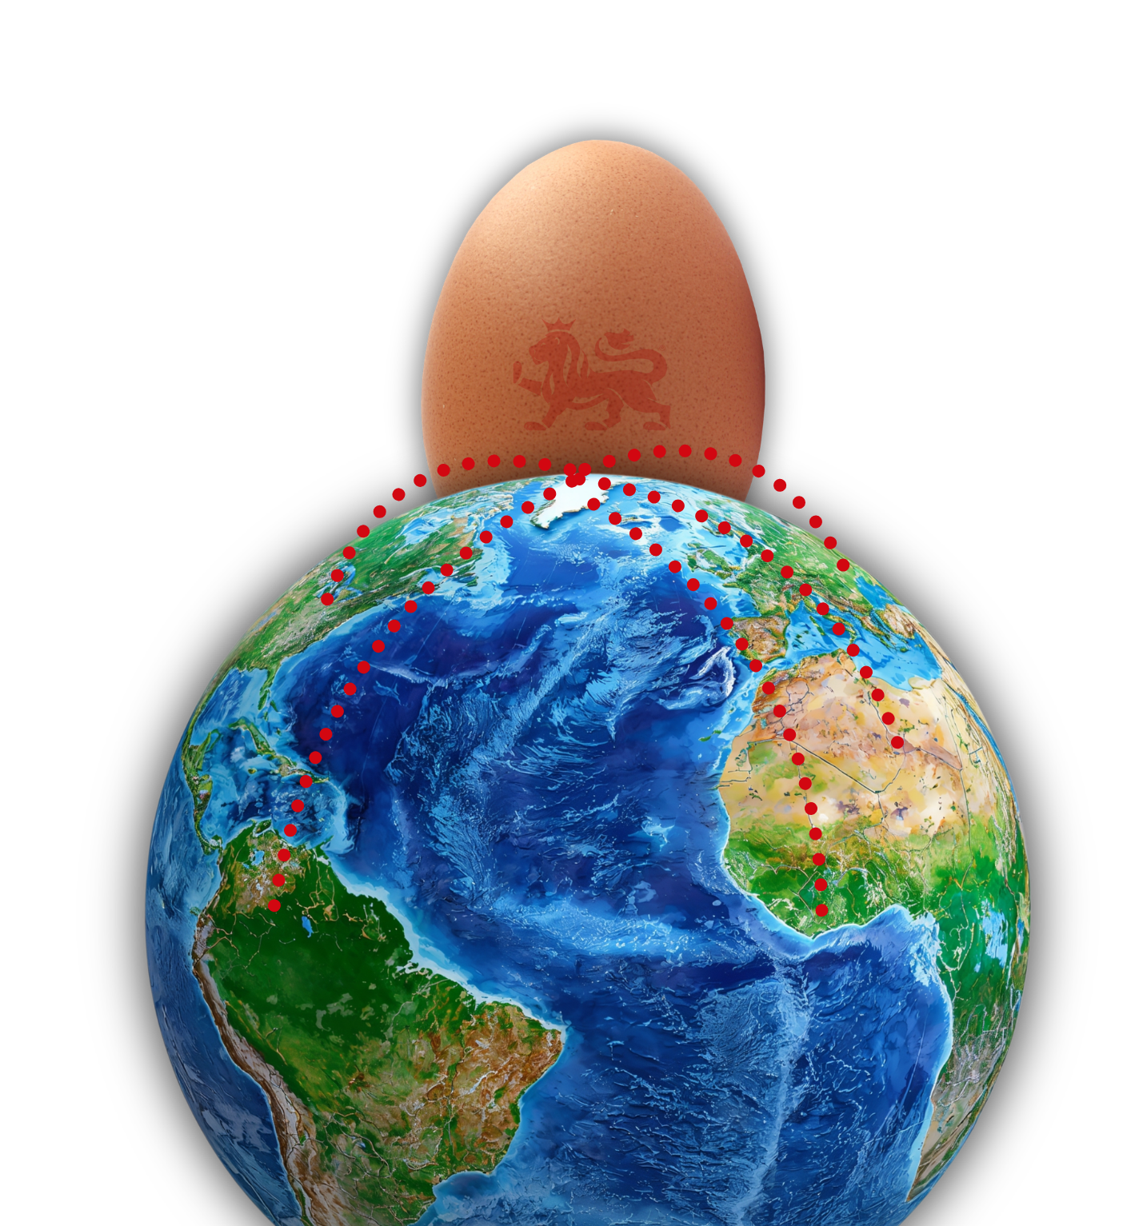

The great global eggspedition

Slide 2
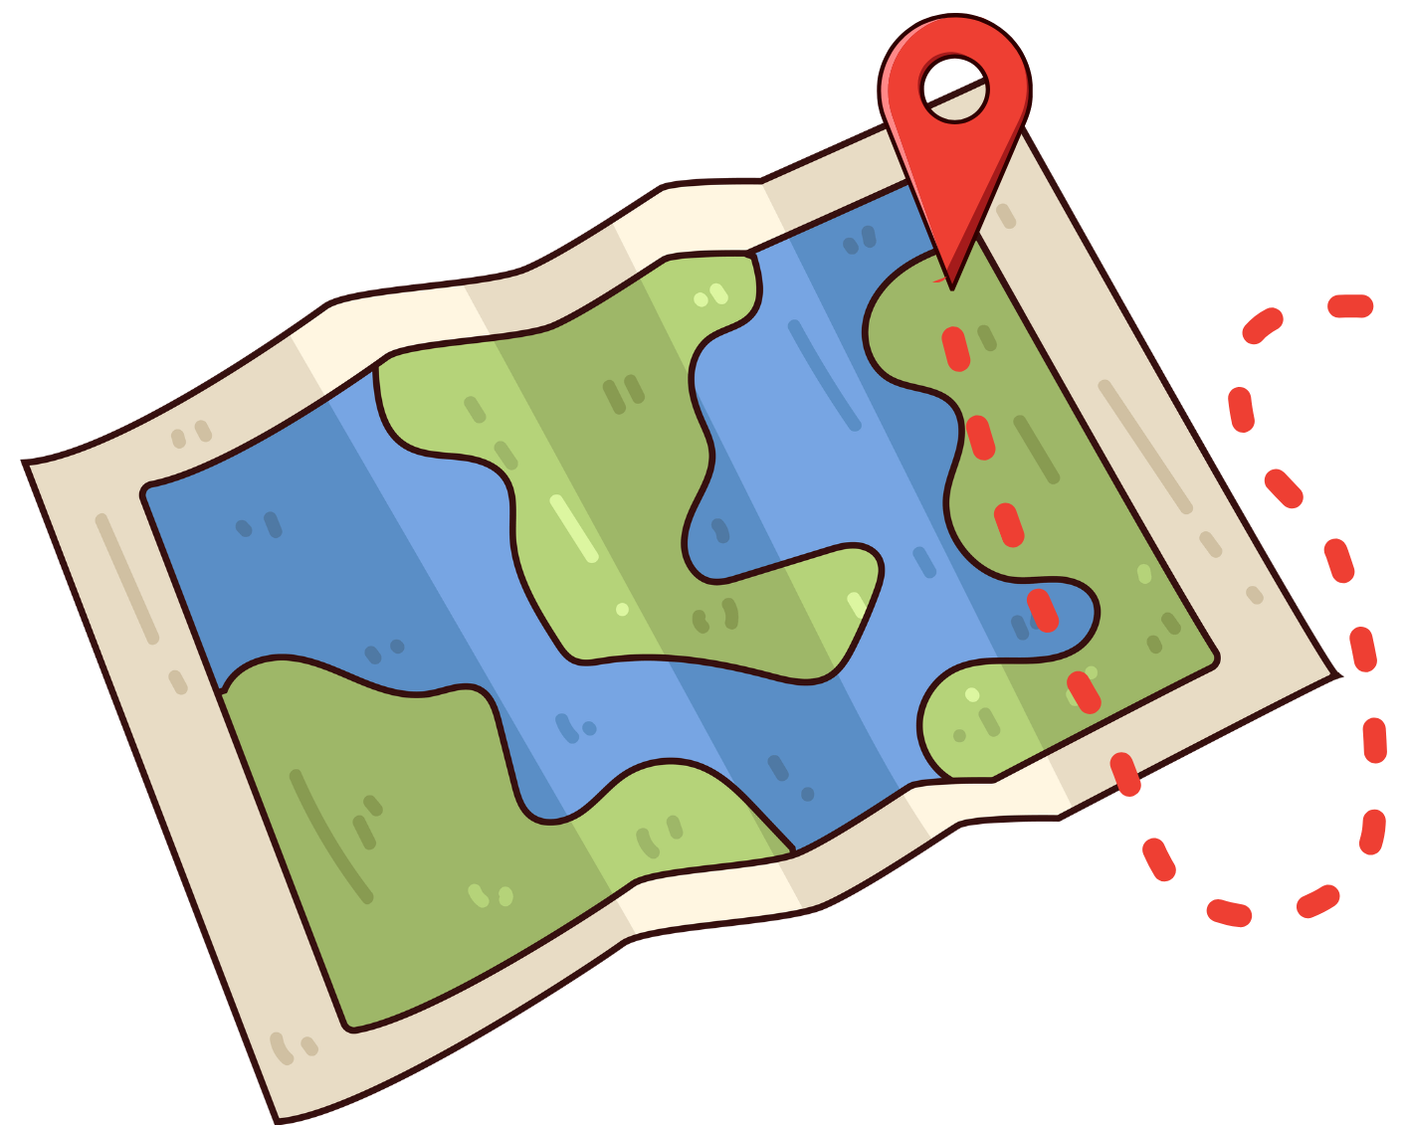
  Eggspedition launch
Welcome to the great global eggspedition!
Today we will discover where eggs come from, how far they travel and how we can make responsible choices when buying eggs.

Slide 3
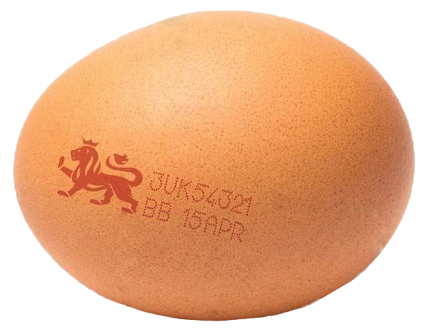
  Egg code explorers
Do you know any countries that eggs come from?​
Eggs have a special code on them that tells us: ​
Which country they come from​
What type of farm the hen is on​
A farm ID

Slide 4
  Egg code explorers
So, for example:
1UK54321​
Each code is made of numbers and letters. ​
​
The first number tells us the farming method used to produce the eggs. There are four different types:
The two letters tell us the country of origin, where the egg is from. ​
​
The five numbers are a unique code that means the egg can be traced back to a specific farm.
Type of farm
1 = Free range
Unique farm code
Country of origin: United Kingdom
0: Organic​
1: Free range​
2: Barn​
3: Cage
2ES67890
Type of farm
2 = Barn
Unique farm code
Country of origin: Spain

Slide 5

  Map your eggs
Geographers use evidence, not guesswork to find out information. ​
Where do eggs travel from?
We are going to use a world map and egg codes to find out. ​​​​

Slide 6
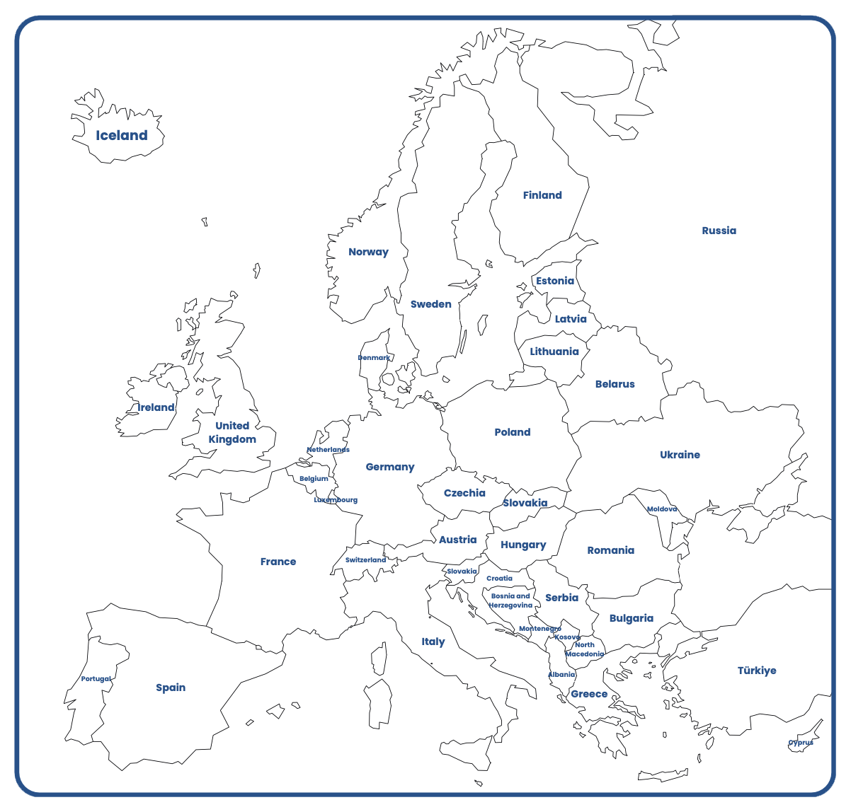
  Egg origins investigation
2FR56478
Farm methods keys:
0: Organic
1: Free range
2: Barn
3: Cage

Slide 7
  Eggs origins investigation
Your task is to:
Look at all the egg codes;
Use the key to work out what country the egg is from;
Find the country on the map of Europe;
Complete the table showing the name of the country;
Find whether it is East, West, North or South of the UK
Identify the type of farm the egg comes from. ​
​
After this, answer the questions. ​

Slide 8
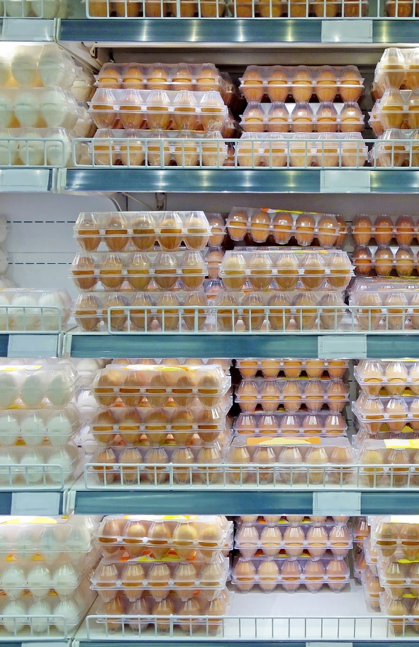
Making responsible choices
Imagine you are the manager of a supermarket. ​
​
Would you choose:​
​
Cheaper eggs that are imported, and you don’t know how the hens are looked after, or production standards?​
British Lion eggs, which have the British Lion Quality mark showing the eggs are from UK farms and meet strict welfare, hygiene, and food safety standards?​

Slide 9
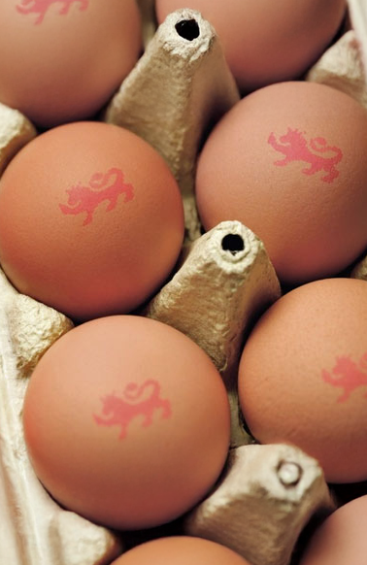
Who would be affected by your choice?​
​
What do you think are the benefits of choosing British Lion eggs? ​
​
Choosing British Lion Eggs means you can be certain that the hens the eggs have come from have been looked after properly and the eggs have been checked for safety and quality. ​
​
Also, by choosing eggs with the British Lion mark, you are supporting UK farmers and local jobs.

Slide 10

Eggspedition reflections
Time to reflect on what you have learned. ​
Finish these sentences: ​
One thing I have learned about where eggs come from is...
One responsible choice I can make is...

Slide 11

Brought to you by

