Slide 1

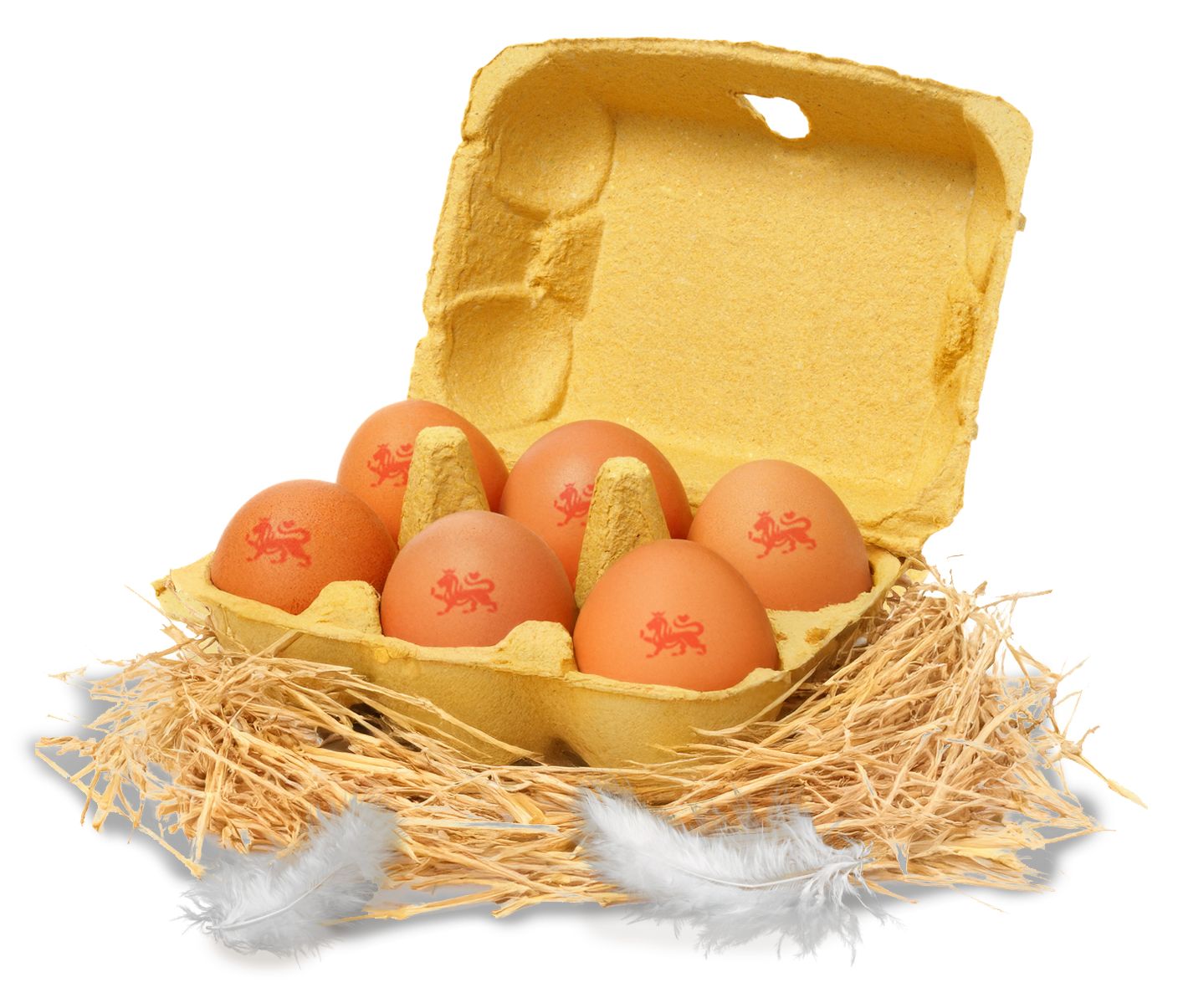
The journey of an egg

Slide 2

Where do you think eggs come from?
Eggs can come from here in the UK or other places around the world. ​

Slide 3
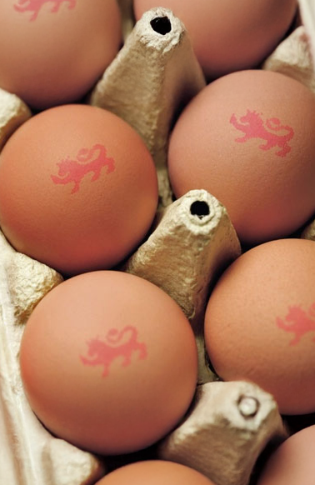
  Where do British eggs come from?
Not all eggs we buy are from the UK. ​
​
If you see the British Lion mark on an egg, it is produced in the UK. ​
​
Eggs with the British Lion quality mark are from UK farms and are checked to make sure they are safe and good quality.

Slide 4
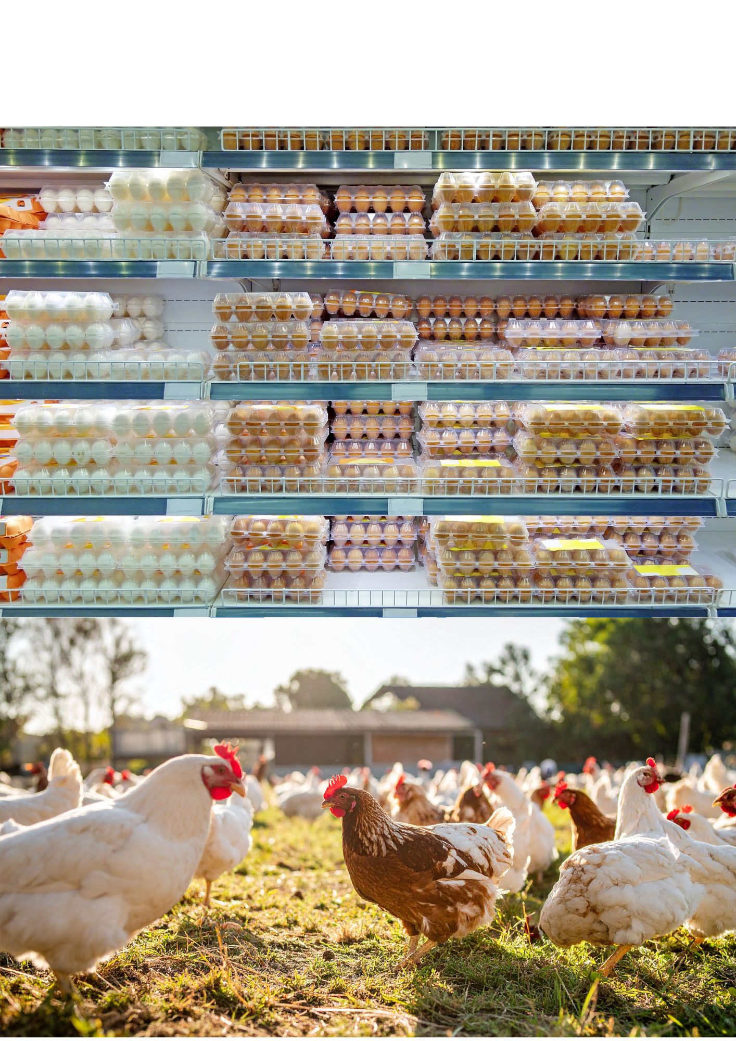

Do eggs grow in shops?
You might get your eggs from a supermarket, but that's not where they start. ​
​
Eggs come from farms. ​
​
Do you know which animal lays these type of eggs?

Slide 5
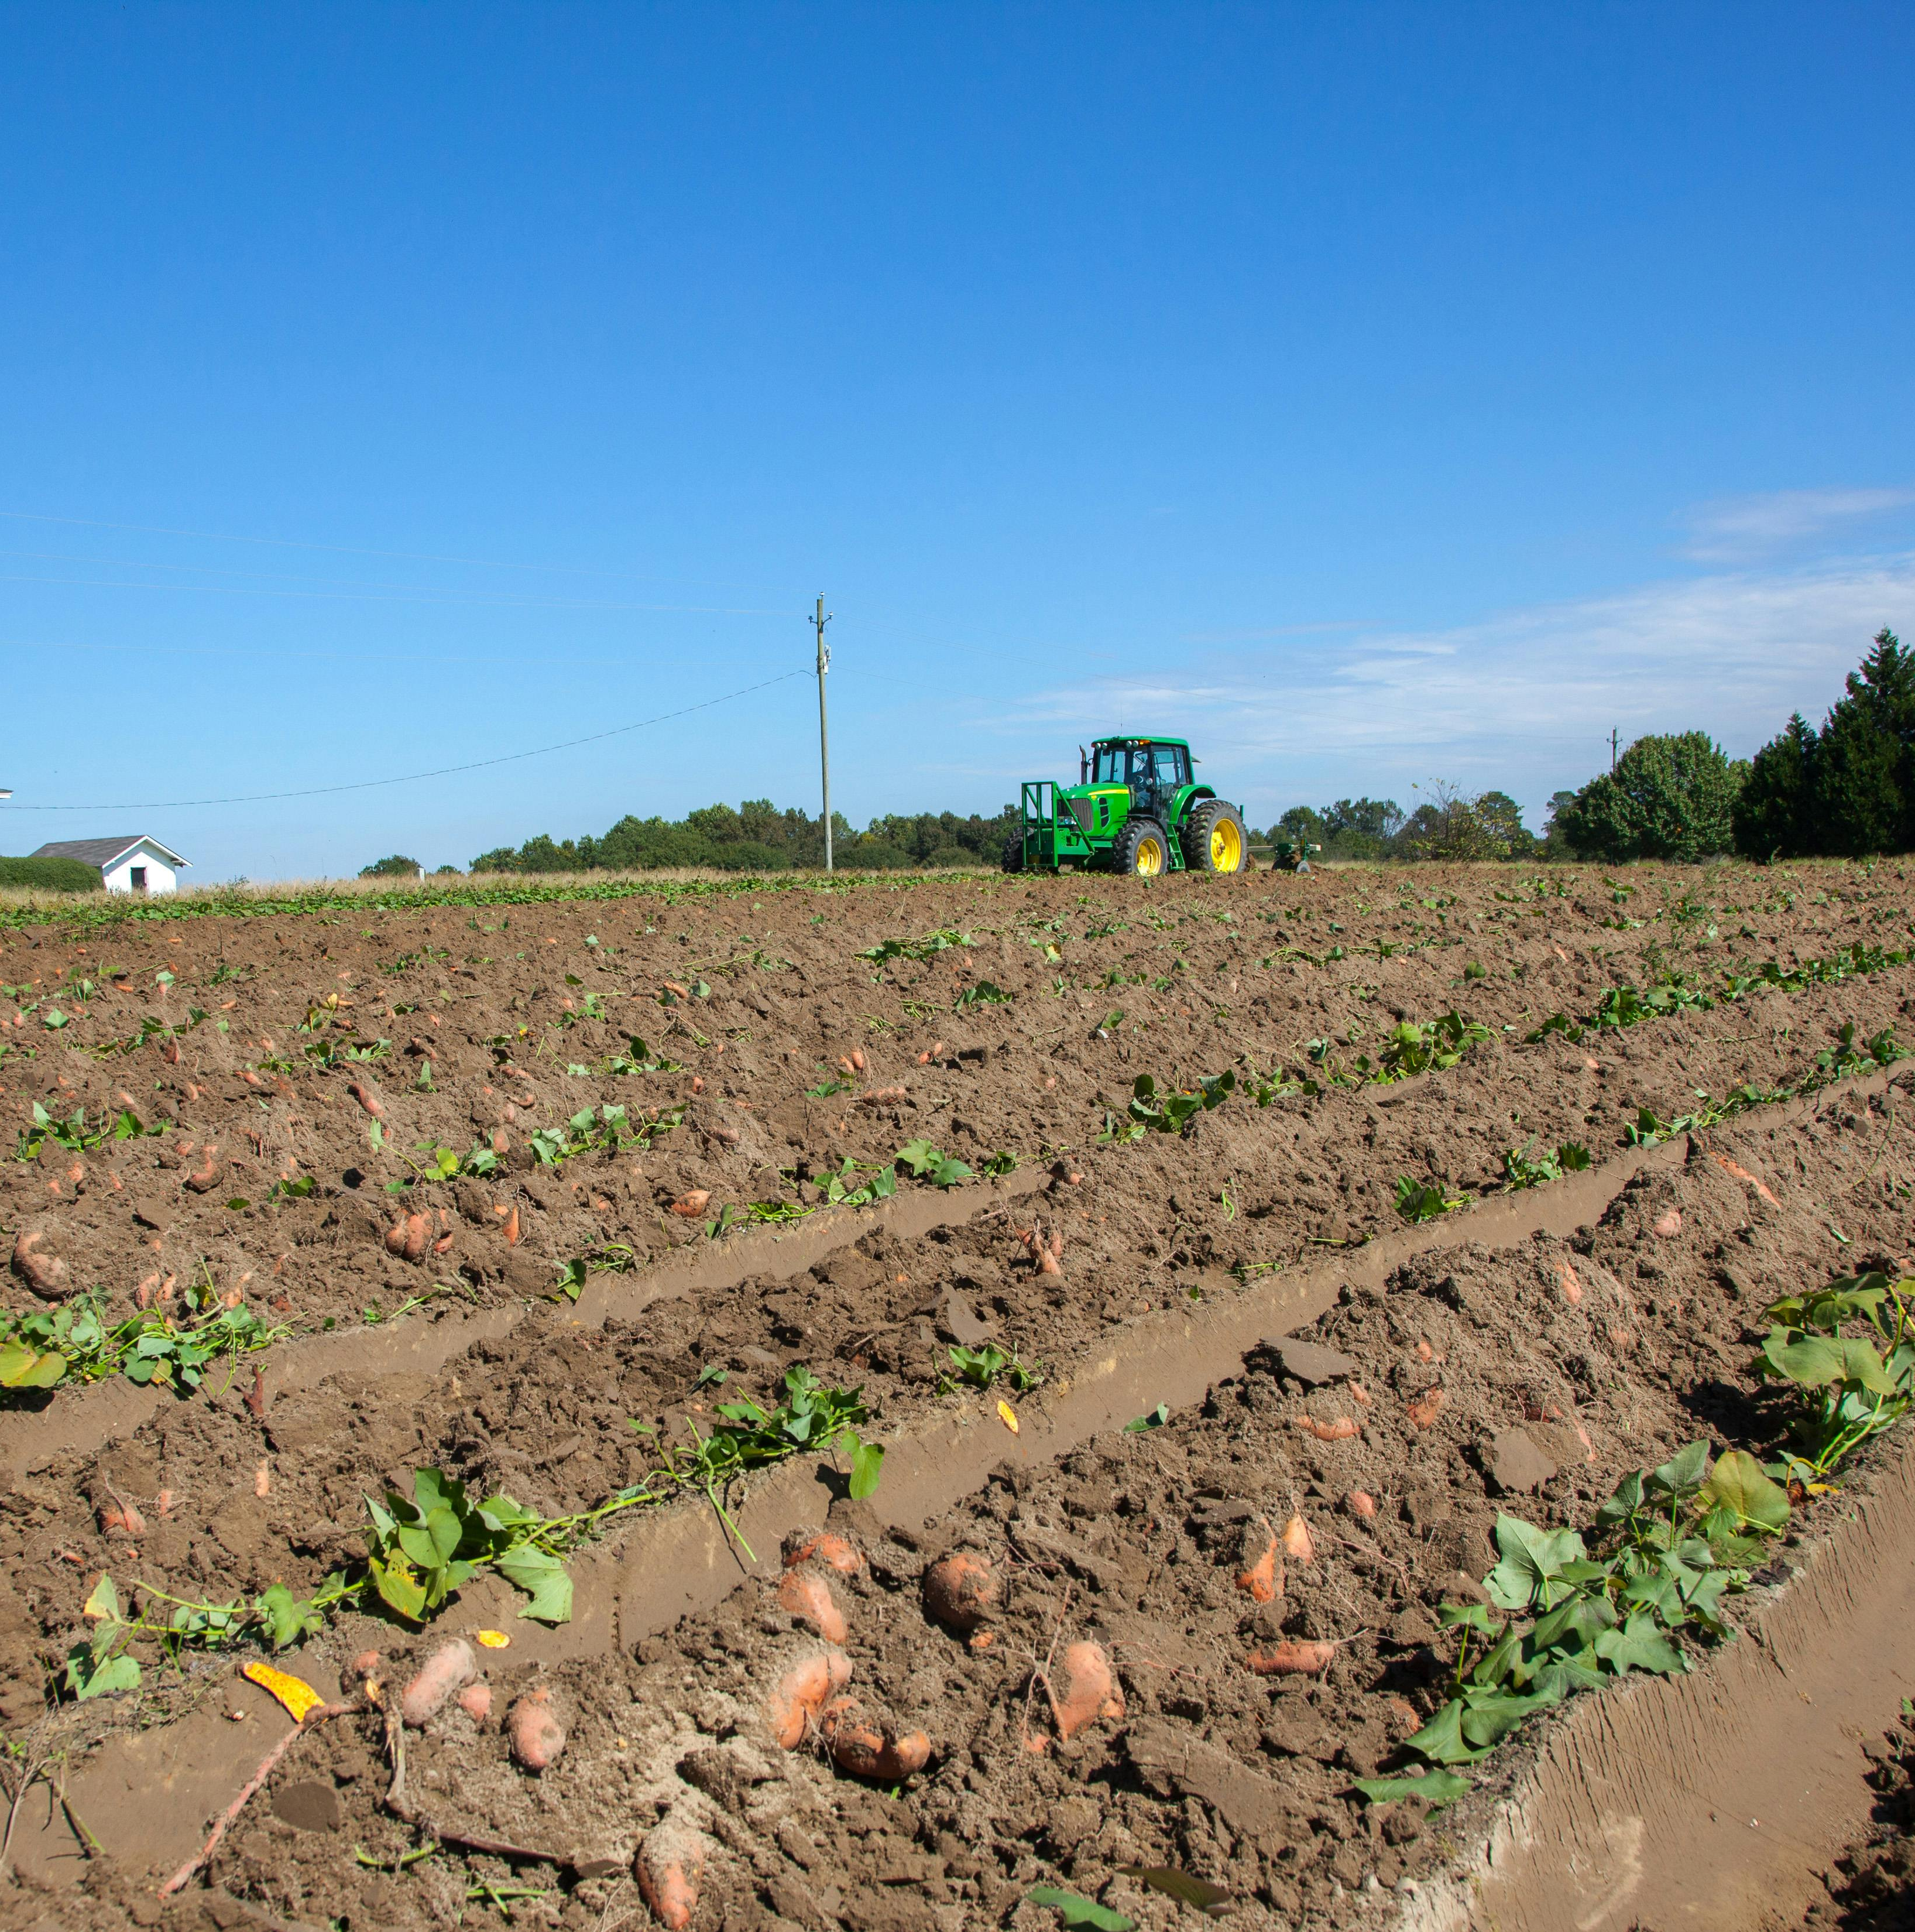
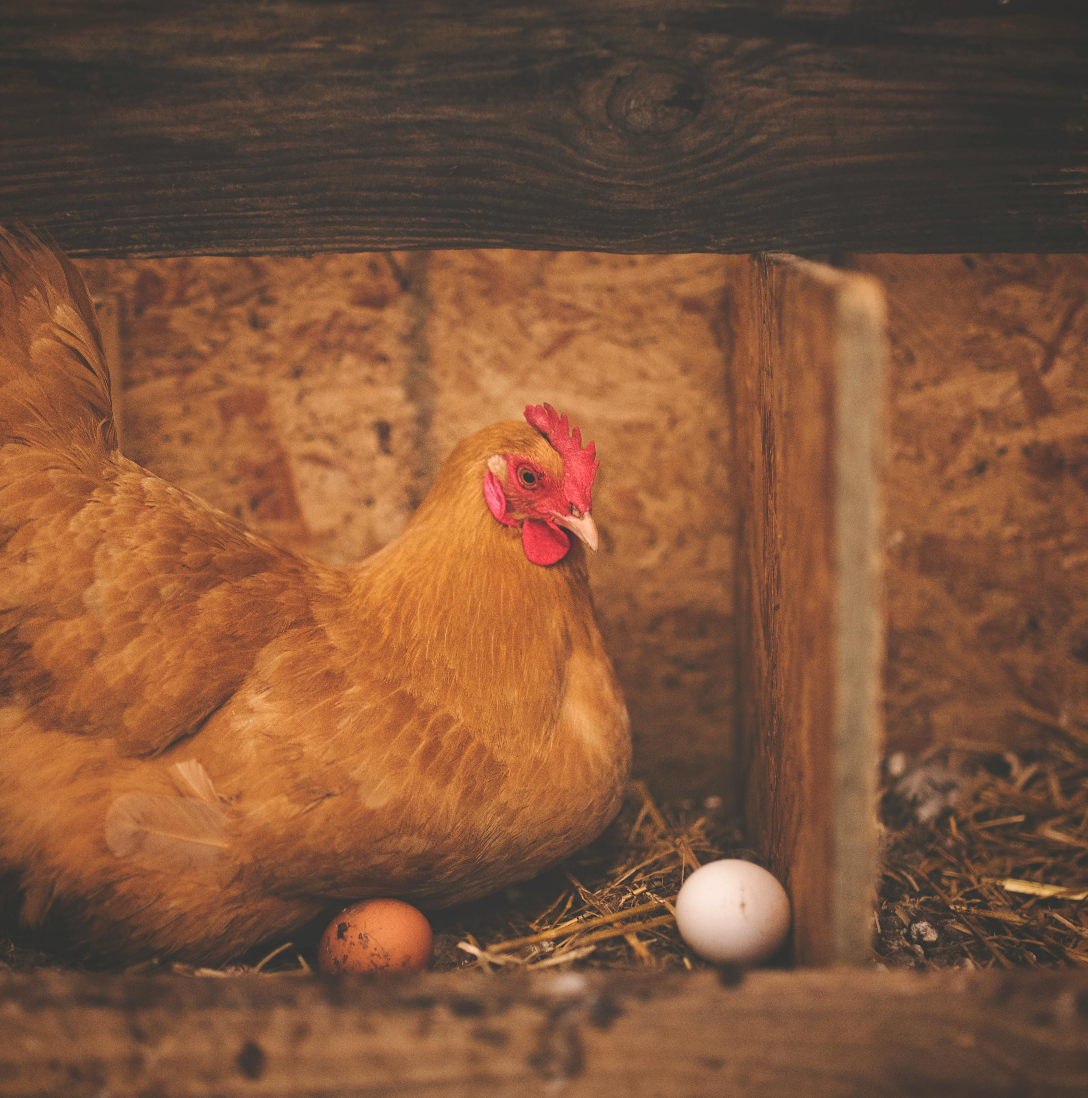
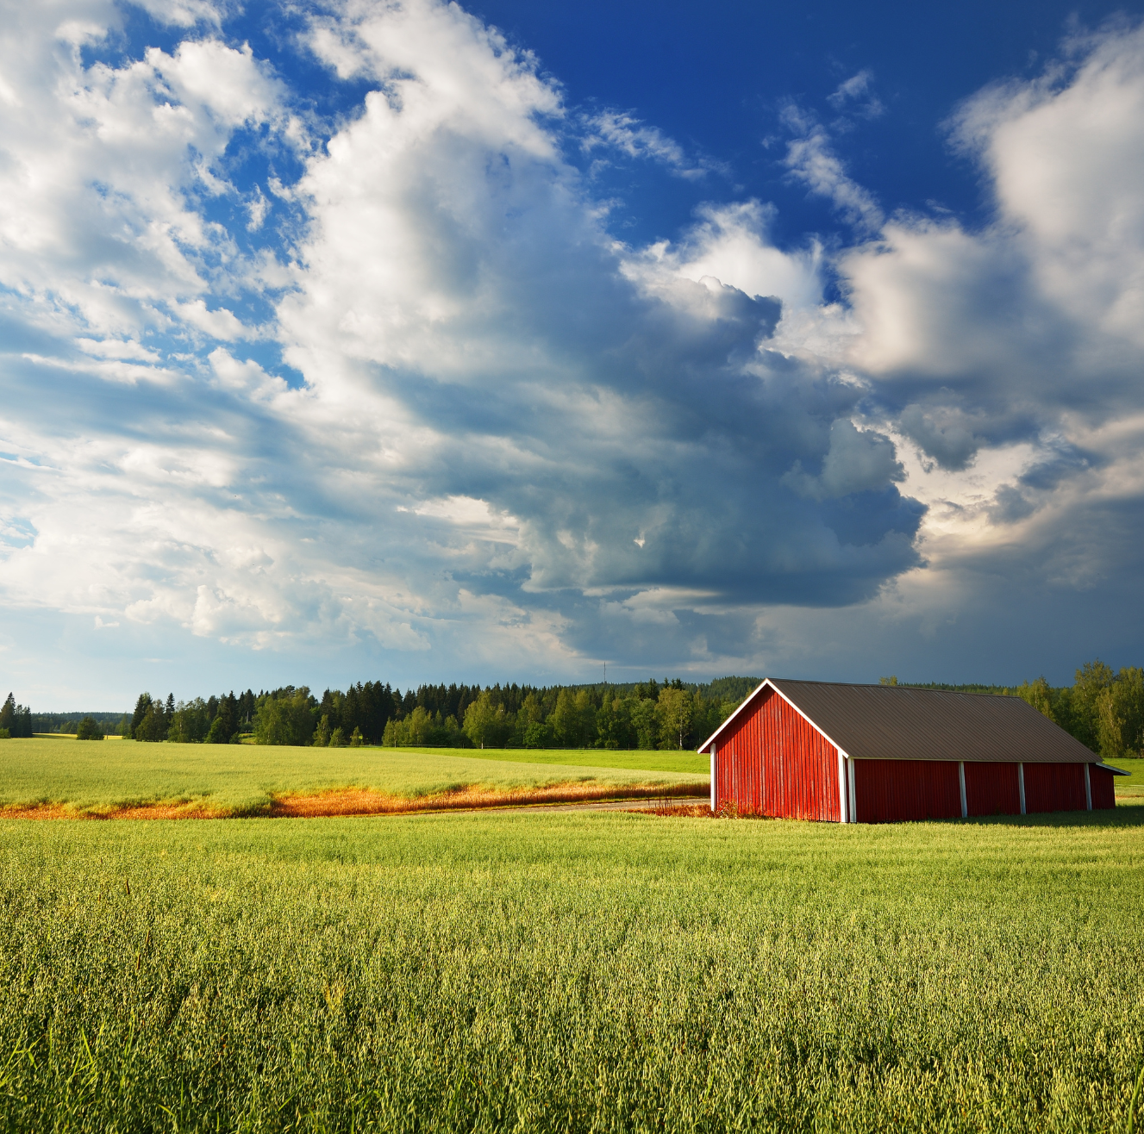
What is a farm?
A farm is a place where food is grown or produced.​
​
Lots of the food we eat every day comes from these farms like milk, fruit, vegetables....and eggs. ​
​
Hens live on farms. They lay their eggs and farmers collect them carefully. ​

Slide 6
Farms
Farms are usually in the countryside or a bit further outside towns and cities. ​
​Why do you think farms are not usually in the middle of cities?
Farms need lots of space so that they can grow crops and raise animals.

Slide 7

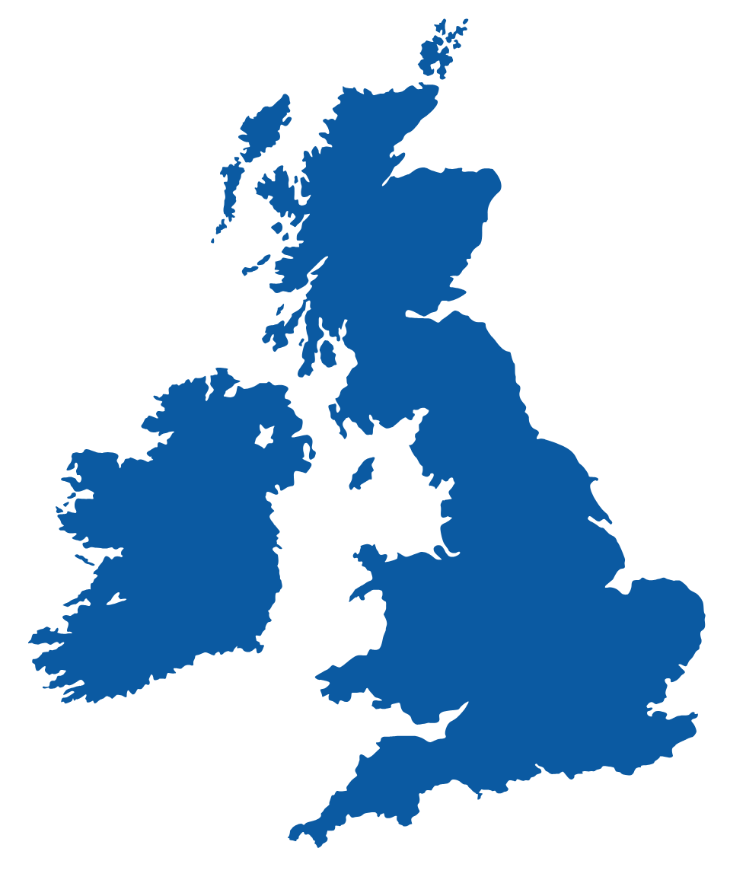
Where is the United Kingdom?
Eggs with the British Lion mark come from farms in the United Kingdom.
Do you know where the UK is?
The UK is where we live

Slide 8
The countries of the UK
The United Kingdom is made up of four countries.
Do you know the names of any of these countries?
Scotland
Which country of the UK do we live in?
Northern Ireland
England
Wales

Slide 9

Eggs all over the UK
British Lion eggs don't just come from one place. ​
​
They come from farms all over the UK.
Why do you think eggs come from lots of different places?

Slide 10
Country labelling
Can you identify the four countries of the UK on a map?​
​
Remember, the four countries are called: ​
​
England​
Scotland​
Wales​
Northern Ireland​​

Slide 11
Thinking like a geographer
British eggs come from farms in each country of the UK. ​
​
Can you remember the names of the four countries?

Slide 12
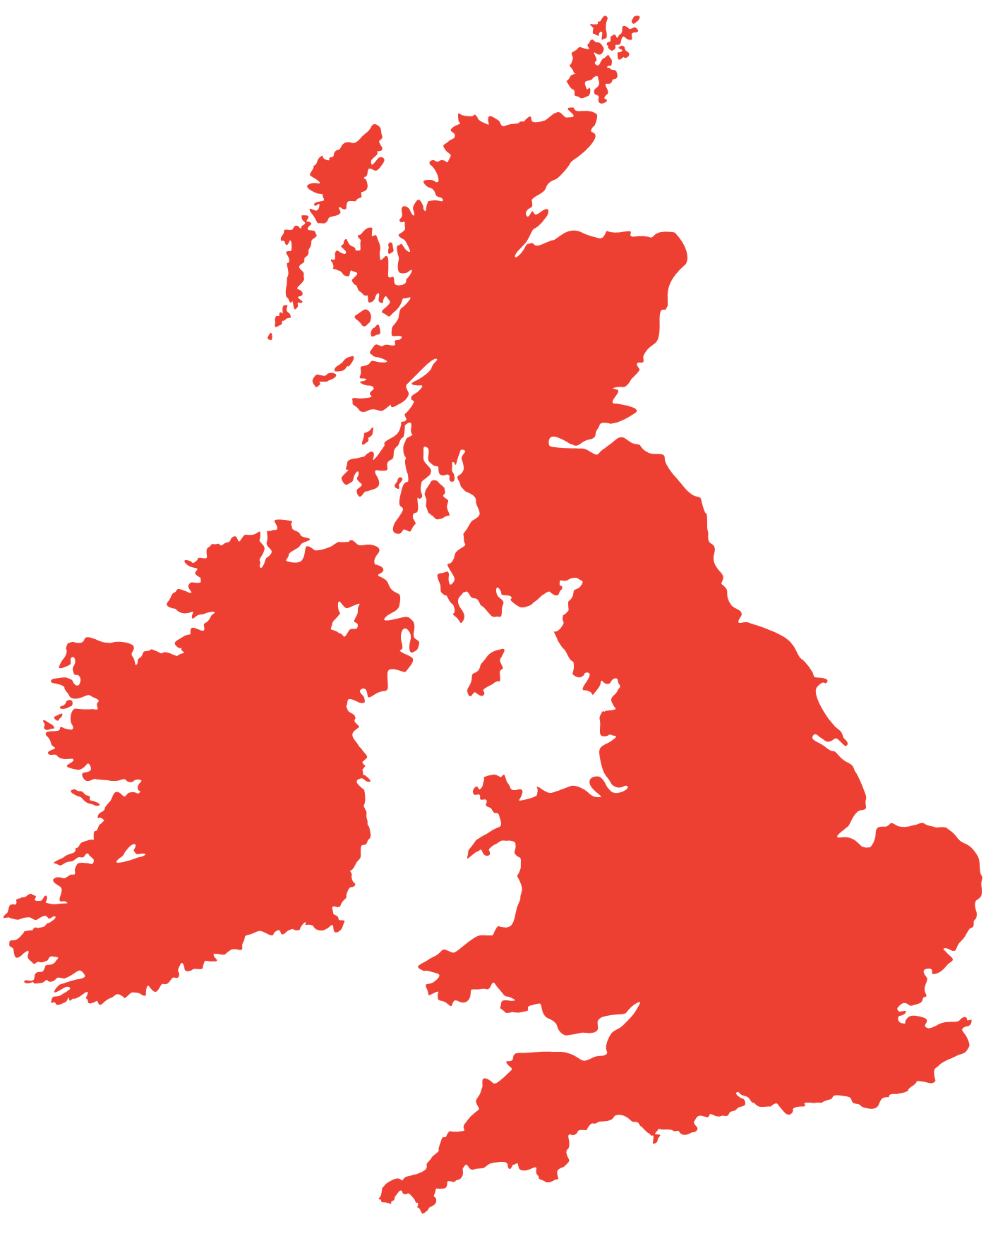
Recap our learning
Who knows where England is on the map? ​
​
Can you name any of the other countries of the UK? ​

Slide 13

Brought to you by

