Slide 1

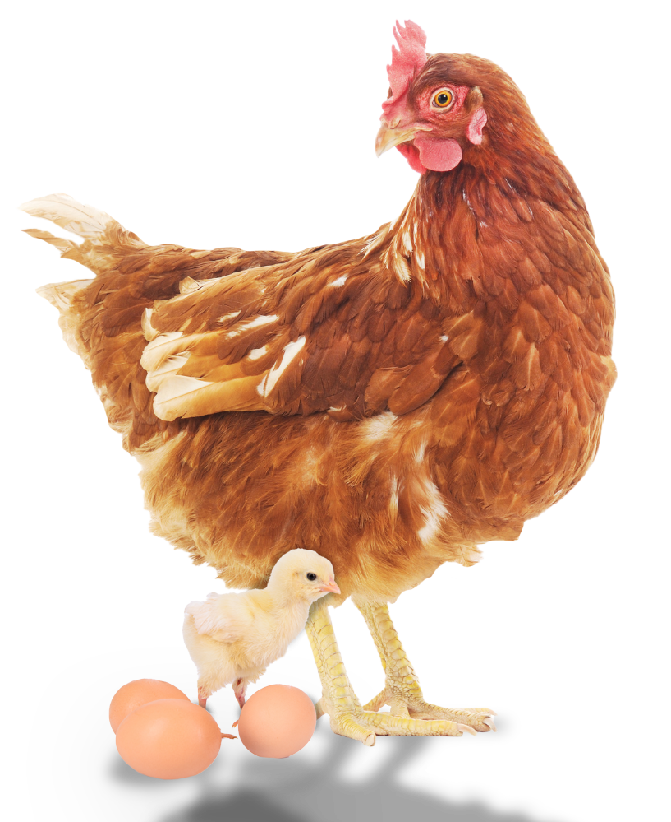
The secret life of eggs

Slide 2
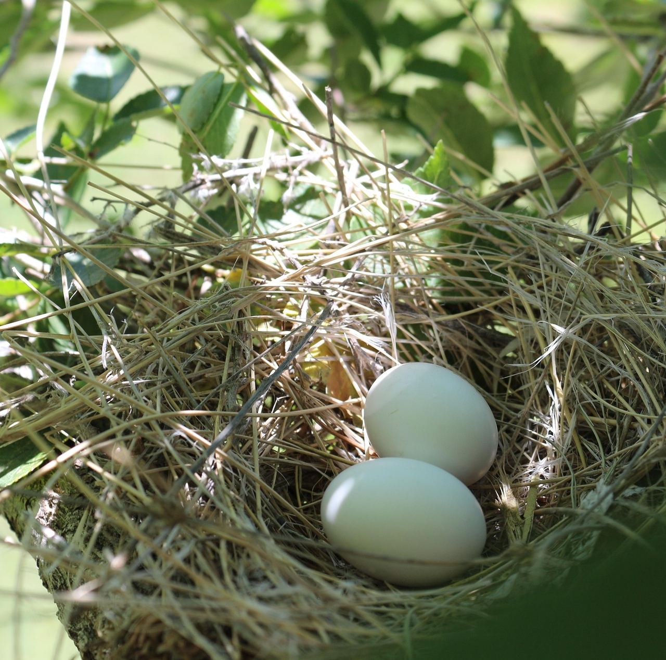
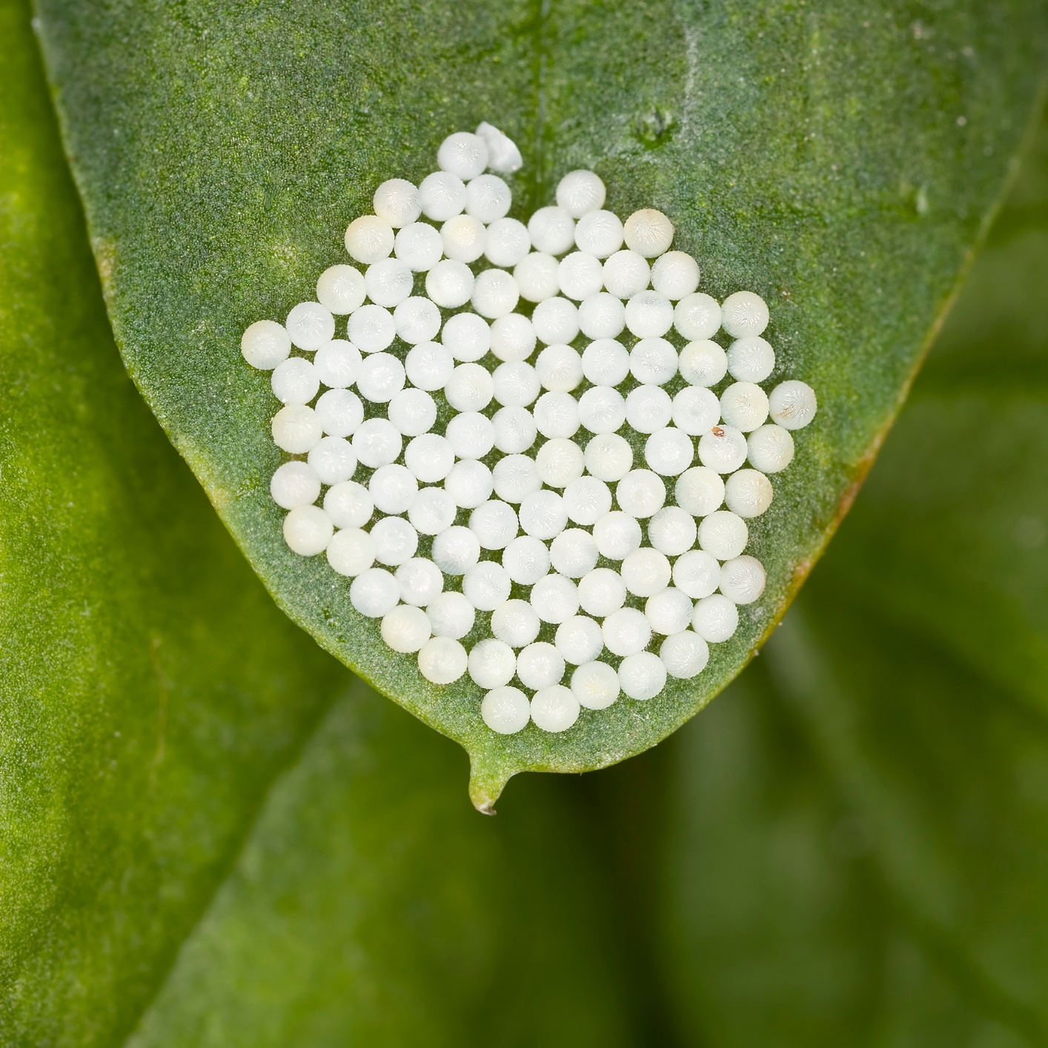
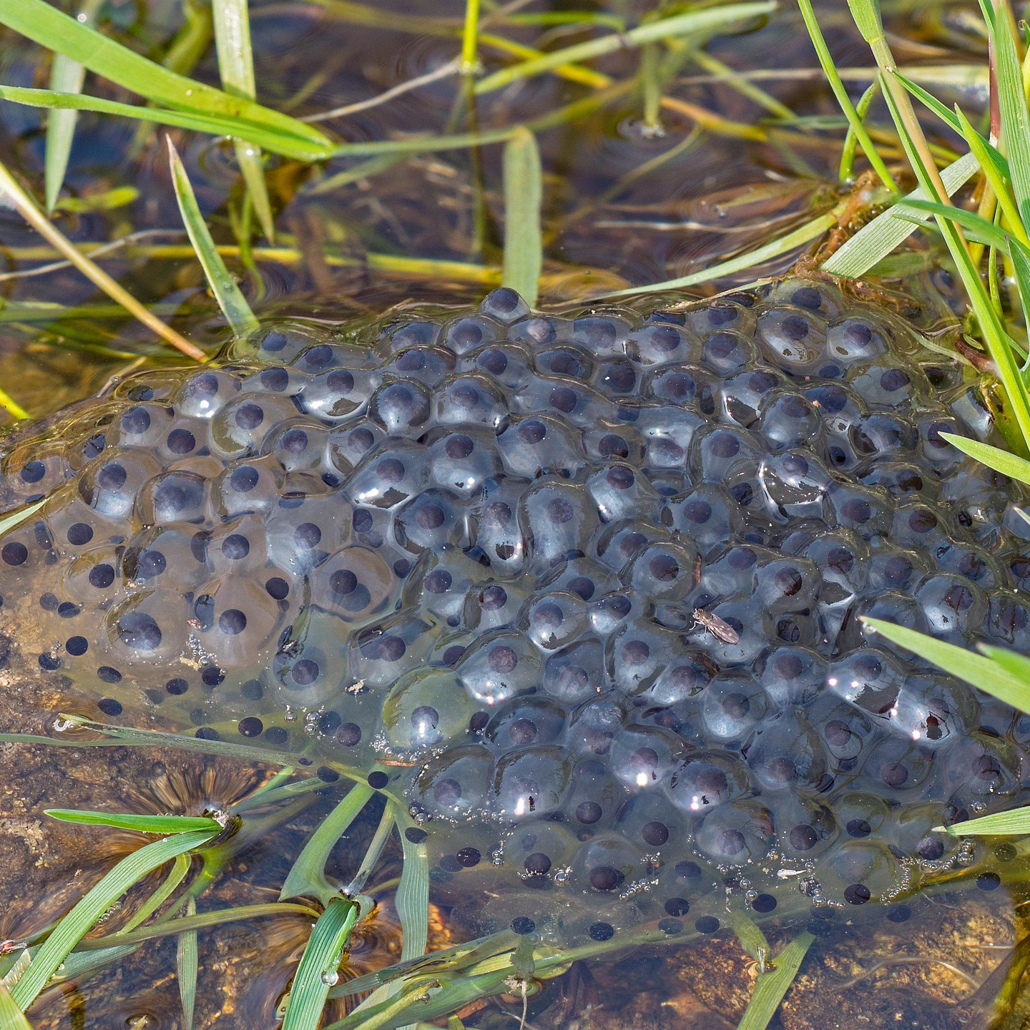
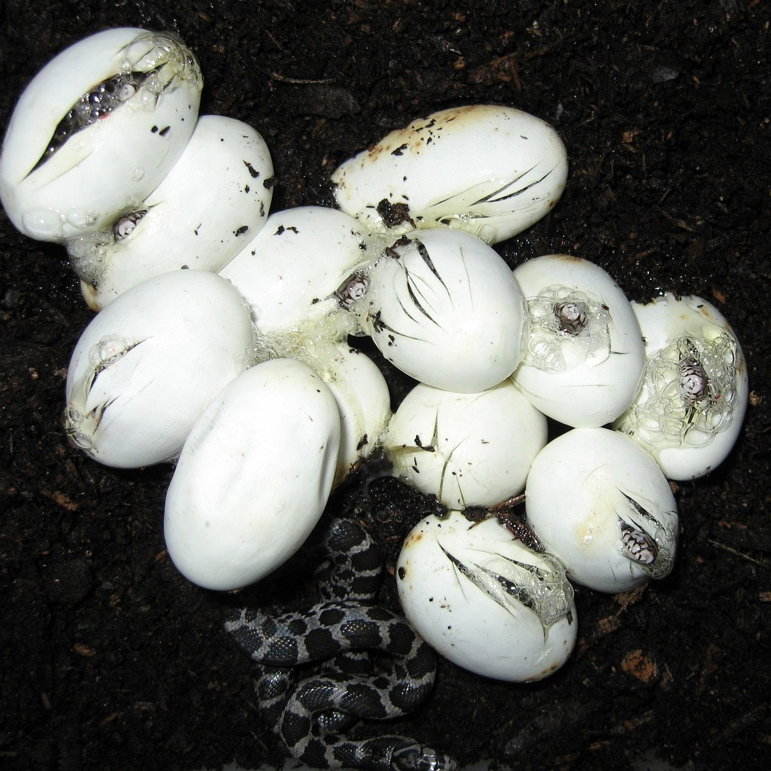

What’s inside the egg?
Every animal begins life from a tiny egg cell. Some eggs we can see. Like the ones animals lay.
Which animals do you know that hatch from eggs?
Can you guess whose eggs these might be? ​ ​
Bird
Butterfly
Frog
Snake

Slide 3
Life cycles
Even though lots of animals lay eggs. The process for this is very different.
Let’s look at some animals’ life cycles and how they are different.

Slide 4
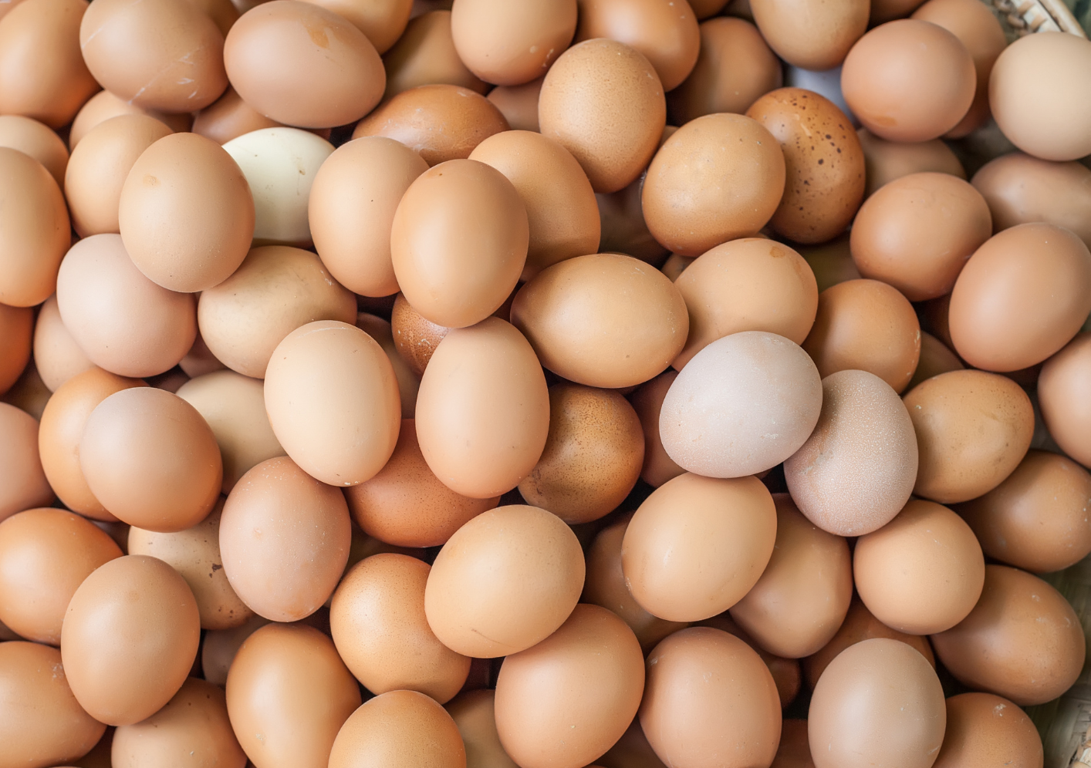
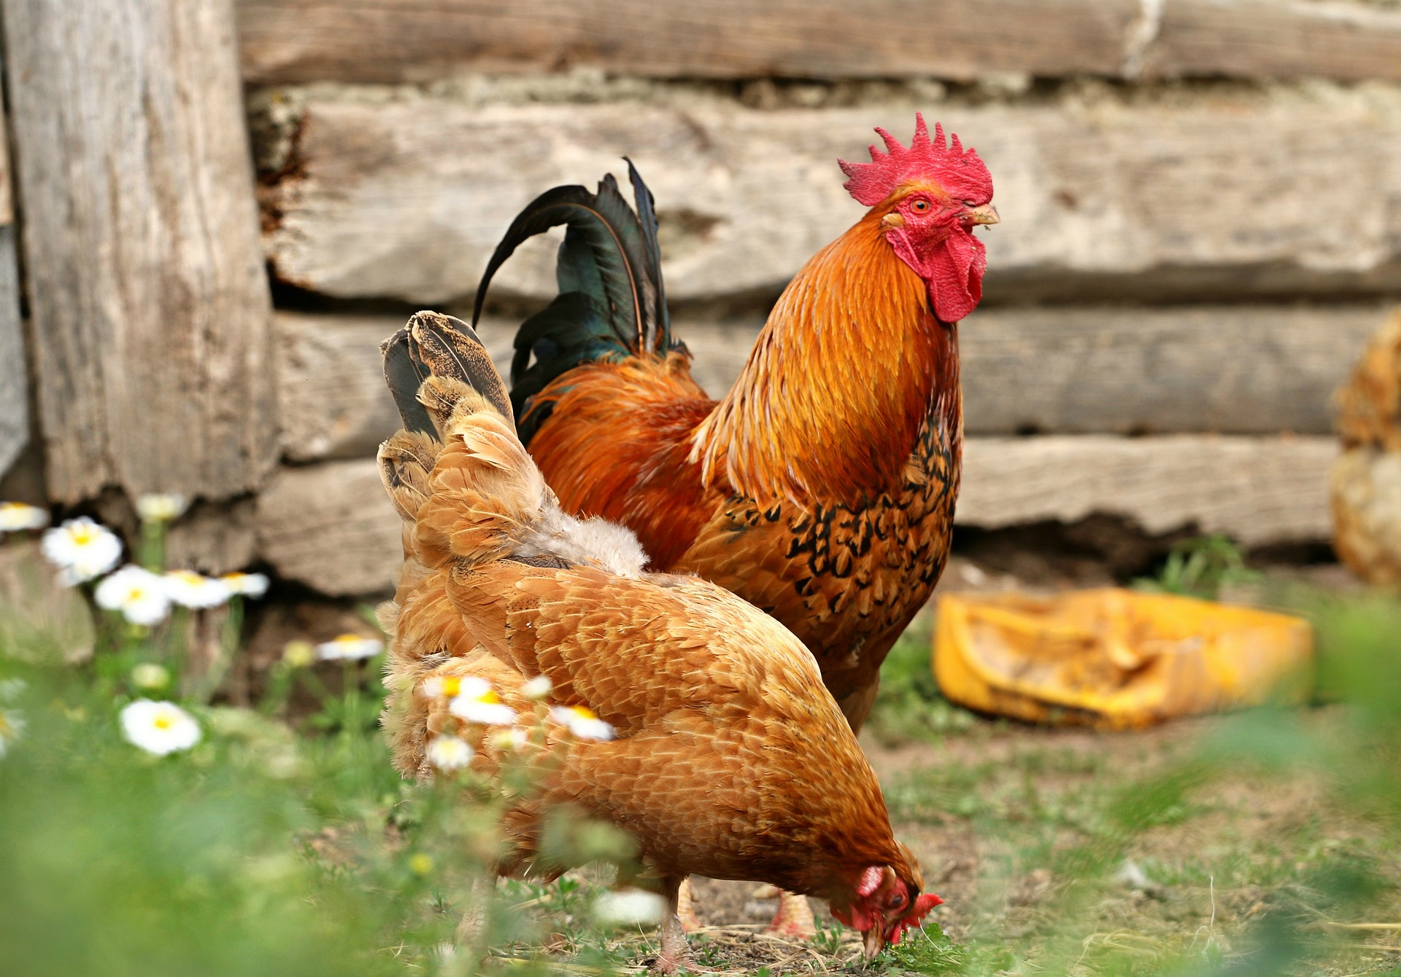
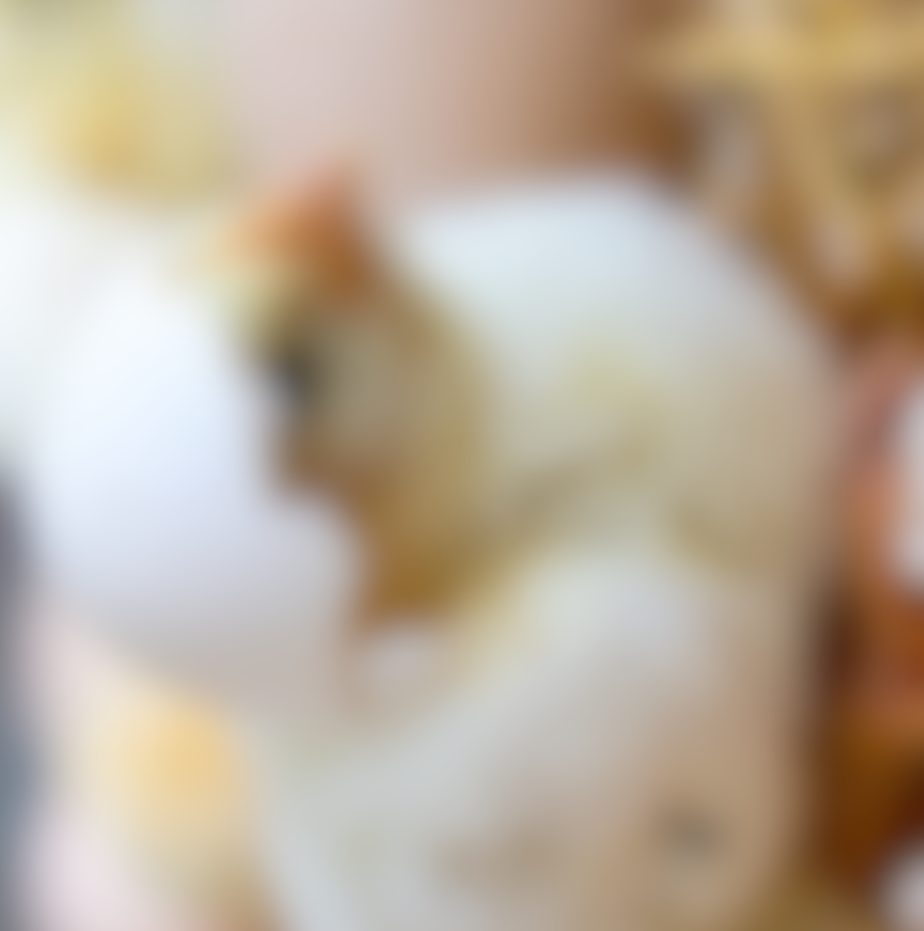
The life cycle of a chicken
A chicken starts its life in a tiny egg. Hens (female chickens) lay their eggs in nests. The hen sits on the egg, which keeps them nice and warm until they are developed.

Slide 5
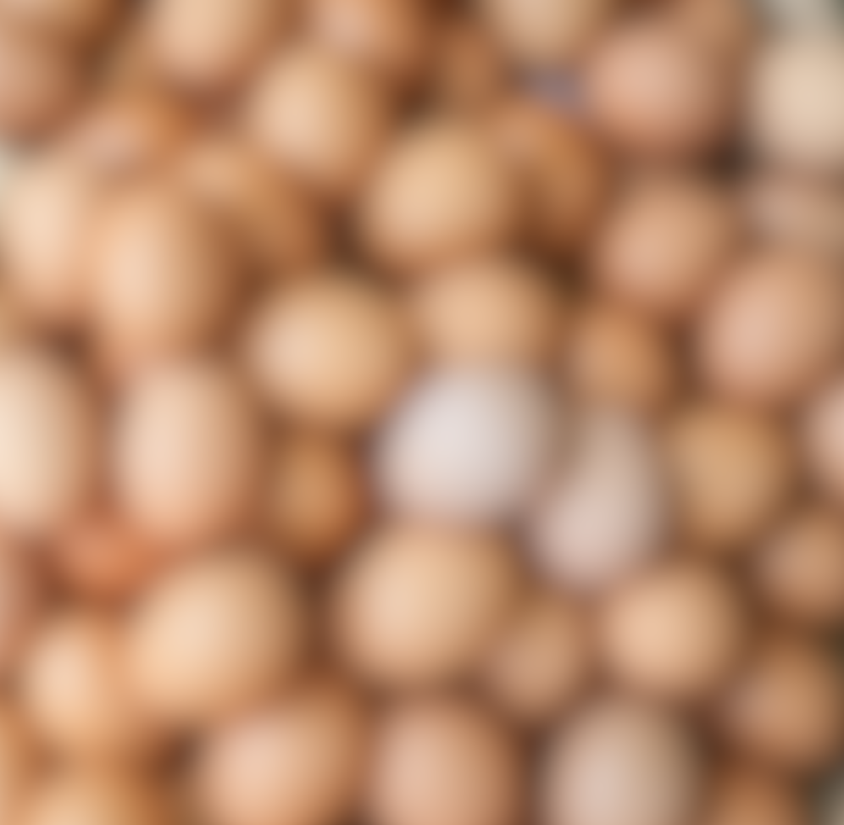
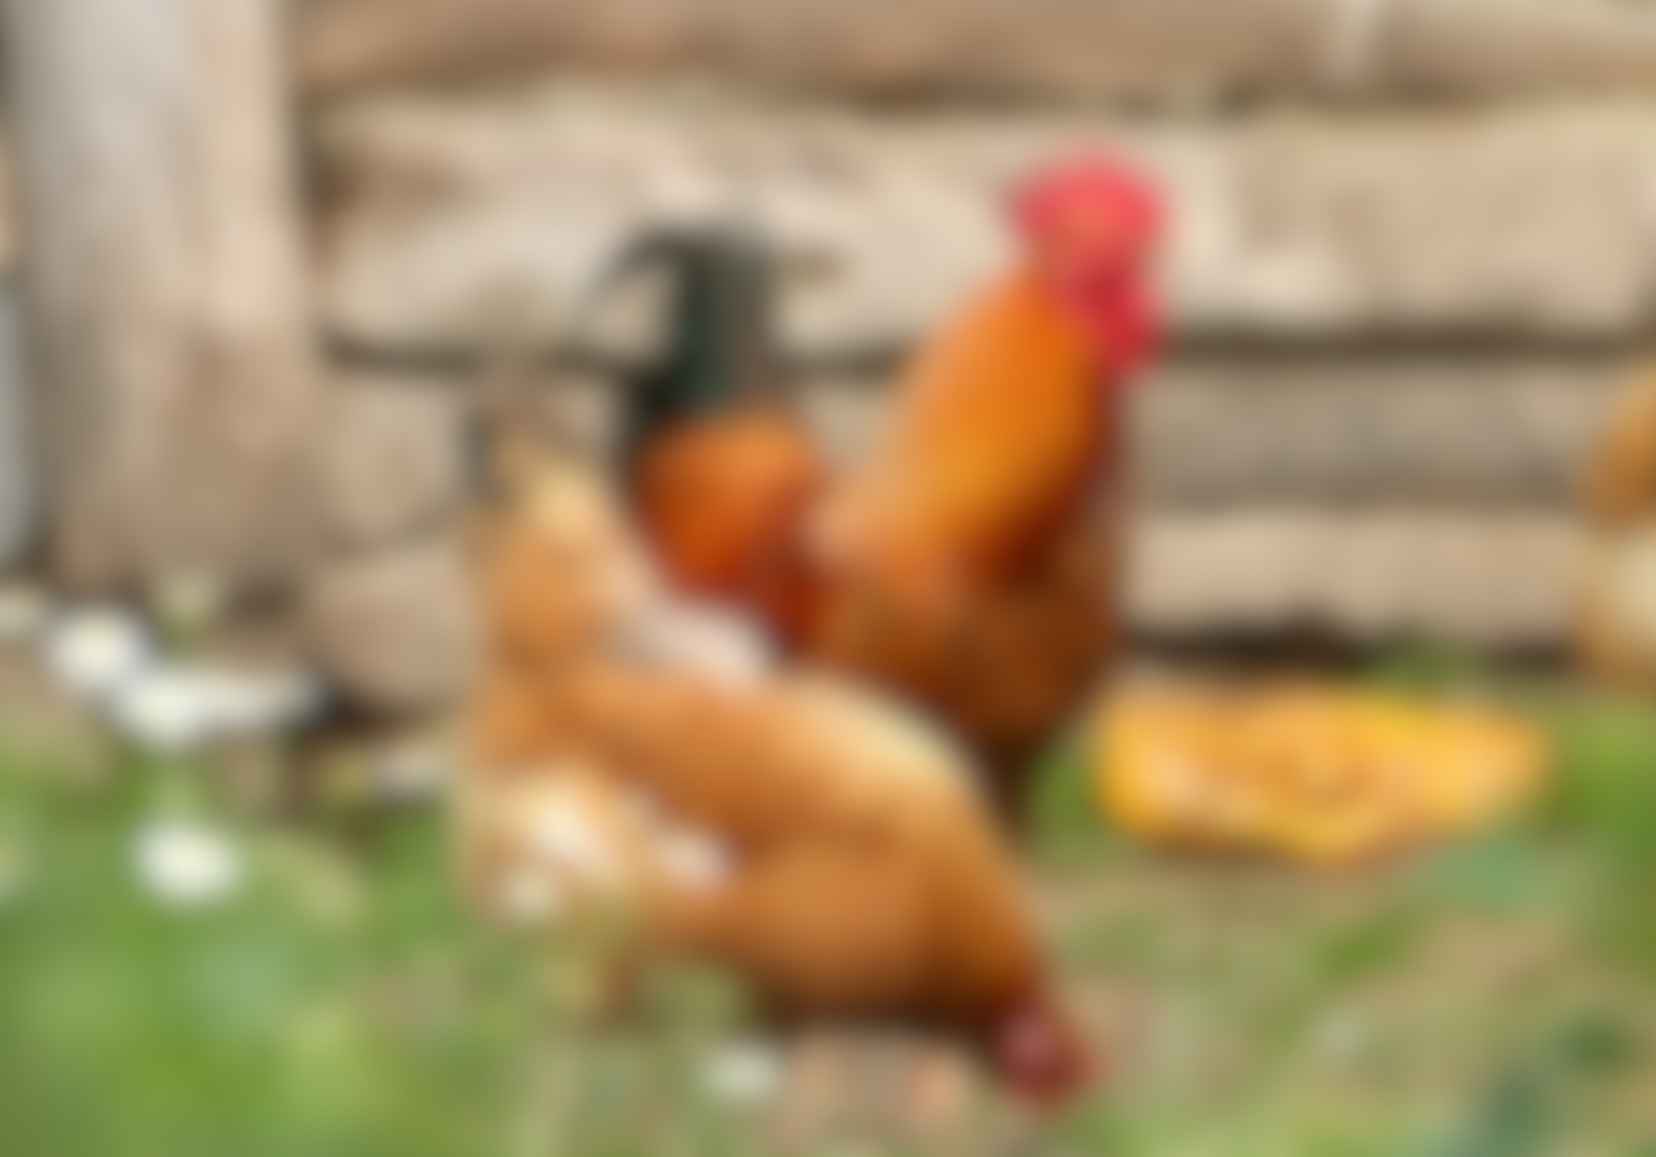
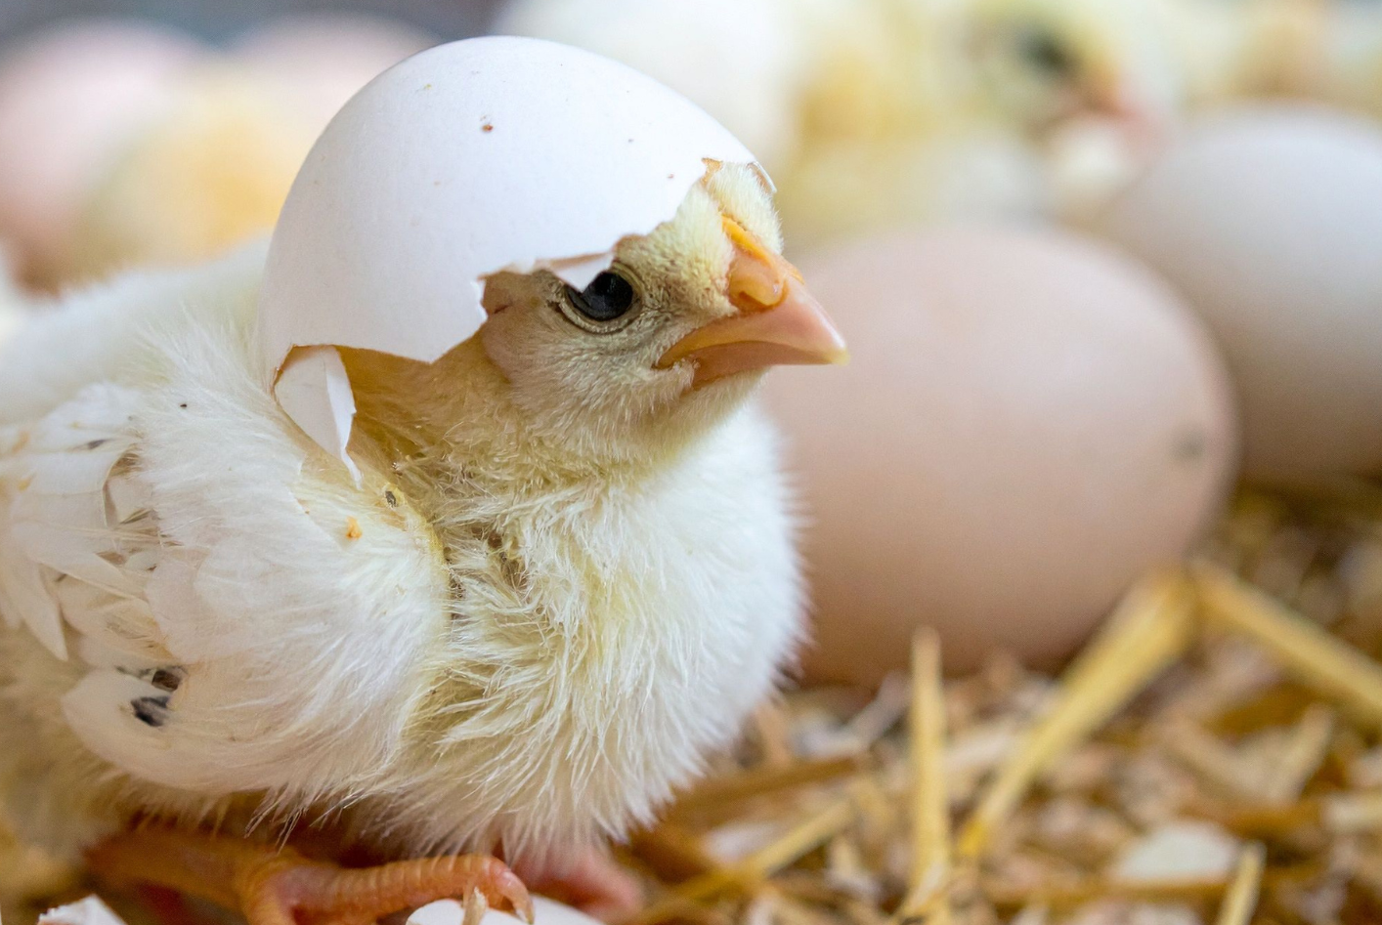
The life cycle of a chicken
It takes about 3 weeks for the chick inside the egg to fully grow. At this point, the egg starts to crack, and the chick comes out. This is called hatching.

Slide 6
The life cycle of a chicken
The chick is now ready to grow. The chick is fed until it is ready to find its own food. ​
​
When it grows older, it will become either a hen (female chicken) or a rooster (male chicken). Then the whole cycle begins again.

Slide 7
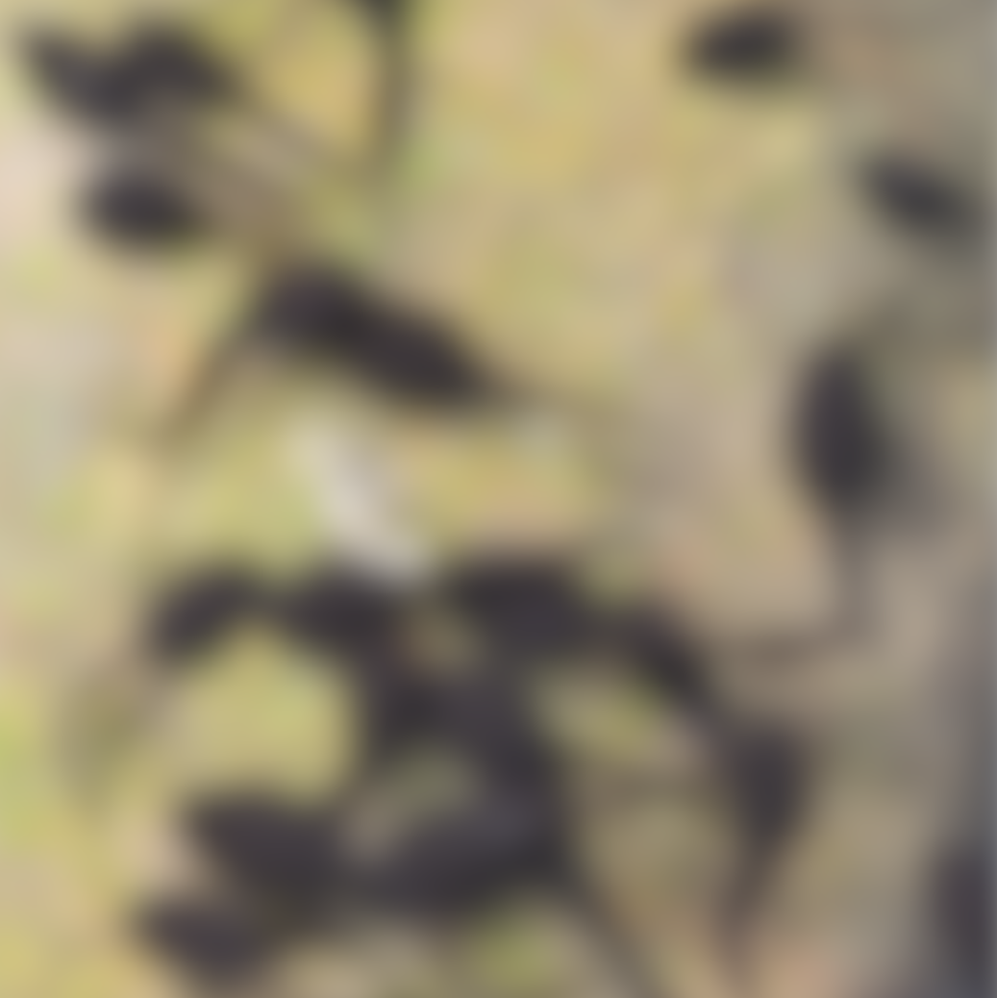
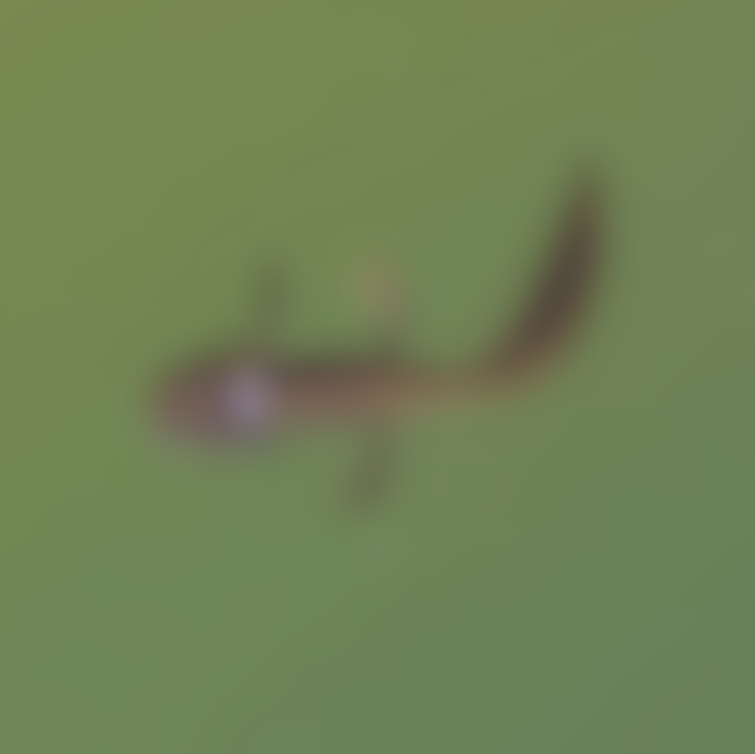
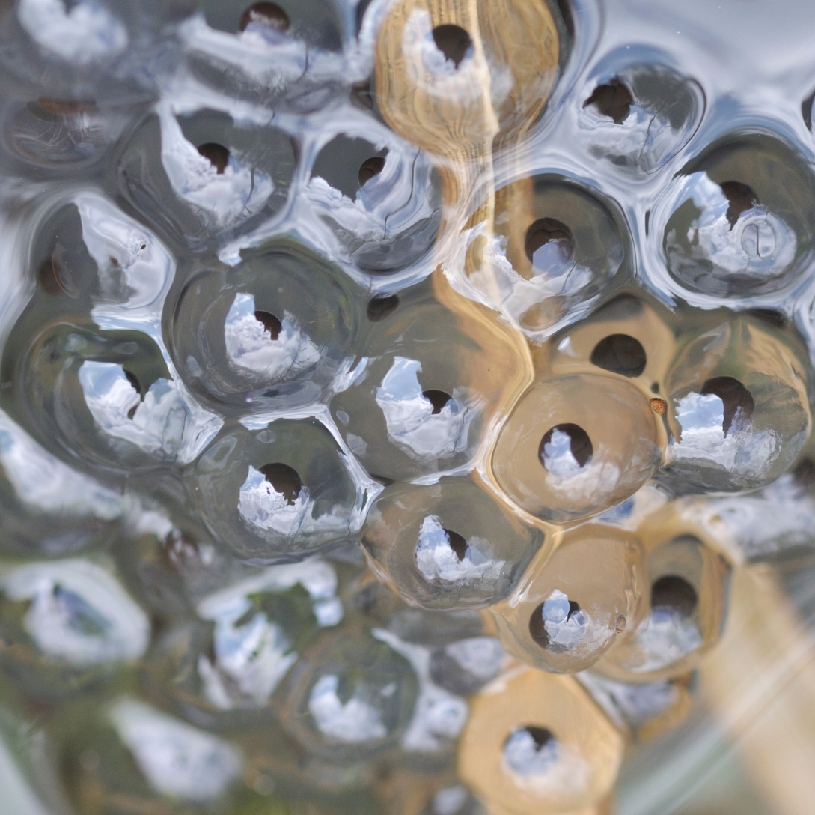
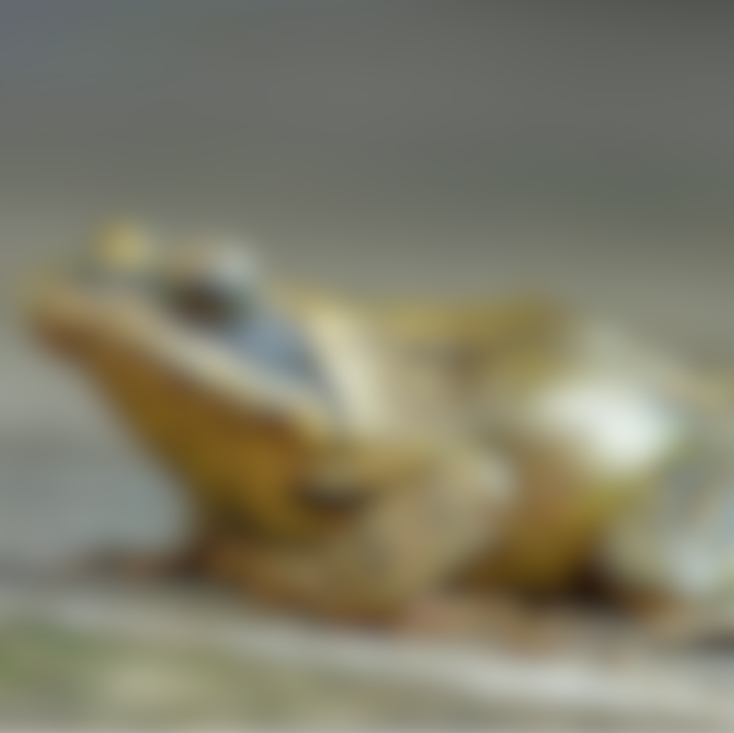
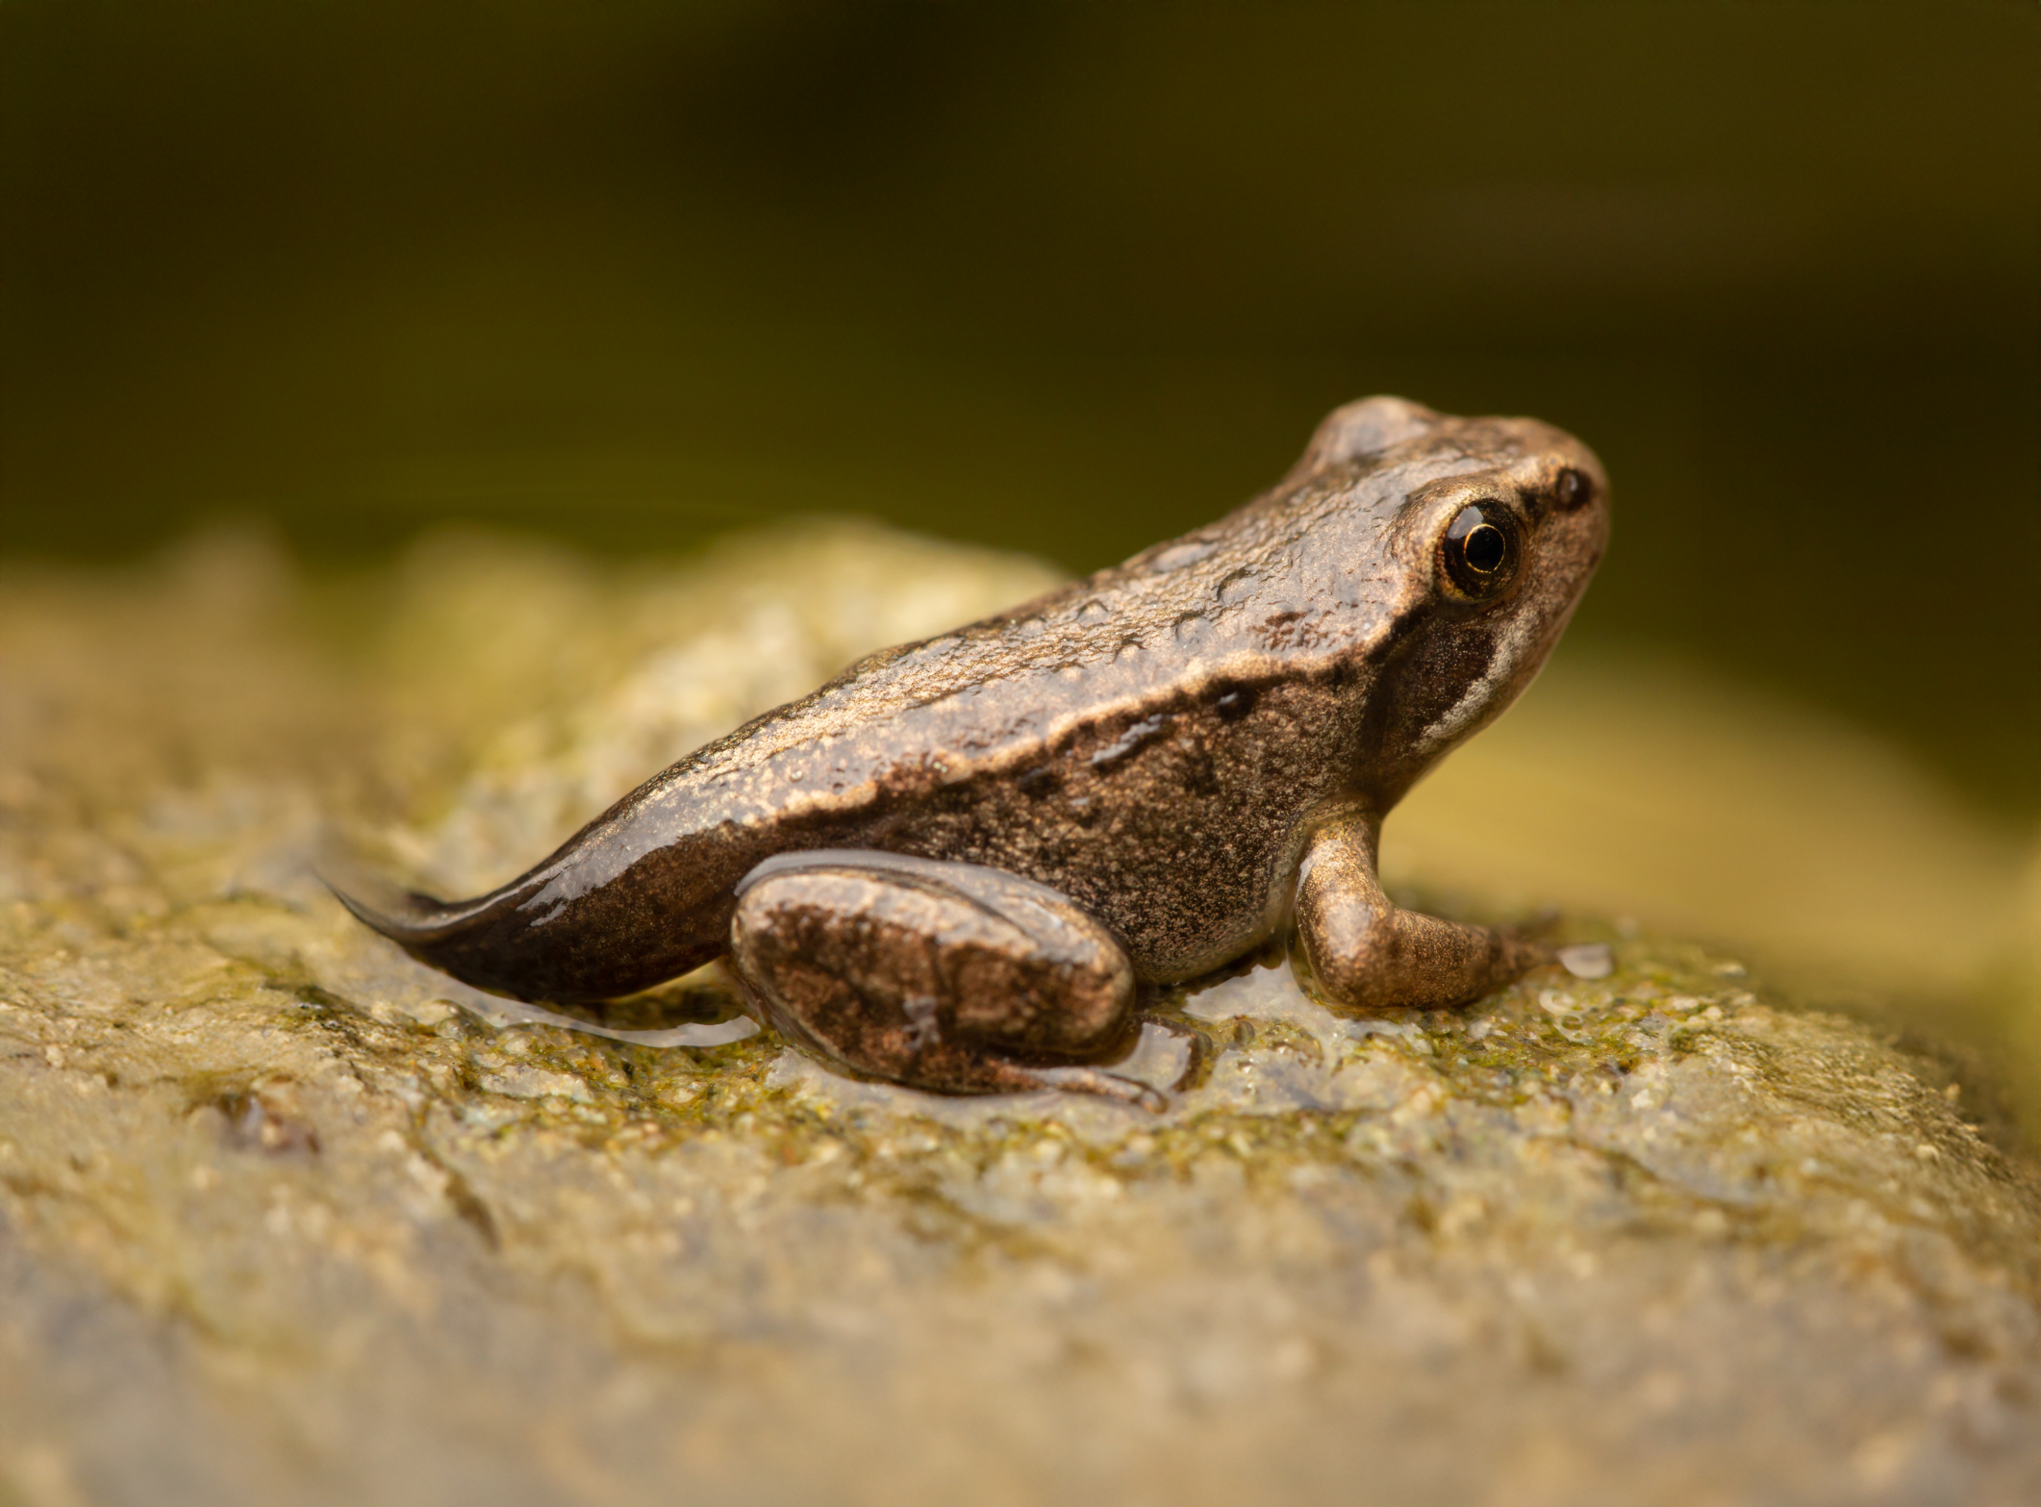
The life cycle of a frog
A female frog lays lots of eggs, called an egg mass or frogspawn. They look a little bit like jelly and are laid in water. ​

Slide 8
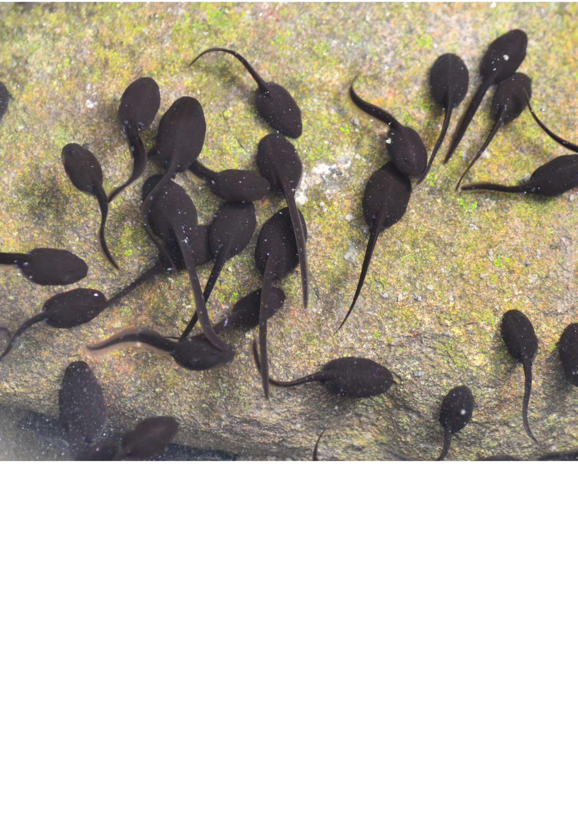

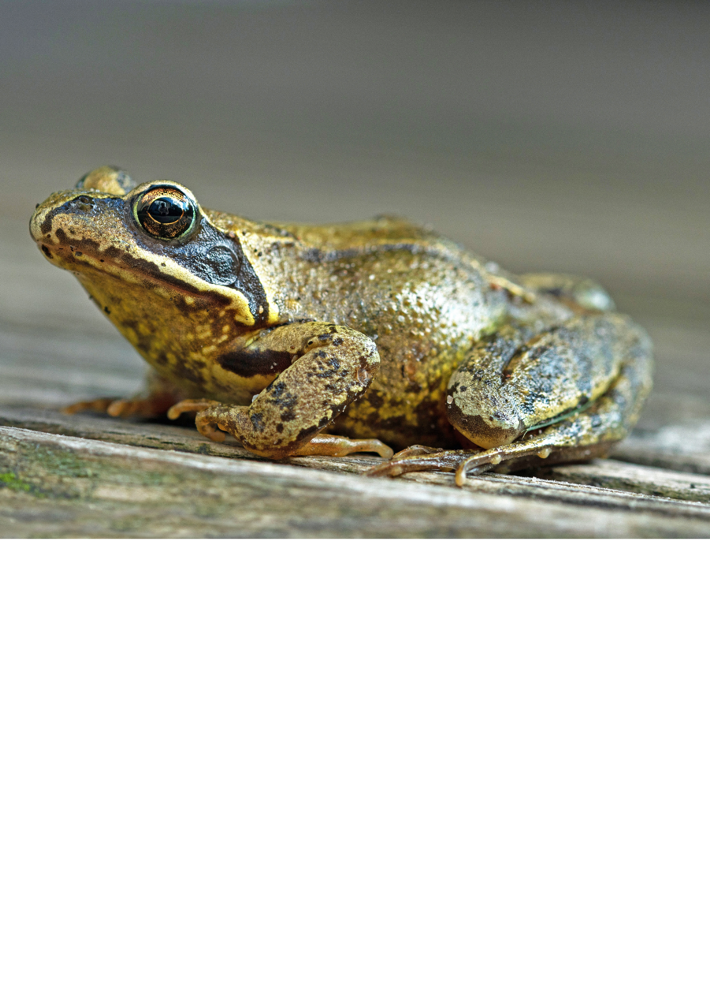
The life cycle of a frog
After just three weeks, the eggs hatch. At this stage, the baby is called a tadpole.

Slide 9
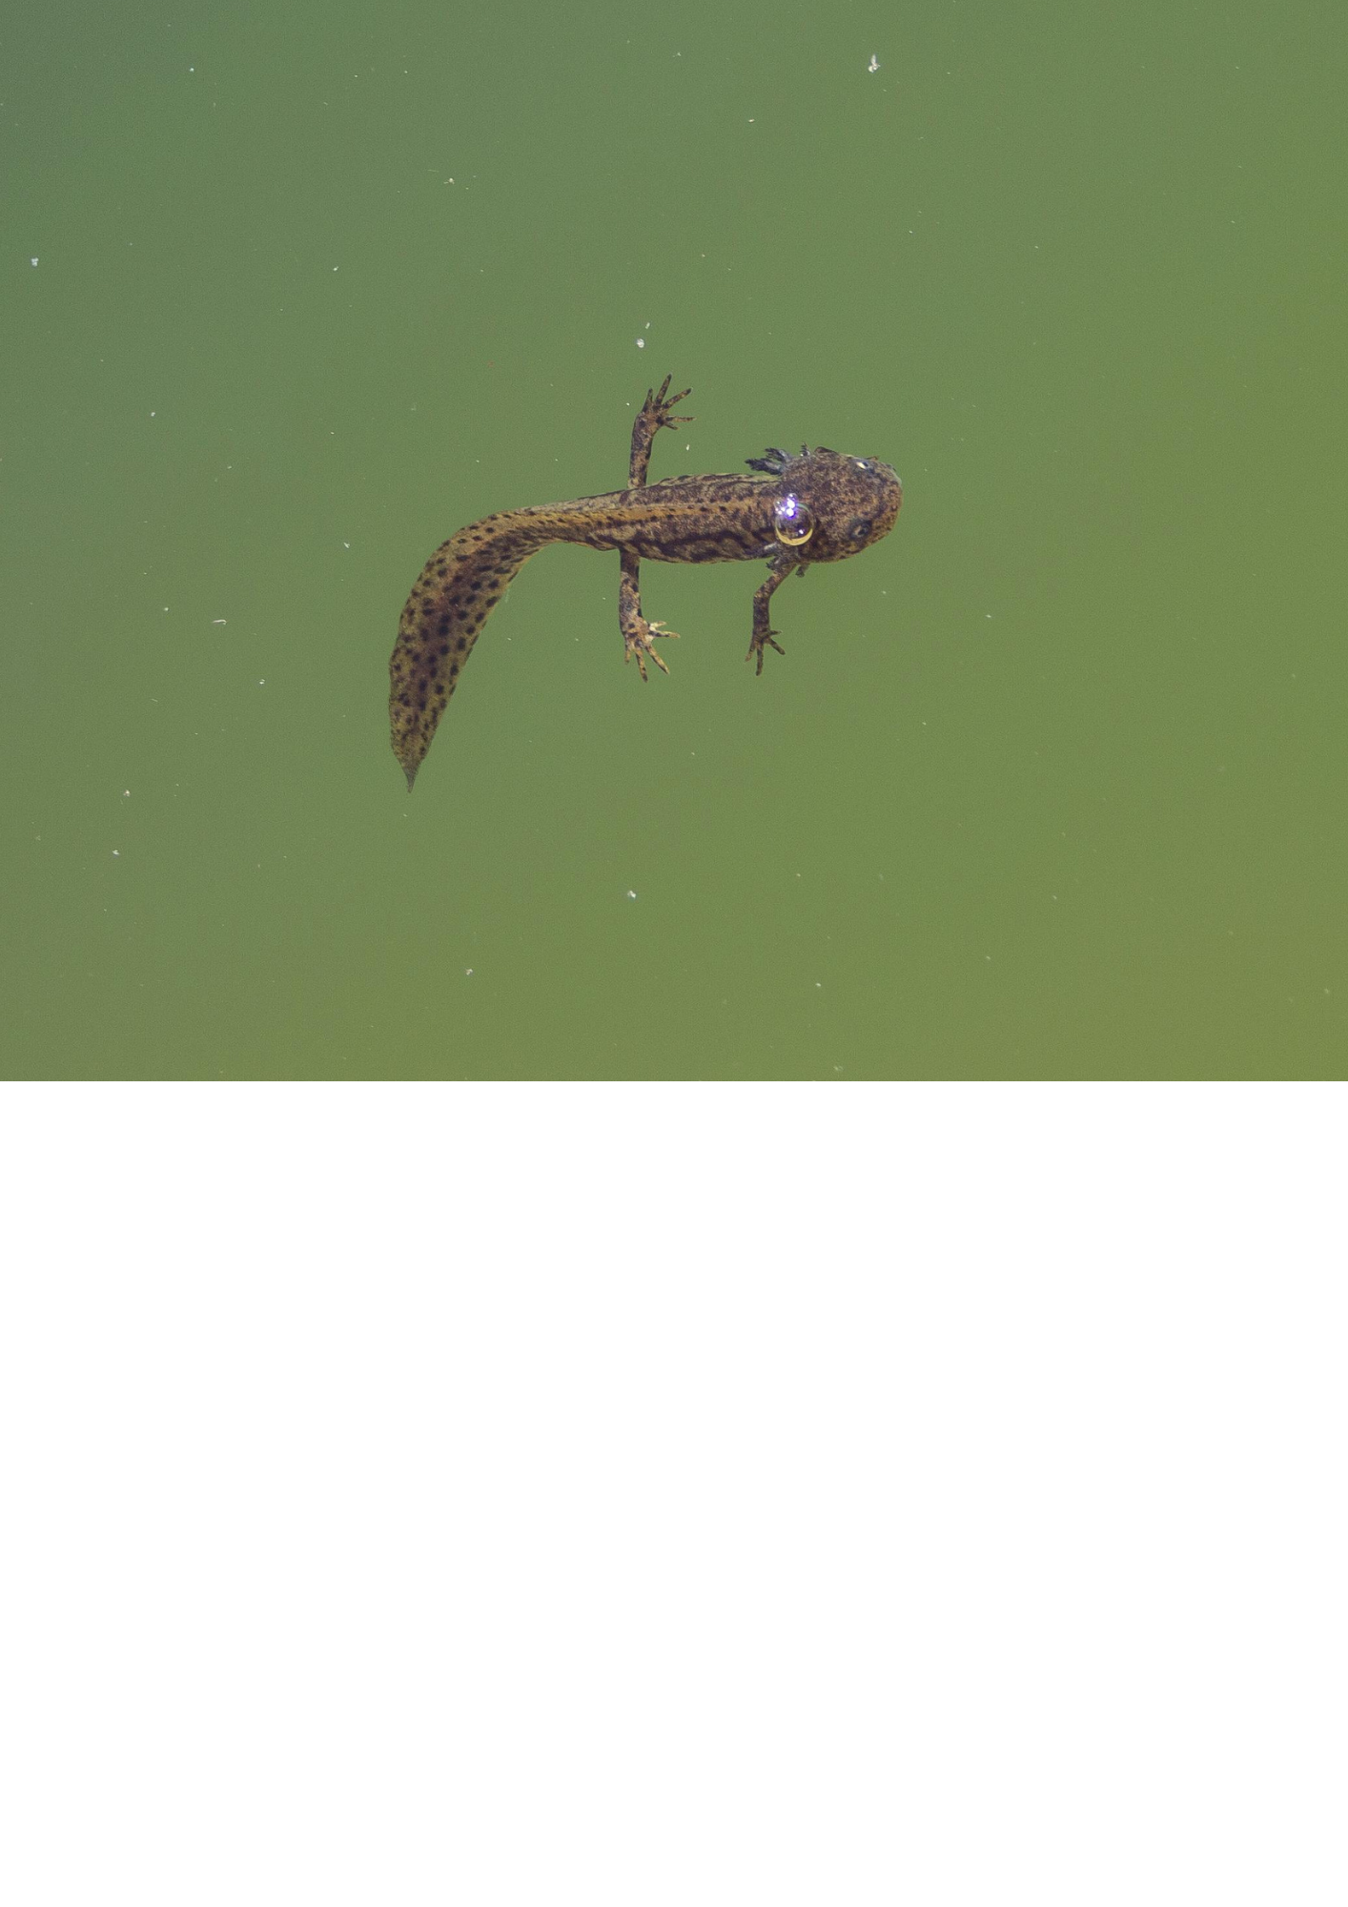
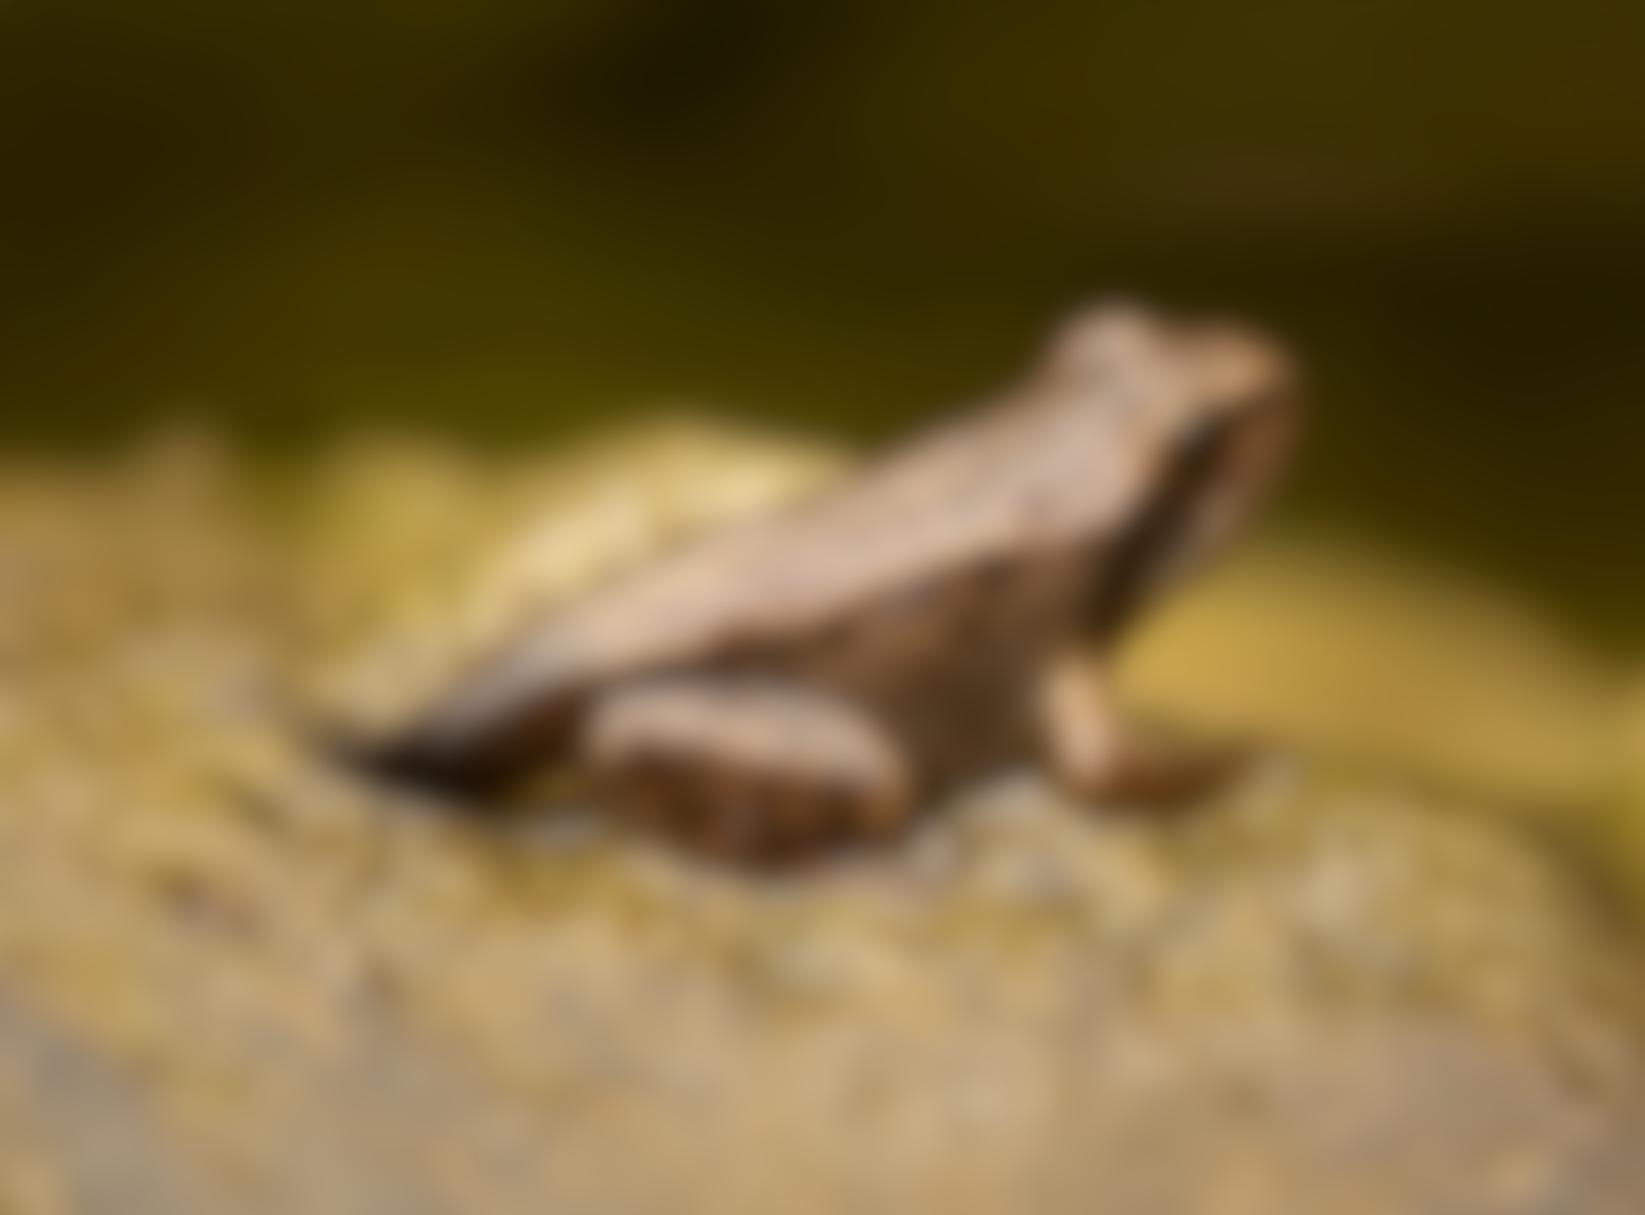
The life cycle of a frog
The tadpole then grows fins and develops a stronger tail. Then, it grows lungs and its back legs.

Slide 10
The life cycle of a frog
Next, it grows its front legs and its tail gets shorter. At this point, it jumps out of the water onto land.

Slide 11
The life cycle of a frog
Now its tail fully disappears, and it starts to eat insects to continue growing. It is now called a froglet.
It takes about 2-4 years for it to grow into an adult frog. Then the whole cycle starts again.

Slide 12
Egg stations
Station 1:
Life cycle builder
Order the stages of a chicken’s life cycle.
Station 2:
Mystery egg
Crack open the eggs and see what’s inside. Can you tell what part of a chicken’s life cycle the object represents? Match the labels to the object.
Station 3:
Invest-egg-ation
Take a look at the eggs and think about what you notice. Are they different or the same? Which egg do you think belongs to each animal?

Slide 13
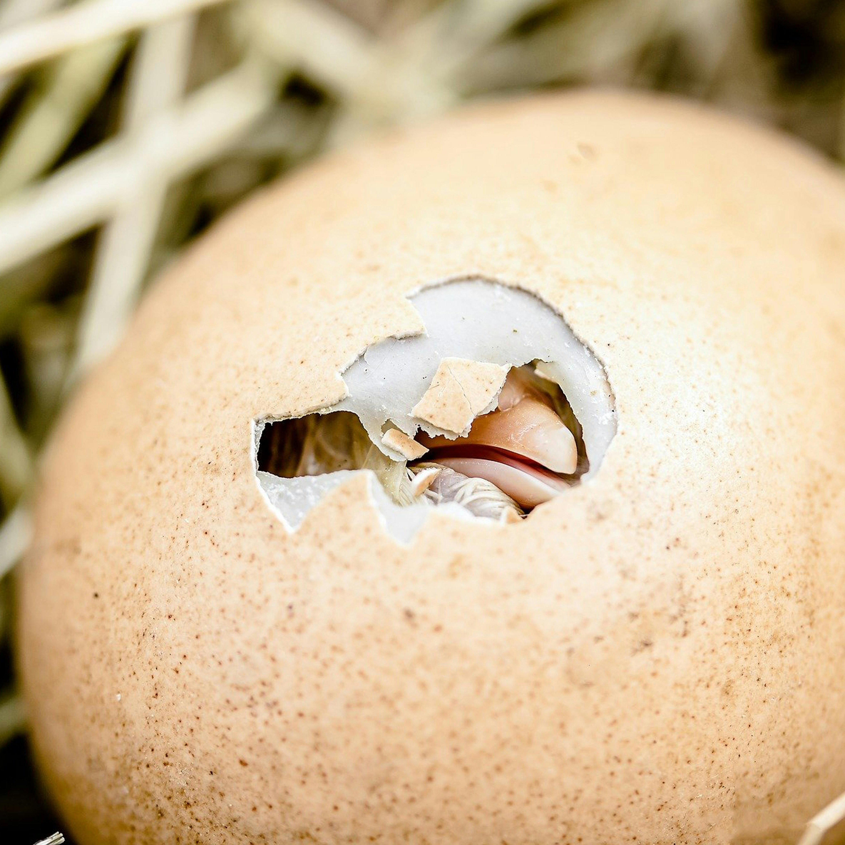
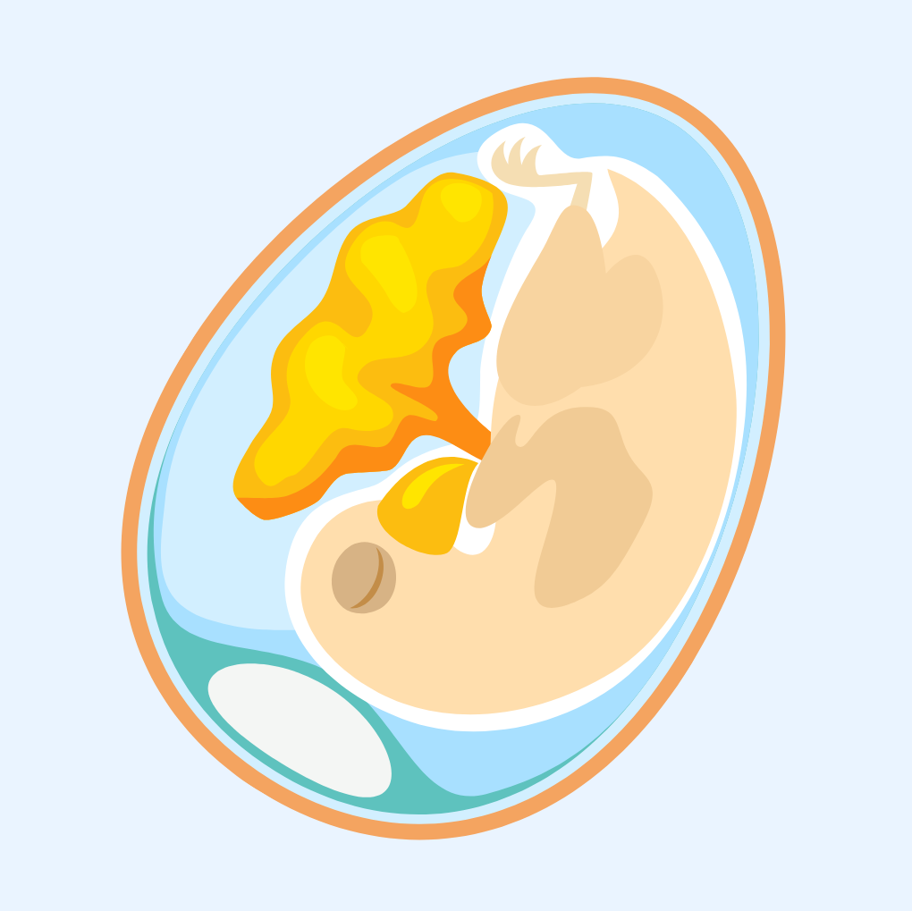
Cracking quiz
We're going to finish the lesson with a quickfire cracking quiz to test what you have learned today.
Question 1:
Name one animal that hatches from an egg.
Birds, snakes, fish. Lots and lots and lots!
What happens inside the hen’s egg before it hatches?
The chick develops and grows.

Slide 14
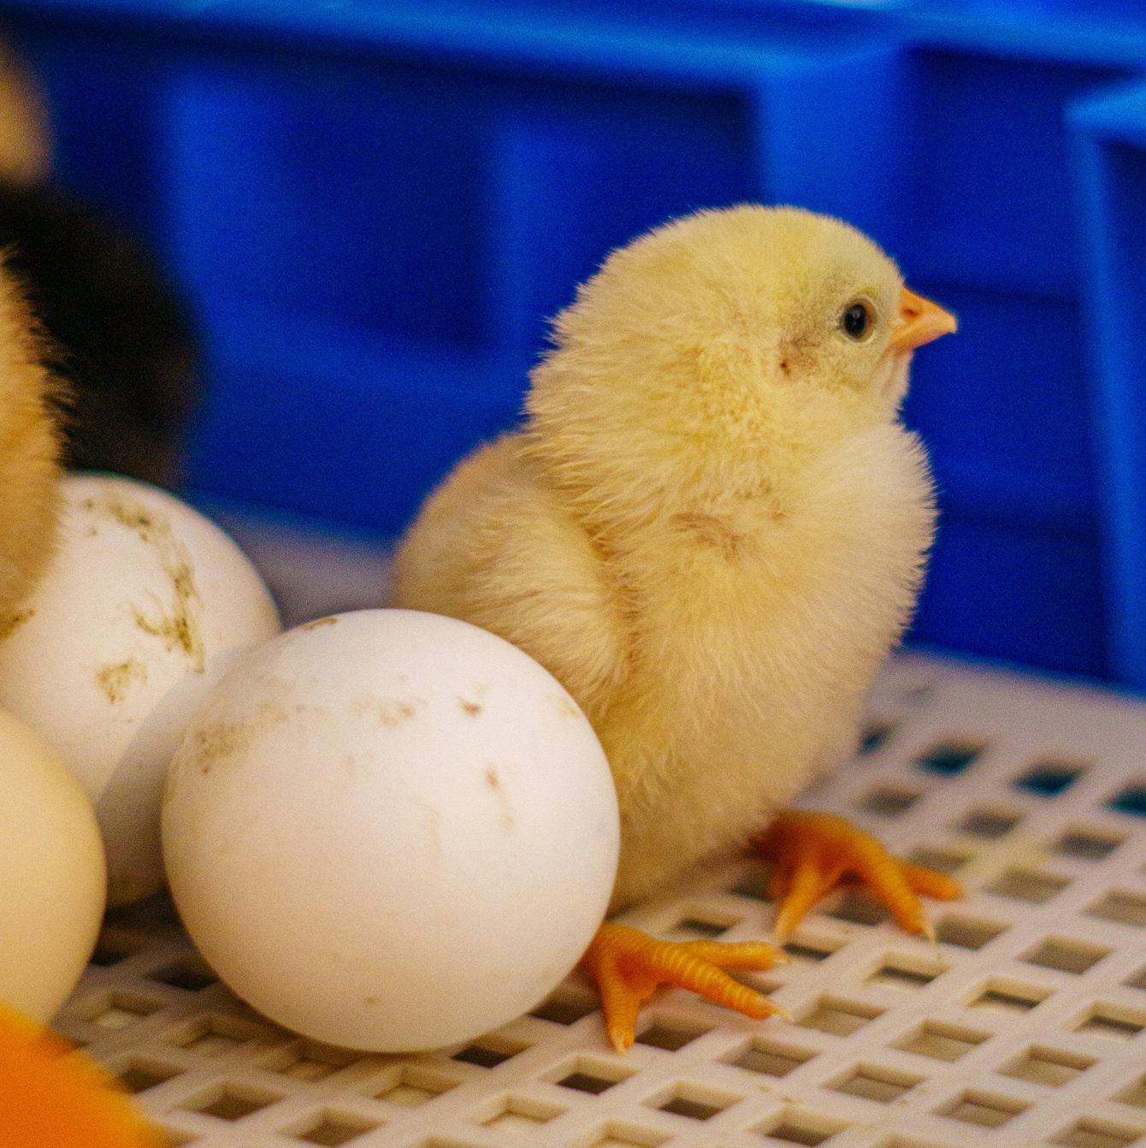
Cracking quiz
Name one animal that hatches from an egg.
Birds, snakes, fish. Lots and lots and lots!
Question 2:
What happens inside the hen’s egg before it hatches?
The chick develops and grows.
What word is used when the baby first comes out it’s egg?
Chick or hatchling.

Slide 15
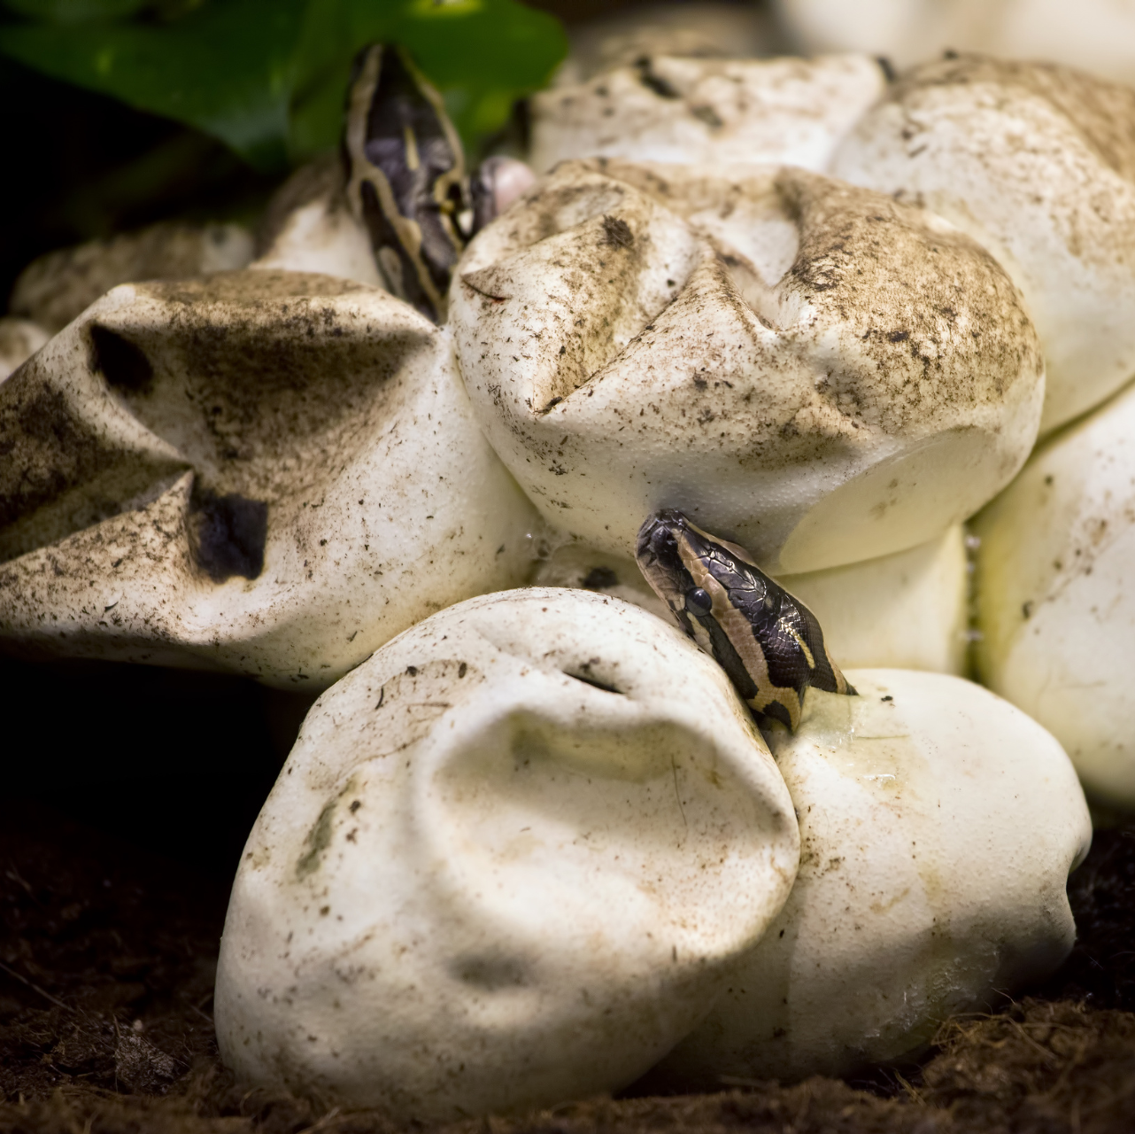
Cracking quiz
What happens inside the hen’s egg before it hatches?
The chick develops and grows.
Question 3:
What word is used when the baby first comes out of its egg?
Chick or hatchling.
Do only birds hatch from eggs?
No, lots of animals hatch from eggs.

Slide 16
Cracking quiz
What word is used when the baby first comes out it’s egg?
Chick or hatchling.
Question 4:
Do only birds hatch from eggs?
No, lots of animals hatch from eggs.

Slide 17
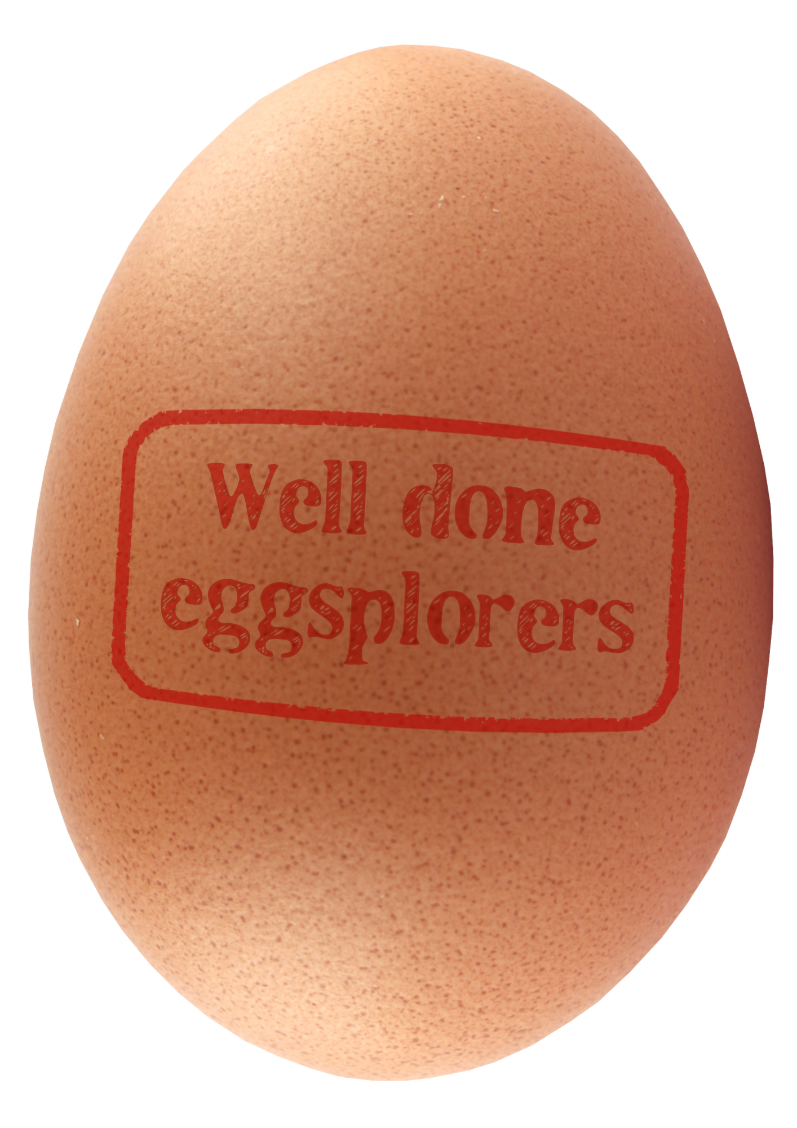
Isn’t that eggscellent!
Wow!
So many different animals hatch from eggs and go through life differently.
See if you can spot any animals that hatched from an egg when you are out and about.

Slide 18

Brought to you by

