Slide 1

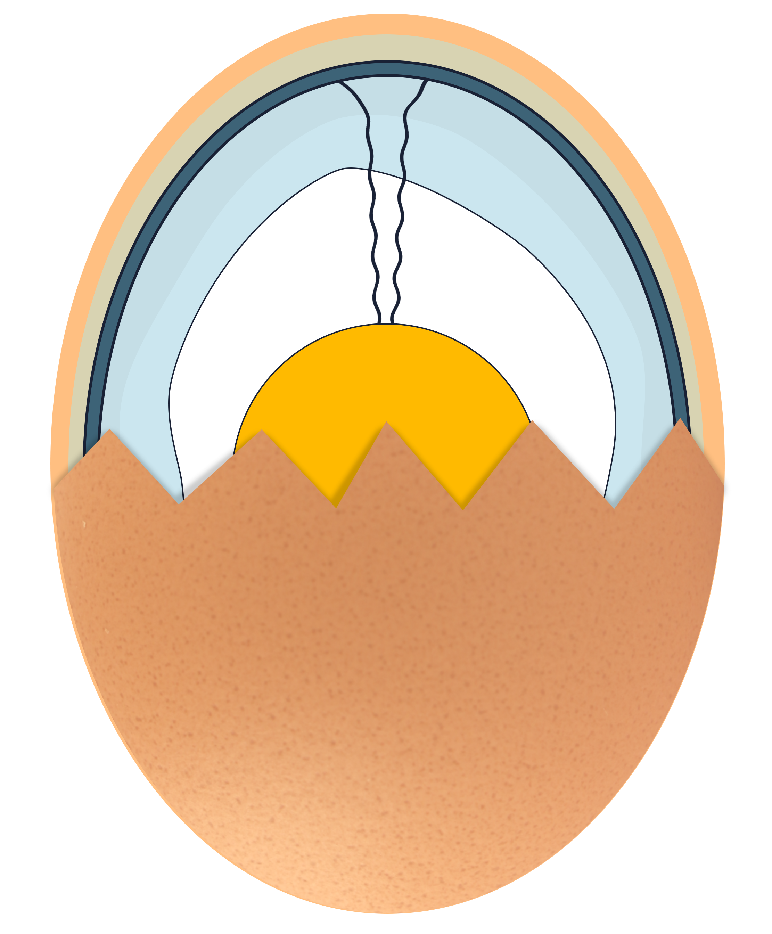

What’s inside an egg?

Slide 2
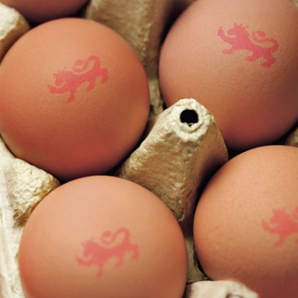
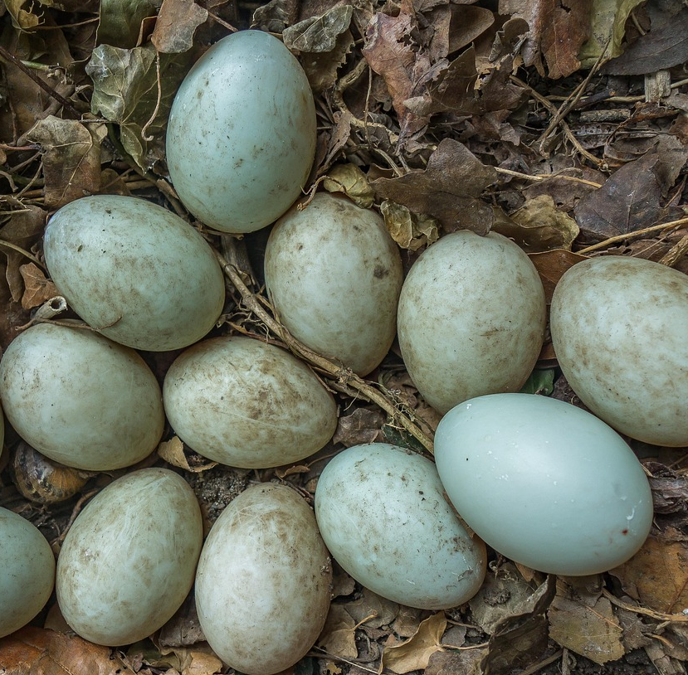
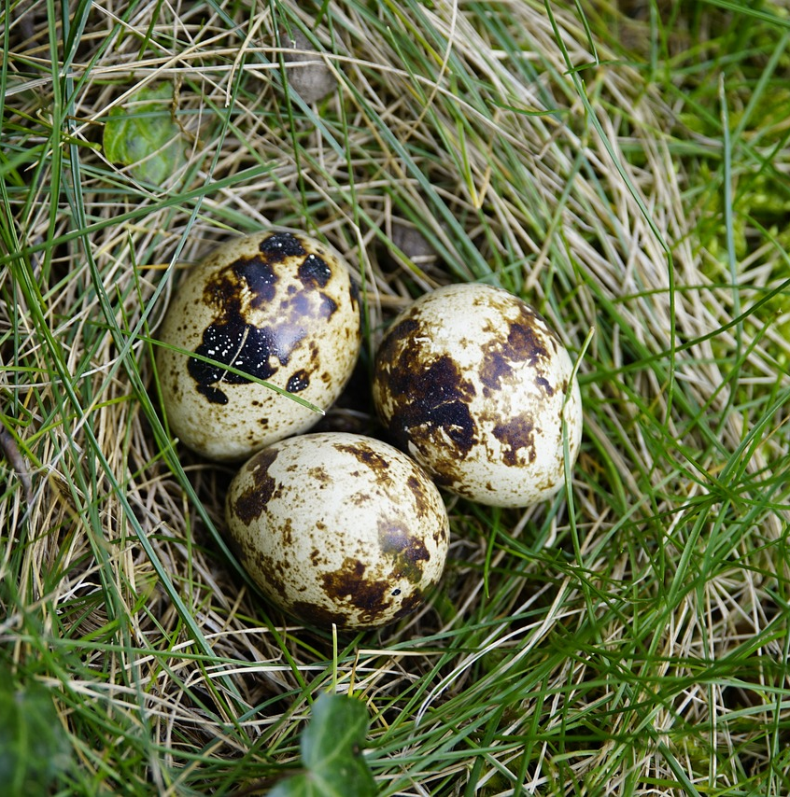
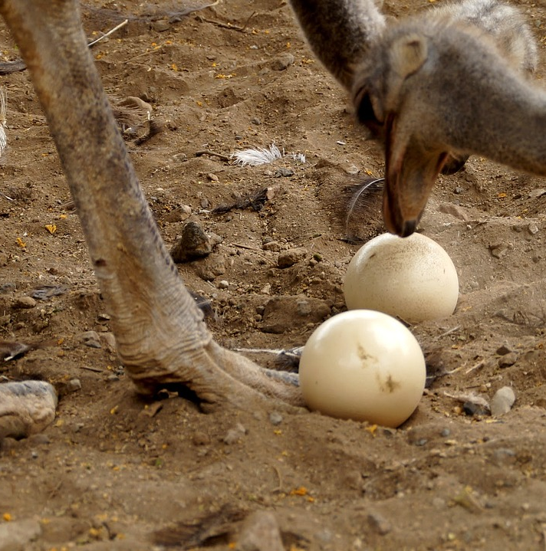

Egg observation
Which bird’s egg do you think is the biggest?
Which egg do you think might be the strongest?
Notes:
Order of eggs: Hen, Duck, Quail and Ostrich

Slide 3
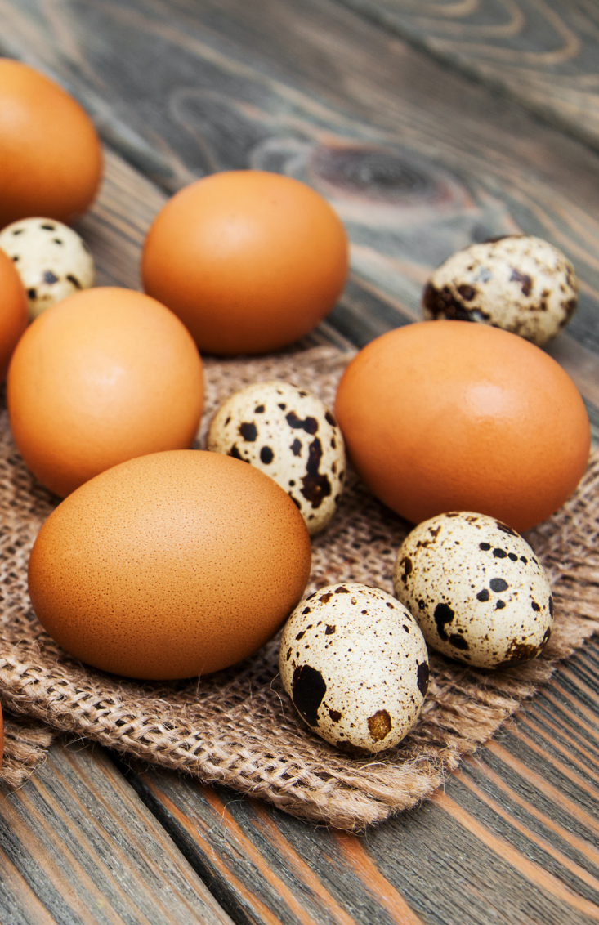
Egg observation
All types of eggs are slightly different, but all are similar in their function. They provide protection and nutrition for the baby animal that is growing inside. ​
​
They are different in their size, the thickness of their shells and the size of the yolk. ​
Do you know what is inside an egg?
Notes:
Order of eggs: Hen, Duck, Quail and Ostrich

Slide 4
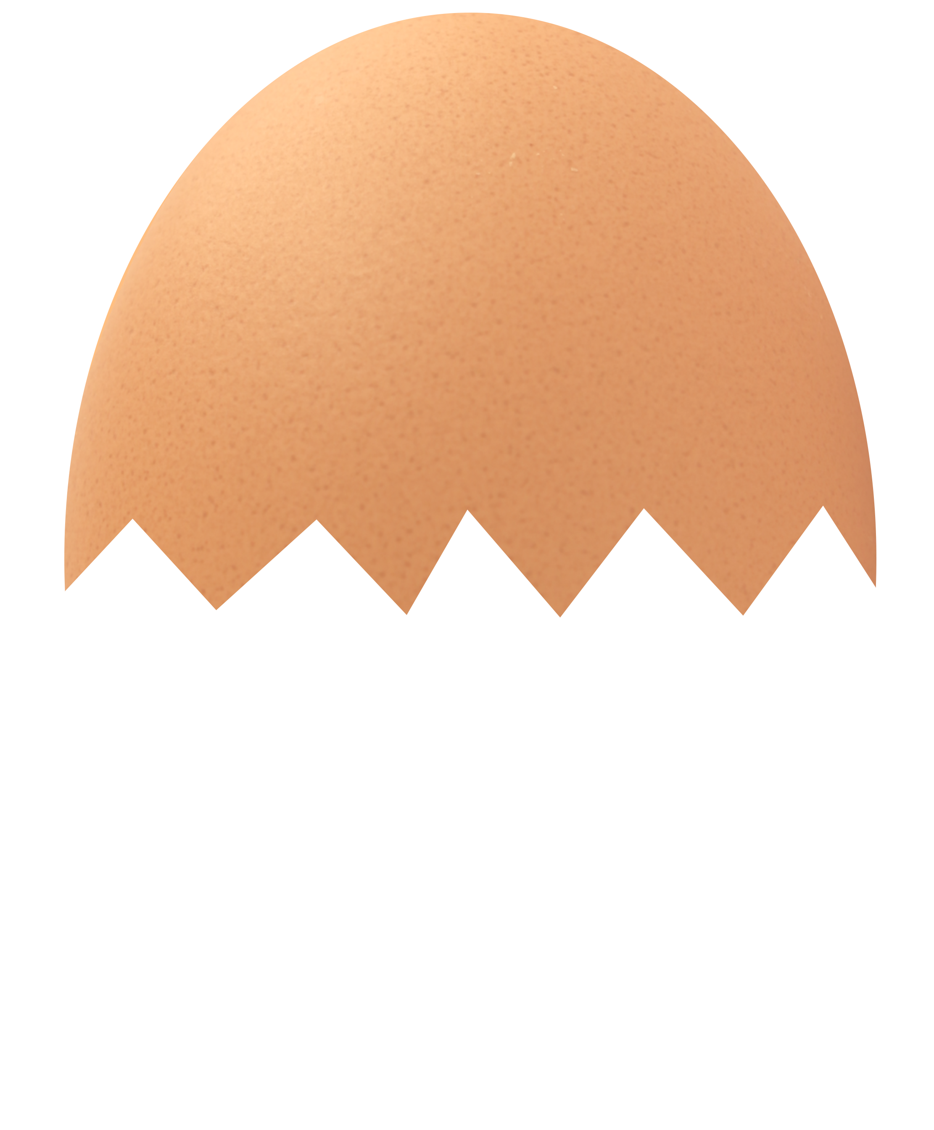
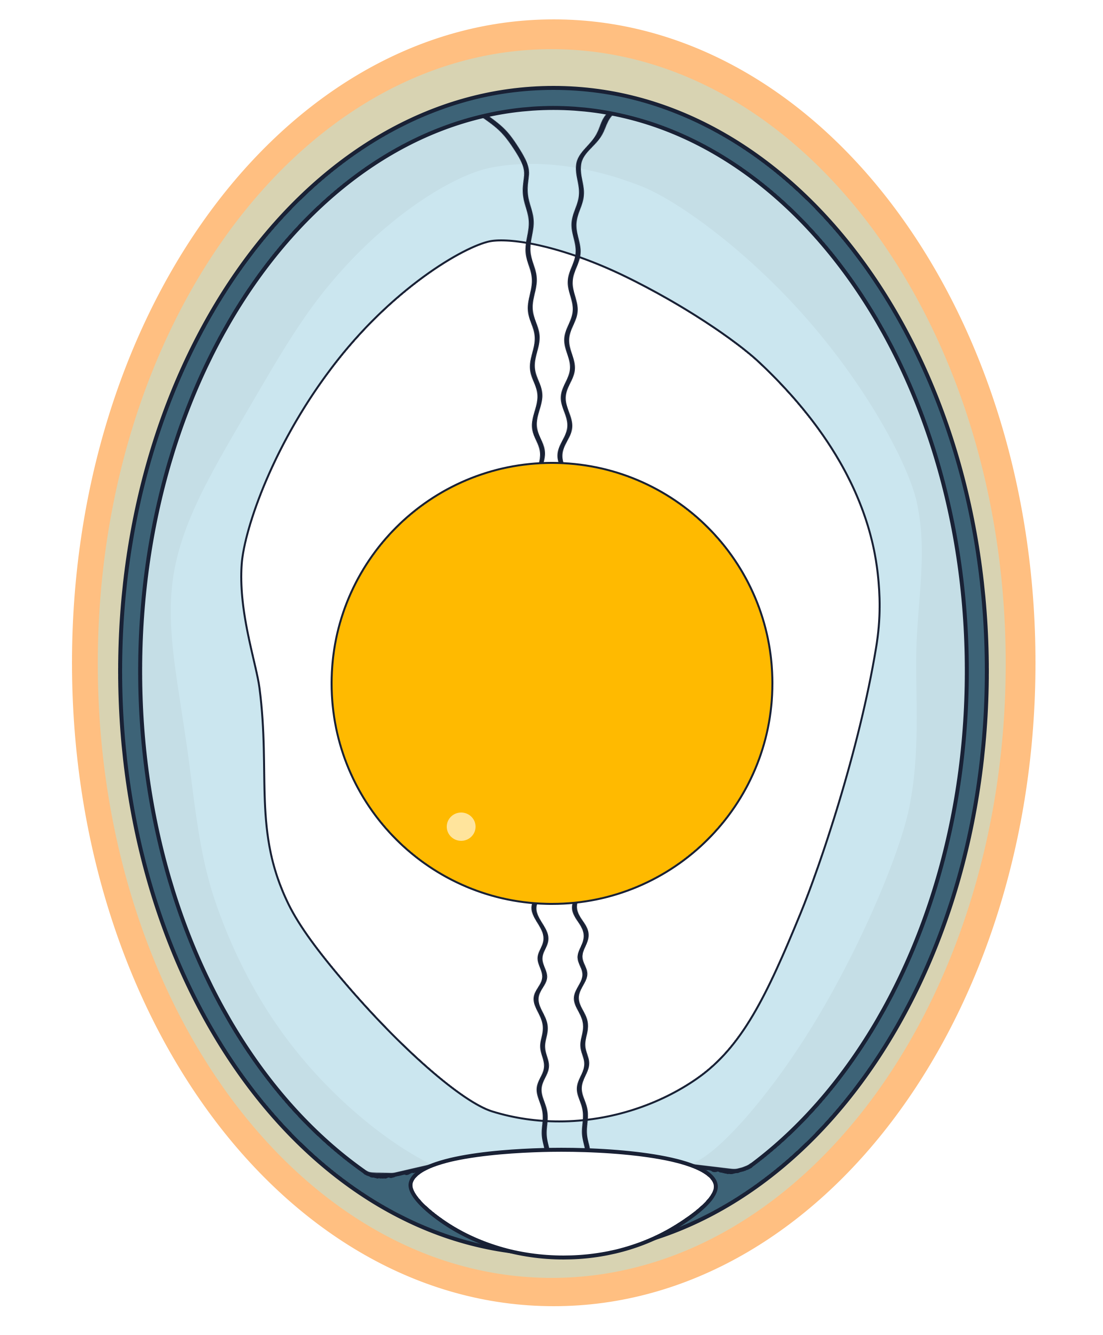
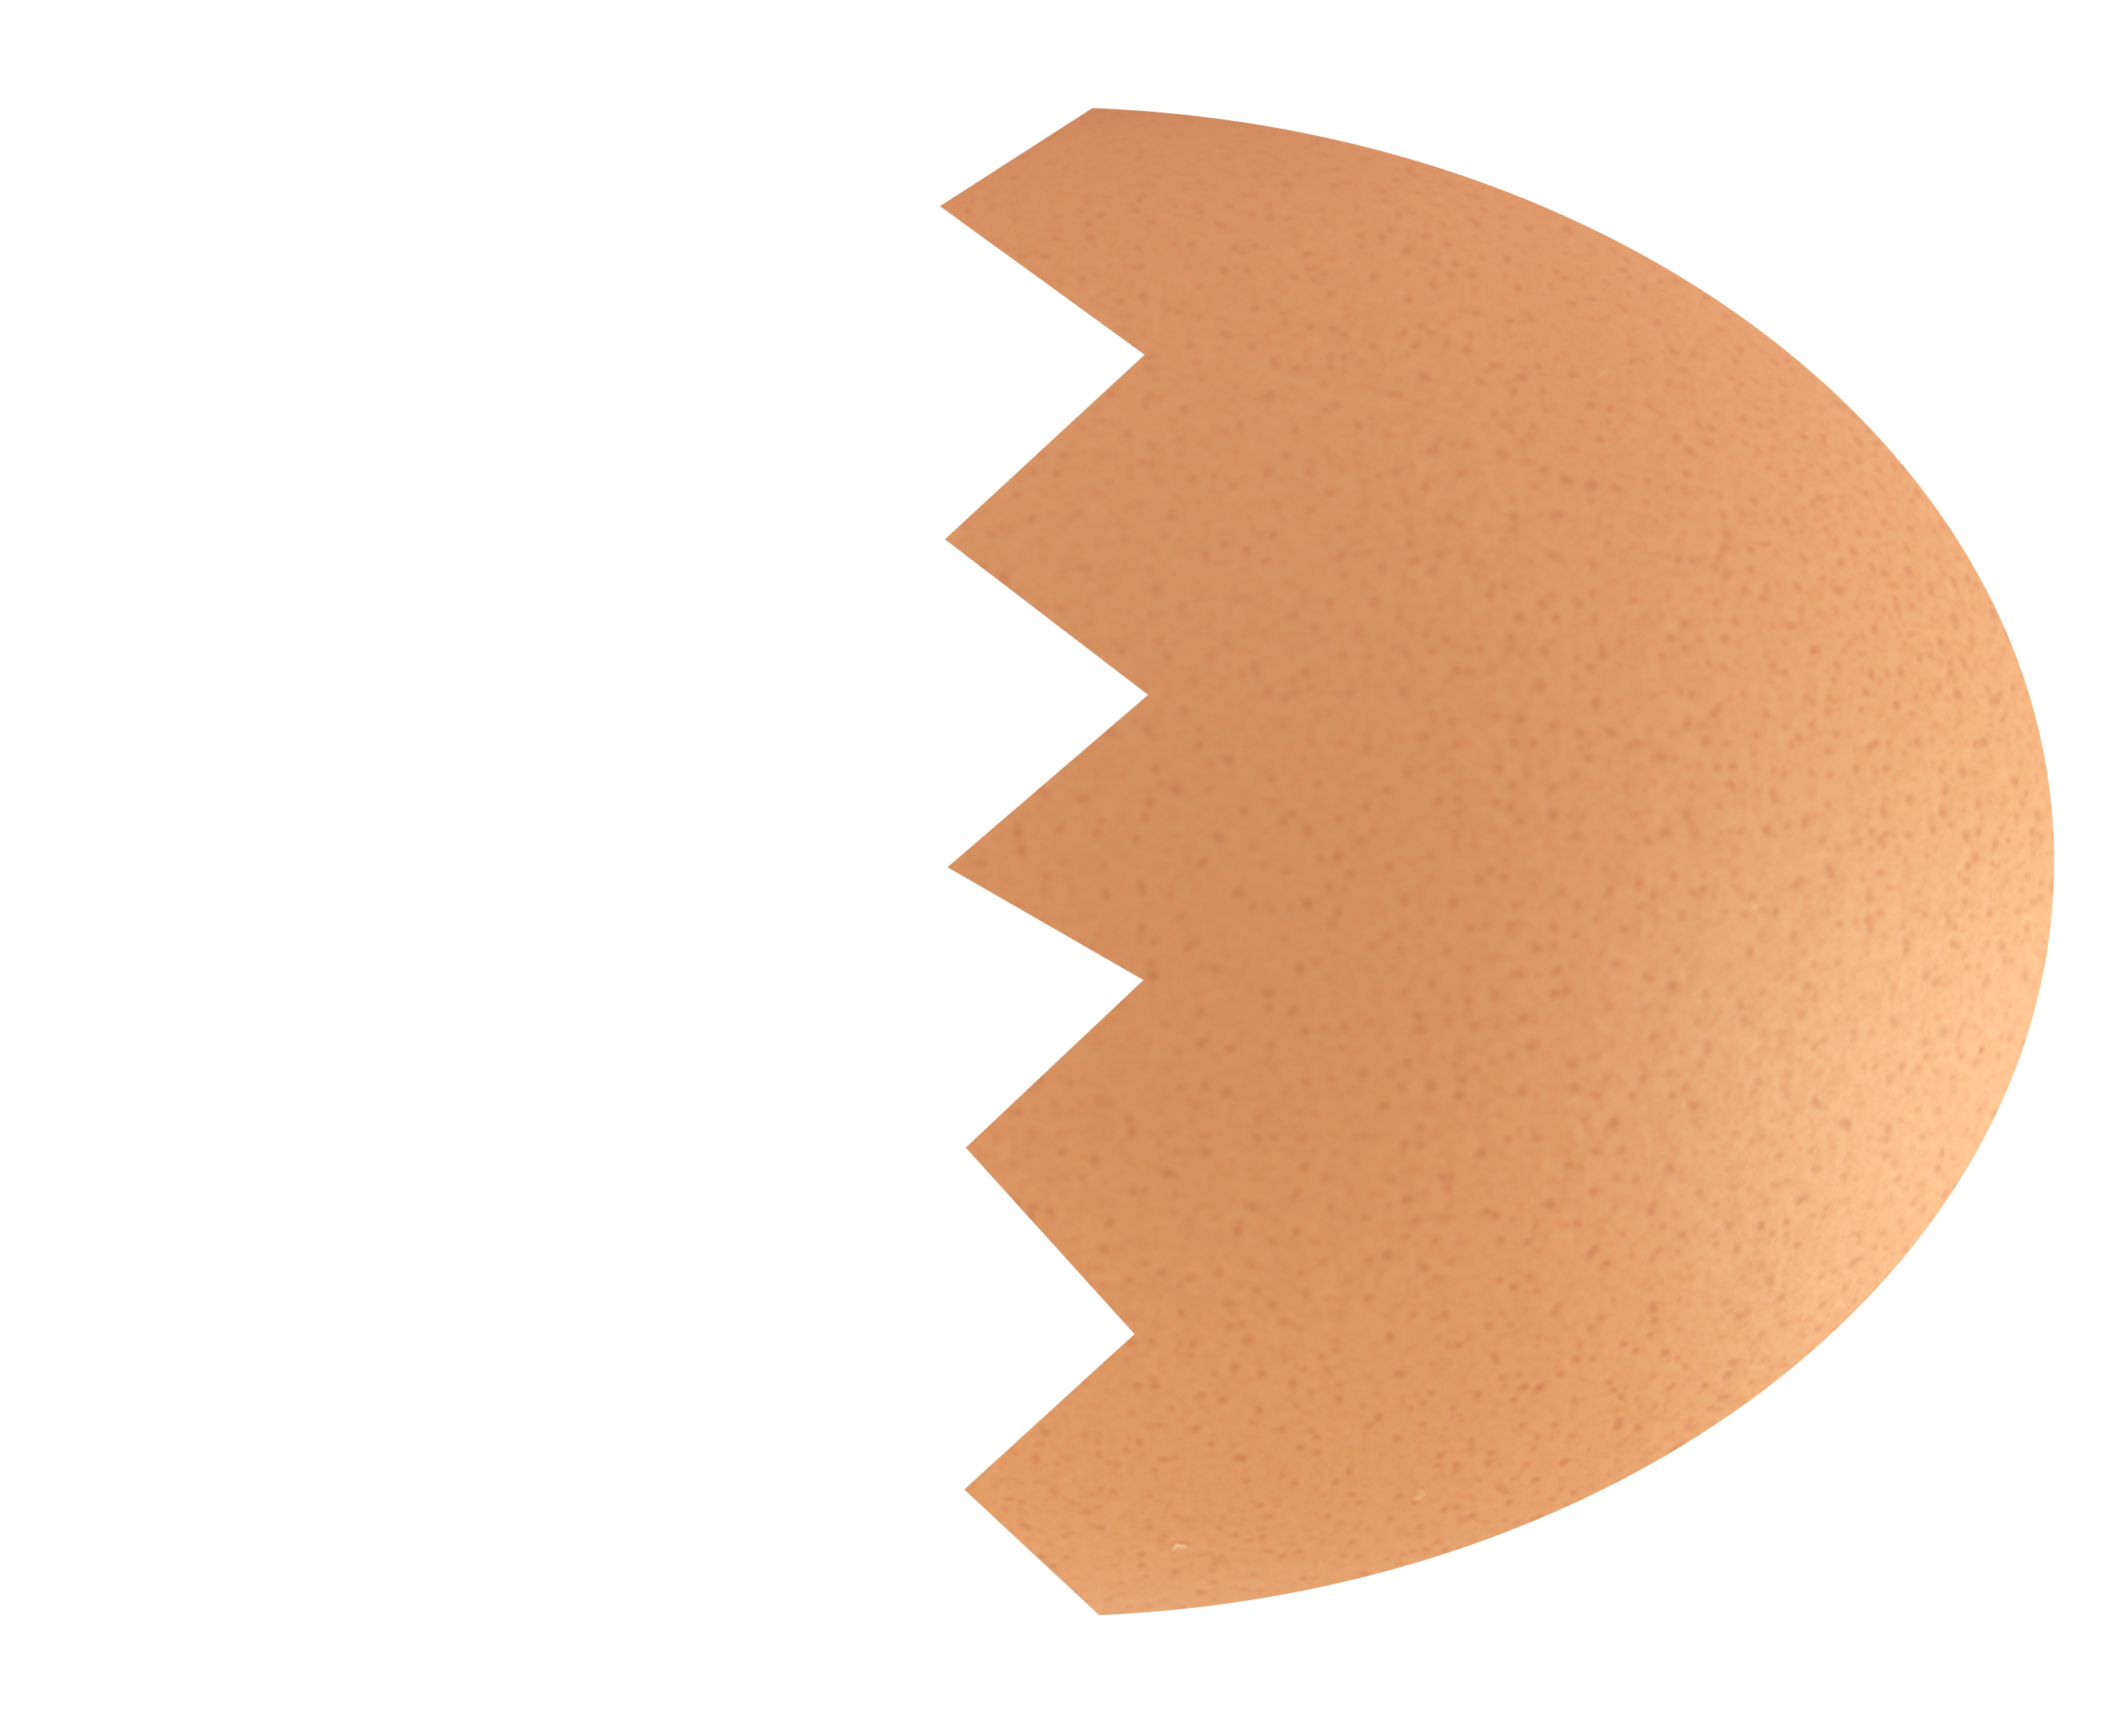
Egg anatomy
Let’s explore a hen’s egg.

Slide 5
Outer membrane
Shell
Air cell
Yolk
Chalazae
Inner membrane
Albumen (egg white)

Slide 6
The shell provides protection for the developing chick and stops bacteria getting in. It has thousands of tiny pores(holes) all over it. This allows for oxygen to get in and carbon dioxide to go out. ​

Slide 7
The outer membrane is a thin layer just inside the shell. It adds an extra barrier to protect the chick from bacteria and physical damage.

Slide 8
The air cell acts as a shock absorber and provides oxygen for the chick as it grows. It is always found at the wide end of the egg. ​

Slide 9
The inner membrane acts as further protection for the chick. The inner membrane is the part that surrounds the albumen. ​

Slide 10
The albumen, also known as the egg white, is the liquid that the chick develops in. It has lots of protein to help the chick grow. ​

Slide 11
The chalazae, that look a bit like twisted ropes, hold the yolk in the centre of the egg keeping it stable.​

Slide 12
The yolk is the primary food source for the developing chick. It has lots of fats, proteins and vitamins. ​

Slide 13
Egg stations
Now it’s your turn to investigate the interior of a hen egg. ​
Each group will get a turn at each activity.
Egg Observation
Observe the cracked egg and identify the different parts.
Yolk A​lbumen​ Membrane Chalazae​ Air cell​
​
Fill in the gaps on the sheet.
3D Model –
Teacher led
Create the 3D model of the inside of a hen's egg.
Label each part with its function.
Labelled diagram
Fill in the sheet, labelling the different parts of the egg and their function.

Slide 14
Complete the sentence
Take a look at each of these unfinished sentences. Work with a partner and write the missing words on your whiteboard. ​
The yolk is held in place by the
.
The air cell is always found at the
end the egg.
The job of the albumen is to
.

Slide 15
Quickfire quiz
Now for a quick quiz to check what you have learned. Answer true or false for each one.
True or false? ​
The yolk is not important.
False
It is very important. The yolk is the food for the embryo (developing chick)

Slide 16
Quickfire quiz
Now for a quick quiz to check what you have learned. Answer true or false for each one.
True or false? ​
The chalazae help keep the yolk in place.
True
The chalazae stabilizes the yolk, keeping it in place.

Slide 17
Quickfire quiz
Now for a quick quiz to check what you have learned. Answer true or false for each one.
True or false? ​
The shell has no holes in it.
False
The shell has thousands of tiny pores all over it. Essential for letting oxygen in and carbon dioxide out.

Slide 18
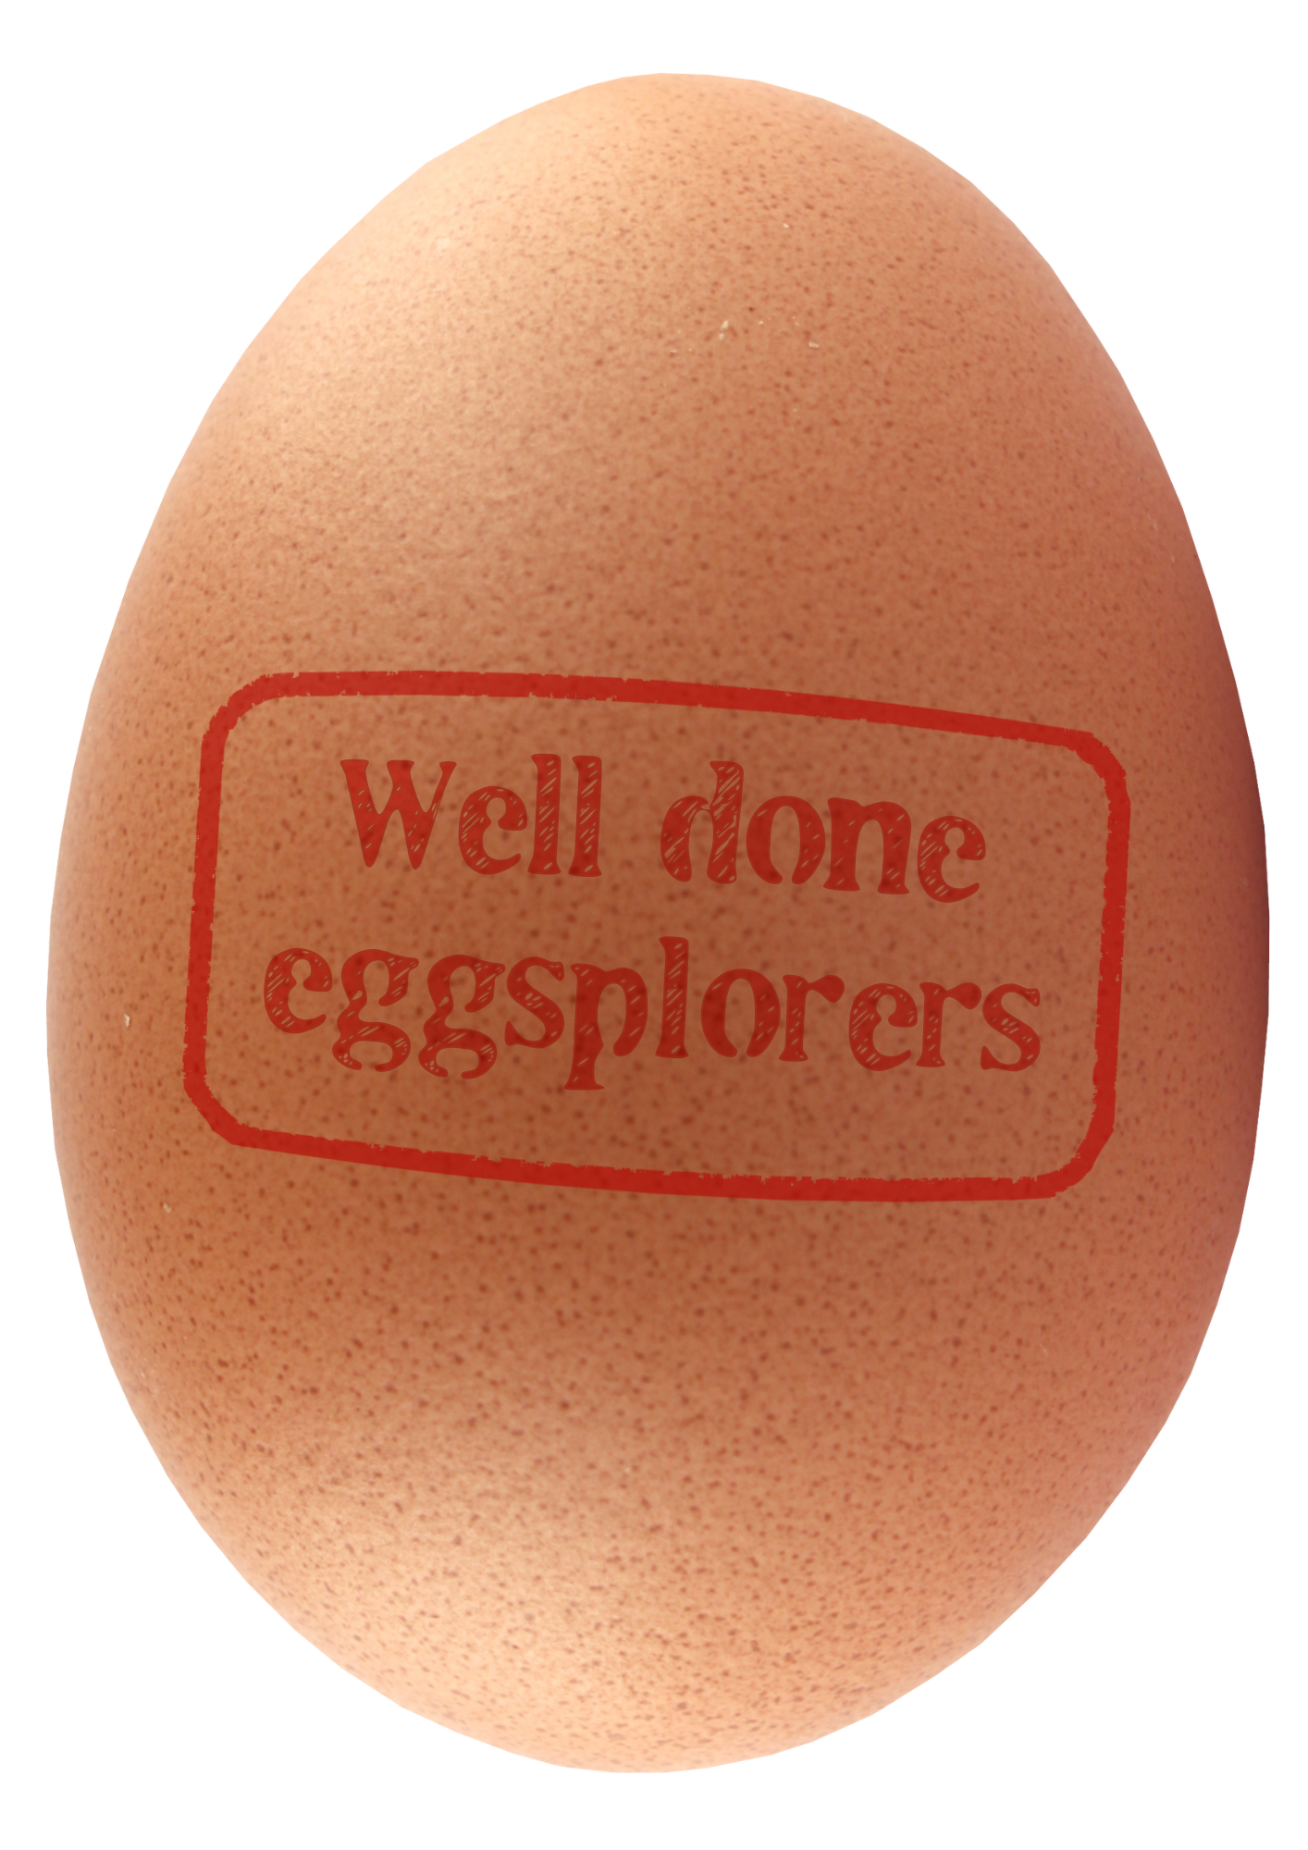
Think like a scientist
Today, we explored the hidden structure inside an egg. ​
​
Scientists ask questions so that they can continue learning more. ​
What do you still wonder about eggs? ​
​
How could you find out?

Slide 19

Brought to you by

