Slide 1
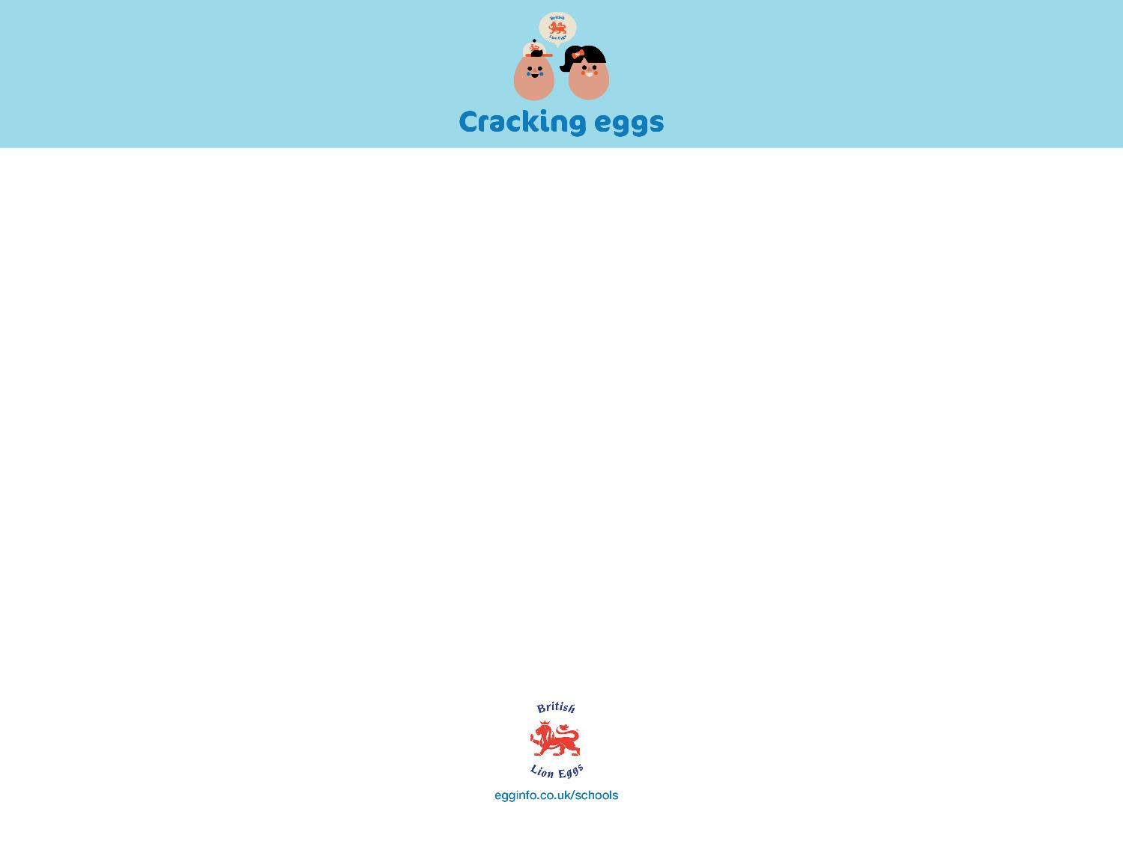
Why do we need a healthy, balanced diet?

Slide 2
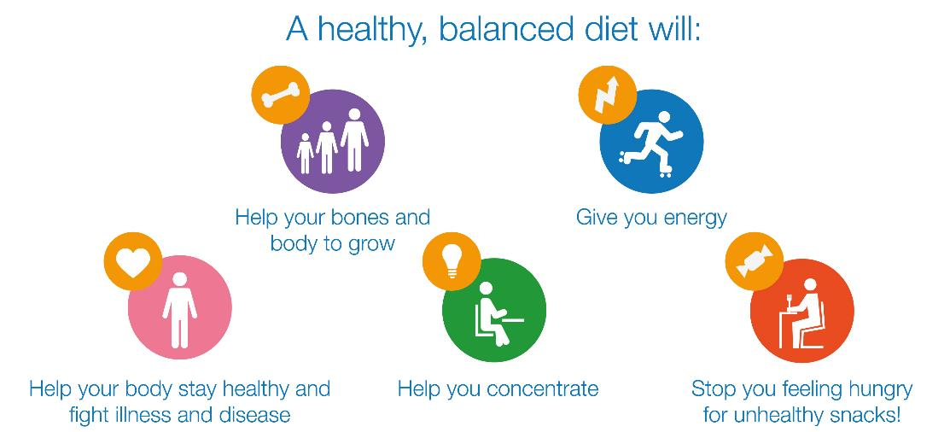
Why do we need a healthy, balanced diet?

Slide 3
So, what is a balanced diet?

Slide 4
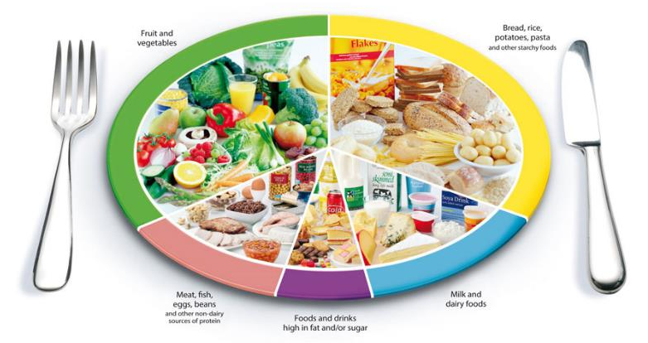
So, what is a balanced diet?
A balanced diet means eating lots of different foods in the right amounts. You should also drink lots of water!

Slide 5
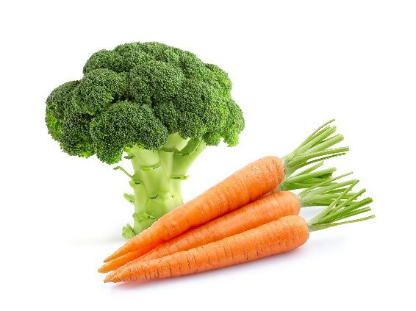
Vegetables & fruit
Did you know?
You should eat more vegetables than fruit because fruit contains more sugar, especially when squeezed
into juice.
Vegetables and fruit give our bodies lots of vitamins and minerals. These help you in lots of ways, keeping you healthy and fighting illness and disease.
Eat lots! About a third of the food you eat should
be vegetables and fruit. Try to eat five different
types and colours a day!

Slide 6
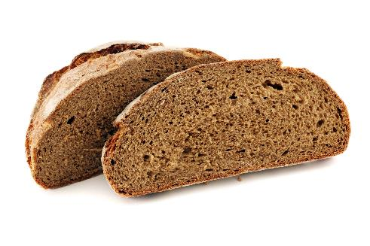
Bread, rice, pasta & other starchy foods
Did you know?
Although potatoes are a vegetable, they are included in the carbohydrates food group.
Foods like bread, rice, pasta and potatoes are called carbohydrates. They help to give your body energy.
Wholegrain versions are healthiest - they contain lots of fibre, which helps your body digest food.
Eat lots! About a third of the food you eat should
be carbohydrates.

Slide 7
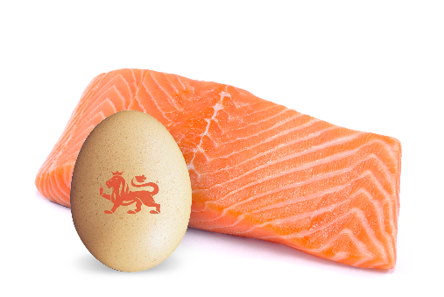
Meat, fish, eggs, beans and other non-dairy sources of protein
Did you know?
There is no suggested limit on the number of eggs you should eat.
Foods like meat, fish, eggs, beans and nuts contain lots of protein, which helps your bones and muscles to grow.
You should eat some of these every day.
They also contain vitamins and minerals, and meat is a good source of iron.

Slide 8
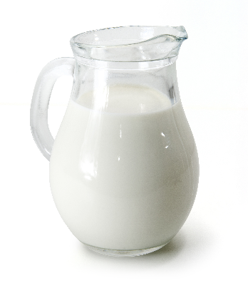
Milk and other dairy products
Did you know?
Some dairy foods contain quite a lot of fat, but you can buy lower fat options like semi-skimmed milk.
Milk and dairy foods like cheese and yoghurt contain lots of protein and calcium, which helps your bones and teeth to grow.
You should eat some of these every day.

Slide 9
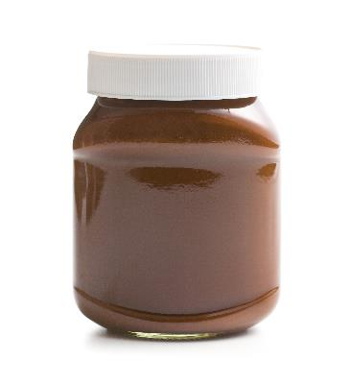
Foods and drinks high in fat and/or sugar
Did you know?
Many cans of fizzy drink contain around 10 teaspoons of sugar!
Foods like crisps, chocolate, sweets and fizzy drinks can contain a lot of sugar, salt or fat.
This doesn’t mean you should never eat them.
They’re fine to eat occasionally, if you usually eat
healthily and exercise.

Slide 10
Eggs
Eggs are packed with protein, which helps
our bones and muscles grow and stay healthy.
Eggs also contain lots of vitamins and minerals our bodies need, like vitamin D, which helps bones and teeth grow and stay healthy.
Cooking eggs is quick and easy. They can be cooked in lots of different ways (e.g. fried, scrambled, poached, boiled) and even combined with other foods (e.g. a tomato and mushroom omelette or frittata).
They’re cheap to buy… and they taste delicious!

